Slide 1
Medical ChatBot
Submitted by
Pansare Sarika
MCA II (Sem: IV)
Guided by
“Mr. Badhe Gajanan”

Slide 2

P.E. Society's
Modern Institute of Business Studies,
Nigdi, Pune - 411044
2021 - 2022

Slide 3
The Medical ChatBot Mission
“Medical chatbots are AI-powered conversational solutions that help patients, insurance companies, and healthcare providers easily connect with each other. These bots can also play a critical role in making relevant healthcare information accessible to the right stakeholders, at the right time.”

Slide 4
Introduction
An AI-fueled platform that supports patient engagement and improves communication in your healthcare organization. Create a rich conversational experience with an intuitive drag-and-drop interface. Easily test your chatbot within the ChatBot app before it connects with patients. Add a medical chatbot to your website in a few clicks.
Chatbots offered by various chatbot platforms have already gained massive popularity in e-commerce, banking, real estate, and customer-oriented businesses. From catching up on news headlines to navigating shopping or banking applications, chatbots have revolutionized the way we use the internet.

Slide 5
Abstract:
The system allows computer to communication between human to computer by using natural language processing (NLP).
There are three analyses which understand natural language i.e., identification of main linguistic relations is completed to parse subject into object of the sentences. After that description of the texts is done.
These semantic interpretation uses knowledge of word meaning Chat bot is an Entity which imitate human discussion in its particular accepted set-up together with at ex tor vocal language with techniques such as Natural Language Processing (NLP).

Slide 6
Existing System:
Many of the existing systems have chats through texts. Some limitations of such Chatbots are, there is no instant response given to the patient, they have to wait for expert’s acknowledgement for a long time. And also, there are a limited number of diseases in the dataset. Technical issues like voice messages are not accurate in the existing system
To extract symptoms from user chat.
To classify and predict the diseases using a decision tree classifier.
To develop a Medical chatbot to predict diseases by symptoms taken as input
In proposed system we are going to develop an algorithm that will be used to identify answers related to user submitted questions. The need is to develop a database where all the related data will be stored and to develop a web interface. The web interface developed will have two parts, one for simple users and one for the administrator.

Slide 7
Need of System
Many of the existing systems have chats through texts. Some limitations of such Chatbots are, there is no instant response given to the patient, they have to wait for expert’s acknowledgement for a long time. And also, there are a limited number of diseases in the dataset. Technical issues like voice messages are not accurate in the existing system
The purpose of a chat-bot system is to simulate a human conversation; the chat-bot architecture integrates a language model and computational algorithm to emulate information chat communication between a human user and a computer using natural language

Slide 8
Hardware & Software Requirement
Software Requirement
Hardware Requirement
Operating System | Windows 7 and above
Browser | Chrome, Internet Explorer Mozilla Firefox
Technology | Java, JSP. Strut 2.0
Development Tool (Editor) | Eclipse Indigo ,Jasper Report ,iReport
Server | Tomcat 7.0
Database | MYSQL
Processor | Pentium-IV and above
RAM | Minimum 512 and above
Hard Disk | Minimum 80 GB and above

Slide 9
Feasibility Study
2.2.1 Technical Feasibility
Technical feasibility highlights all technological aspects of the system.
Platform for the system is windows.
Designing of the project is done through Visual Studio Code, Notepad++.
Front-end of the project will be done in HTML CSS Bootstrap& Java Script and JSP, Servlet. From the above technological aspects, it is known that the system used for the project is technically feasible as it is being developed on open-source platform and all other software tools that are supported by this platform are easily available for the use.
2.2.2 Performance Feasibility
Using this to automate the existing manual system by the help of computerized and full- fledged computer software, fulfilling their requirements, so that their valuable data/information can be stored for a longer period with easy accessing and manipulation of the same.

Slide 10
Feasibility Study
2.2.3 Time Feasibility
Computer used is depend on user it may be large or small, but it is simple to read the data form database because they are stored directly into the database, less time is required for data fetching from database. This step is time saving for showing better result

Slide 11
Objectives of the Project
To Create a web application to be used in place of paper work could be much better.
To develop an algorithm that will be used to identify answers related to user submitted questions. The need is to develop a database where all the related data will be stored and to develop a web interface. The web interface developed will have two parts, one for simple users and one for the administrator.
To developed using Java framework using and MySQL the server technology to create strong secured system for Medical Chatbot.
Speech to text.

Slide 12
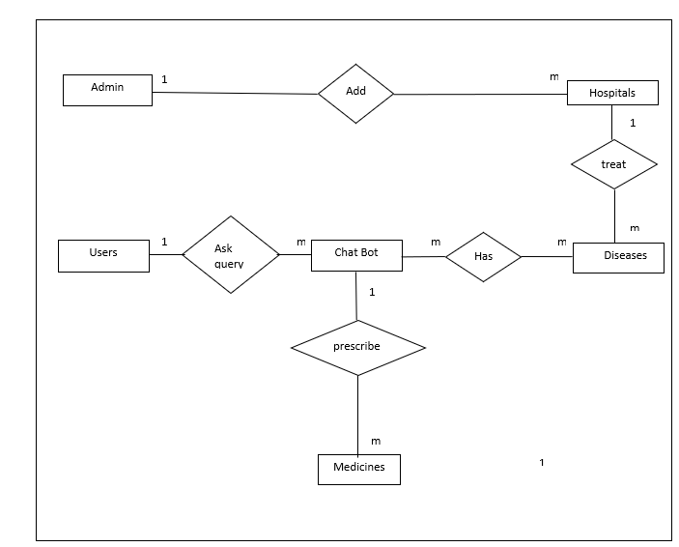
Entity Relationship Diagram

Slide 13
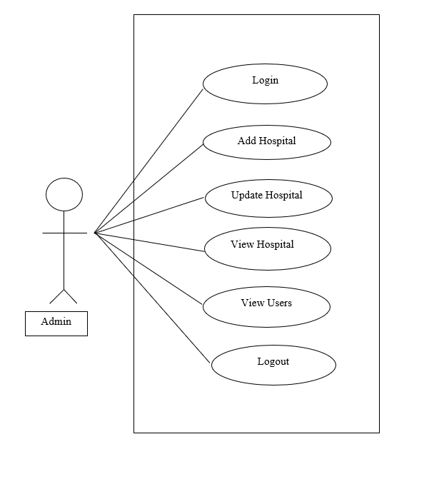
Use Case Diagram For Admin

Slide 14
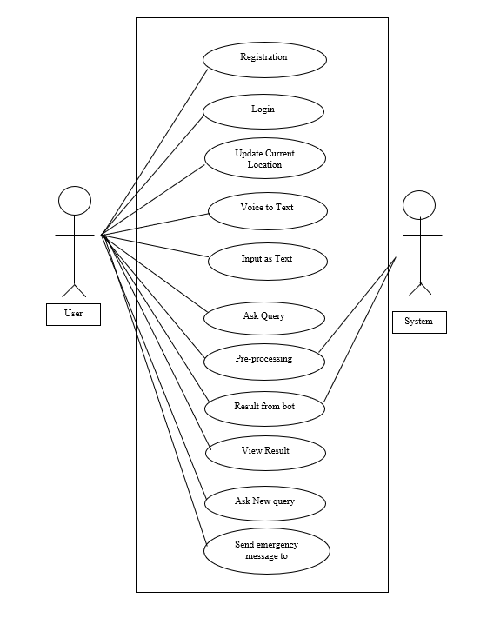
Use Case Diagram For User

Slide 15
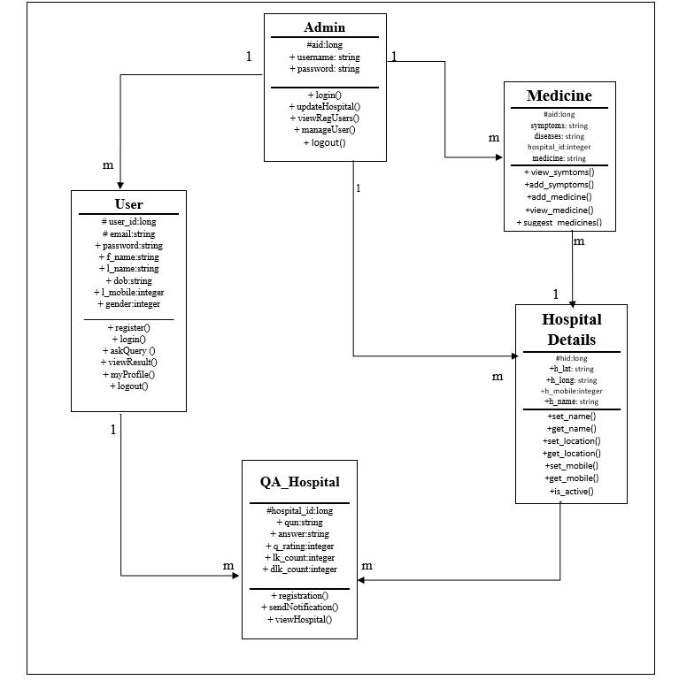
Class Diagram

Slide 16
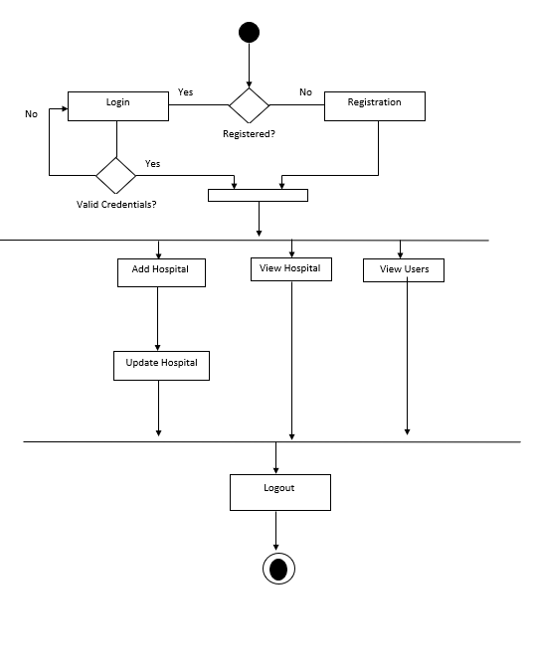
Activity Diagram For Admin

Slide 17
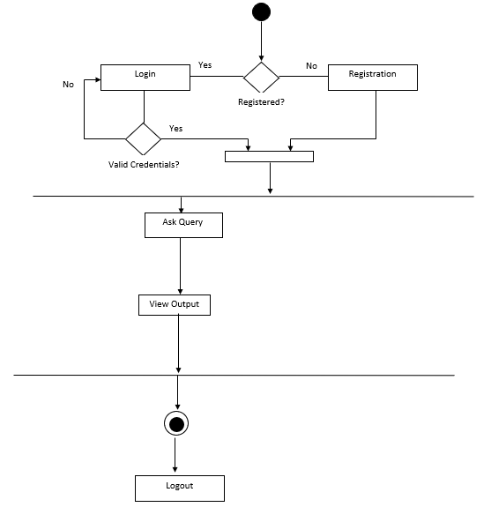
Activity Diagram For User

Slide 18
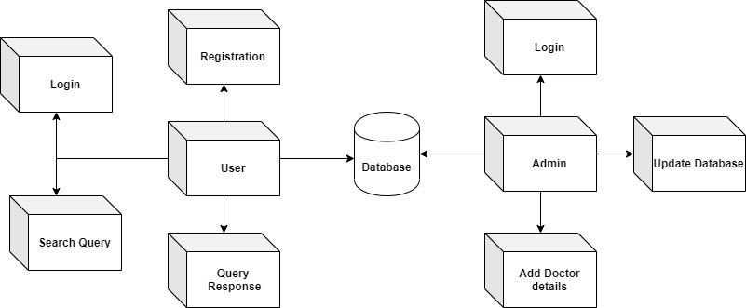
Deployment Diagram

Slide 19
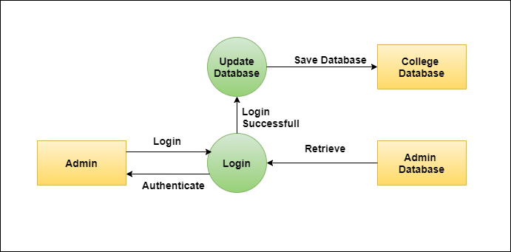
Module Hierarchy Deagram Admin ChatBot

Slide 20
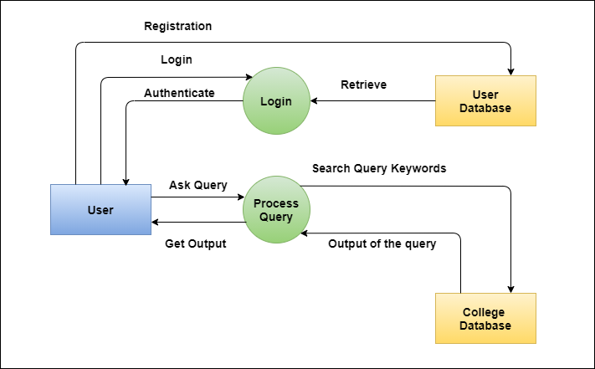
User ChatBot

Slide 21
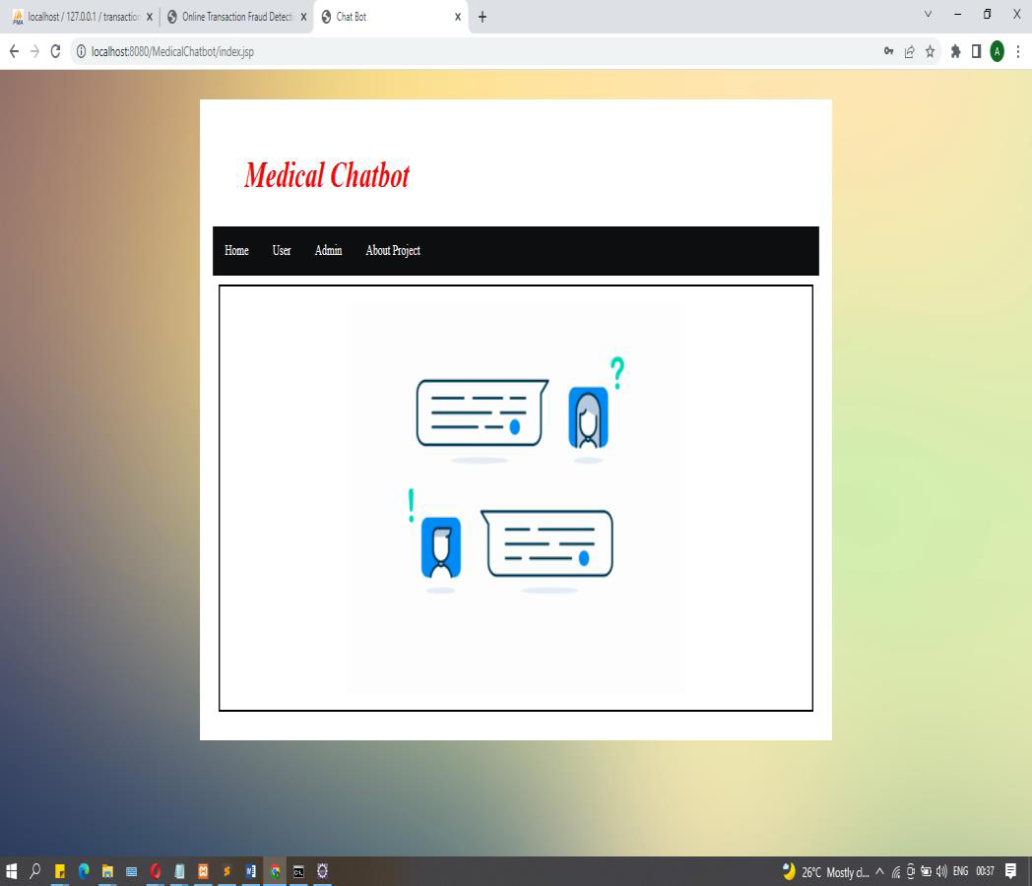
Dashboard

Slide 22
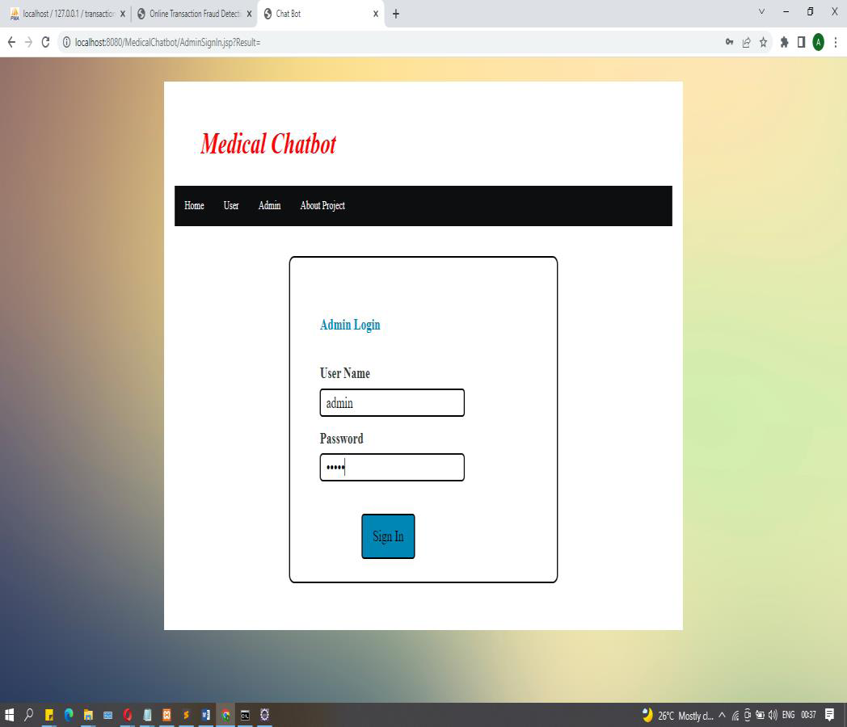
Login Panel

Slide 23
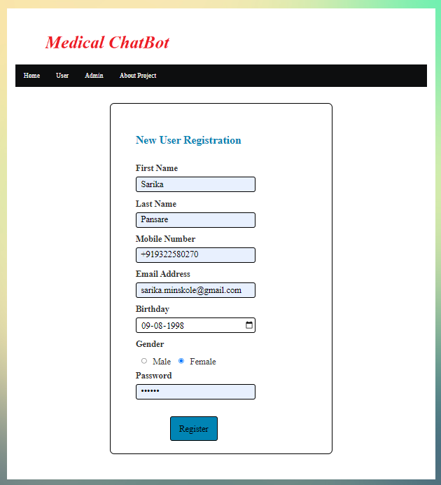
User Registration

Slide 24
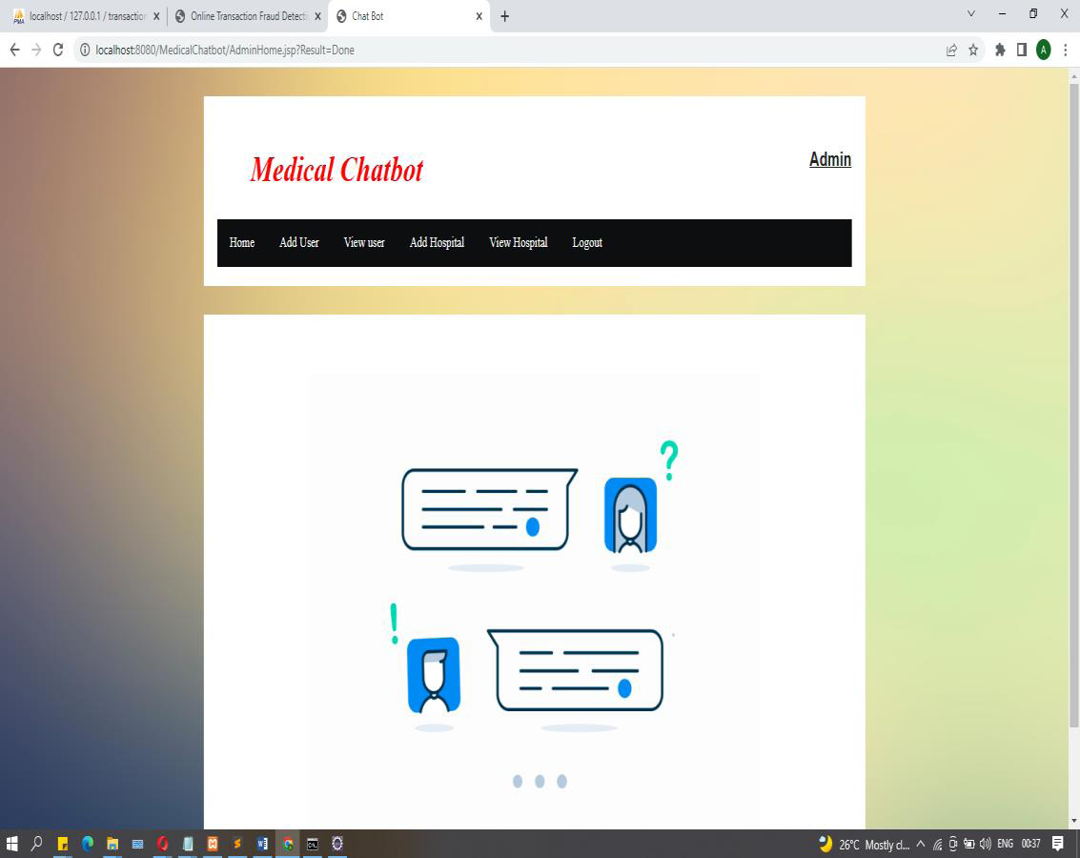
Admin Login Dashboard

Slide 25
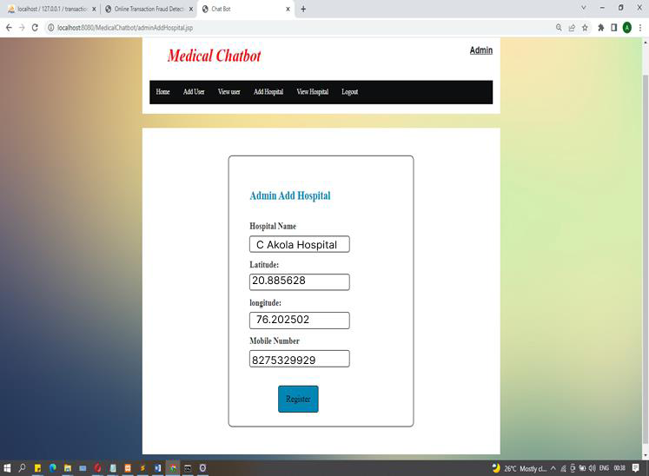

Add New Hospital:

Slide 26
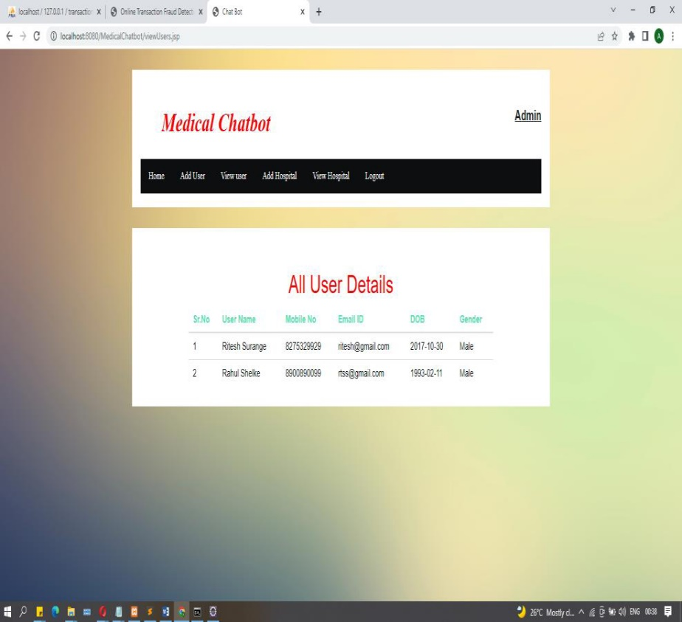
User List:

Slide 27
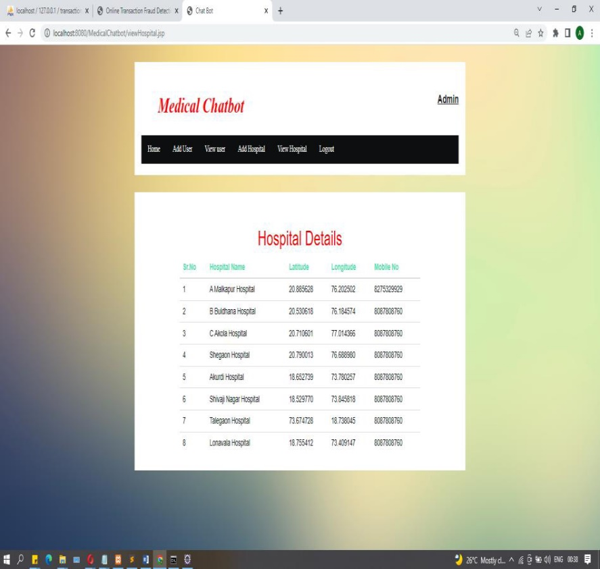
Hospital List:

Slide 28
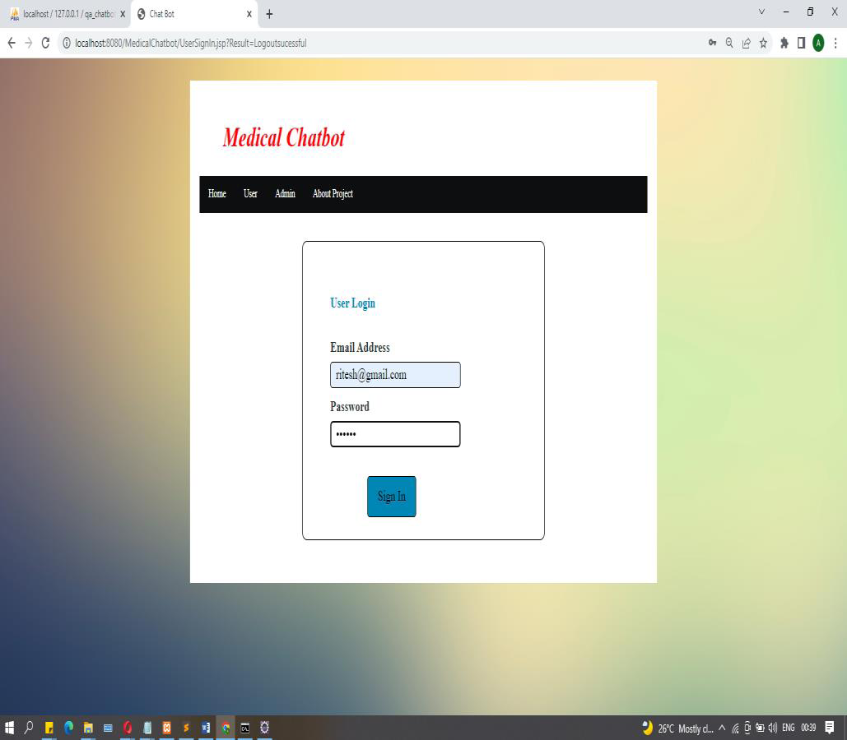
User Login:

Slide 29
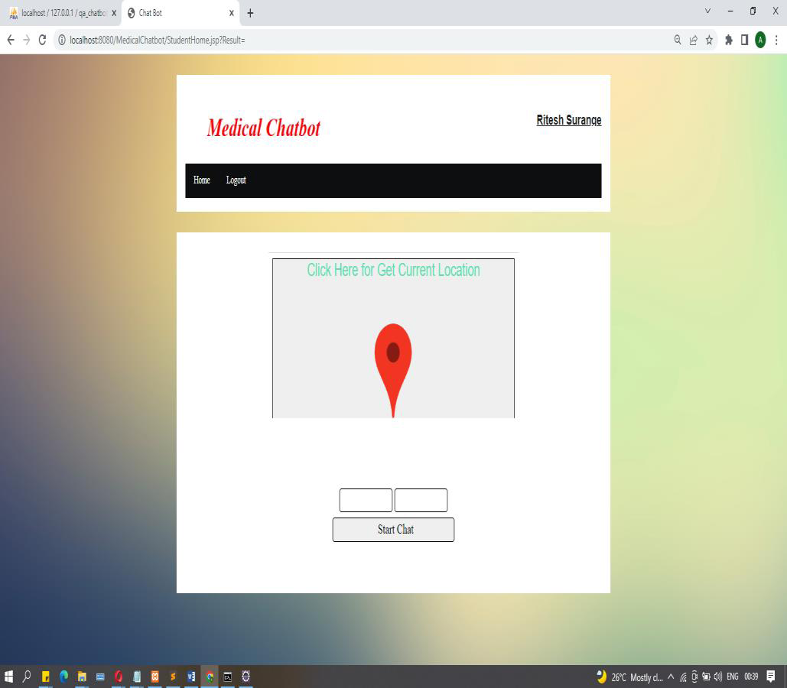
Add your Current Location:

Slide 30
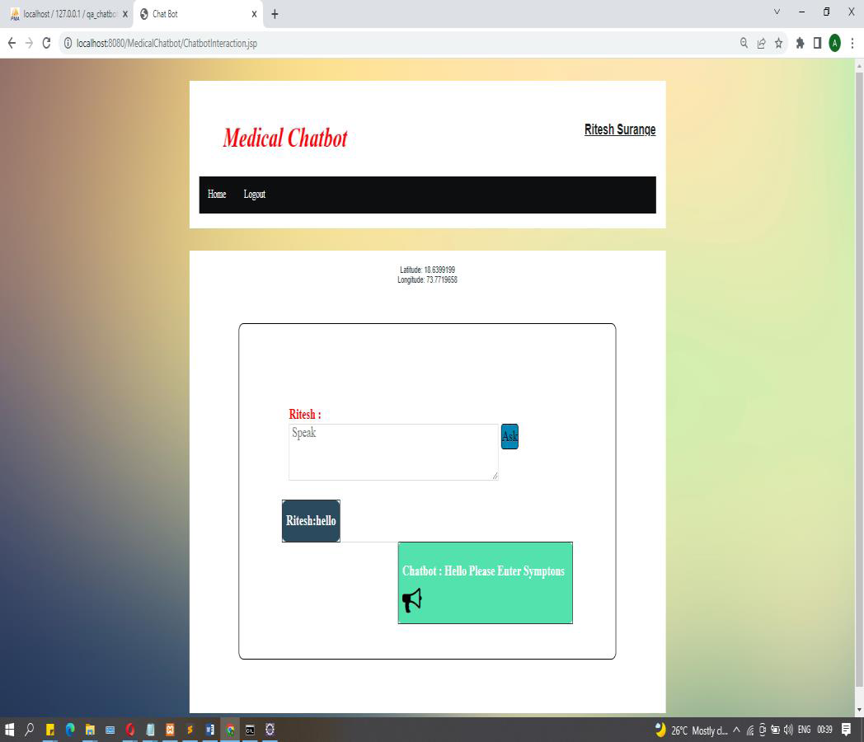
Add Query:

Slide 31
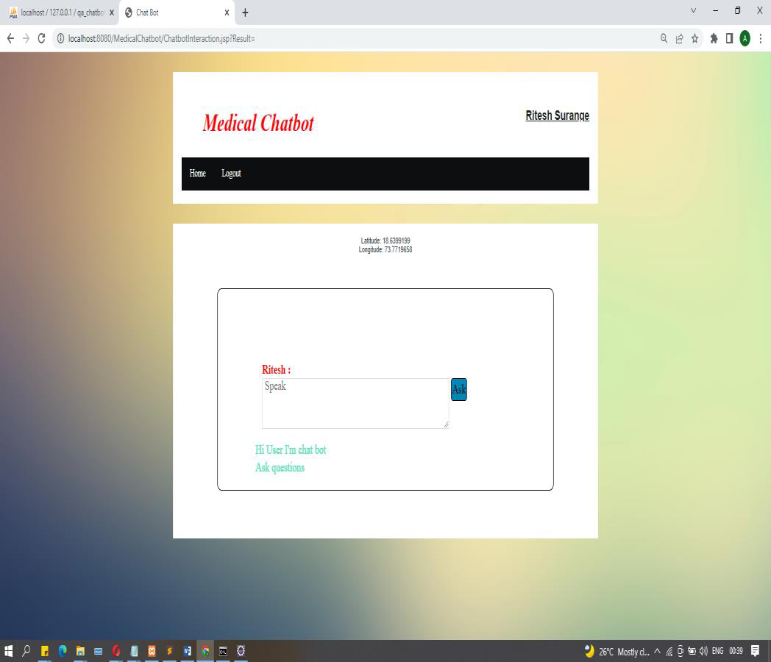
Add Query:

Slide 32
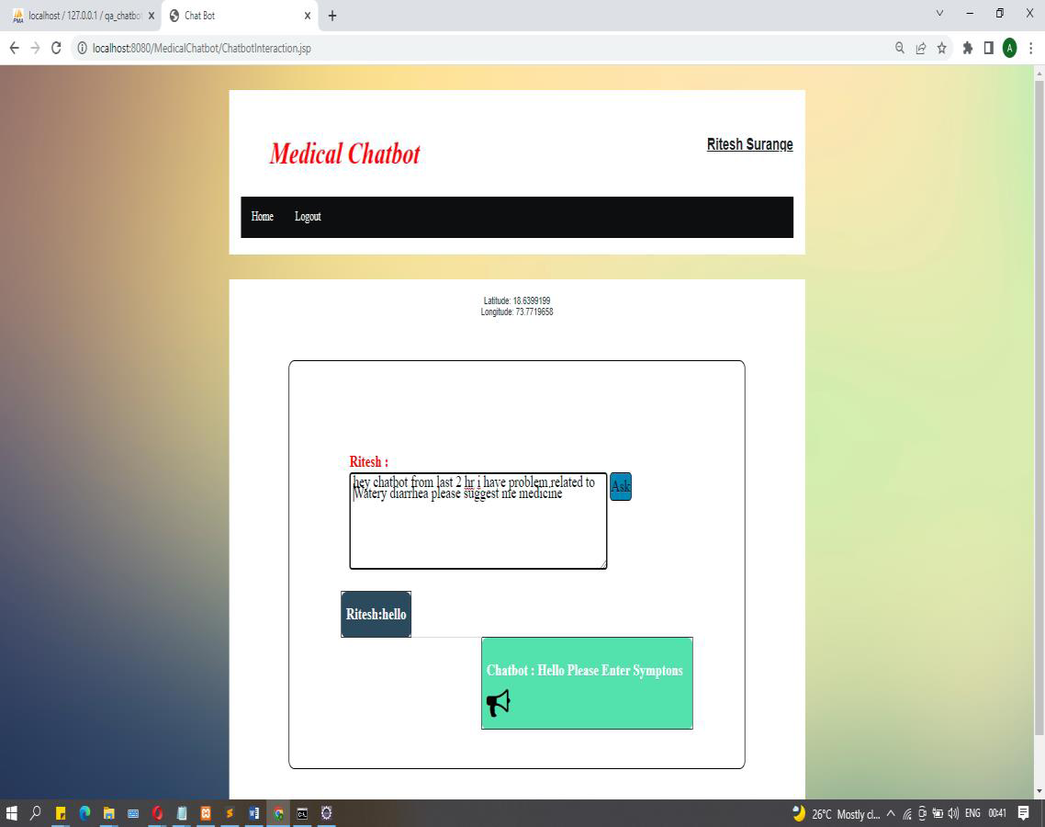
ChatBot Reply’s:

Slide 33
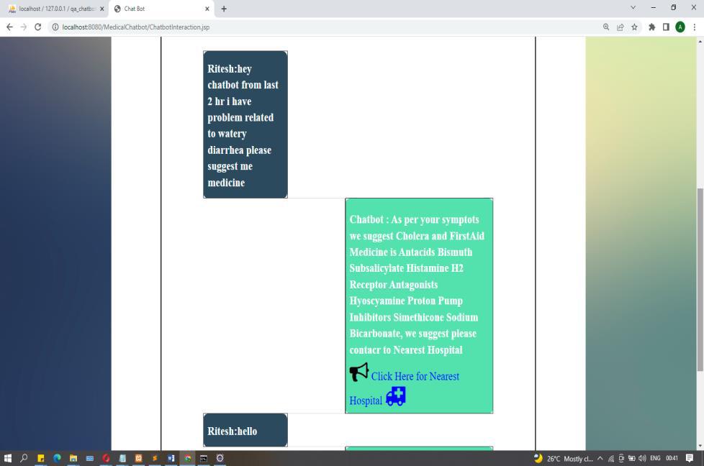
ChatBot Reply’s:

Slide 34
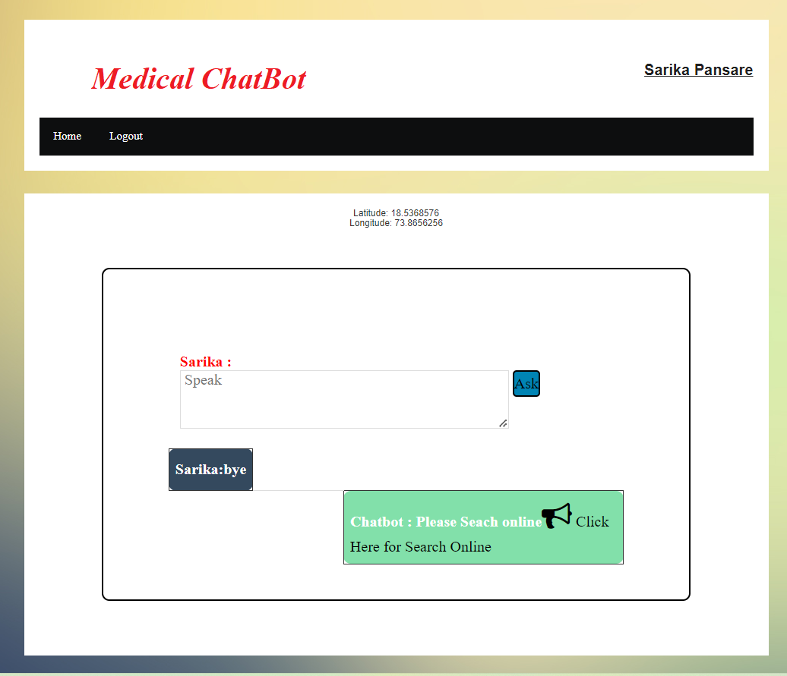
ChatBot Reply’s:

Slide 35
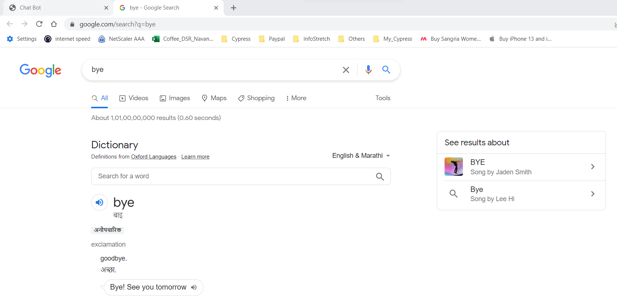
ChatBot Reply’s:

Slide 36
Testing
5.1 Test Strategy
The purpose of testing is to discover errors. Testing is the process of trying to discover every conceivable fault or weakness in a work product. It provides a way to check the functionality of components, subassemblies, assemblies and/or a finished product It is the process of exercising software with the intent of ensuring that the Software system meets its requirements and user expectations and does not fail in an unacceptable manner.
Unit testing
Unit testing involves the design of test cases that validate that the internal program logic is functioning properly, and that program inputs produce valid outputs. All decision branches and internal code own should be validated. It is the testing of individual software units of the application .it is done after the completion of an individual unit before integration. This is a structural testing, that relies on knowledge of its construction and is invasive.

Slide 37
White Box Testing:
White Box Testing is a testing in which in which the software tester has knowledge of the inner workings, structure and language of the software, or at least its purpose. It is purpose. It is used to test areas that cannot be reached from a black box level.
Black Box Testing:
Black Box Testing is testing the software without any knowledge of the inner workings, structure or language of the module being tested. Black box tests, as most other kinds of tests, must be written from a definitive source document, such as specification or requirements document, such as specification or requirements document.
System Test
System testing ensures that the entire integrated software system meets requirements. It tests a configuration to ensure known and predictable results. An example of system testing is the configuration oriented system integration test. System testing is based on process descriptions and owns, emphasizing pre-driven process links and integration points.

Slide 38
Proposed System
In proposed system we are going to develop an algorithm that will be used to identify answers related to user submitted questions. The need is to develop a database where all the related data will be stored and to develop a web interface. The web interface developed will have two parts, one for simple users and one for the administrator.
Methodologies of Problem solving:
Search nearest hospitals:
User’s location can get automatically and view nearest hospitals to users based on symptoms of the users.
Speech to text :
Here user can search using speech and it convert to text using MFCC technique

Slide 39
Limitations
1.To extract symptoms from user chat.
2. To classify and predict the diseases using a decision tree classifier.
3. To develop a Medical chatbot to predict diseases by symptoms taken
as input.
4. The development of more reliable algorithms for healthcare chatbots requires programming experts who require payment.
5. Moreover, backup systems must be designed for failsafe operations, involving practices that make it more costly, and which may introduce unexpected problems.
6. Lack of Human interaction
7. Lack of empathy, and natural emotions
8. Unable to handle exceptions

Slide 40
Advantages of Proposed System
The system is very simple in design and to implement. The system requires very low system resources and the system will work in almost all configurations. It has got following features
Ensure data accuracy.
Minimize manual data entry.
Minimum time needed for the various processing
Greater efficiency
Better Service
Minimum time required

Slide 41
Disadvantages of Proposed System
The development of more reliable algorithms for healthcare chatbots requires programming experts who require payment.
Moreover, backup systems must be designed for failsafe operations, involving practices that make it more costly, and which may introduce unexpected problems.
Lack of Human interaction
Lack of empathy, and natural emotions
Unable to handle exceptions

Slide 42
Bibliography
Nudtaporn Rosruen and Taweesak Samanchuen, “Chatbot Utilization for Medical Consultant System,” in the 2018 Technology Innovation Management and Engineering Science International Conference (TIMES-iCON2018)
Mrs. Rashmi Dharwadkar, Dr. Mrs. Neeta A. Deshpande, “A Medical Chatbot, “in International Journal of Computer Trends and Technology (IJCTT)–Volume60Issue1June2018
Divya Madhu, Neeraj Jain C. J, Elmy Sebastain, Shinoy Shaji , Anandhu Ajaya kumar,” A Novel Approach for Medical Assistance Using Trained Chatbot” in International Conference on Inventive Communication and Computational Technologies
Lin Ni, Chenhao Lu, Niu Liu, and Jiamou Liu, “MANDY: Towards A Smart Primary Care Chatbot Application,” in Internal and emergency medicine, 10(2):171–175,2017.
V.Manoj Kumar, A. Keerthana, M. Madhumitha, S. Valliammai, V. Vinithasri,” Sanative Chatbot for Health Seekers”, International Journal of Engineering And Computer Science ISSN:2319-7242Volume
5 Issue -03 March, 2016 Page No. 16022-16025
E. Pratt, “A Primer Artificial Intelligence and Chatbots in Technical Communication – A Primer,” pp. 2–9,2017.

Slide 43
Thank You!

