Slide 1
BDE Solution
Bde Candidate

Slide 2
Introduction
The given datasets are:
website_dataset.csv
facebook_dataset.csv
google_dataset.csv
The main task:
combine data from 3 given input datasets
in a most accurate way,
cleaned and transformed data.

Slide 3
Terminology & Details
Language and environment: Pyspark (python+spark) - jupyter notebook – databricks
web_data, website_data - referring to the website dataset ( website_dataset.csv )
fb_data, facebook_data - referring to the facebook dataset ( facebook_dataset.csv )
gg_data, google_data - referring to the google dataset ( google_dataset.csv )
{dataset}_missing - referring to null value percentage of dataset for each column
{dataset}_distinct - referring to unique value percentage of dataset for each column
web_fb - website_dataset and facebook_dataset
web_fb_left - website_dataset and facebook_dataset join with left operation
web_fb_inner - website_dataset and facebook_dataset join with inner operation
remaining_gg - non-matched data in google_dataset after join operation
web_fb_gg_full - website_dataset, facebook_dataset, google_dataset are merged into that dataset

Slide 4
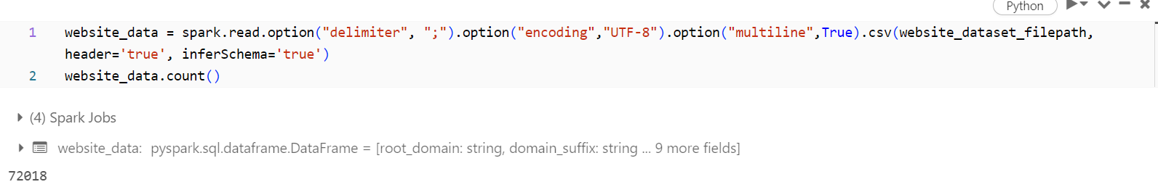
Data Reading
Problem (new line characters):
multiline option
encoding option with UTF-8

Slide 5
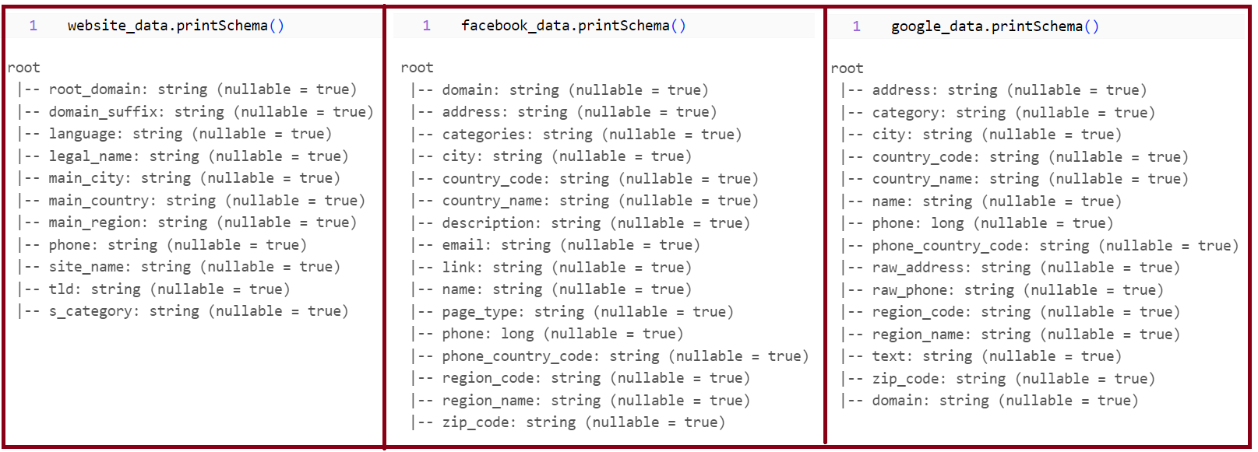
Understanding Data

Slide 6
Understanding Data Website_data

Slide 7
Understanding Data Facebook_data

Slide 8
Understanding Data Google_data

Slide 9
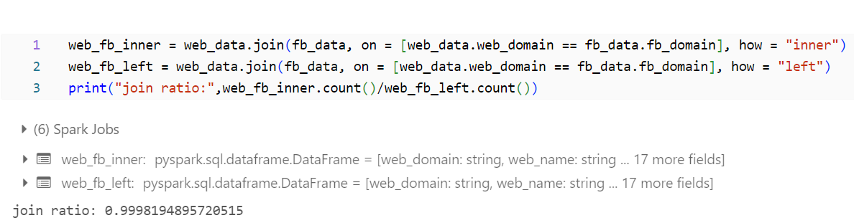
Data Preparation and Merging

Slide 10
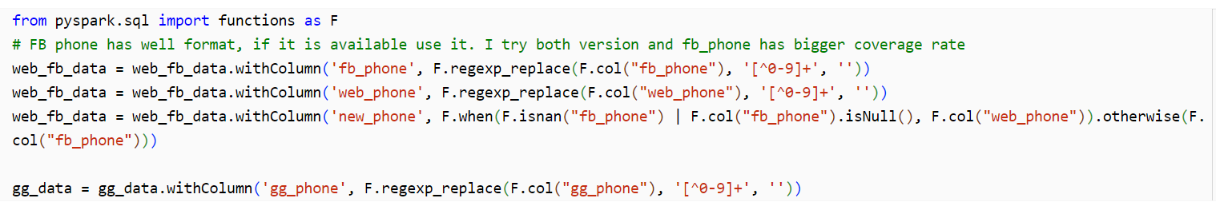
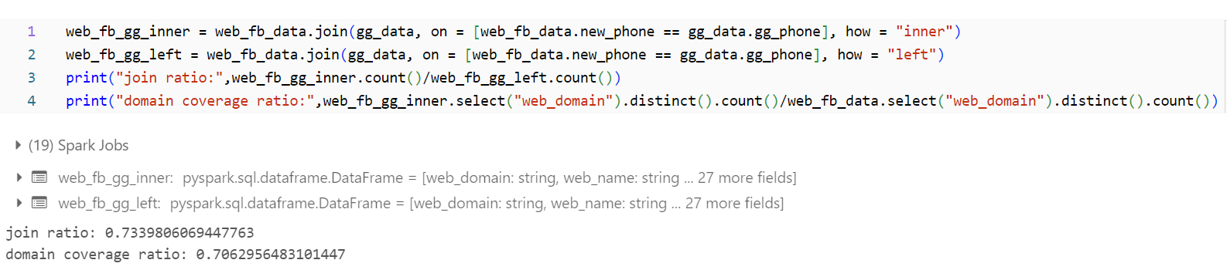
Data Preparation and Merging

Slide 11
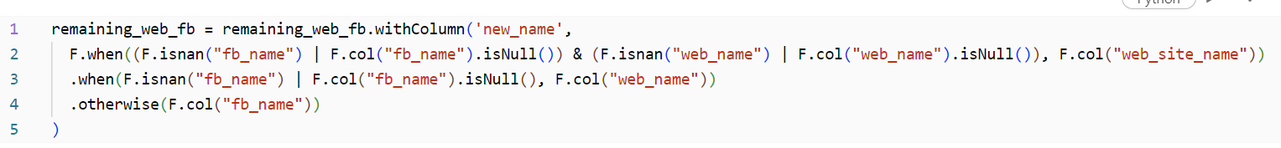
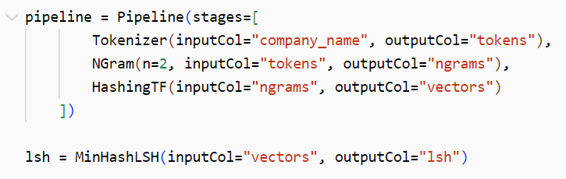
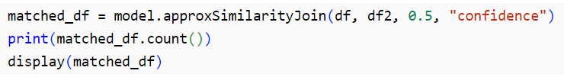
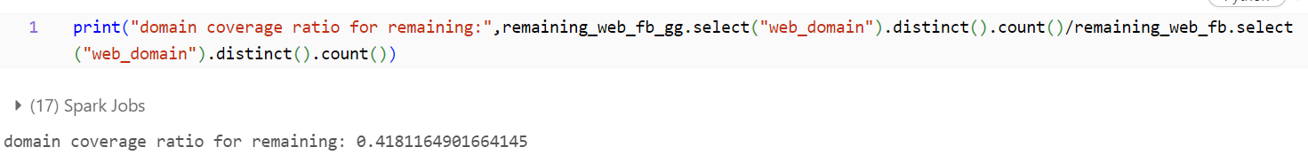
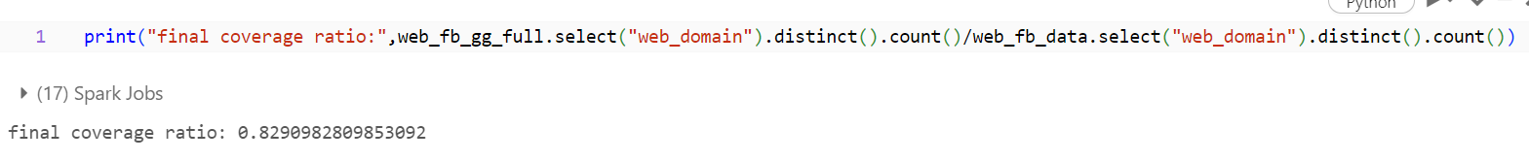
MinHashLSHModel & approxSimilarityJoin

Slide 12
Conclusion
The project successfully merged data from three distinct sources
website, Facebook, and Google
Achieving an 82.9% coverage,
this process can be further improved
enhancement and optimization
When I encounter very similar data across sources,
I can prioritize data from the source
with the highest reliability
based on my domain-specific knowledge
or previous experiences.

Slide 13
Thank you
BDE candidate

