Slide 1
Data Science
Explanations and Examples
By John Foxworthy

Slide 2
Outline for Today’s Presentation
Explanations
Examples
Supervised Learning
Unsupervised Learning
Machine Learning
Deep Learning
Reinforcement Learning
Supervised Learning
With and without features
Unsupervised Learning
But we first start . . . a little data science background and survey results

Slide 3
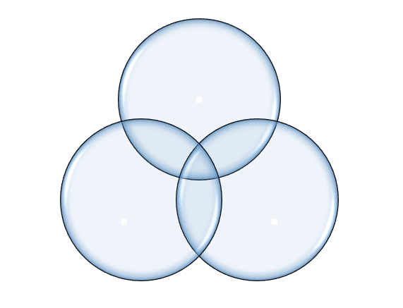
Data Science is the application of mathematics or statistics to a business case, using the tools of software programming along with database administration.

Slide 4
Data Science Survey Statistics
https://www.kaggle.com/surveys/2017

Slide 5
Data Science Framework | Short Definition
Supervised Learning | Prescribed Target
Unsupervised | Descriptive No Target
Machine Learning | Generalized Technique
Deep Learning | Neural Network
Reinforcement Learning | Software Agent

Slide 6
Data Science Terms
Overfitting
Hyperparameter
Backtesting
Classification
Clustering
Sorting
Artificial
Intelligence
Data Wrangling
Hypothesis Testing

Slide 7
Data Science Language
Narrative
Analytics
Natural Language
Mathematical Language
Programming Language

