Slide 1
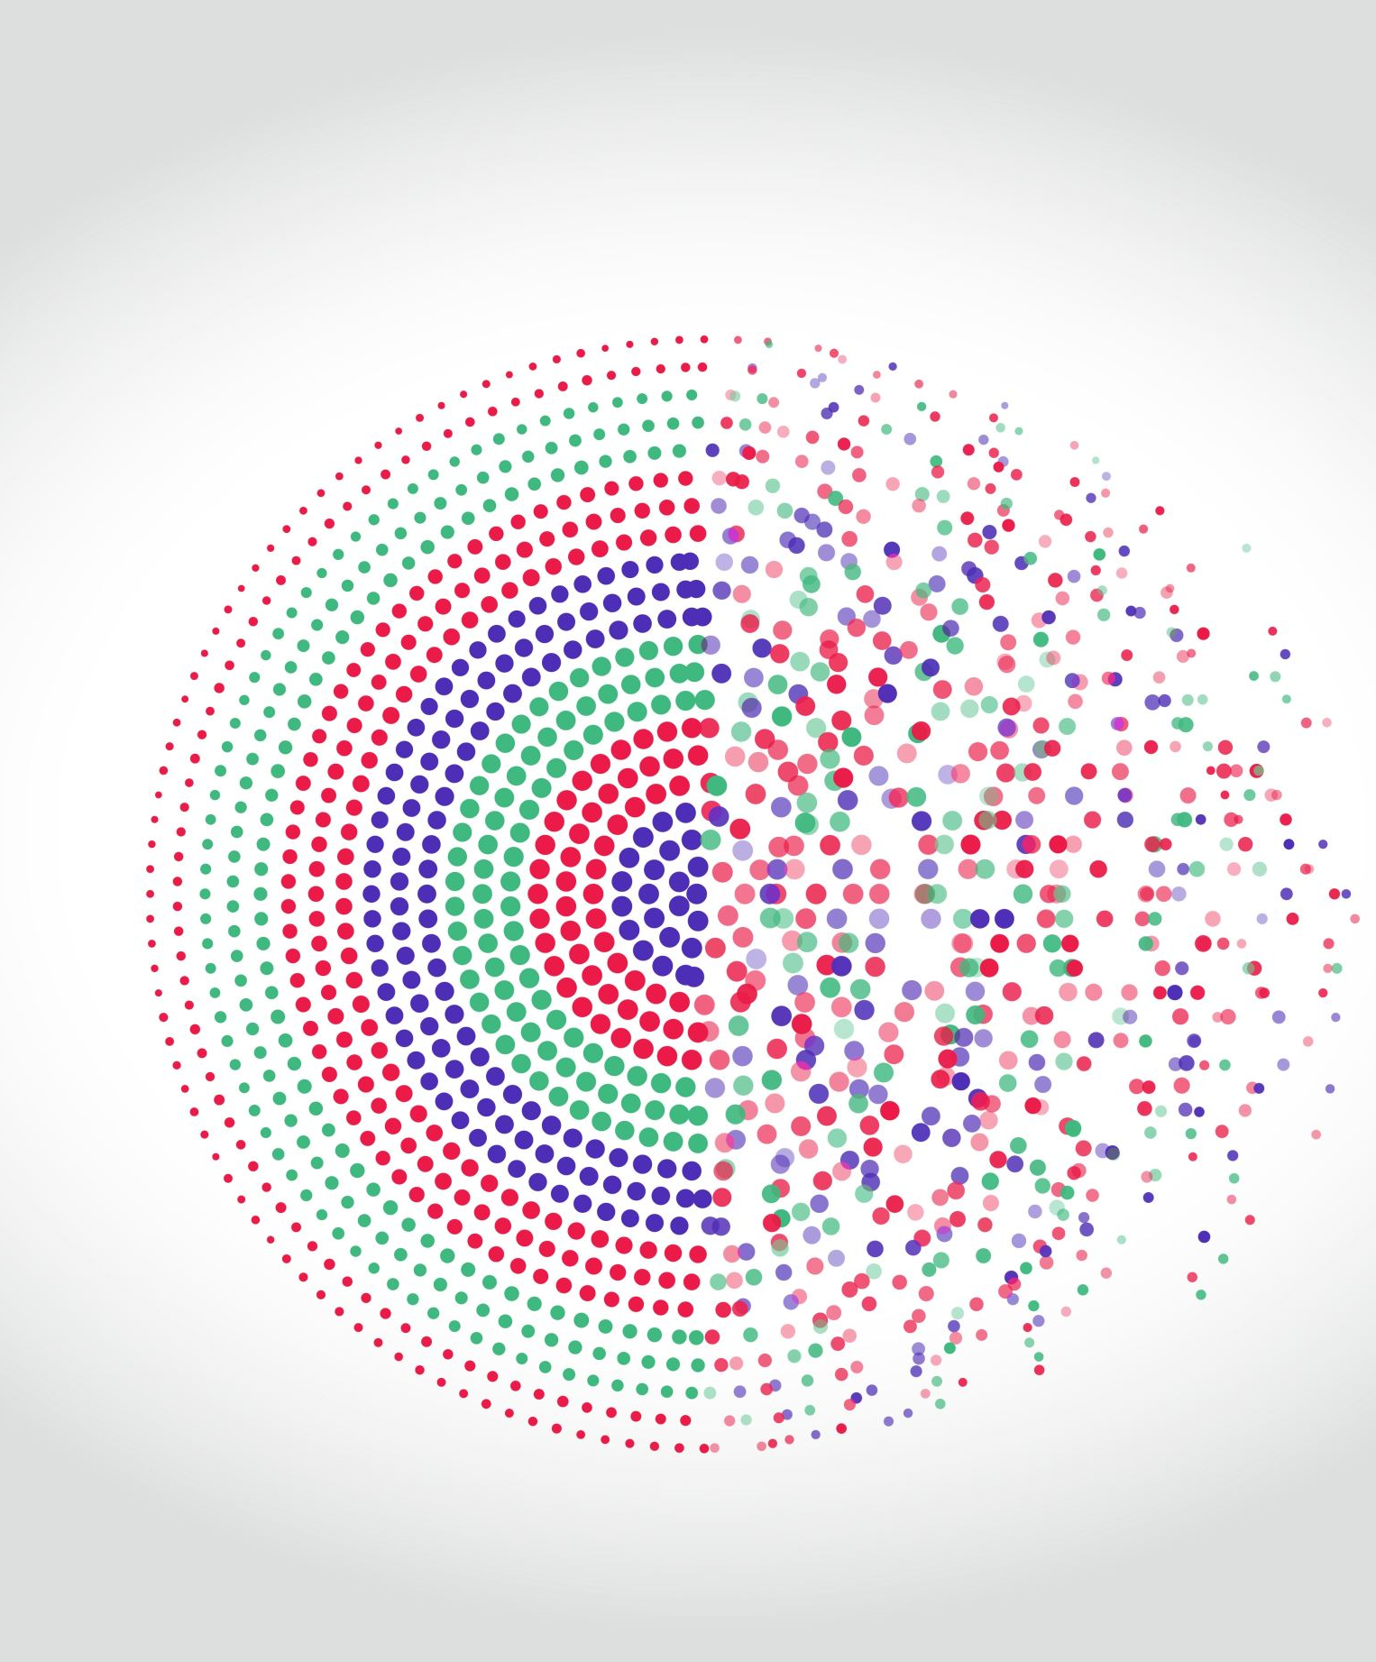
ResNet Model Trained on MNIST Dataset with PyTorch
By john Thomas Foxworthy
June 30, 2022

Slide 2
Outline of Today’s Presentation
Introduction of Neural Networks with Definitions
Characteristics of ResNet
Code Walkthrough
Questions
1
2
3
4

Slide 3
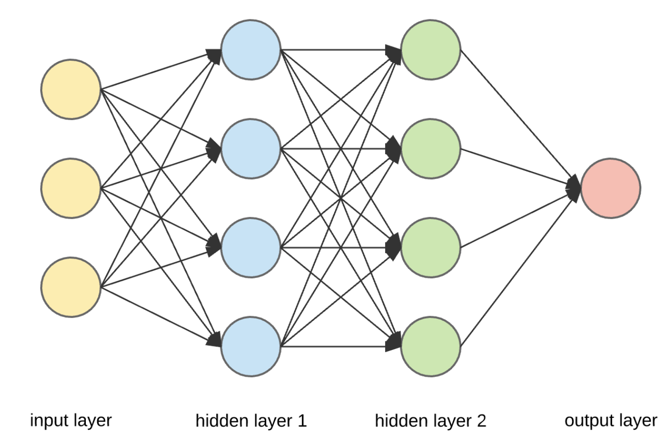
Introduction to Neural Networks
Classical Neural Network
Neuron (Nodes), Layers, and a Neural Network
Activation Function, a Pass, an Epoch, and a Loss Function
Not ResNet

Slide 4
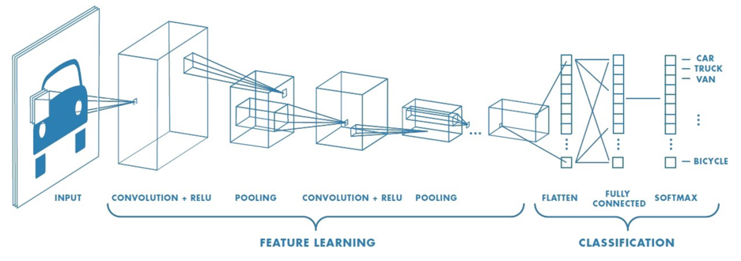
Introduction to Neural Networks
Convolutional Neural Network
Not ResNet

Slide 5
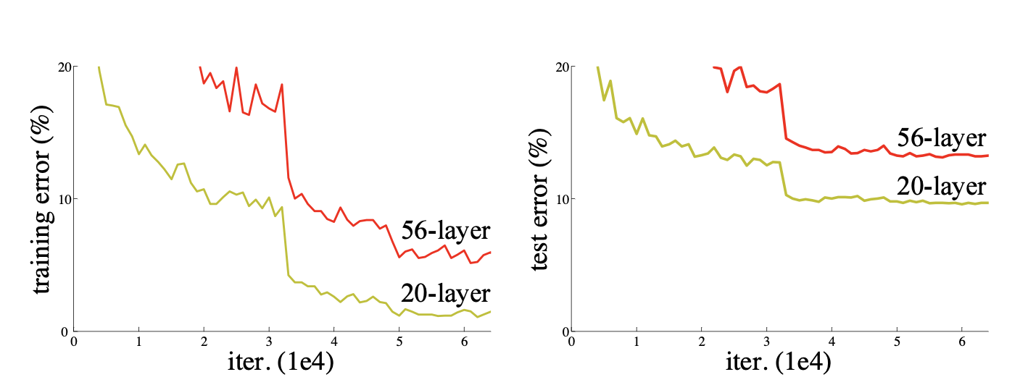
2. Characteristics of ResNet Based on the Original Research Paper
Degradation:
Increasing the depth of the network also decreases the performance for both training and test data
Deep Residual Learning Framework is the solution

Slide 6
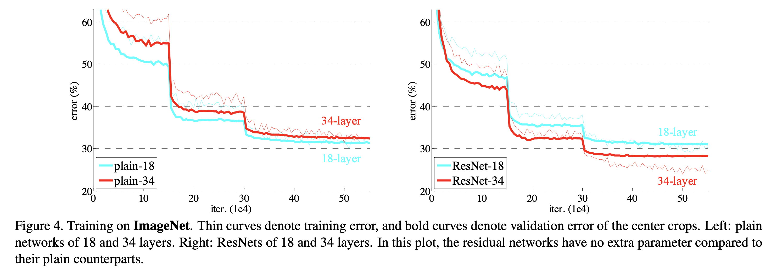
2. Characteristics of ResNet Based on the Original Research Paper
I chose ResNet 18 . . .

Slide 7
2. Characteristics of ResNet Based on the Original Research Paper
One the most popular Neural Network designs with more than 124,000 citations, according to Google Scholar
Extremely deep CNN composed of 152 layers
Initializer created by one of the authors, Kaiming He
Deep Residual Learning Framework to address Degradation
Several Hyperparameter Configurations to Enhance Efficiency in Processing and Accuracy
Batch Size of 256
Learning Rate starts at 0.1, but as errors plateau, it is 0.01
Trained by 60 x 10⁴ iterations
Weight Decay of 0.0001 with a moment of 0.9
No Dropout so no removal of units in the NN
Ten Crop Testing

Slide 8
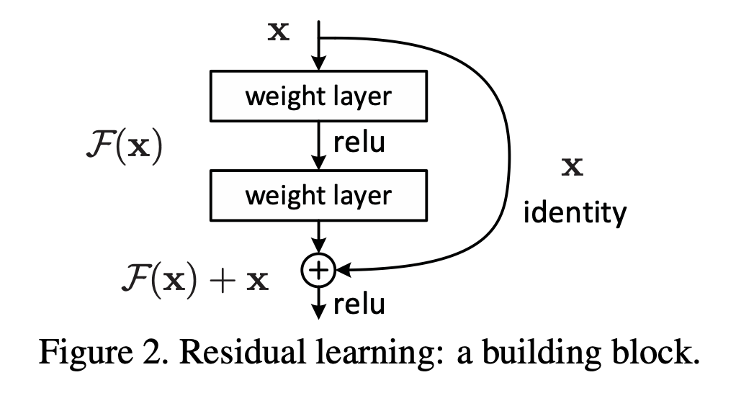
2. Characteristics of ResNet Based on the Original Research Paper
Residual Block
Adds Explicit Identity Connections to help learn the required identity mappings
Network will decide how deep it needs to be so can deal with more complexity
Skip connections work with depth, otherwise impractical
Time Cost is difficult to reach optimality
“Do I need to learn more or am I good?”, says ResNet
No new parameter introduced by identity connections so less computational burden

Slide 9
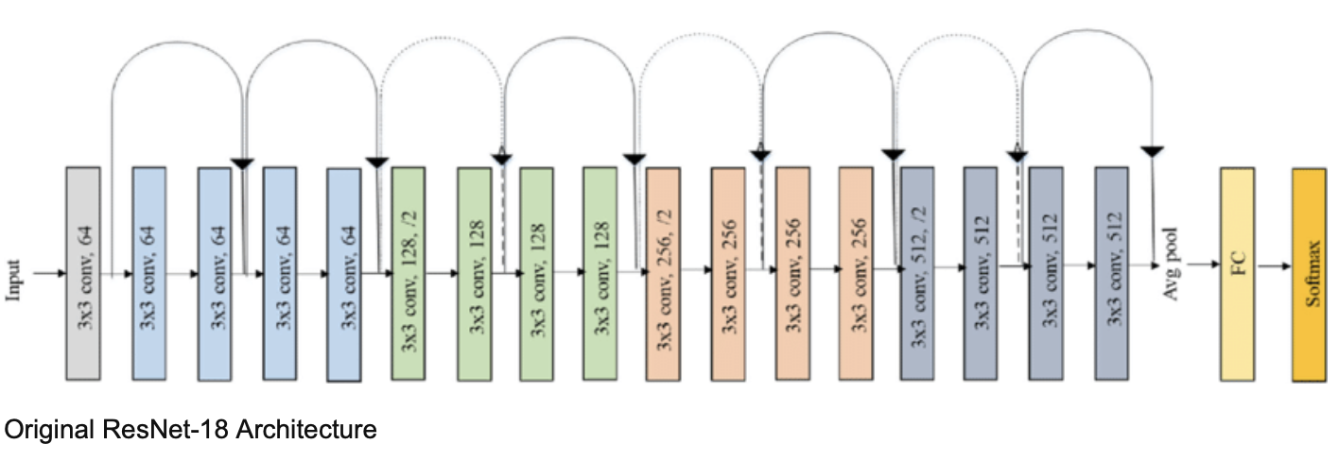
3. Code Walkthrough
MNIST dataset
60,000 training samples
10,000 test samples
10 classes

Slide 10
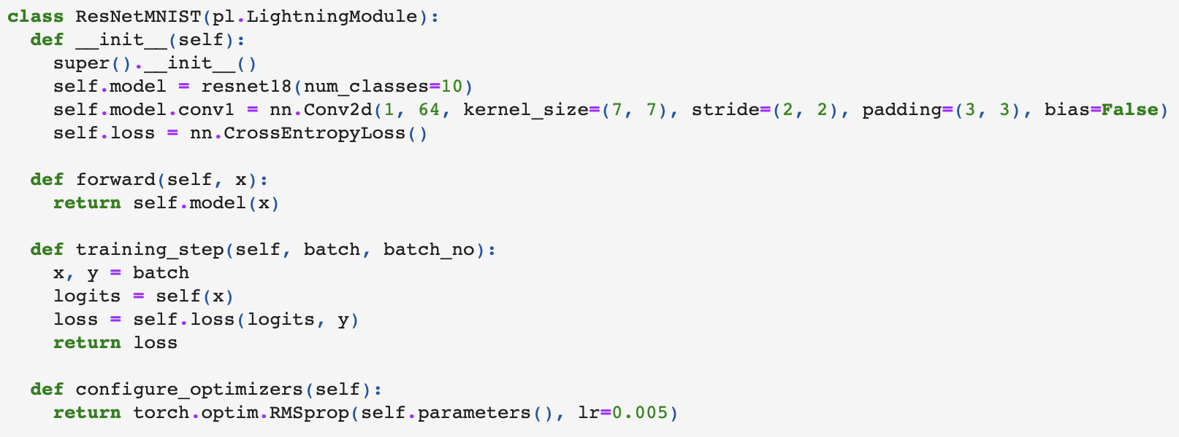
3. Code Walkthrough
Parameter | Value | Description
In Channels | 1 | The Number of Input Channels in the Input mage
Out Channels | 64 | The Number of Output Channels Produced by the Convolution
Kernel Size | (7, 7) | Information retrieval from each part of the image, and its movement is the stride
Stride | (2, 2) | How much the computer should move to pick up its next feature box of the image For example, a stride too big might miss out on features of an image
Padding | (3, 3) | Amount of outer sample size The input size of a sample is reduced as moves thru layers Padding helps with output sample size of the network Zero padding adds zero to any boundary of the input image, which is discarded
Bias | False | No learnable bias in the output as there are no values sampled with weights
Cross-Entropy Loss Function is a Cost Minimization Function that penalizes the model when it estimates a low probability for a target class.
Learning rate is a Hyperparameter
Too high: Quick for new data, but may forget old data
Too low: Learns too slow, insensitive to noise and outliers
An alternative is a schedule for the learning rate
https://pytorch.org/docs/stable/generated/torch.nn.Conv2d.html
ResNet 18 with 10 classes

Slide 11
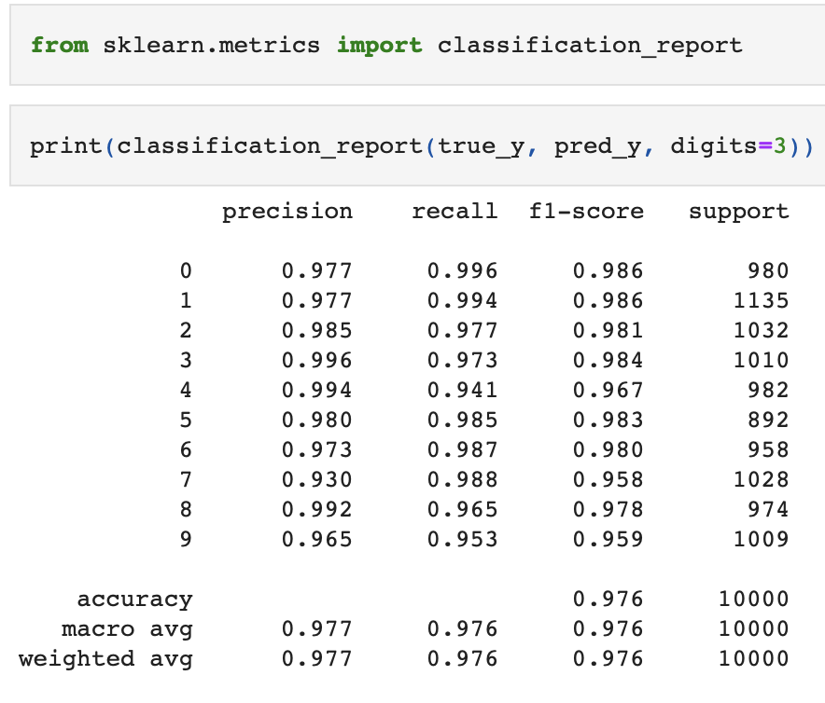
3. Code Walkthrough
A 0.976 level of accuracy overall
At least 0.958 or greater in each of the 10 classes

Slide 12
4. Any Questions

