Slide 1

Customer Shopping Behavior Analysis
Uncovering spending patterns, customer segments, and product preferences from 3,900 transactions

Slide 2

Dataset at a Glance
3,900
Purchases
18
Columns
37
Missing Values
Review Rating column
$59.76
Avg Purchase
Features span demographics, purchase details, and shopping behavior — including subscription status, discounts, and review ratings.

Slide 3


Data Preparation in Python
Clean & Standardize
Imputed missing Review Ratings by category median; renamed columns to snake_case
Feature Engineering
Created age_group and purchase_frequency_days columns
Load to PostgreSQL
Cleaned DataFrame exported to database for SQL analysis

Slide 4
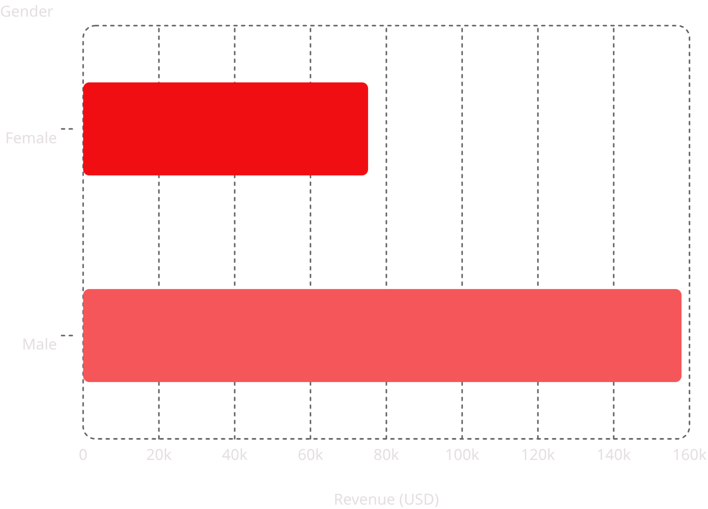
Revenue by Gender
Key Finding
Male customers generated 2.1× more revenue than female customers.
Male
Female
$157,890 total
$75,191 total

Slide 5
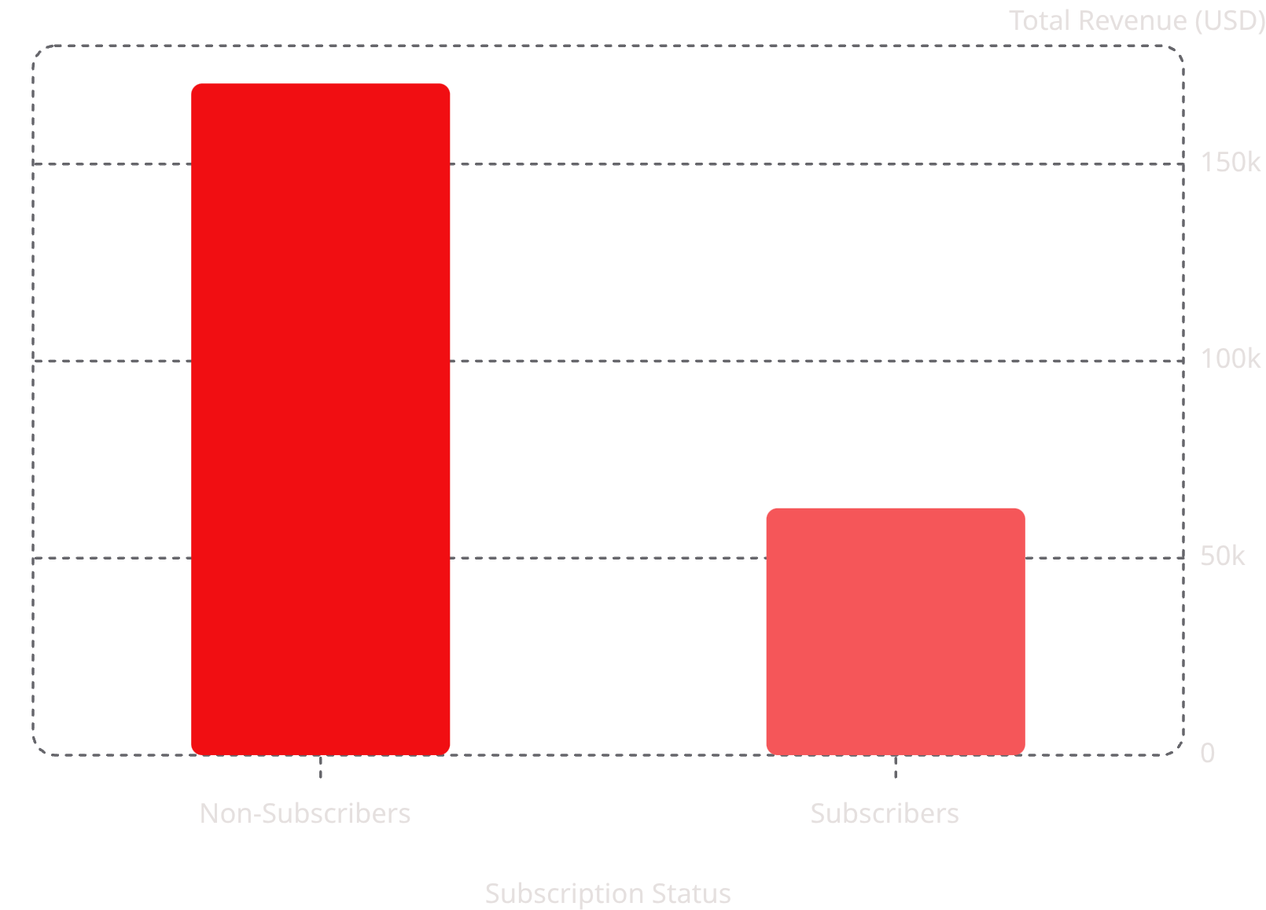
Subscribers vs. Non-Subscribers
Subscription Insights
Non-subscribers drive 73% of total revenue, but average spend is nearly identical.
Non-Subscribers
Subscribers
2,847 customers · $59.87 avg
1,053 customers · $59.49 avg

Slide 6

Products & Discounts
Top 5 Products by Rating
Gloves (3.86) · Sandals (3.84) · Boots (3.82) · Hat (3.80) · Skirt (3.78)
Most Discounted Products
Hat (50%) · Sneakers (49.7%) · Coat (49.1%) · Sweater (48.2%) · Pants (47.4%)
Shipping Comparison
Express: $60.48 avg vs. Standard: $58.46 avg — minimal difference

Slide 7
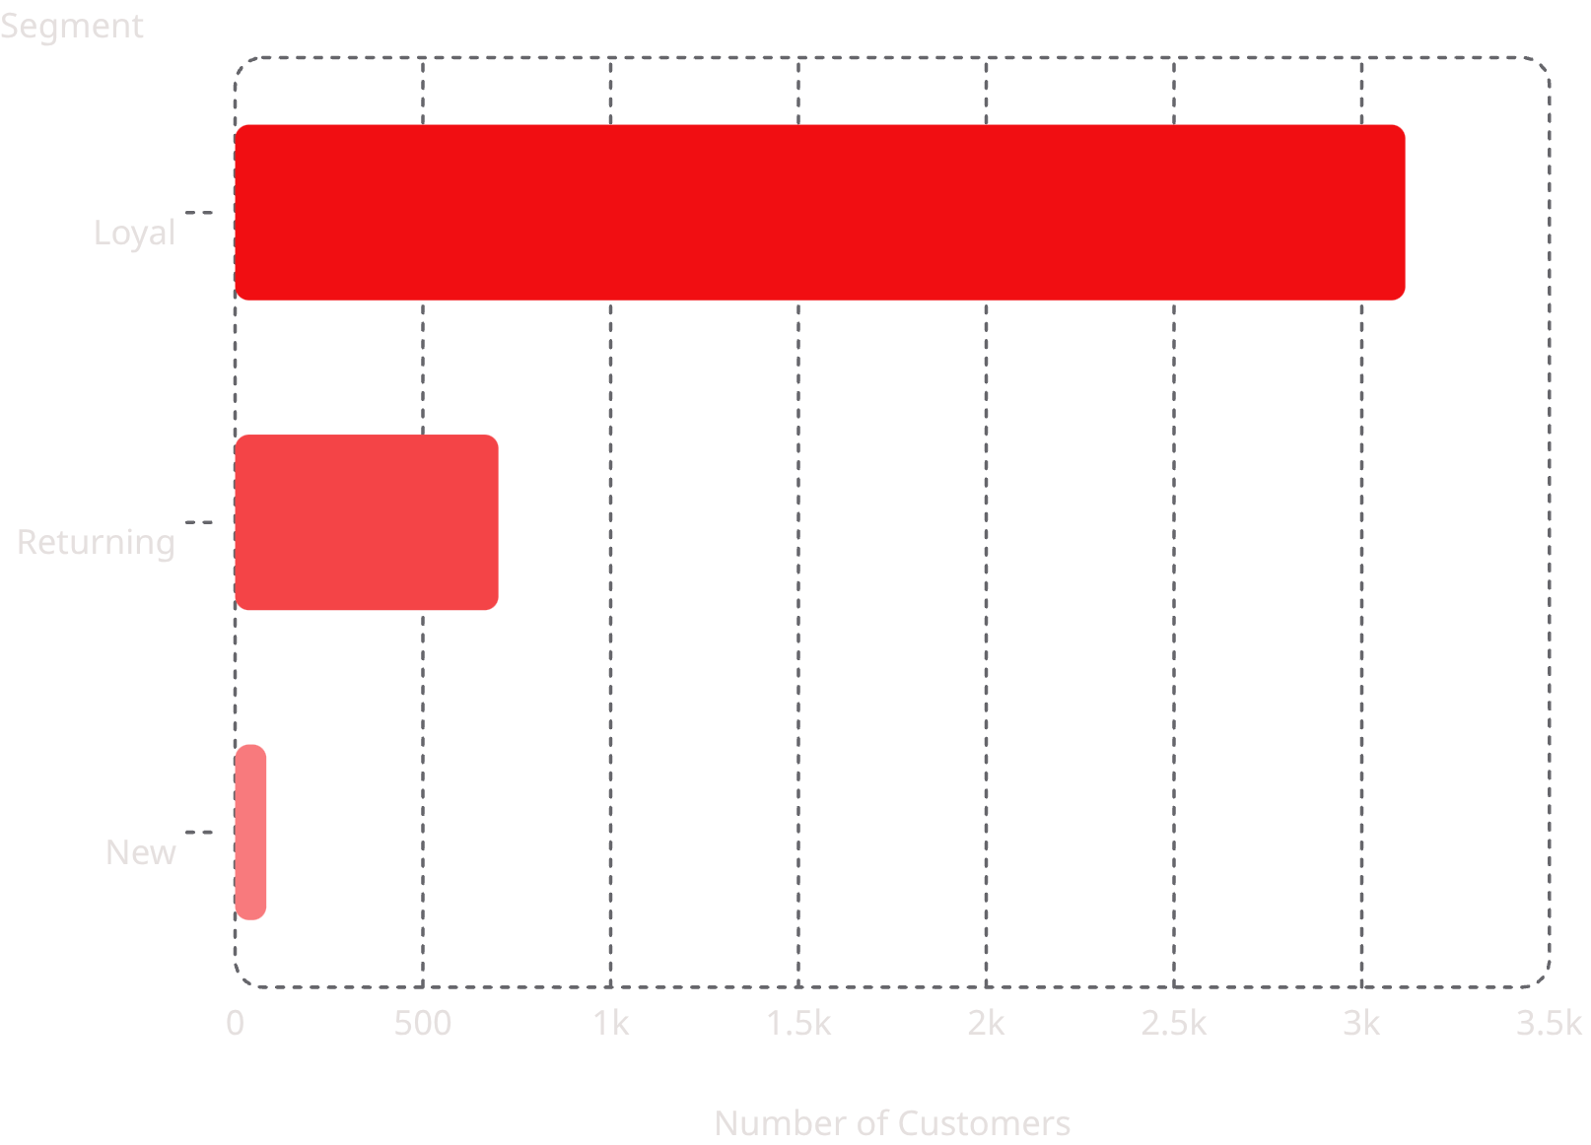

Customer Segmentation
Segment Breakdown
80% of customers are classified as Loyal based on purchase history.
Loyal: 3,116 customers
Returning: 701 customers
New: 83 customers
Repeat buyers with 5+ purchases: 958 subscribers vs. 2,518 non-subscribers

Slide 8
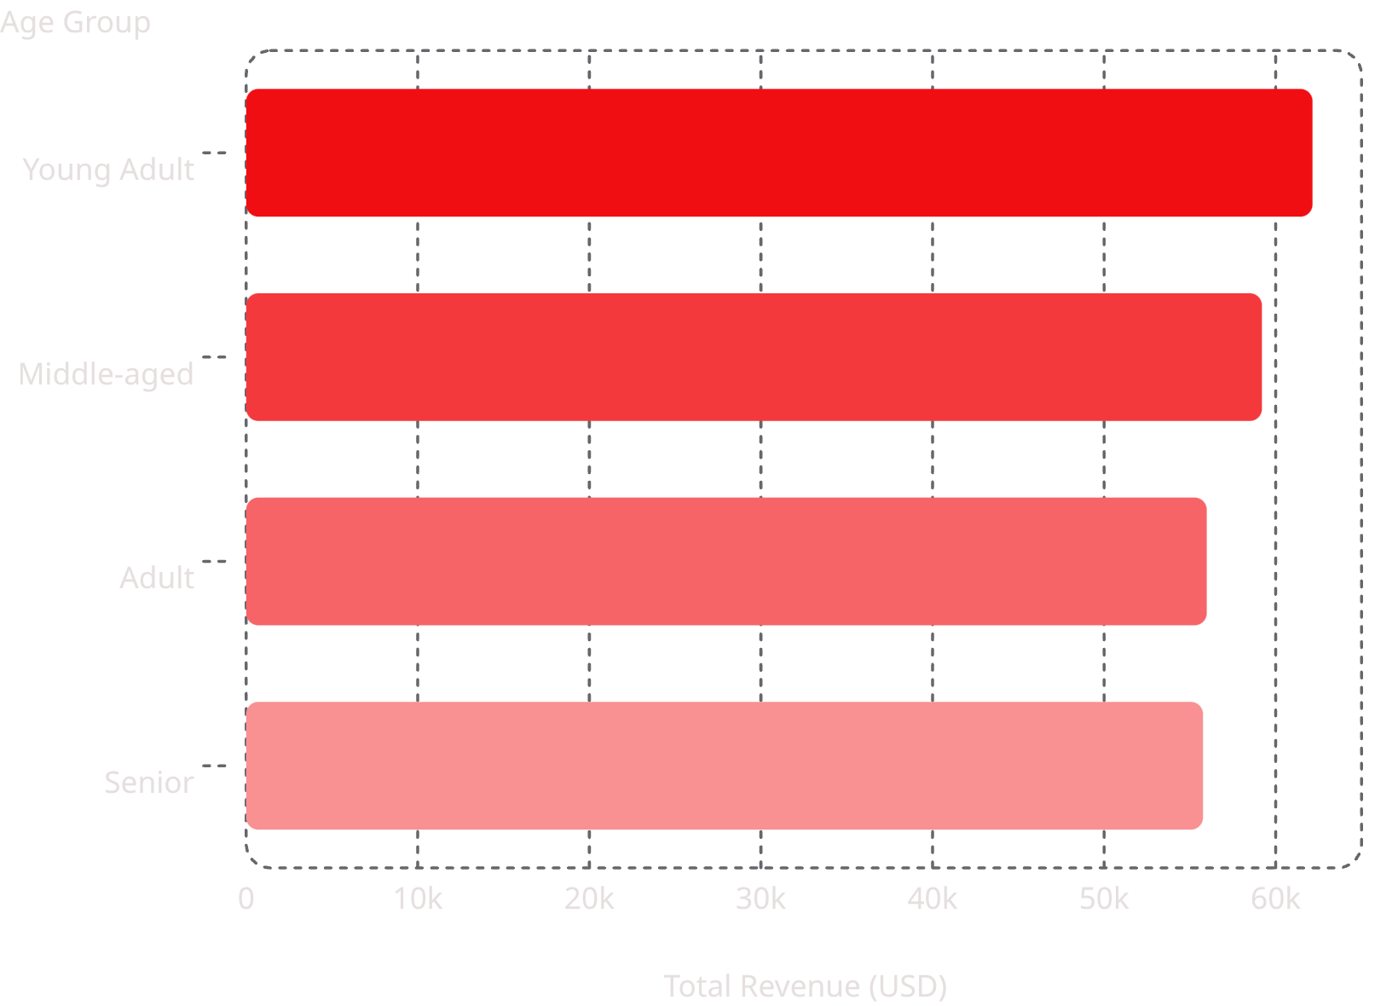
Revenue by Age Group
Age Group Insights
Young Adults lead revenue, but all groups are relatively balanced — opportunity across all segments.
Young Adult
Middle-aged
Adult
Senior
$62,143
$59,197
$55,978
$55,763

Slide 9
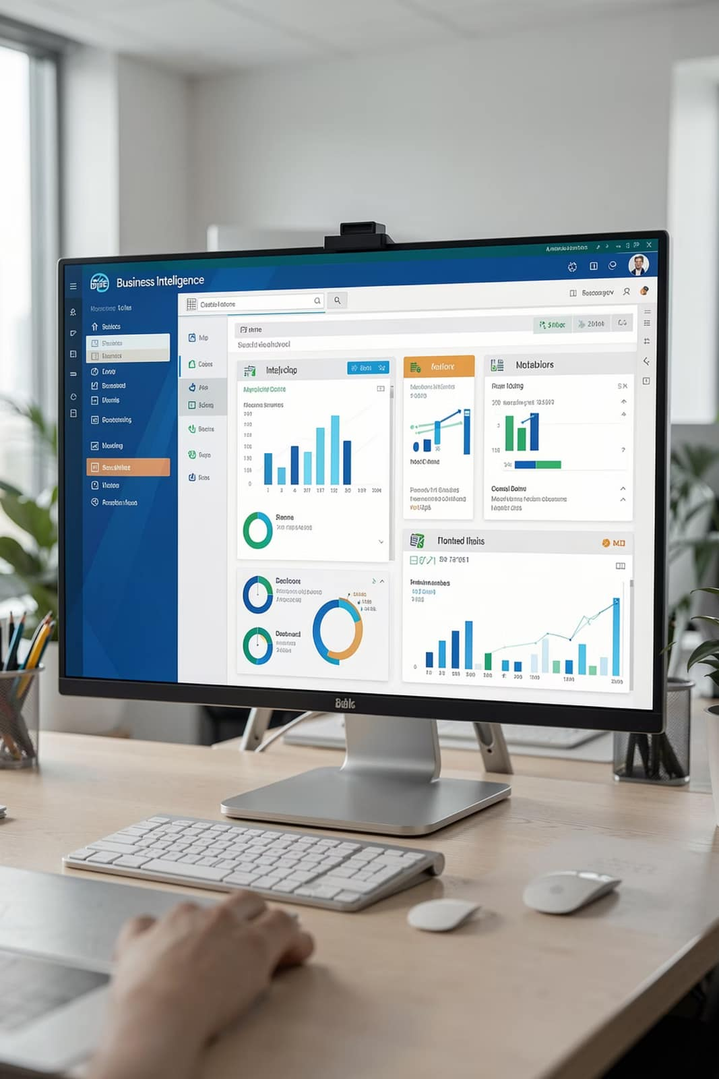
Power BI Dashboard
KPIs
Filters
3.9K customers · $59.76 avg purchase · 3.75 avg rating
Subscription, Gender, Category, Shipping Type
Visuals
Revenue & Sales by Category and Age Group

Slide 10

Business Recommendations
Boost Subscriptions
Promote exclusive subscriber benefits
Loyalty Programs
Reward repeat buyers to grow Loyal segment
Review Discount Policy
Balance sales boosts with margin control
Targeted Marketing
Focus on high-revenue age groups & express-shipping users

