Slide 1
Legal Holding Retrieval on CaseHOLD
Comparing TF-IDF, BM25, a Sentence Transformer and Hybrid Reciprocal Rank Fusion
Sarim Khan (23F10CSE00486)
CSE4144 Information Retrieval · B.Tech CSE, Semester VII, 2026-27
Guide: Ms Shweta Sharma · Manipal University Jaipur
Notes:
Introduce the project: retrieving the legal holding a court cites, using classical and neural IR models on the CaseHOLD dataset.

Slide 2
The problem: finding the precedent that supports a point
A lawyer knows the argument. They need the cited case whose holding backs it.
▸ Legal arguments rest on precedent
Courts write “other courts have held…” and cite a case, followed by a parenthetical stating its holding.
▸ Manual search does not scale
Thousands of decisions; a natural information retrieval task.
▸ Lexical vs semantic matching
TF-IDF/BM25 match exact words. Dense models match meaning but may not know legal language.
▸ Goal of this project
Recast CaseHOLD as retrieval and compare 4 required rankers + 2 extensions with standard IR metrics.
Vocabulary mismatch
Citing passage talks about:
“fears of a gas pipeline”
Correct holding talks about:
“stigma damages … severance damages”
Few shared words, same legal point. This is why we compare lexical, dense and hybrid rankers.
Legal Holding Retrieval on CaseHOLD · Sarim Khan · CSE4144
2
Notes:
Explain the motivation and the vocabulary mismatch problem.

Slide 3
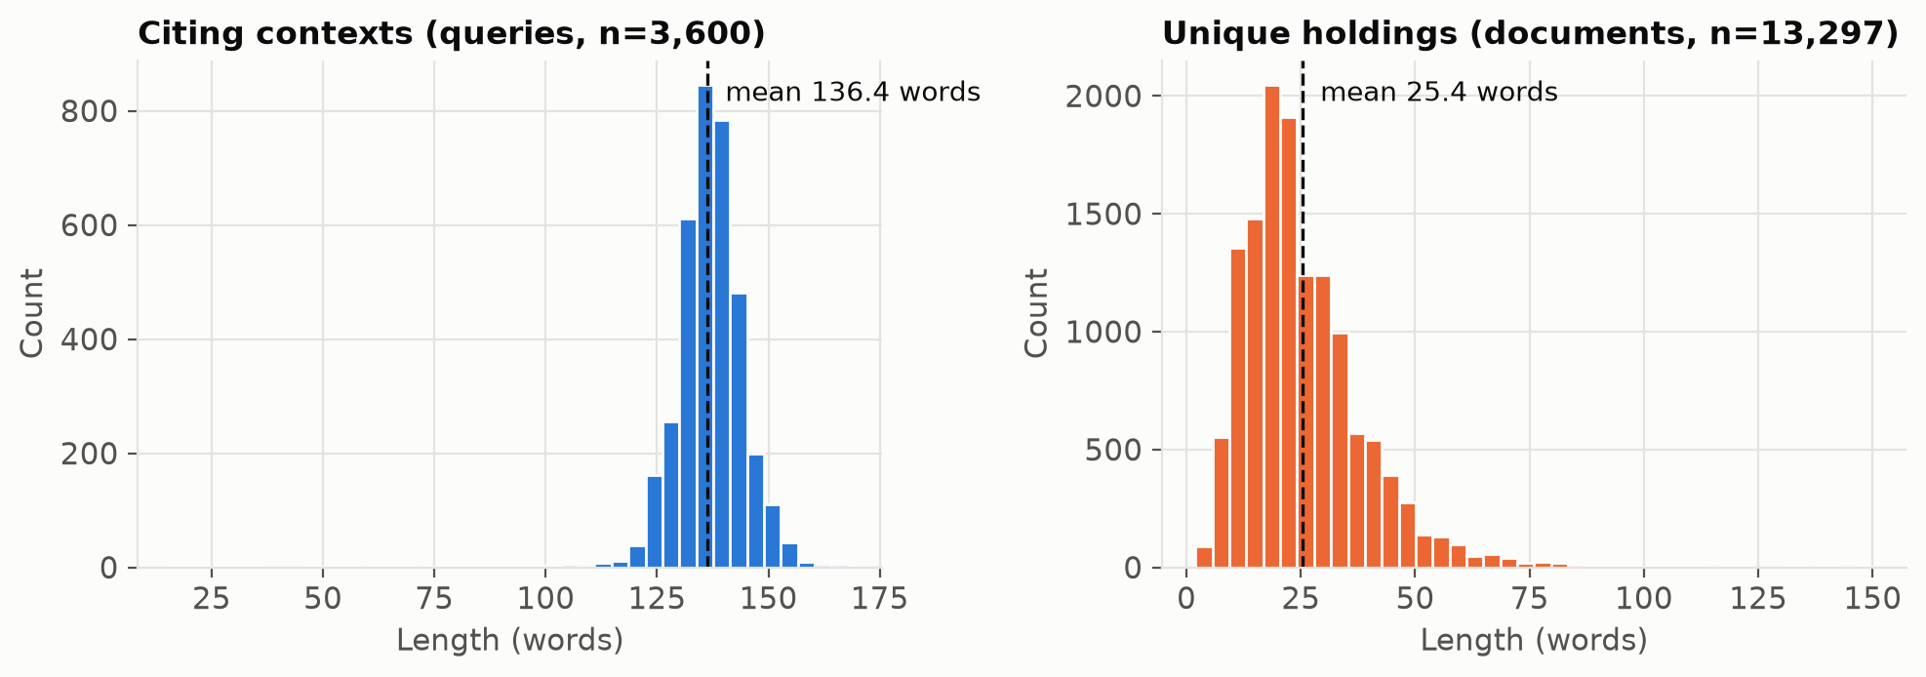
Dataset: CaseHOLD (LexGLUE version)
53,000+ citing passages from US court decisions, each with 1 correct and 4 wrong holdings
Split | Queries | Unique holdings | Words / query | Words / holding
Train | 45,000 | 50,291 | 136.3 | 26.4
Validation | 3,900 | 14,138 | 136.3 | 25.4
Test | 3,600 | 13,297 | 136.4 | 25.4
▸ Built from the Harvard Law case law corpus (Zheng et al., ICAIL 2021)
▸ Wrong options = most TF-IDF-similar holdings → deliberately hard
▸ Correct answer spread evenly over 5 positions (713–727 per position)
▸ Long queries (~136 words), short holdings (~25 words)
Length distributions in the test split
Legal Holding Retrieval on CaseHOLD · Sarim Khan · CSE4144
3
Notes:
Hugging Face: coastalcph/lex_glue, config case_hold.

Slide 4
An example: test query 0
Choices 1-3 are on the same topic; that is what makes it hard
Citing context (query)
… Other courts, in the same or similar circumstances, have held that the anticipation of increased interference or potential hazards on the land remaining after a taking, which one court has labeled “stigma damages,” can be considered in assessing severance damages. See, e.g., Vector Pipeline, L.P., v. 68.55 Acres of Land, 157 F.Supp.2d 949, 957 (N.D.Ill.2001) (<HOLDING>); United States v. 14.38 Acres of Land, 80 F.3d
0: holding that actual damages under respa included emotional damages
1: holding that increased fear of flooding was a matter that factfinder could properly consider in assessing severance damages
2: holding that local buyers fear of possible knapweed infestation legitimately affected calculation of severance damages
3: recognizing concept of stigma damages as they apply to property which is in fact contaminated
4 ✓ correct: holding that stigma damages were properly included in calculation of severance damages where proximity of gas pipeline could trigger fears about possible mishaps
Legal Holding Retrieval on CaseHOLD · Sarim Khan · CSE4144
4
Notes:
Walk through the example: the passage, the <HOLDING> marker, and the five options.

Slide 5
Turning CaseHOLD into a retrieval task
Full-pool setting
5-choice setting
Query = citing passage (3,600 queries). Documents = every unique holding in the test split (13,297). Exactly one relevant document per query. The realistic search setting.
Each query is ranked only against its own five options, matching the original multiple-choice CaseHOLD task. Accuracy = correct holding ranked first (random = 0.20).
Evaluation metrics
▸ Precision@10, Recall@10/100, MAP and nDCG@10, plus Precision-Recall graphs
▸ With one relevant document at rank r: AP = 1/r, so MAP = MRR, and Precision@10 is capped at 0.1
▸ Wilcoxon signed-rank test on per-query AP to check whether gains over BM25 are significant
Legal Holding Retrieval on CaseHOLD · Sarim Khan · CSE4144
5

Slide 6
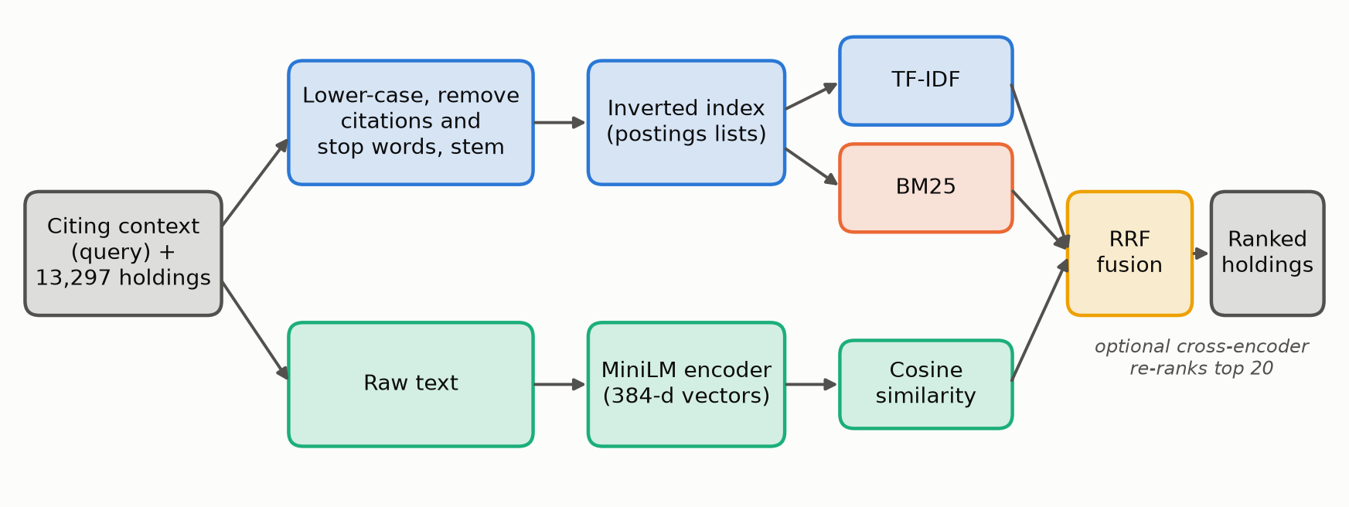
System pipeline
A sparse path and a dense path, merged by Reciprocal Rank Fusion
Legal Holding Retrieval on CaseHOLD · Sarim Khan · CSE4144
6
Notes:
Sparse path: preprocessing, inverted index, TF-IDF and BM25. Dense path: raw text to MiniLM vectors and cosine similarity. RRF merges the ranked lists.

Slide 7
Preprocessing and the inverted index
▸ Normalise
Lower-case, remove the <HOLDING> marker, join dotted abbreviations (e.g. → eg)
▸ Tokenise
Split on non-alphanumerics; drop 1-letter tokens and any token with a digit (removes reporter citations like 157 F.Supp.2d 949)
▸ Stop words
scikit-learn English list + legal words: holding, held, v, see, eg, id, cf, supra, citing
▸ Stem
Porter stemmer
▸ Dense path
Uses raw text: stemming would destroy the sentences the model was trained on
Correct holding of query 0 after preprocessing
stigma, damag, properli, includ, calcul, sever, damag, proxim, ga, pipelin, trigger, fear, possibl, mishap
Inverted index (test pool) | Value
Distinct terms | 7,233
Postings | 150,284
Avg. indexed terms / holding | 12.56
Avg. postings list length | 20.78
Index build time (BM25) | 0.15 s
Legal Holding Retrieval on CaseHOLD · Sarim Khan · CSE4144
7

Slide 8
Ranking models
TF-IDF (vector space)
Weight (1 + log tf) × idf, unit-length vectors, cosine similarity
BM25
score(q,d) = Σ idf(t) · tf·(k1+1) / (tf + k1·(1 − b + b·|d|/avgdl))
idf(t) = ln(1 + (N − df + 0.5) / (df + 0.5))
Chosen on validation: k1 = 0.4, b = 1.0
Reciprocal Rank Fusion
RRF(d) = Σ over models m of 1 / (k + rank_m(d))
No score normalisation needed: BM25 scores are unbounded, cosine lies in [−1, 1].
k = 60 (standard) for main results; k = 5 chosen on validation as an extra run.
Okapi BM25 (own implementation)
Term-frequency saturation (k1) and length normalisation (b) on our inverted index
Sentence Transformer
all-MiniLM-L6-v2: 6 layers, 384-d vectors, cosine similarity
Hybrid RRF
Fuses the top-1000 lists of TF-IDF, BM25 and dense using only rank positions
Ext. 1: fine-tuned dense
MiniLM trained 1 epoch on 45,000 CaseHOLD training pairs (MNR loss, hard negative)
Ext. 2: cross-encoder
ms-marco-MiniLM-L6-v2 re-scores the top 20 of the hybrid list
Legal Holding Retrieval on CaseHOLD · Sarim Khan · CSE4144
8

Slide 9
Choosing parameters on the validation split
All choices made on 3,900 validation queries (MRR), then frozen
Decision | Options tried (validation MRR) | Chosen
Query length (BM25) | full 0.300 · last 64 words 0.278 · last 32 0.154 | Full context
BM25 k1, b | grid of 54 settings, best MRR 0.308 | k1 = 0.4, b = 1.0
TF-IDF preprocessing | tokens 0.281 · + stop words 0.274 · + stemming 0.300 | Stop words + stem
Dense model | MiniLM 0.228 · bge-small 0.158 · bge + instruction 0.176 | all-MiniLM-L6-v2
RRF constant k | k=1: 0.330 · k=5: 0.331 · k=10: 0.331 · k=60: 0.318 · k=100: 0.316 | k = 5 (extra run)
Low k1 and high b suit short documents, where repeating a term adds little meaning. Stop-word removal alone did not help TF-IDF; adding stemming did.
Legal Holding Retrieval on CaseHOLD · Sarim Khan · CSE4144
9

Slide 10
Full-pool results on the test split
3,600 queries × 13,297 holdings. Max possible Precision@10 is 0.1.
Ranking model | P@10 | Recall@100 | MAP (= MRR) | nDCG@10
TF-IDF | 0.049 | 0.728 | 0.317 | 0.349
BM25 | 0.049 | 0.709 | 0.320 | 0.354
Sentence Transformer | 0.037 | 0.604 | 0.234 | 0.258
Hybrid RRF (TF-IDF + BM25 + Dense) | 0.053 | 0.762 | 0.327 | 0.367
Hybrid RRF, k = 5 | 0.054 | 0.759 | 0.341 | 0.380
Hybrid RRF (BM25 + Dense) | 0.049 | 0.747 | 0.314 | 0.347
Hybrid + cross-encoder | 0.039 | 0.762 | 0.181 | 0.215
Dense, fine-tuned (ext.) | 0.058 | 0.802 | 0.395 | 0.432
Hybrid RRF (BM25 + fine-tuned Dense) | 0.060 | 0.821 | 0.401 | 0.440
Rows 1-4 are the four required models; “ext.” rows are the extensions. Highlighted = best run.
Legal Holding Retrieval on CaseHOLD · Sarim Khan · CSE4144
10

Slide 11
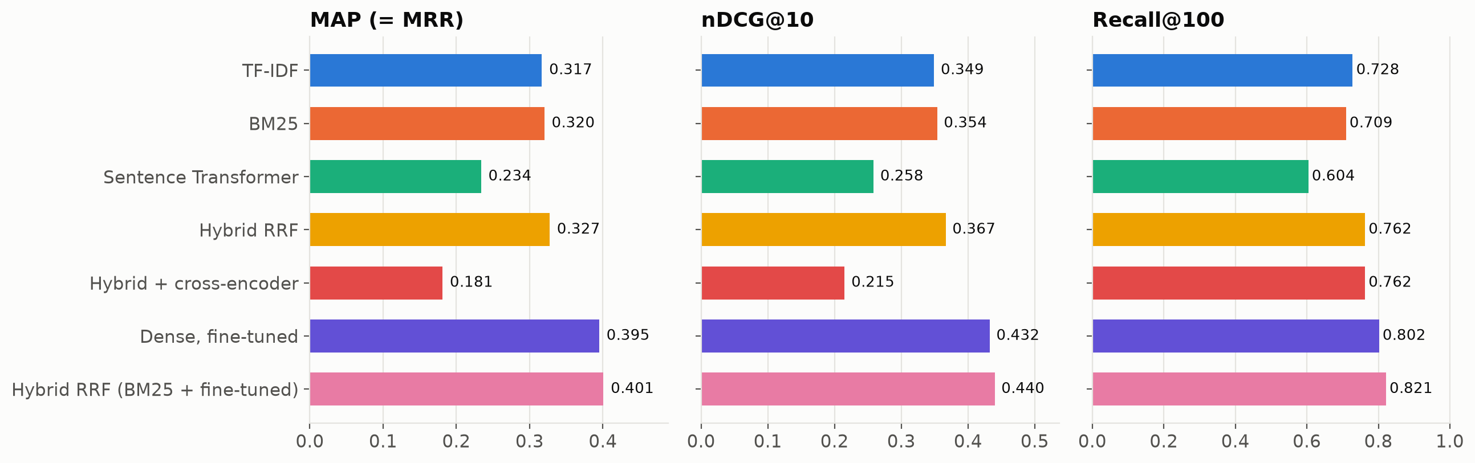
What the results show
0.320
0.709 → 0.762
0.234 → 0.395
0.181
BM25 MAP: best required single model (dense 0.234)
Recall@100, BM25 → three-way RRF
Dense MAP after fine-tuning on CaseHOLD
Cross-encoder MAP: web-trained re-ranker hurts
Legal Holding Retrieval on CaseHOLD · Sarim Khan · CSE4144
11
Notes:
Best run overall: BM25 + fine-tuned dense, MAP 0.401, Recall@100 0.821. Wilcoxon p for three-way hybrid vs BM25: 3.2e-16.

Slide 12
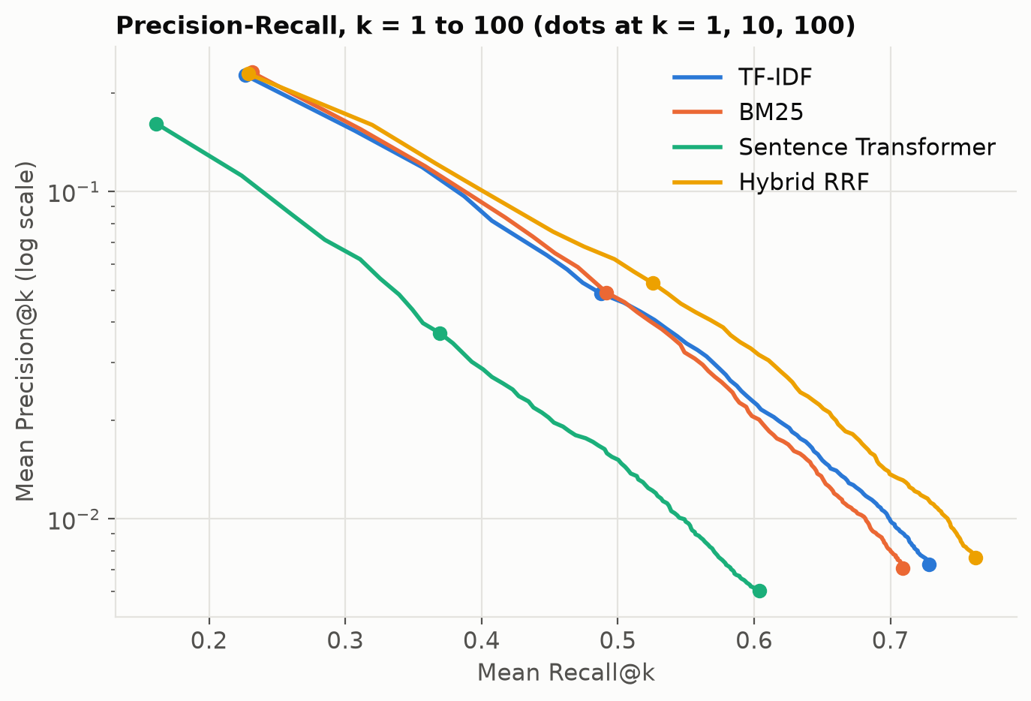
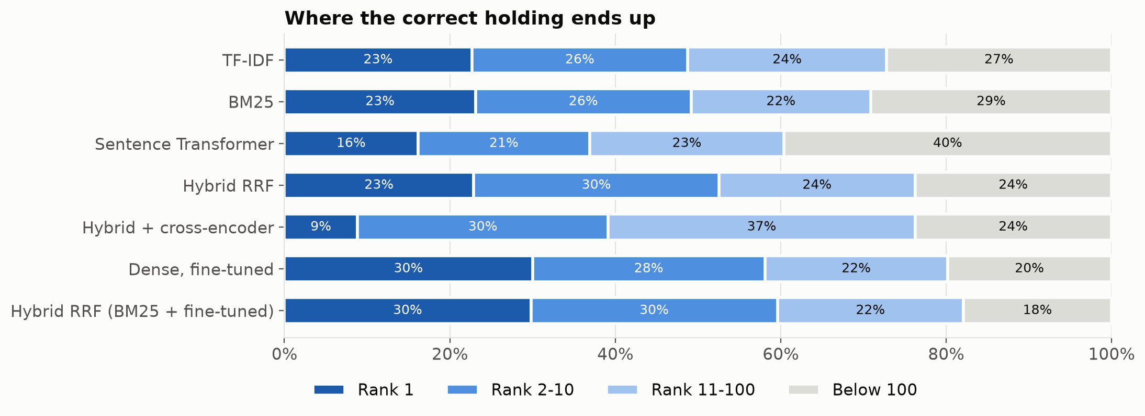
Precision-Recall and where the correct holding lands
One relevant holding per query, so precision falls roughly as 1/k; plotted on a log scale.
The hybrid curve rises above BM25 as k grows: fusion mainly pulls answers from deep in the list into the top 100.
Legal Holding Retrieval on CaseHOLD · Sarim Khan · CSE4144
12

Slide 13
5-choice setting (original CaseHOLD format)
Every method is far above chance (0.20), but the ordering changes
Ranking model | Accuracy | MRR | Recall@2 | nDCG@5
TF-IDF | 0.554 | 0.726 | 0.764 | 0.795
BM25 | 0.579 | 0.745 | 0.788 | 0.809
Sentence Transformer | 0.523 | 0.705 | 0.738 | 0.779
Dense, fine-tuned (ext.) | 0.637 | 0.785 | 0.842 | 0.839
Hybrid RRF (TF-IDF + BM25 + Dense) | 0.584 | 0.746 | 0.784 | 0.810
Hybrid RRF (BM25 + Dense) | 0.563 | 0.736 | 0.787 | 0.803
Hybrid RRF (BM25 + fine-tuned Dense) | 0.624 | 0.777 | 0.834 | 0.833
Cross-encoder (ms-marco) | 0.386 | 0.605 | 0.611 | 0.703
▸ Wrong options were chosen by TF-IDF similarity
All five candidates share vocabulary, so the lexical signal RRF adds helps less.
▸ Domain training wins
The fine-tuned dense model is the most accurate single ranker here.
▸ Context
Zheng et al. report ~0.6 macro-F1 for fine-tuned BERT on their split (not directly comparable).
Legal Holding Retrieval on CaseHOLD · Sarim Khan · CSE4144
13

Slide 14
Error analysis: the models fail on different queries
461
▸ Complementary errors → fusion helps
Both rank it first in 372 queries; the disagreements are what RRF exploits.
▸ Hybrid's wrong top-1 is rarely a distractor
Only 13% of misses are one of the query's own 4 wrong options; word overlap with the correct holding is low (Jaccard 0.09).
▸ Longer holdings are easier
BM25 MRR rises from 0.199 (≤15 words) to 0.411 (>40 words): more terms to match.
▸ Some citations cannot be recovered
A citation used for a procedural point the surrounding text never mentions defeats every ranker that only reads the context.
queries where BM25 ranks the answer first but the dense model does not
209
queries where only the dense model ranks it first
1,589
Query 296: dense rank 1, BM25 rank 1,883
Context: two officers say they were ordered to “cease all contact” with each other …
Correct: holding that governmental actions restricting police officers sexual conduct of an extramarital affair were reasonable
No shared keywords, so BM25 misses it; the dense model links the meaning.
queries (44%) where neither puts it in the top 10
Legal Holding Retrieval on CaseHOLD · Sarim Khan · CSE4144
14

Slide 15
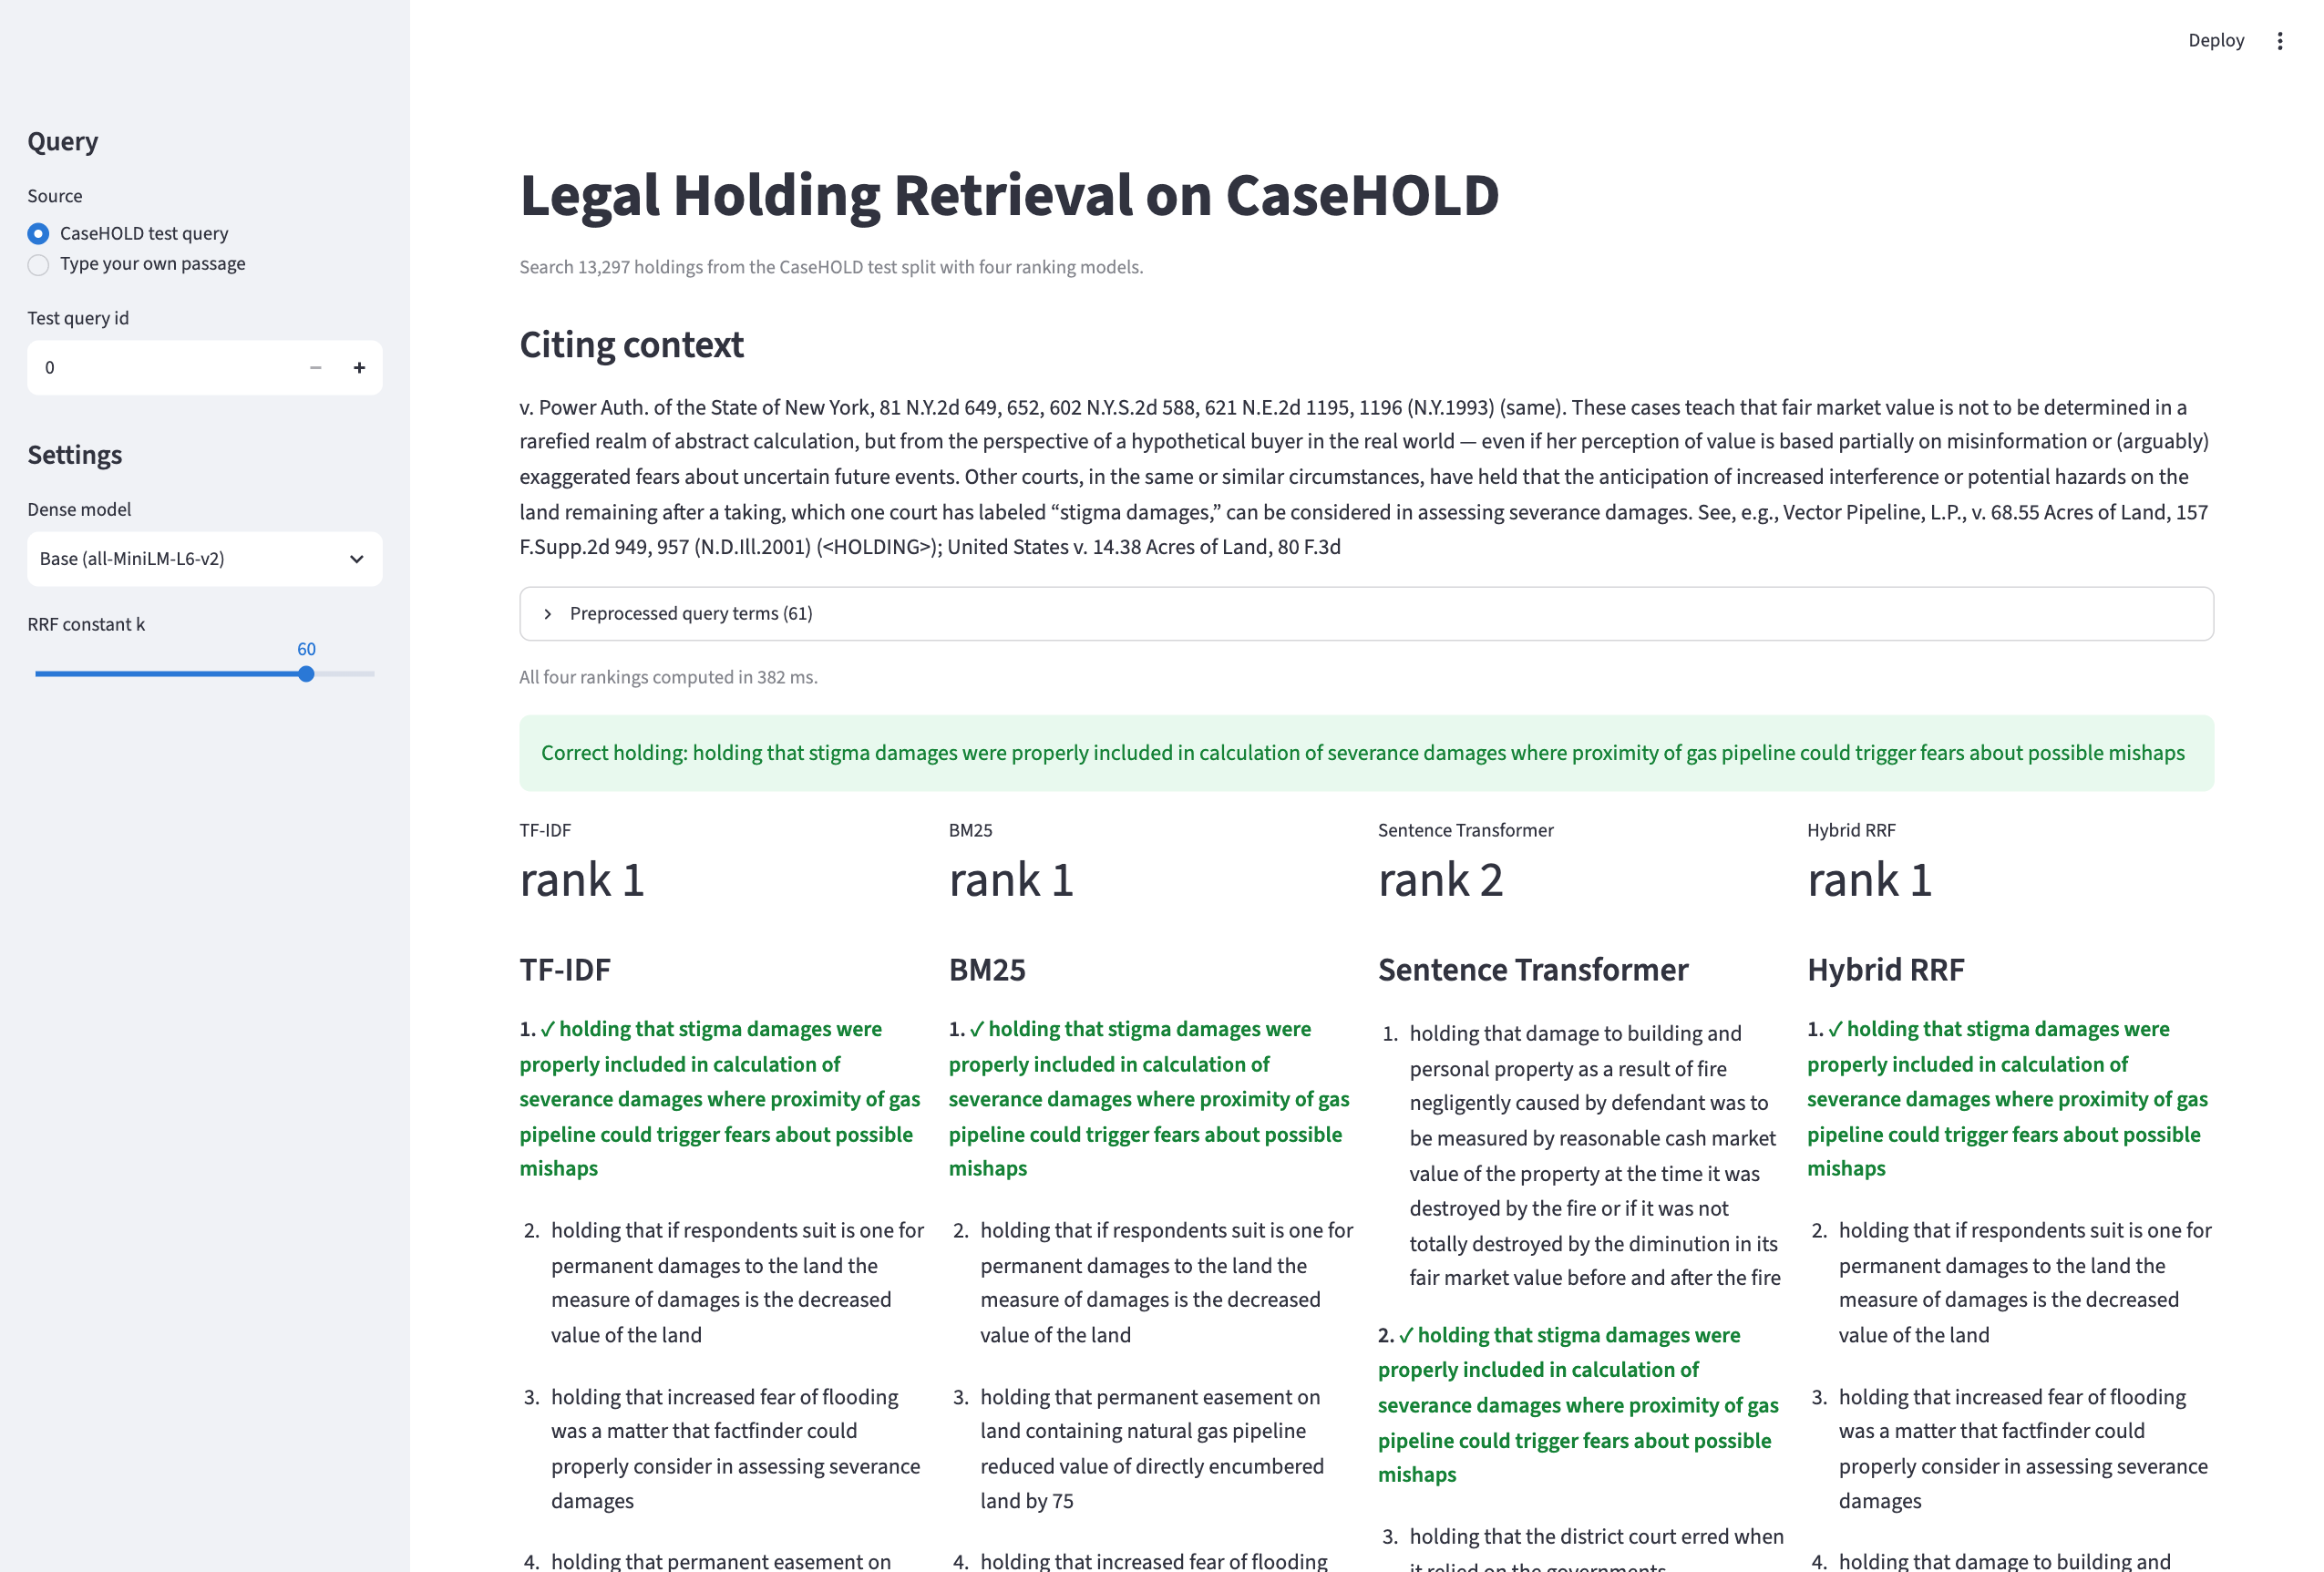
Live demo: Streamlit search interface
Pick a CaseHOLD test query or type any passage; compare all four rankers side by side
▸ Shows preprocessed query terms
▸ Top 10 from TF-IDF, BM25, dense (base or fine-tuned) and RRF
▸ Marks the correct holding and its rank in each list
▸ BM25 answers by walking the postings lists: well under a second
streamlit run app/search_app.py
Legal Holding Retrieval on CaseHOLD · Sarim Khan · CSE4144
15
Notes:
Switch to the browser. Show query 0, then type a custom passage. Toggle the fine-tuned model.

Slide 16
Conclusion and future work
Key lessons
Limits and next steps
▸ Lexical models are strong on legal text
Tuned BM25 (MAP 0.320) beats an off-the-shelf dense model (0.234).
▸ Fusion helps recall more than the top rank
Three-way RRF lifts Recall@100 to 0.762; MAP moves to 0.327.
▸ Domain data matters most
Fine-tuning lifts dense MAP to 0.395; BM25 + fine-tuned dense is best (0.401).
▸ One relevant holding per query: legally valid alternatives count as wrong
▸ Pool is the test split, not a full case-law database
▸ Try a legal-domain encoder (Legal-BERT)
▸ Train the cross-encoder on CaseHOLD itself
▸ Weight the rankers inside RRF instead of treating them equally
Legal Holding Retrieval on CaseHOLD · Sarim Khan · CSE4144
16

Slide 17
Thank you · Questions?
Code, results and demo: github.com/sarimkhan-sketch/casehold-legal-retrieval
Key references: Robertson & Zaragoza 2009 (BM25) · Reimers & Gurevych 2019 (Sentence-BERT) · Cormack et al. 2009 (RRF) · Zheng et al. 2021 (CaseHOLD) · Chalkidis et al. 2022 (LexGLUE)

