Slide 1
Testing a Library Management System
A Flask + SQLite REST API verified with 45 automated pytest test cases
Sarim Khan (23F10CSE00486)
Software Testing · B.Tech CSE, Semester VII, 2026-27
Guide: Dr. Manmohan Sharma · Manipal University Jaipur

Slide 2
Problem and solution
▸ Problem
Small libraries track loans on paper: copies get double-lent, fines are worked out by hand.
▸ Solution
A REST API that enforces the lending rules on the server.
▸ Testing goal
Prove every rule works, including edge cases and misuse, with tests that re-run in seconds.
Business rules under test
Loan period: 14 days
Late fine: Rs 5 per day
Max 3 books per member at a time
Cannot borrow the same book twice
Only admin can add / edit / delete books
ISBN-13 with valid checksum, unique
Username 3-20 chars, unique (any case)
Password 6-64 chars, stored hashed
Library Management System Testing · Sarim Khan · Software Testing
2

Slide 3
System design
Python 3.12 · Flask 3 · SQLite · pytest
Client
HTTP + JSON
(test client / demo.py)
auth.py
login_required
admin_required
validators.py
input rules
books.py / loans.py
business logic
db.py
SQLite
users · tokens
books · loans
→
→
→
→
Role | Can do
Guest | Search and view the catalogue
Member | Register, log in, borrow up to 3 books, return, see own loans
Admin | Everything above + add / update / delete books, see all and overdue loans
Library Management System Testing · Sarim Khan · Software Testing
3

Slide 4
Testing strategy
Every test: fresh temporary database + a fixed clock (1 Sep 2026)
Technique | Example from this project
Unit | check_isbn("9780306406158") → "isbn checksum is invalid"
Boundary value analysis | Username length 2 / 3 / 20 / 21; borrowing the 3rd and the 4th book
Equivalence partitioning | Copies: valid 1-100 vs text, decimal, boolean, negative
Negative | Wrong password, unknown book id, plain-text body instead of JSON
Security | Password hashed in DB, fake tokens rejected, "role": "admin" ignored, SQL injection
Role-based access | Member adding a book → 403; returning another member's loan → 403
Integration / system | Full journey: register → borrow → return late → fine Rs 10 → logout
Regression | Whole suite re-run after every fix (3 cycles)
Library Management System Testing · Sarim Khan · Software Testing
4

Slide 5
Five testing phases
45 test cases, one pytest function each
Phase | Module | Testing type | Test cases | Result
1 | Validation & fine rules | Unit, BVA, ECP | TC-01 – TC-09 (9) | 9/9 PASS
2 | Authentication | Functional, Negative, Security | TC-10 – TC-19 (10) | 10/10 PASS
3 | Book catalogue | Functional, Role-based access, Database | TC-20 – TC-31 (12) | 12/12 PASS
4 | Loans | Functional, BVA, Integration | TC-32 – TC-42 (11) | 11/11 PASS
5 | Whole system | System, Integration, Security | TC-43 – TC-45 (3) | 3/3 PASS
Test ID = function name: TC-35 is test_tc35_borrow_limit() in tests/test_phase4_loans.py
Library Management System Testing · Sarim Khan · Software Testing
5

Slide 6
Example: boundary test on the borrowing limit
TC-35 · Loans · Priority High
Scenario
Borrowing limit of 3 active books (BVA on the limit)
Steps
1. Add 4 books; 2. Member borrows books 1, 2 and 3; 3. Member borrows book 4
Expected
First 3 succeed (201); 4th returns 409 "borrowing limit of 3 books reached"
Actual
C1 FAIL (blocked by DEF-01), C2 FAIL (DEF-03); C3 PASS after fix
def test_tc35_borrow_limit(api):
setup_books(api, count=4)
member = api.member()
for book_id in (1, 2, 3):
assert api.borrow(member, book_id)\
.status_code == 201
res = api.borrow(member, 4)
assert res.status_code == 409
# Bug found (DEF-03):
# if len(active) > 3: <- allows a 4th
# Fix:
# if len(active) >= 3:
Library Management System Testing · Sarim Khan · Software Testing
6

Slide 7
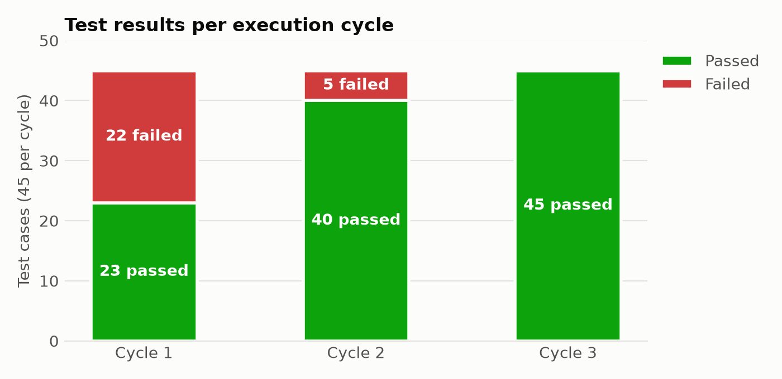
Execution results
135 automated executions over 3 cycles
22 → 5 → 0
failures per cycle
80.0%
108 of 135 executions passed (all cycles)
98.5%
statement coverage in the final cycle (pytest-cov)
Library Management System Testing · Sarim Khan · Software Testing
7

Slide 8
Defect log
6 defects reproduced by tests and fixed · 3 found by code review
ID | Severity | Defect | Found by | Status
DEF-01 | Critical | Adding a book returned HTTP 500 (blocked 21 tests) | TC-20 (Cycle 1) | Fixed
DEF-02 | Medium | 'sarim' and 'Sarim' could both register | TC-13 (Cycle 1) | Fixed
DEF-03 | High | Borrow limit off by one: 4 books allowed | TC-35 (Cycle 2) | Fixed
DEF-04 | High | Reducing copies below loans → negative stock | TC-28 (Cycle 2) | Fixed
DEF-05 | Medium | Book update: text copies → 500, 0 accepted | TC-29 (Cycle 2) | Fixed
DEF-06 | High | Deleting a borrowed book erased loan records | TC-30 (Cycle 2) | Fixed
DEF-07 | Medium | Login tokens never expire | Code review | Deferred
DEF-08 | Medium | No limit on failed login attempts | Code review | Open
DEF-09 | Low | Possible race on the last copy (not reproduced) | Code review | Open
Library Management System Testing · Sarim Khan · Software Testing
8

Slide 9
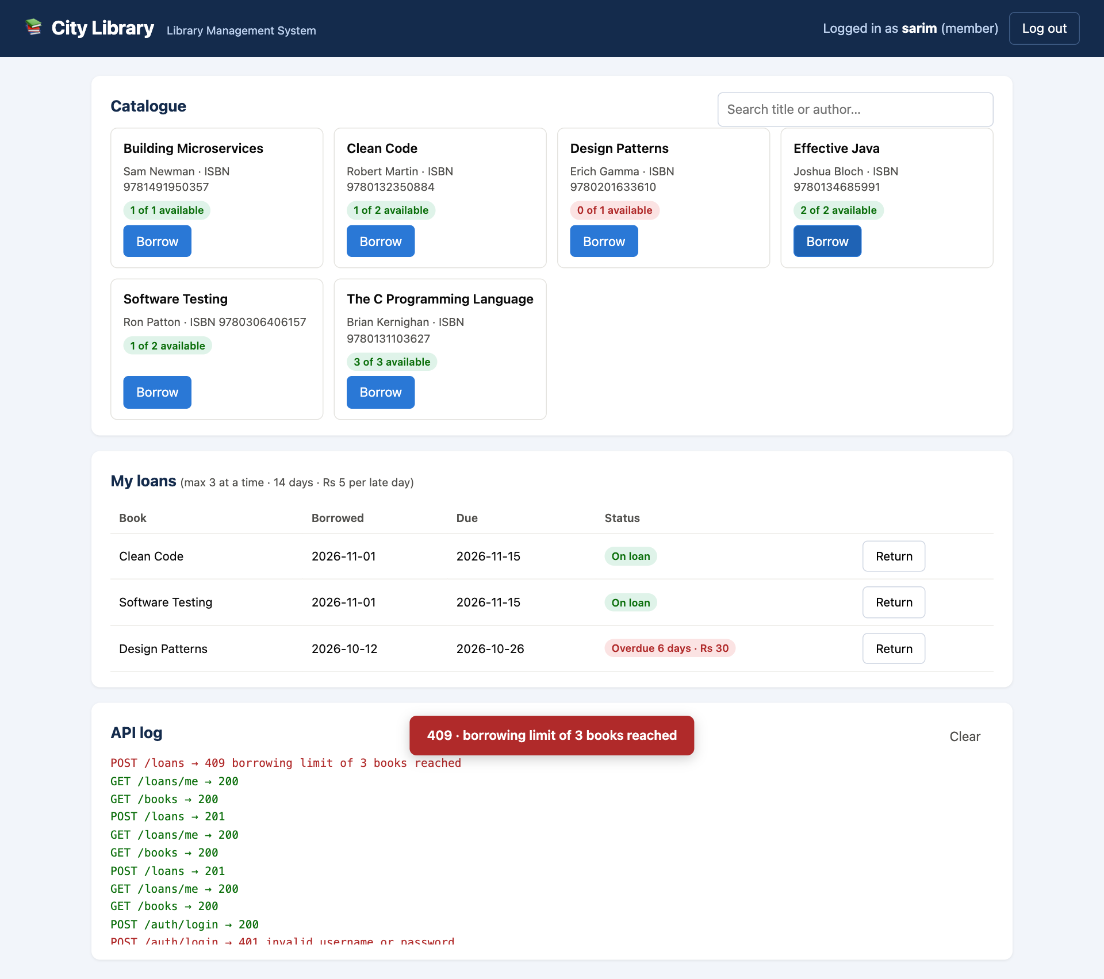
Demo: City Library web page
python run.py → http://127.0.0.1:5000 (plain HTML + JS, works offline)
▸ Member view
Search, borrow, return; overdue loans show the fine before returning
▸ Admin view
Add books, change copies, delete, all / overdue loans
▸ Errors shown as status + message
e.g. red “409 · borrowing limit of 3 books reached”
▸ API log panel
Every request and its HTTP code, so each click is a visible test case
▸ Browser check
scripts/ui_check.py drives Edge/Chrome with Playwright: 14/14 checks pass, incl. XSS
Library Management System Testing · Sarim Khan · Software Testing
9

Slide 10
Live demo plan
Runs on Windows with Python only; no Postman or Node.js
python run.py
website with sample data; log in as sarim / secret123 and admin
python -m pytest -v
runs all 45 test cases (~7 s)
python -m pytest --cov=library
same run + coverage table
python scripts/ui_check.py --show
watch the browser test click through the site
Library Management System Testing · Sarim Khan · Software Testing
10

Slide 11
Conclusion
▸ Testing found real bugs
6 defects, including a crash and two wrong business rules.
▸ Boundary tests pay off
The 3-book limit bug only shows up exactly at the boundary.
▸ Regression matters
Fixing the cycle 1 crash revealed 5 hidden defects in cycle 2.
▸ Final state
45/45 pass, 98.5% statement coverage.
Future work
▸ Token expiry (DEF-07)
▸ Lock account after repeated failed logins (DEF-08)
▸ Atomic borrow update + concurrency test (DEF-09)
▸ Run the suite on every push with GitHub Actions
Library Management System Testing · Sarim Khan · Software Testing
11

Slide 12
Thank you · Questions?
github.com/sarimkhan-sketch/library-management-testing

