Slide 1
Purchasing Policy Changes for FY21 & Updates for – FY22
Business and Finance

Slide 2
Best Practices
Get a quote for goods or services before any work starts.
Issue a PO to the supplier for the goods or services.
Submit invoice with PO # on it for final payment once goods or services have been received.

Slide 3
Objectives – use already approved suppliers & small businesses
Finding awarded suppliers – either Workday Sunrise or the link below
Sunmart
https://cfo.asu.edu/sunmart
Small business questionnaire in Workday now when you submit a req over $10,000 not using a small business.
Pay an Invoice requisition type – upcoming changes and alternatives
Effective July 1 – extra approval needed from Dean/VP for ALL pay an invoice type requisitions in Workday

Slide 4
Technology Purchases
Apple Products – must be purchased by RTS or UTO directly due to initial device setup requirements
Submit requests for these at the link below:
Link for new technology purchase from RTS: Purchase Requests
https://arizonastateu.sharepoint.com/sites/OKEDRTS/SitePages/Place-Order.aspx
Technology requisition types in Workday – require extra step now for approval routing - submit to RTS for approval: http://links.asu.edu/KE-DTSR-Review
Once RTS has approved in Workday – then REQ routes to cost center manager for approval

Slide 5
Pcard – Important updates
Pcard Restricted Purchases as of: 4/2/21
https://www.asu.edu/purchasing/forms/restrictlist.pdf
*Key items – Printing anything with an ASU logo on it
Must be trademark approved supplier!
Link to trademark approved suppliers:
https://www.asu.edu/purchasing/tm/licensee-list.pdf
Amazon is restricted on the pcard except for e-books!
New Biological form – turn around not immediate
https://cfo.asu.edu/ehs-biological-and-chemical-purchase-or-transfer-form

Slide 6
NGC Gift Card Purchasing in Workday
New gift card purchasing process through Workday
NGC now in Sunrise for gift cards
Instructions: https://www.asu.edu/purchasing/pdf/Purchasing-Gift-Cards.pdf
Make sure to allow at least 5 business days for your first order to go through!
Workday questionnaire required for order completion
Requester is required to send details from the purchase to taxaccounting@asu.edu for tax reporting tracking purposes.

Slide 7
Speakers & Honorariums
Key things to remember
All individuals receiving a speaker payment or an honorarium payment – must be setup in Workday!
The Speaker/honorarium agreement must be fully approved PRIOR to the date of the event!
Link to form: Speaker Form

Slide 8
Independent Contractors
If you are paying an individual $600 or more in a calendar year an ICC form will be required for the PO to issue and/or the payment to be processed.
Link to Docusign form: ICC form (the department contact requesting the services should complete the form).
Department contact can be copied of final approved ICC if they are added in the form section below
ASU Department Approver (Optional)
Name:
Full Name
Email:
A completed speaker agreement – negates the need for the ICC

Slide 9
Exceptions to ICC
Exceptions. Per FIN 421-01, the checklist must be completed for engagements of all service providers except for:
• Athletic officials.
• Corporations, partnerships, or other business entities not operating as a single-member LLC.
• Expense reimbursement only — no income or honorarium payment is included.
• Guest lecturers and speakers visiting for fewer than two weeks.
• Individuals performing external peer review consulting services as part of departmental or
program accreditation or performance monitoring.
• Payments to a service provider that will not exceed $600 across the university in a single
calendar year.
• Performers giving a limited number of performances, including DJs, artists and performers.
• Photographers.
• Service providers for construction or tenant improvement.
• Service providers for tangible goods or equipment rentals

Slide 10
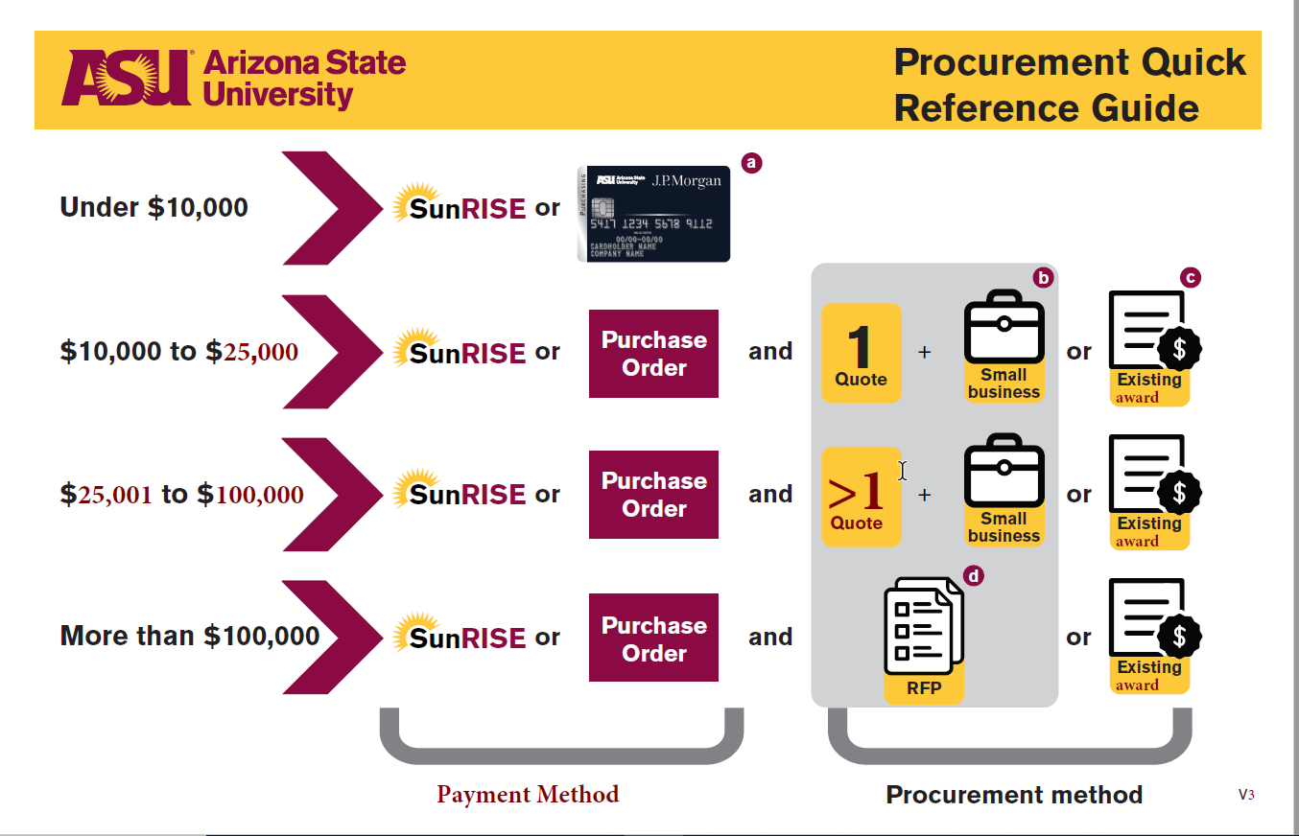
Quick Reference Guide - Revised

Slide 11
Resources
Procurement Website https://cfo.asu.edu/procurement
Quick Reference Guide https://www.asu.edu/purchasing/forms/quick-guide.pdf
Diversity and Small Business Programs https://cfo.asu.edu/purchasing-diversity
SunMart https://cfo.asu.edu/sunmart
Documentation needed for requisitions https://cfo.asu.edu/procurement-guide; Orders and requisitions tab
Purchasing Forms https://cfo.asu.edu/procurement-forms
PUR Policy Manual https://www.asu.edu/aad/manuals/pur/index.html
ProcureBot https://procurementchat.asu.edu/ba/asu/procurement-assistant
Do Business with ASU https://cfo.asu.edu/business/do-business-asu

