Slide 1
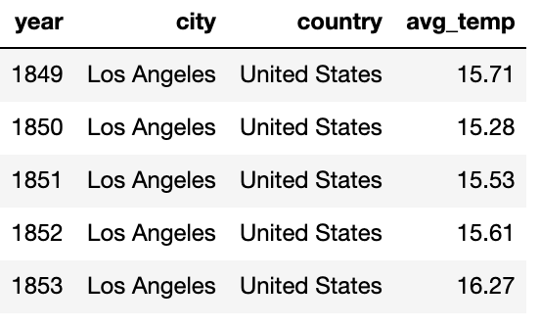
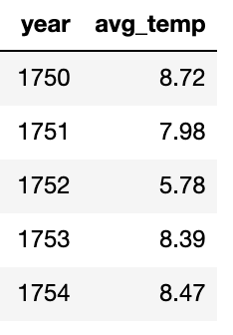
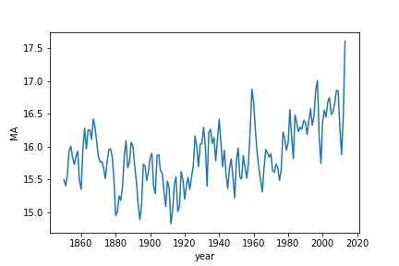
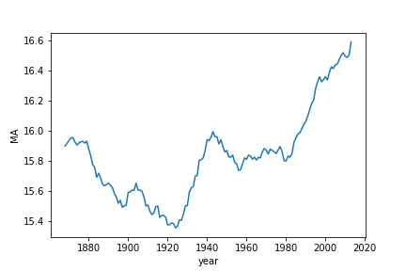
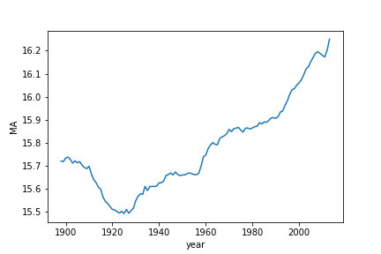
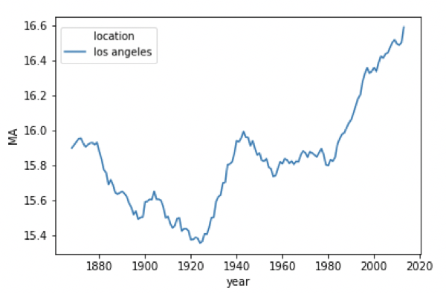
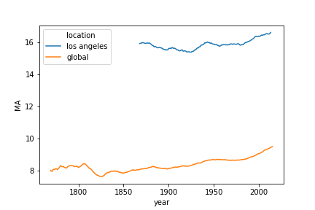
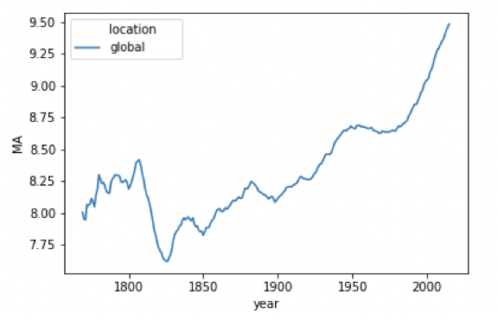
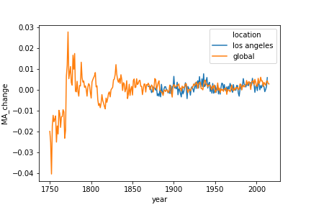
Sarina
Chen
EXPLORE WEATHER TRENDS
GLOBAL + LOS ANGELES
LOS ANGELES
GLOBAL
OUTLINE
Find my closest city in ‘United States’ in city_list → ‘Los Angeles’
Query and export Los Angeles average temperature data
Query and export global average temperature data
SELECT
year
, avg_temp
FROM
city_data
WHERE
city = ‘Los Angeles’
AND country = 'United States’
;
SELECT
year
, avg_temp
FROM
global_data
;
QUERY WITH SQL
EXTRACT DATA
LA Average over 2 years
LA Average over 20 years
LA Average over 50 years
OUTLINE
Try 2-year window → graph is too noisy
Try 20 year window → graph is smoother
Try 50 year window → graph is smoother but some trends are lost
Make sure this works for both LA and global data
Outlier in 1960
Just right!
Loss of spike in 1940s
[1]
[2]
[3]
[4]
[5]
import pandas as pd
import seaborn as sns
city_data = pd.read_csv("weather_losangelesUSA.csv")
city_data["MA"]=city_data["avg_temp"].rolling(window=20).mean()
sns.lineplot(x="year",y="MA", data=city_data)
MANIPULATE WITH PYTHON
20 YEAR
MOVING AVERAGES
OBSERVATIONS
OUTLINE
Observe trends in Los Angeles in 1849 to 2013.
Observe trends in the world in 1750 to 2015 (larger range than Los Angeles).
Compare the temperature of Los Angeles against the average temperature across the globe.
Compare how similar the temperatures change (especially with increase in global warming).
VISUALIZE WITH PYTHON
INFERRING LA AND
GLOBAL
COMPARING LA WITH GLOBAL
1
How has Los Angeles been doing?
3
How does Los Angeles compare with the world?
The average temperature between 1849 and 2013 is 15.9 C. There is a small peak in the 1940s, but temperature has been consistently rising since the 1960s.
Los Angeles is higher than the average global temperature because it’s closer to the equator. Since the 1950s, both Los Angeles and the world are getting hotter.
city_data["MA"]=city_data["avg_temp"].rolling(window=20).mean()
sns.lineplot(x="year",y="MA", data=city_data)
city_data.describe()
[10]
[11]
[12]
[13]
global_data["location"] = "global"
city_data["location"] = "los angeles"
combined = pd.concat([city_data, global_data])
sns.lineplot(x="year", y="MA", hue="location",data=combined)
[4]
[5]
[6]
2
How has the world been doing?
4
Are temperature fluctuations similar?
The average temperature between 1750 and 2015 is 8.4 C. There is a dip in the early 1800s, but overall, temperature has been rising since the 1820s.
increase
Both increase by around 0.5% in 1940s
By comparing percent changes of the moving averages, both seem to be increasing at similar rates. The world was getting hotter slightly faster than Los Angeles was in 2000 through 2010.
decrease
Both didn’t change much in 1960s
[7]
[8]
[9]
[14]
[15]
global_data["MA"]=global_data["avg_temp"].rolling(window=20).mean()
sns.lineplot(x="year",y="MA", data=global_data)
global_data.describe()
combined["MA_change"]=combined["avg_temp_change"]. \
rolling(window=20).mean()
sns.lineplot(x="year", y="MA_change", hue="location",data=combined)

