Slide 1
A pso-based algorithm for finding gapped motifs
Sarina Heshmati
sarinaheshmatii@gmail.com

Slide 2
introduction

Slide 3

introduction
INTRODUCTION
01 of 20
What is a motif? Or a gap?
Particle Swarm Optimization
Our main modification
PWM vs. Consensus

Slide 4
Biological view

Slide 5
Motif finding in biological view
BIOLOGICAL VIEW
02 of 20
What is a motif and which motif are we looking for?
Transcription Factor Binding Sites
Co-express gene and understanding gene’s functionality

Slide 6
Challenges of laboratory methods
BIOLOGICAL VIEW
03 of 20
DNA length vs. motif’s
Slight mutation
Technic is important!

Slide 7
Computational view

Slide 8
Lets define the problem
COMPUTATIONAL VIEW
04 of 20
Motif search vs. De-novo motif finding
Deterministic vs. non-deterministic
Input
Output

Slide 9
Different methods & their challenges

Slide 10
Different methods
DIFFERENT METHODS
05 of 20
Consensus based
PWM based
Evolution based algorithms (consensus based)
Previous PSO and its issues

Slide 11
Challenges and shortage
DIFFERENT METHODS
06 of 20
Gap-modeling
Differing number of binding sites per sequence

Slide 12
The PSO+ method
DIFFERENT METHODS
07 of 20
Particle Swarm Optimization and Swarm intelligence
The modifications
Consensus & PWM hybrid
Gap modelling
Statistical Post process

Slide 13
methodology

Slide 14
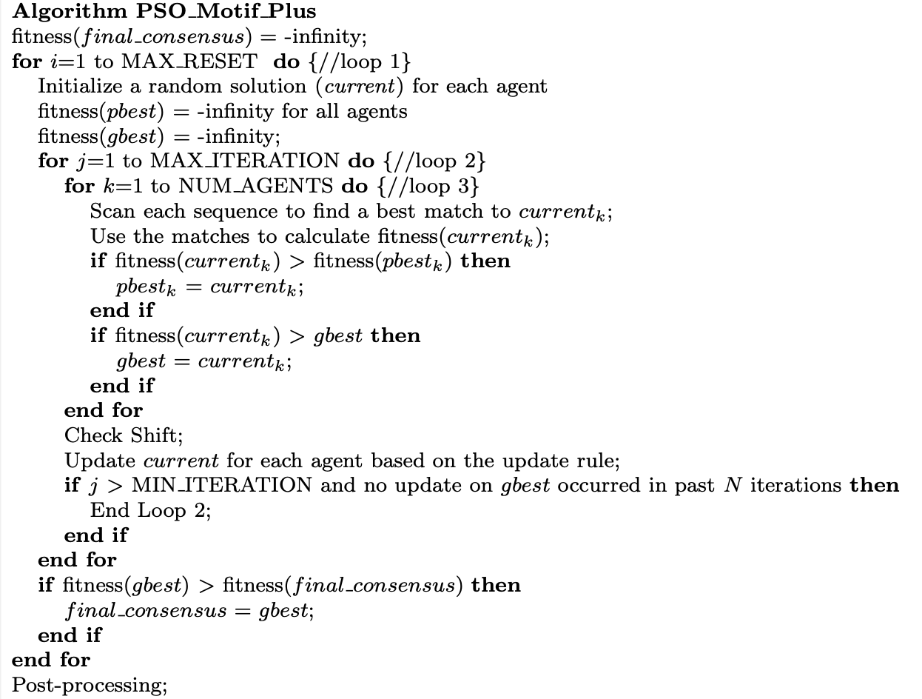
methodology
METHODOLOGY
08 of 20

Slide 15
Answer space & scoring
METHODOLOGY
09 of 20
Discrete answer space
Using PWM & consensus
Calculating fitness

Slide 16
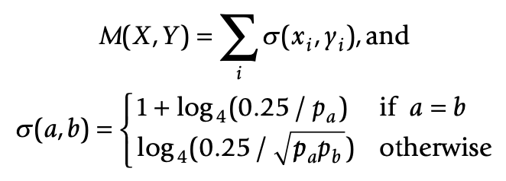
Matching score
METHODOLOGY
10 of 20

Slide 17
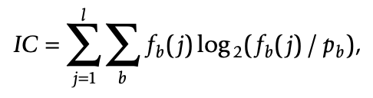
fitness score
METHODOLOGY
11 of 20

Slide 18


Initialization of the agents
METHODOLOGY
12 of 20
Two strategies

Slide 19
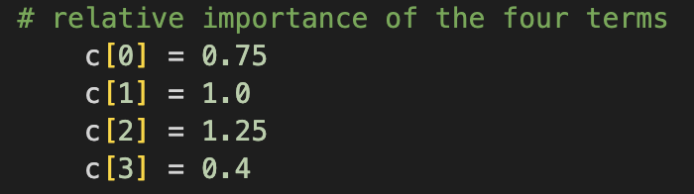
Update rule
METHODOLOGY
13 of 20
Has to be compatible with the discrete answer space

Slide 20
Gapped motifs and their model
METHODOLOGY
14 of 20
Two types of gaps
Two types of modeling
Problem and solution re-definition

Slide 21
Post processing
METHODOLOGY
15 of 20
Differing number of binding sites in each sequence
Statistical-two-step filtering
Each step

Slide 22
Performance measurements
METHODOLOGY
16 of 20
Redefining precision, recall and F-score
Data set considerations

Slide 23
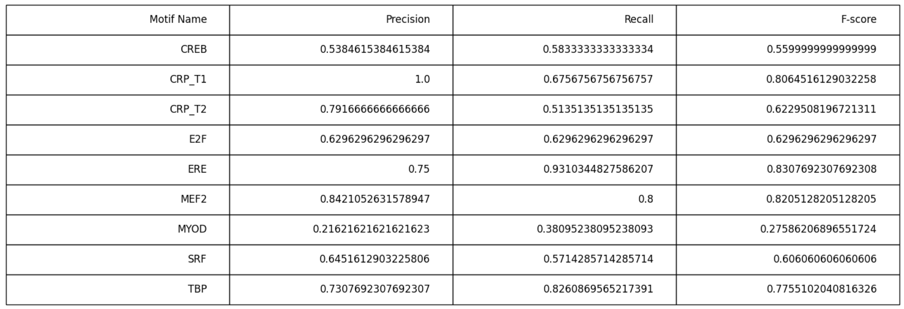

Slide 24
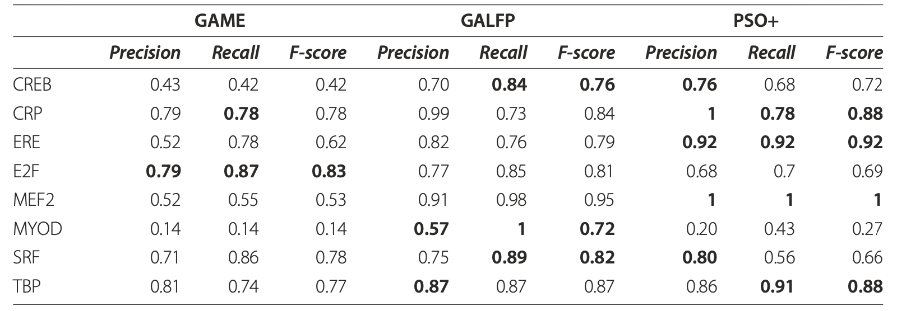

Slide 25
conclusion

Slide 26
conclusion
CONCLUSION
17 of 20
PSO+ advantages:
Gapped motifs
Differing number of Binding sites on each sequence
High speed and well accuracy

Slide 27
conclusion
CONCLUSION
18 of 20
PSO+ Disadvantages:
Post process can be more sophisticated and personalized
Local optima issue

Slide 28
Final words

Slide 29
refrences
FINAL WORDS
19 of 20
1. Tompa M, Li N, Bailey T, Church G, De Moor B, Eskin E, Favorov A, Frith M, Fu Y, Kent W, Makeev V, Mironov A,
Noble W, Pavesi G, Pesole G, Regnier M, Simonis N, Sinha S, Thijs G, van Helden J, Vandenbogaert M, Weng Z, Workman C, Ye C, Zhu Z: Assessing computational tools for the discovery of transcription factor binding sites. Nat Biotechnol 2005, 23:137-44.
2. Bailey T, Elkan C: Fitting a mixture model by expectation maximization to discover motifs in biopolymers. Proc Int Conf Intell Syst Mol Biol 1994, 2:28-36.
3. Roth F, Hughes J, Estep P, Church G: Finding DNA regulatory motifs within unaligned noncoding sequences clustered by whole-genome mRNA quantitation. Nat Biotechnol 1998, 16:939-45.
4. Lawrence C, Altschul S, Boguski M, Liu J, Neuwald A, Wootton J: Detecting subtle sequence signals: a Gibbs sampling strategy for multiple alignment. Science 1993, 262:208-14.
5. Liu X, Brutlag D, Liu J: BioProspector: discovering conserved DNA motifs in upstream regulatory regions of co- expressed genes. Pac Symp Biocomput 2001, 127-38.
6. Pavesi G, Mauri G, Pesole G: An algorithm for finding signals of unknown length in DNA sequences. Bioinformatics 2001, 17:S207-14.
7. Sinha S, Tompa M: Discovery of novel transcription factor binding sites by statistical overrepresentation. Nucleic Acids Res 2002, 30:5549-60.
8. Keich U, Pevzner P: Finding motifs in the twilight zone. Bioinformatics 2002, 18:1374-81.
9. Buhler J, Tompa M: Finding motifs using random projections. J Comput Biol 2002, 9:225-42.
10. Wei Z, Jensen ST: GAME: detecting cis-regulatory elements using a genetic algorithm.
Bioinformatics 2006
11. Chan TM, Leung KS, Lee KH: TFBS identification based on genetic algorithm with combined representations and adaptive post-processing. Bioinformatics 2008, 24(3):341-349.
12. Lei C, Ruan J: A novel swarm intelligence algorithm for finding DNA motifs. International Journal of Computational Biology and Drug Design 2009, 2:323-339.
13. Zhou W, Zhou C, Liu G, Huang Y: Identification of Transcription Factor Binding Sites Using Hybrid Particle Swarm Optimization. RSFDGrC 2005, 438-445.

Slide 30
Thanks for your attention. Contact info:
FINAL WORDS
20 of 20
sarinaheshmatii@gmail.com

