Slide 1
Quasi-minimal residual algorithm
Sarina Heshmati
sarinaheshmatii@gmail.com

Slide 2
introduction

Slide 3

Introduction
INTRODUCTION
01 of 21
The new world needs new tools in order to solve its problems.
The tools need to efficient, precise and simple.
QMR is one of the answers.

Slide 4
BRIEF EXPLANATION

Slide 5
WHAT IS QMR?
BRIEF EXLANATION
02 of 21
Residual
Quasi
Minimal

Slide 6
WHAT IS QMR?
BRIEF EXLANATION
02 of 21
Residual
Minimal
Quasi

Slide 7
WHAT IS QMR?
BRIEF EXLANATION
02 of 21
Quasi
Residual
Minimal

Slide 8
WHAT IS QMR?
BRIEF EXLANATION
02 of 21
Minimal
Quasi
Residual

Slide 9
WHAT IS QMR?
BRIEF EXLANATION
02 of 21
Minimal
Quasi
Residual

Slide 10
WHAT IS QMR?
BRIEF EXLANATION
03 of 21
Iterative method as an improvement over the MINRES algorithm
Minimizing the residual by projecting it onto a Krylov subspace
The Difference with CG algorithm
Can be improved by using the appropriate preconditioners

Slide 11
The algorithm

Slide 12

The steps for solving: $$Ax=b$$
THE ALGORITHM
04 of 21
1.
Initial guess: $x_{0}$
Initial guess: 𝑥_0
Initial residual: $r_{0}=b − {Ax}_{0}$
Initial residual: 𝑟_0=𝑏 − 〖𝐴𝑥〗_0
2.
Preconditioned residual: $z_{0}=M^{−1}r_{0}$
Preconditioned residual: 𝑧_0=𝑀^(−1) 𝑟_0
3.
For k from 0 to convergence:
Initial search direction: $y_{0}=N^{−1}z_{0}$
Initial search direction: 𝑦_0=𝑁^(−1) 𝑧_0

Slide 13
THE ALGORITHM
05 of 21
3.
a.
$Ay_{k}$, $A^{T}z_{k}$
a.
𝐴𝑦_𝑘, 𝐴^𝑇 𝑧_𝑘
b.
$$α_{k}=\frac{{(r}_{k}, z_{k})}{(y_{k}, Ay_{k})}$$
$$β_{k}=\frac{(r_{k},A^{T}z_{k})}{(y_{k},A^{T}z_{k})}$$
b.
𝛼_𝑘=(〖(𝑟〗_𝑘, 𝑧_𝑘))/((𝑦_𝑘, 𝐴𝑦_𝑘))
𝛽_𝑘=((𝑟_𝑘,𝐴^𝑇 𝑧_𝑘))/((𝑦_𝑘,𝐴^𝑇 𝑧_𝑘))
c.
$$x_{k+1}=x_{k}+α_{k}y_{k}$$
c.
𝑥_(𝑘+1)=𝑥_𝑘+𝛼_𝑘 𝑦_𝑘
d.
$$r_{k+1}=r_{k}−α_{k}Ay_{k}$$
d.
𝑟_(𝑘+1)=𝑟_𝑘−𝛼_𝑘 𝐴𝑦_𝑘
e.
$$q_{k+1}=M^{−1}r_{k+1}$$
$$w_{k+1}=N^{−1}A^{T}q_{k+1}$$
e.
𝑞_(𝑘+1)=𝑀^(−1) 𝑟_(𝑘+1)
𝑤_(𝑘+1)=𝑁^(−1) 𝐴^𝑇 𝑞_(𝑘+1)
f.
$$y_{k+1}=q_{k+1}+β_{k}y_{k}$$
$$z_{k+1}=w_{k+1}+β_{k}z_{k}$$
f.
𝑦_(𝑘+1)=𝑞_(𝑘+1)+𝛽_𝑘 𝑦_𝑘
𝑧_(𝑘+1)=𝑤_(𝑘+1)+𝛽_𝑘 𝑧_𝑘
Krylov subspace vectors
Step sizes
Update the solution
Update the residual
Left & right preconditioned residuals
Update the search directions

Slide 14
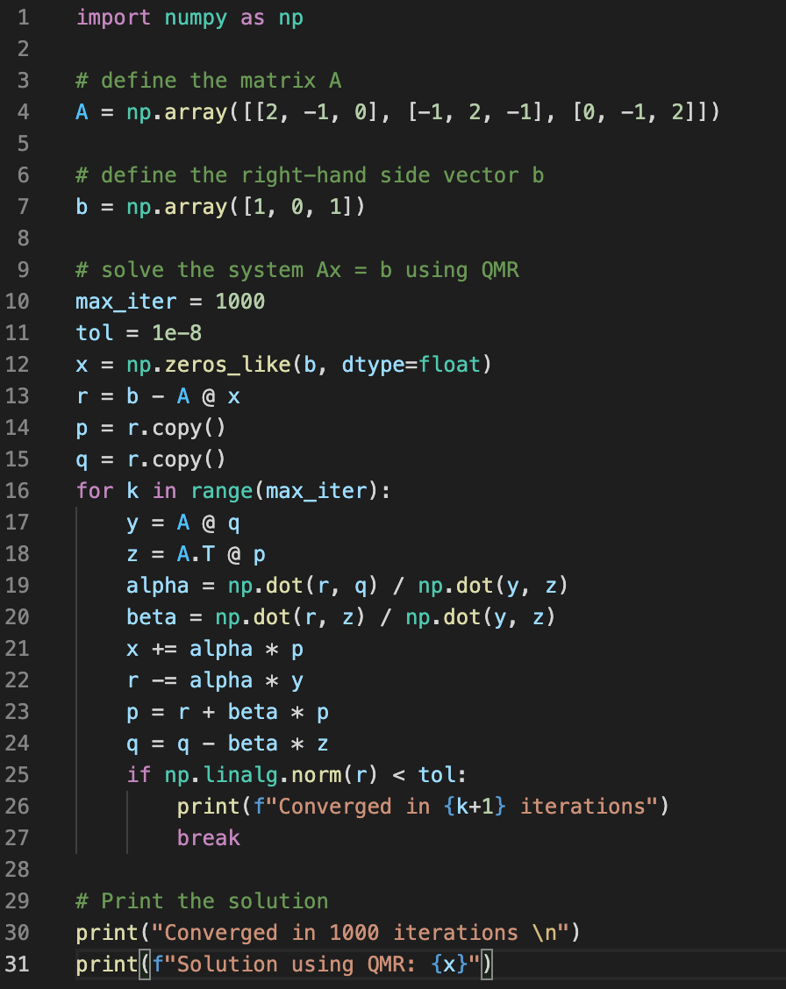
THE ALGORITHM
06 of 21

Slide 15
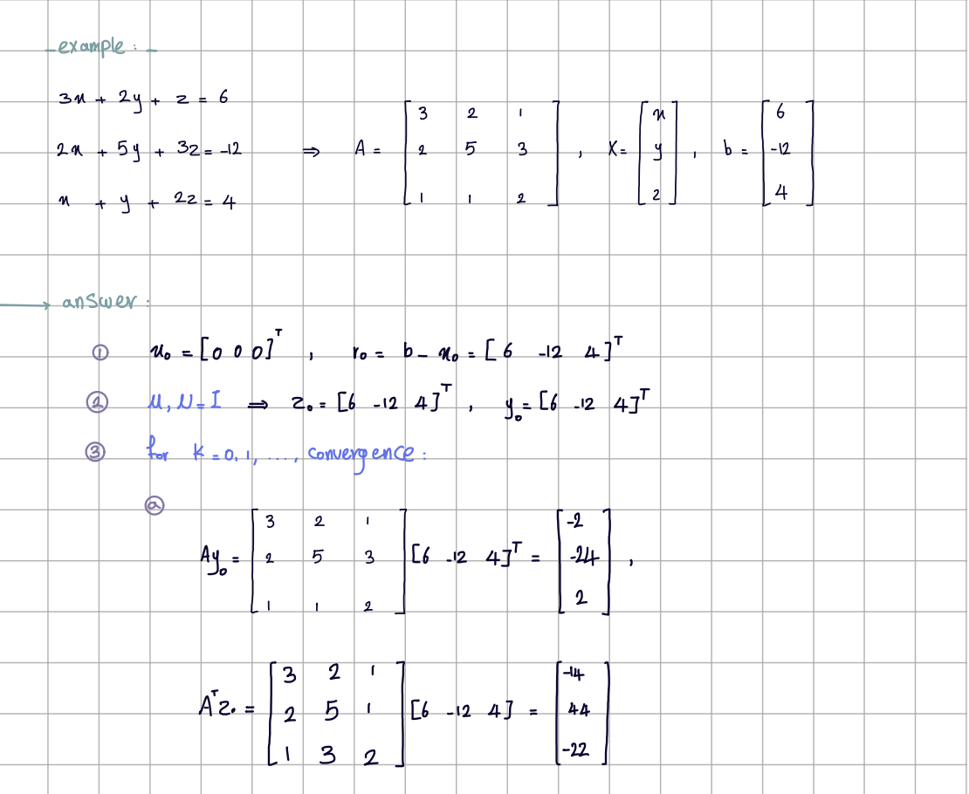
THE ALGORITHM
07 of 14

Slide 16
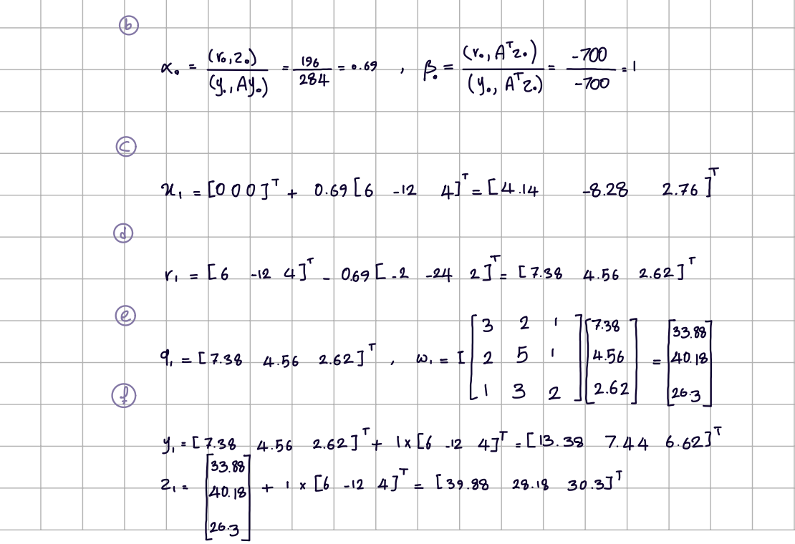
THE ALGORITHM 08 of 21

Slide 17

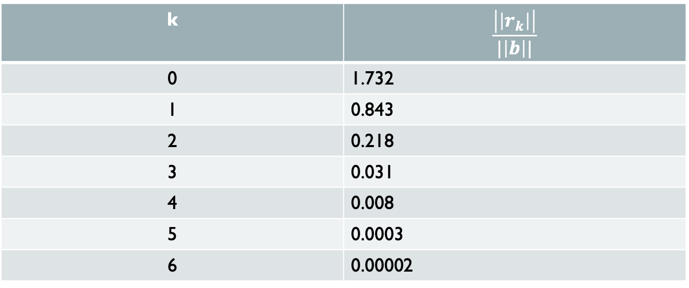
Each iteration’s answer (tol = $1e−6$)
THE ALGORITHM 09 of 21
k | $$\frac{\left|\left|r_{k}\right|\right|}{|\left|b\right||}$$
0 | 1.732
1 | 0.843
2 | 0.218
3 | 0.031
4 | 0.008
5 | 0.0003
6 | 0.00002

Slide 18

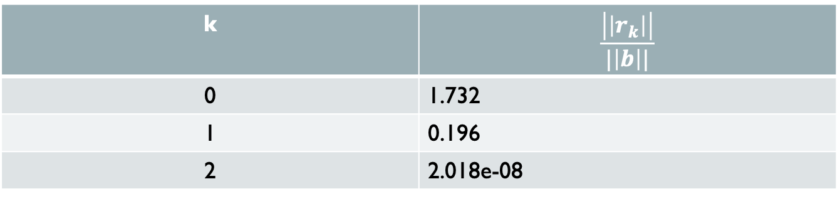
Each iteration’s answer (tol = $1e−6$) using IC method for preconditioners
THE ALGORITHM 10 of 14
k | $$\frac{\left|\left|r_{k}\right|\right|}{|\left|b\right||}$$
0 | 1.732
1 | 0.196
2 | 2.018e-08

Slide 19
Comparison, number of iterations
THE ALGORITHM 11 of 21
QMR without any preconditioners | QMR with preconditioners
7 | 3

Slide 20

Time and space complexity
THE ALGORITHM 12 of 21
time | space
O($n^{2}$) | O($n$)
The given time complexity is in general and the actual amount is very dependence on the matrix properties.

Slide 21
strengths and weaknesses

Slide 22
Strengths and weaknesses
STRENGTHS AND WEAKNESSES
13 of 21
strengths
weaknesses
Non-symmetric
Indefinite
Ill-conditioned
Highly singular

Slide 23
Non-symmetric

Slide 24
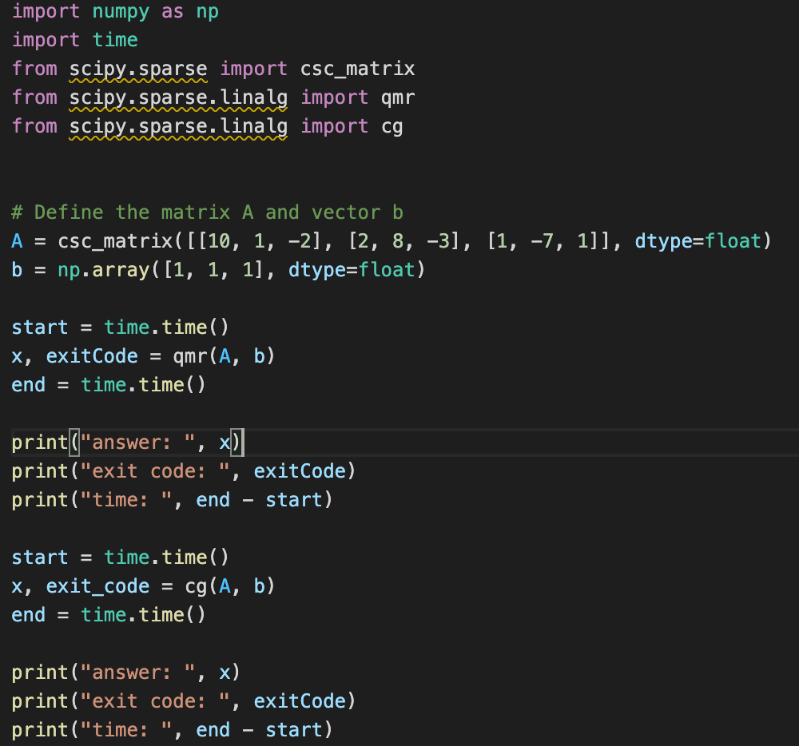
STRENGTHS AND WEAKNESSES
14 of 21

Slide 25
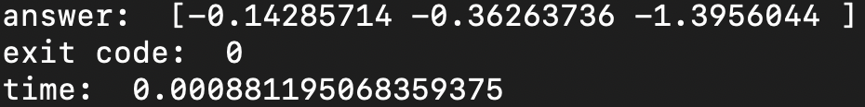
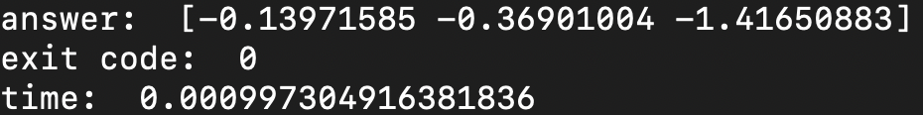
Non-symmetric
STRENGTHS AND WEAKNESSES
15 of 21
QMR
CG

Slide 26
Ill-conditioned

Slide 27
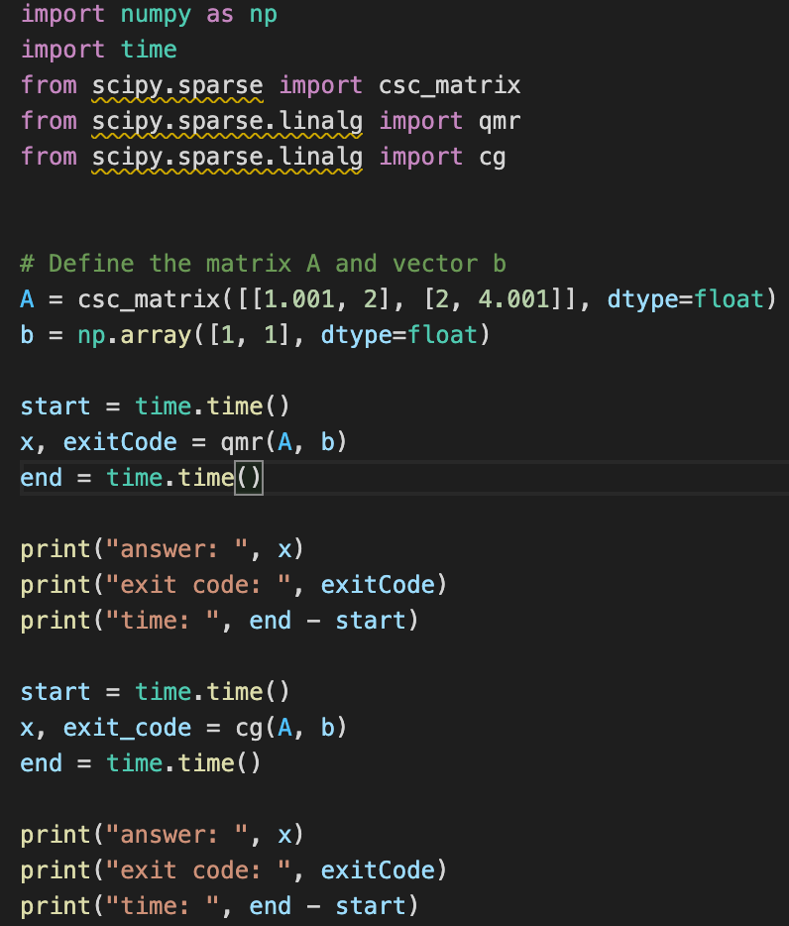
STRENGTHS AND WEAKNESSES
16 of 21

Slide 28
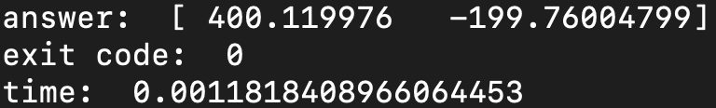
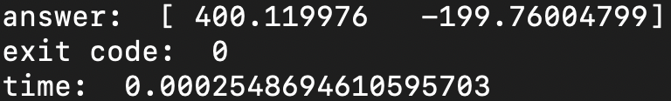
Ill-conditioned
STRENGTHS AND WEAKNESSES
17 of 21
QMR
CG

Slide 29
Other Strengths & weaknesses
STRENGTHS AND WEAKNESSES
18 of 21
Strengths
weaknesses
Can be implemented in a way that allows for parallelization, hence it is well-suited for large matrices.
Requires more memory space since it is a bi-orthogonal method.

Slide 30
applications

Slide 31
applications
Eigenvalue problems
Partial differential equations
Optimization

Slide 32
conclusion

Slide 33
conclusion
STRENGTHS AND WEAKNESSES
19 of 21
Iterative bi-orthogonal Krylov subspace method.
Well-suited for indefinite and non-symmetric matrices.
Can be improved with appropriate preconditioners.
More precision given it’s a bi-orthogonal method.
High memory cost.

Slide 34
refrences
STRENGTHS AND WEAKNESSES
20 of 21
Yousef Saad "Iterative Methods for Sparse Linear Systems”
https://mathworld.wolfram.com/Quasi-MinimalResidualMethod.html
C.T.Kelley"Iterativemethodsforlinearandnonlinearequations"

Slide 35
Thanks for your attention. Contact info:
STRENGTHS AND WEAKNESSES
21 of 21
sarinaheshmatii@gmail.com
sarinaheshmati@aut.ac.ir
+989102460274

