Slide 1
Mental Health

Slide 2
Introduction
Mental health is a significant public health challenge
Profoundly important for all areas of life
Linked to wider inequalities
Comes at a cost to economy £10.7 billion
Expected to rise as a result of the pandemic
Our dashboard helps to identify:
trends in general & mental health over time
regions within Scotland to focus efforts
groups most vulnerable to mental health issues

Slide 3
Overview
Disease of the digestive system is most prevalent
Respiratory disease has increased by 39% from 2002-2012
Life expectancy continues to rise in Scotland
However, life expectancy in Scotland is below that of our UK counterparts
Approx. 75% of those undertaking health self assessment consider their health to be ‘good or very good’

Slide 4
Mental Health
Mental health is a significant issue in our society
There is both social and economic costs
Symptom of other issues: social, deprivation etc.
Different challenges compared to physical health
There is a downward trend in mental health score (WEMWBS) over the last decade
Identify and monitor key KPIs should help uncover and treat key areas

Slide 5
Geographical differences
Mental wellness varies by region
Local authority level
Metrics: mental health score and deaths due to suicide per 100,000
Scottish Index Multiple Deprivation (SIMD)
Area with the lowest MH Score include:
East Ayrshire (rank: 6)
Glasgow City (rank: 1)
Dundee City (rank: 7)
Area with highest suicide rates:
Orkey Islands
Dundee City
Clackmannanshire

Slide 6
Demographics
The mental wellness score shows variations in gender, however the margin is small
Those over the age 65 had the highest score on average
Those with limiting health conditions have a lower score than those without
House Ownership (a measure of economic prosperity) show home owners have a higher score

Slide 7
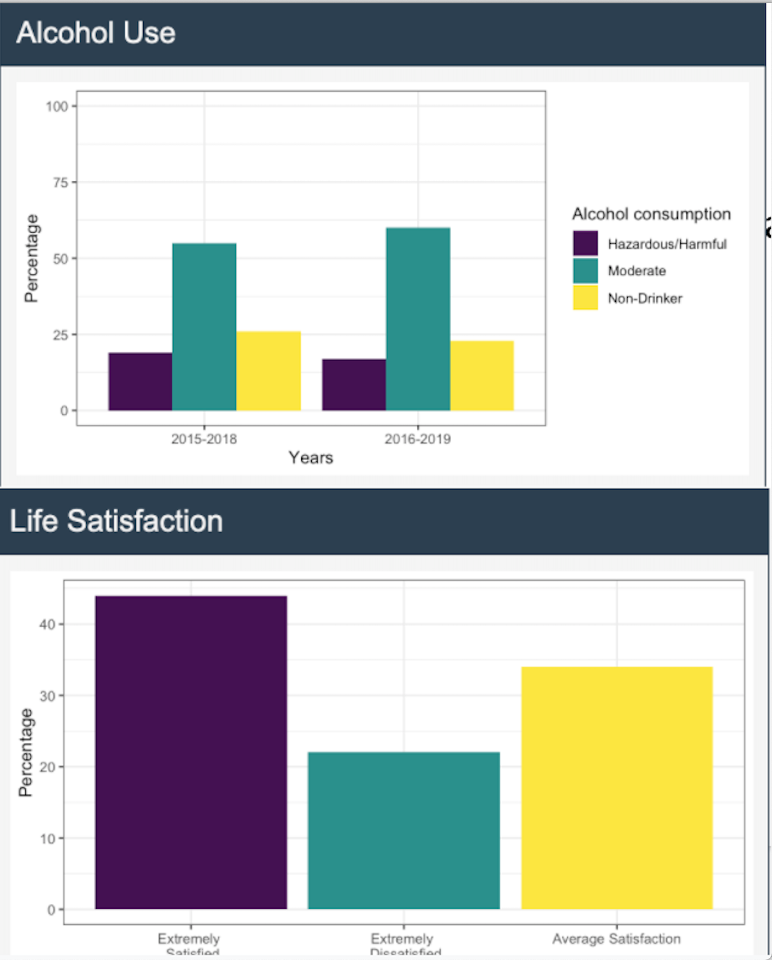
Other Indicators
There exists a relationship between drugs, alcohol and mental health problems
Show where these issues are prevalent
Show which population groups are affected
Show the issues that are affected
Distinctions between different areas
e.g. Edinbugh vs W. Isles, rural vs urban
Where and how services should be funded
Improve overall general health reporting
Western Isles

Slide 8
Deaths
In 2019 there were 833 deaths by suicide in Scotland, a rise of 49 from 2018
In 2019 two-thirds of suicides were men
Clearly greater support is needed for men in more deprived areas as confirmed in a survey by Samaritans
The rate of deaths from Dementia and Alzheimers continues to rise, we have seen an 64% increase between 2011-19
The number of females deaths is approx. double in 2019, this ties to the higher life expectancies of women

Slide 9
Summary
Mental health is linked to physical health conditions, which also affects life expectancy
Young adults - focus required to improve mental wellbeing for younger adults to reduce risk of subsequent mental ill health later in life
Gender - two separate issues:
Females are more likely to record a lower wellbeing score than men.
Rates for suicide are consistently higher for men.
Poverty is linked to mental health - the prevalence of mental ill health is highest among those living in deprived area

