Slide 1
Graze
Sari, Masood, Imogen, Ethney

Slide 2
Problem Statement
The team was tasked with creating a project that focused on sustainability or social good. Creating a solution to diversity, sustainability, health and education or food insecurity.

Slide 3
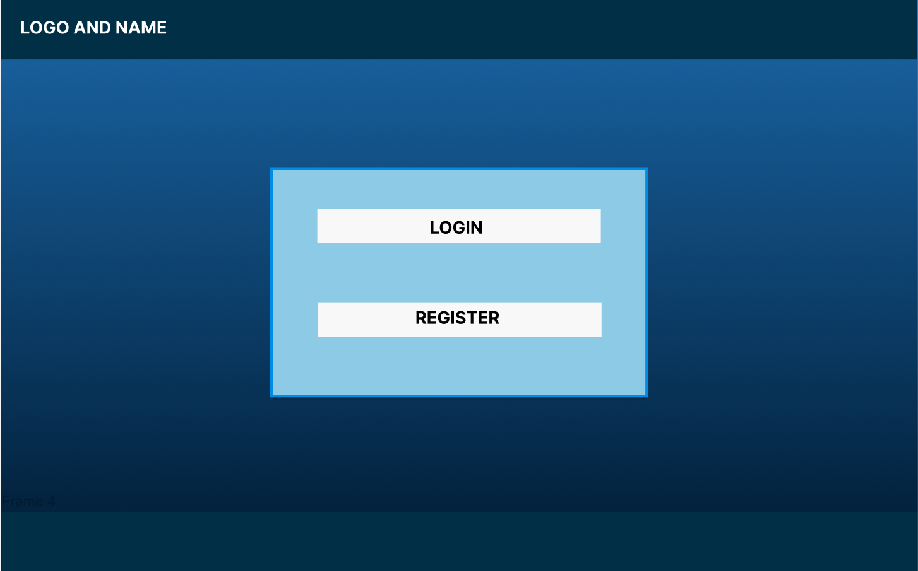
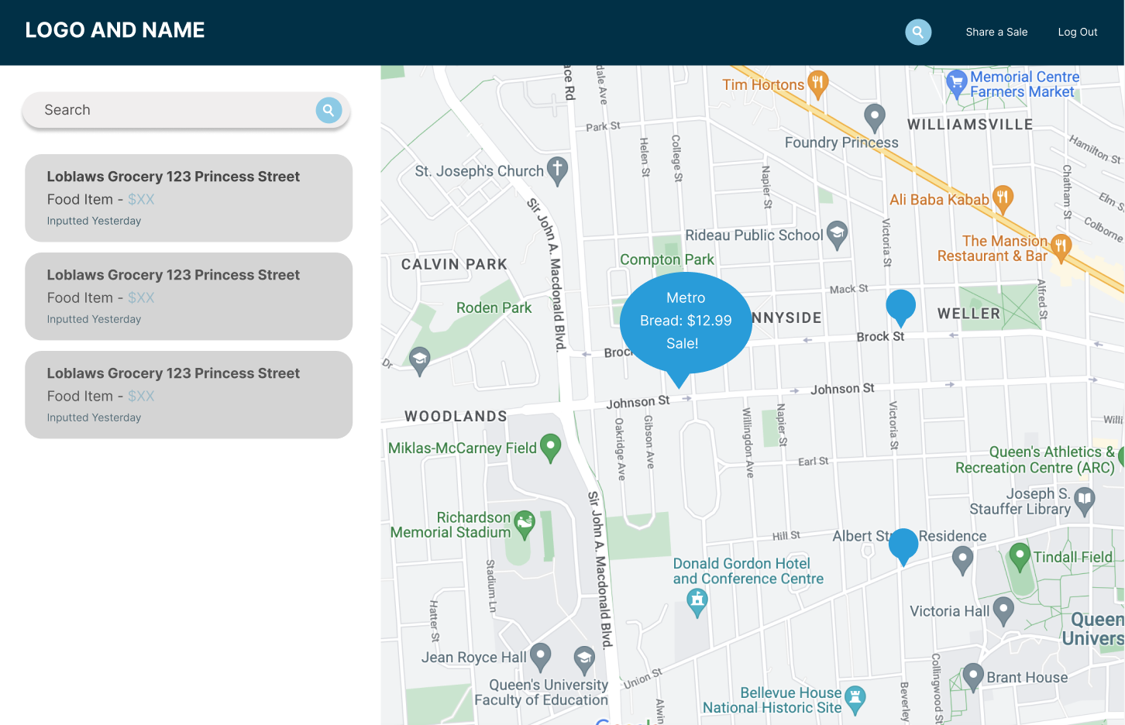
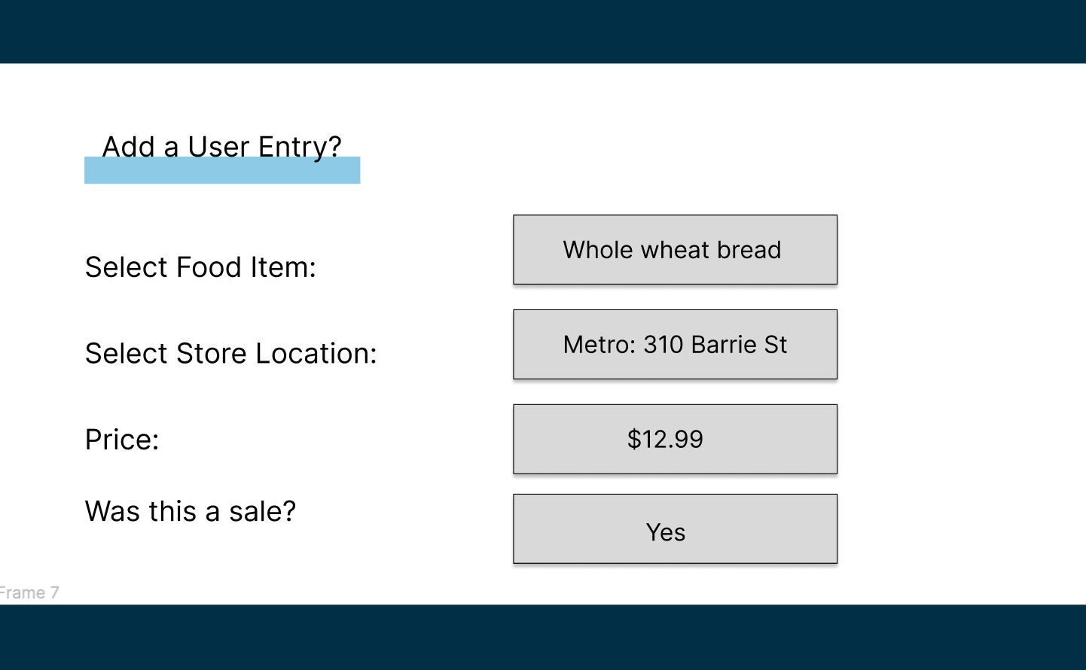
Our Solution
We focused on societal good and food insecurity.
Our solution helps target the growing cost of living and inflation in food prices.

Slide 4
Graze
Community-driven
Empowering citizens to find affordable
groceries
Real time sharing of price comparisons
& new sales

Slide 5
DEMO

Slide 6
Graze
Combat food insecurity through social justice
Pressure on stores to compete for lower prices
Discourage price fixing at large chains

