Slide 1

ANALYSIS AND PREDICTION OF CUSTOMER CHURN IN TELECOM INDUSTRY

Slide 2
ABSTRACT
Churn Examination is one of the widespread used study on Subscription Oriented Businesses for analyzing the behavior and activities of customers in order to predict beforehand which customer is likely to exit the service agreement.
Built on Machine Learning procedures and algorithms it has become very significant for companies in today’s market as securing of another client is more costlier than their maintenance. The paper analyses the relevant studies on Customer Churn Analysis in Telecom Business to present overall information to readers about the commonly used data mining means, and performance of the methods.
Initially, we present the details about the availability of public datasets and various customer details in each dataset for predicting customer churn. Then, we compare and contrast various analytical modeling systems and compare their performances and results. Conclusively, we review what kinds of performance metrics have been used to gauge the current churn prediction approaches. Examining all these three viewpoints is very critical for developing a more well-organized churn prediction structure for telecom businesses.

Slide 3
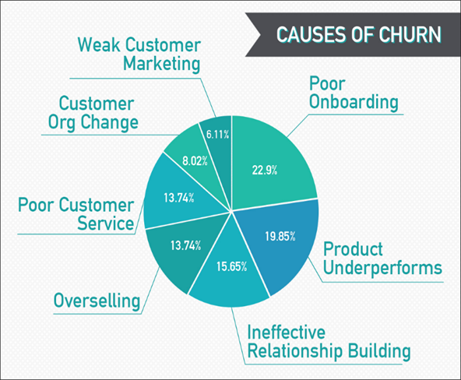
INTRODUCTION
Churn Analysis is one of the world wide used analysis on Subscription Oriented Industries to analyze customer behaviors to predict the customers which are about to leave the service agreement from a company. It is based on Machine Learning methods and algorithms and become so important for companies in today’s commercial conditions as gaining a new customer’s cost is more than retaining the existing ones.

Slide 4
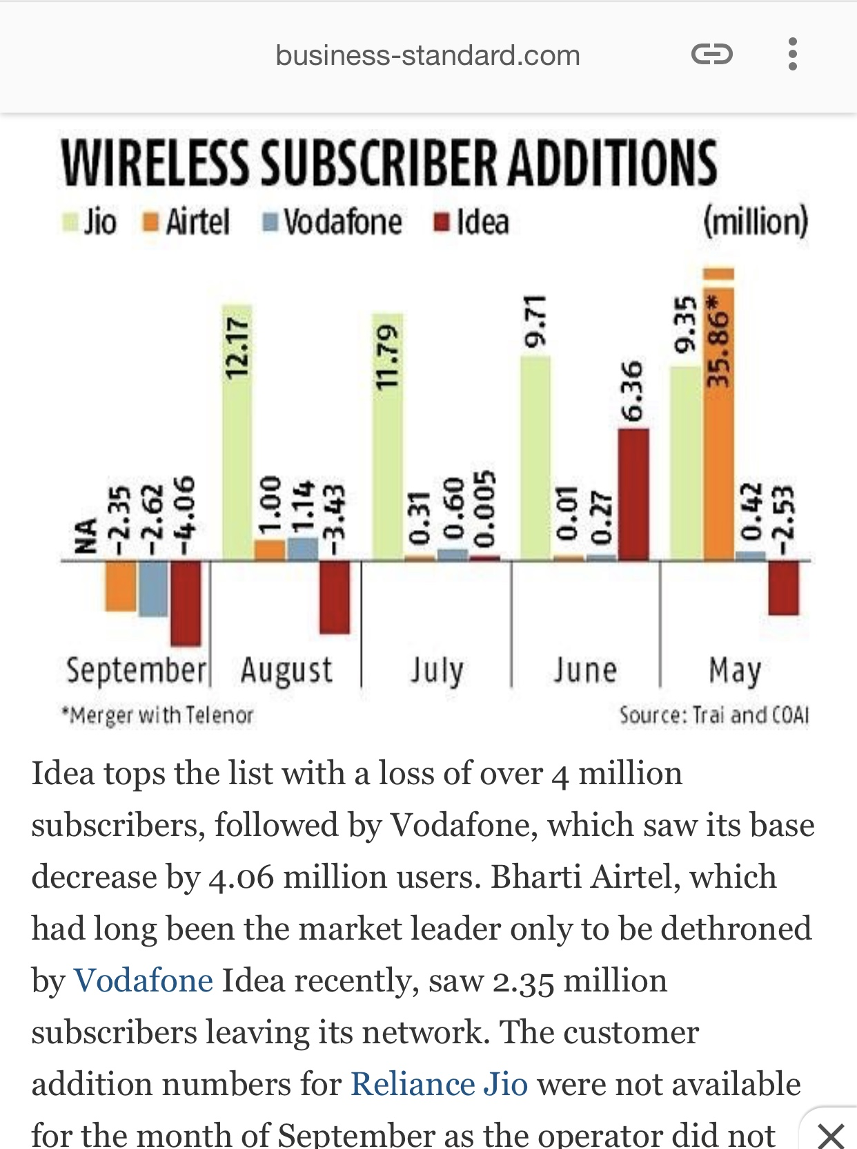
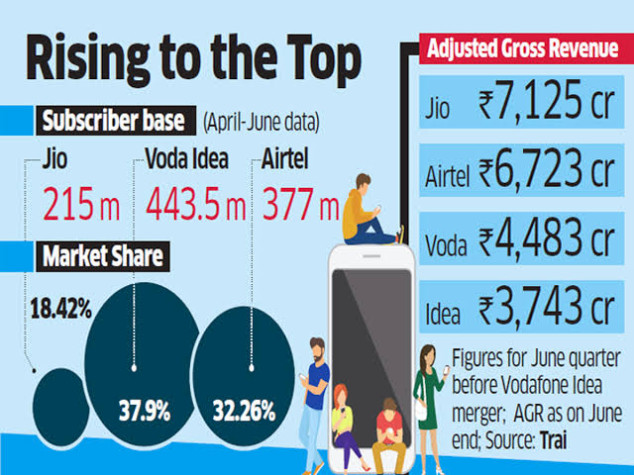

Slide 5
LITERATURE SURVEY
This literature survey includes the current knowledge including substantive findings, as well as theoretical and methodological contributions to this topic. This literature review contains at least 7 published researches
Which includes :-
Existing theories about the topic which are accepted universally.
Books written on the topic, both generic and specific.
Research done in the field usually in the order of oldest to latest.
Challenges being faced and ongoing work, if available.

Slide 6
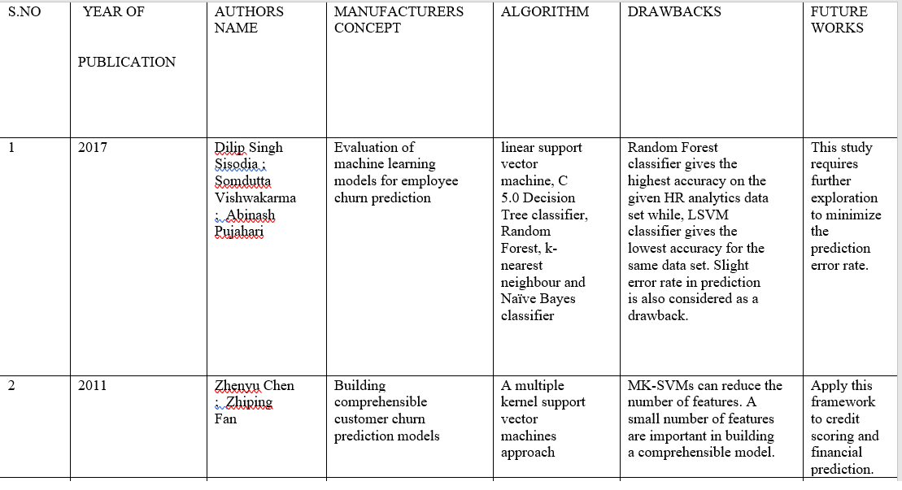

Slide 7
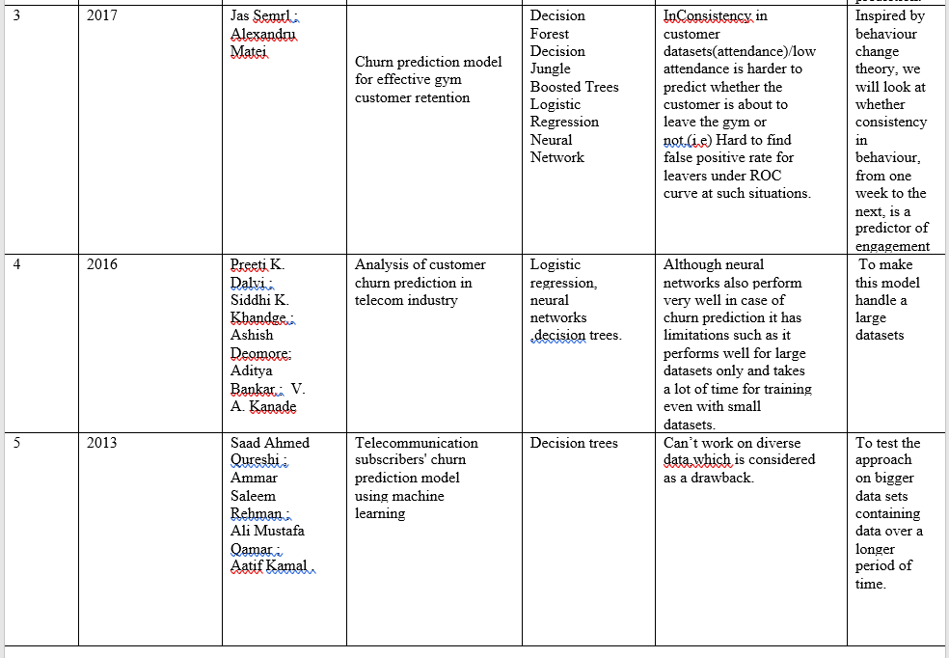

Slide 8
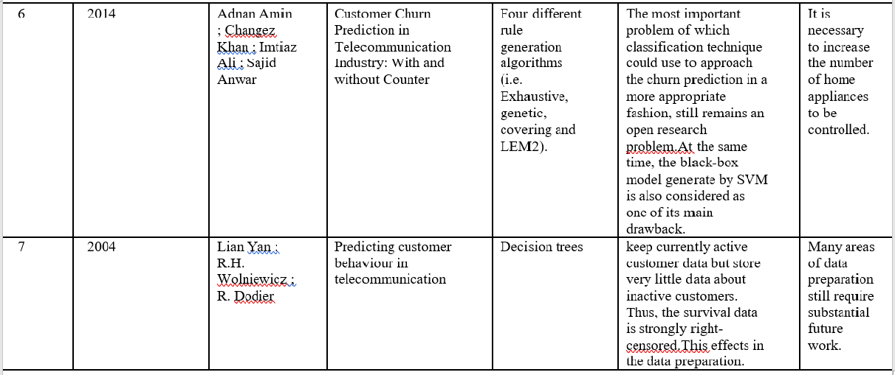

Slide 9
Predicting Customer Churn
Churn prediction consists of detecting which customers are likely to cancel a subscription to a service based on how they use the service. We want to predict the answer to the following question: “Is this customer going to leave us within the next X months?” There are only two possible answers, yes or no; a binary classification task.
Why it matters?
Businesses often have to invest substantial amounts attracting new clients, so every time a client leaves it represents a significant investment lost. Both time and effort then need to be channelled into replacing them. Being able to predict when a client is likely to leave and offer them incentives to stay can offer huge savings to a business.
What is the main challenge?
In a real world application, our data would never be too tidy or easy to work with and we would have to undertake a much more rigorous process for evaluating our predictions.Once we have our initial results / predictions, the next stage would be to iterate over the steps (cleaning the data, feature selection, modelling, etc.) in an effort to boost the accuracy (or whatever scoring metric you use) of our model. The addition or removal of features, the tuning of hyper parameters, or simply the use of a more complete or larger dataset may all boost our model.

Slide 10
MODULES DESCRIPTION
DATASET
PRE-PROCESSING
TRAIN_TEST_SPLIT
FEATURE EXTRACTION
CLASSIFICATION
ACCURACY SCORE & CONFUSION MATRIX

Slide 11
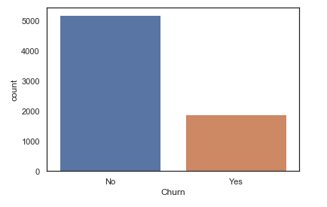
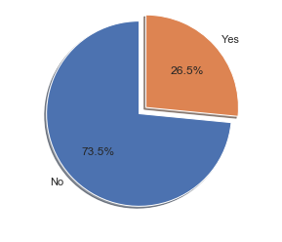
The data set is obtained from Kaggle Website, is used in this paper for the churn analysis and prediction. This data set comprises 18 attributes and 7044 records or tuples. The bar graph and pie chart respectively shown below gives the number of customers that will churn.

Slide 12
ACCURACY AND PERFORMANCE
Factors considered in measuring performance are accuracy , sensitivity, specificity and precision .accuracy in the sense how good the classifier is performing sensitivity means how perfect the classifier is with respect to positive entries.
There are 2 kinds tuples ,positive and negative tuples. positive tuples obey some specific rules whereas negative tuples do not .
factors taken into consideration
true positive(TP) tuples under consideration is perfectly positively classified i.e expected and observed tuple were positive.
True negative(TN):if tuple was observed negative and expectation was same False positive(FP): data tuples were mistakenly classified as positive however expected outcome was the opposite .
False negative(FN) were actually supposed to be classified as positive but were shown to be negative.

Slide 13
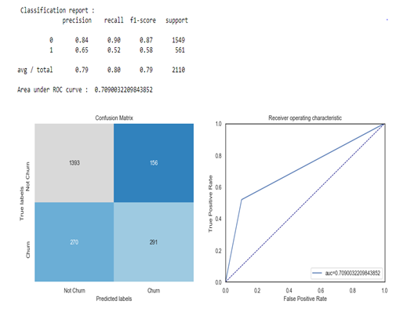
We can calculate the performance measures of the created classifiers by using the following equations representing the relationship b/w the tuples wrt to the performance measuring factors.
Accuracy=TP+TN/P+N ---------------(1)
Sensitivity=TP/P------------------------(2)
Specificity=TN/N-----------------------(3)
Precision=TP/TP+FP-------------------(4)
Confusion matrix:simple tool to check whether tuples belonging to a class are perfectly classified.

Slide 14
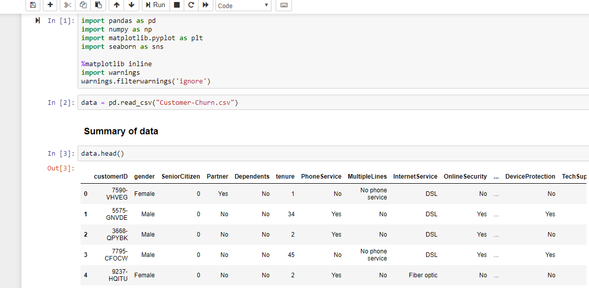
Importing CSV file and creating dataframe

Slide 15
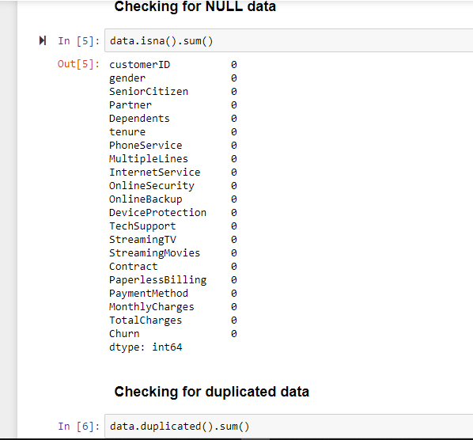
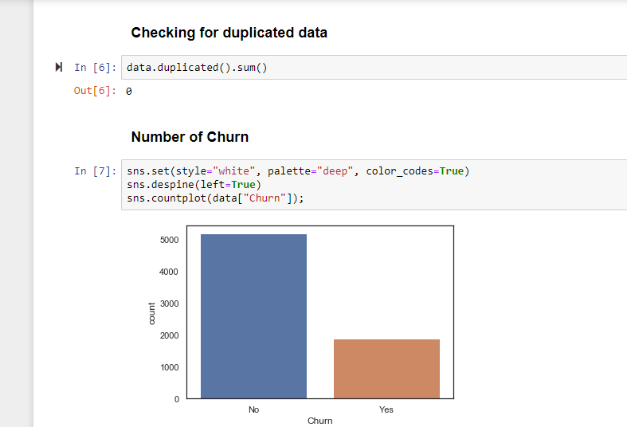
Data wrangling

Slide 16
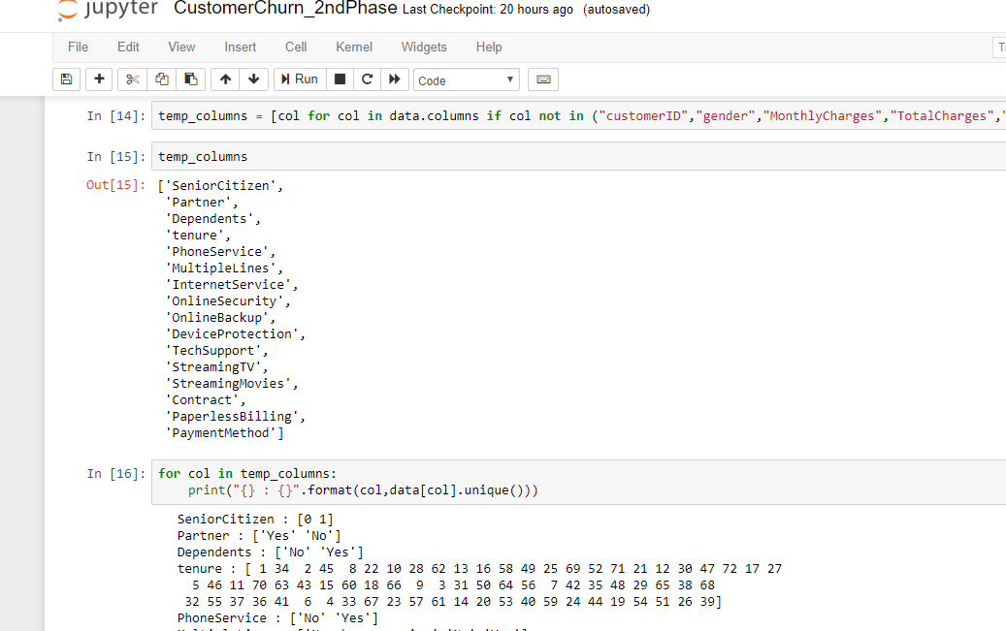
Feature selection

Slide 17
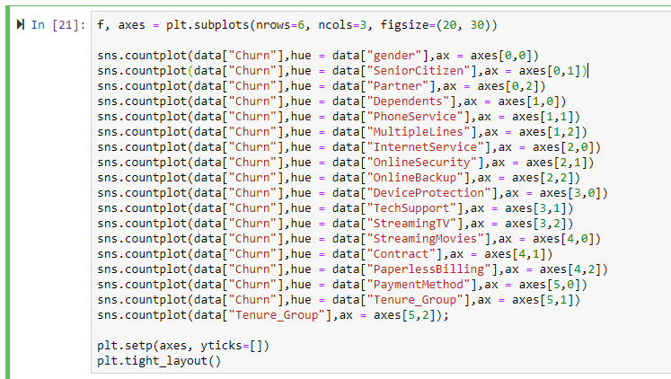
Data visualization

Slide 18
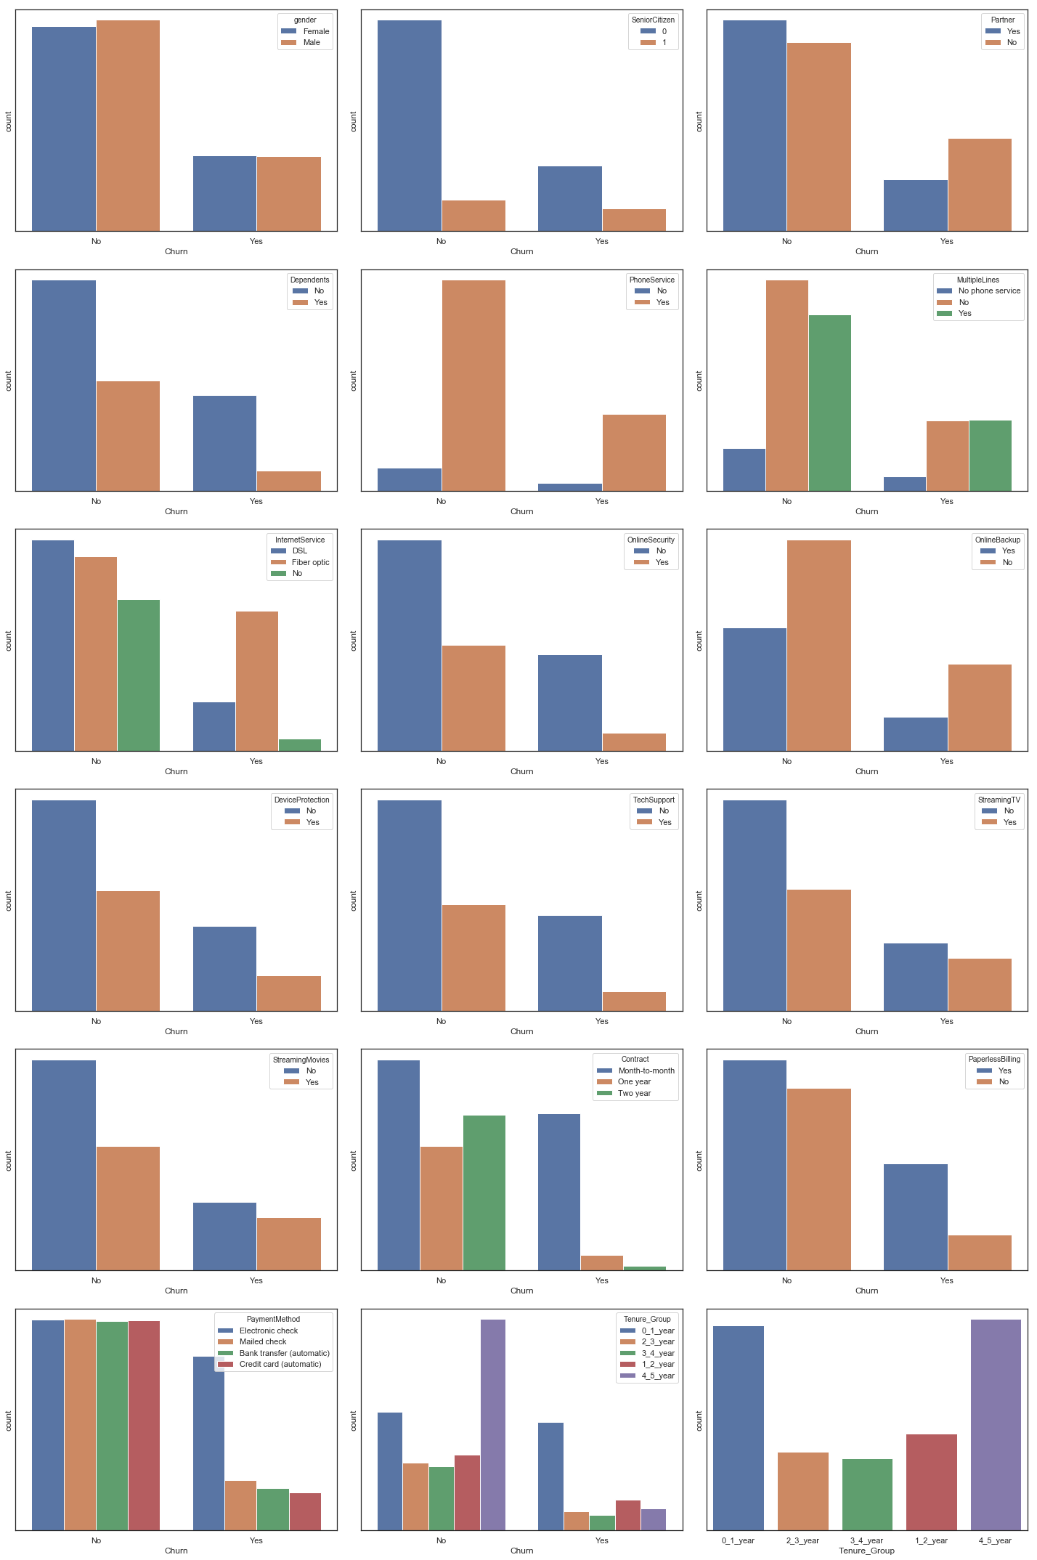

Slide 19
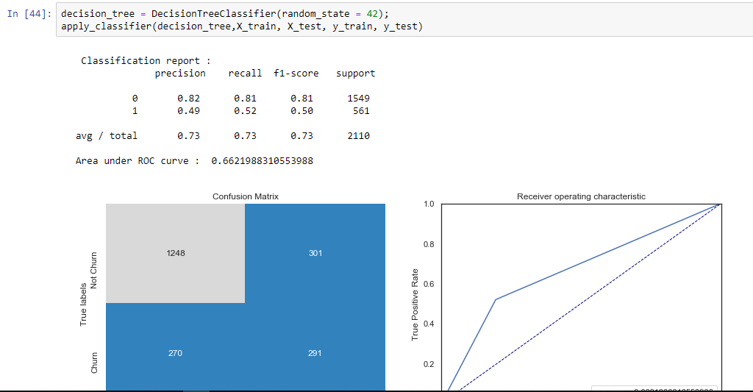
EVALUATING ALGORITHMS AND TRAINING MODELS 1.DECISION TREE PERFORMANCE REPORT

Slide 20
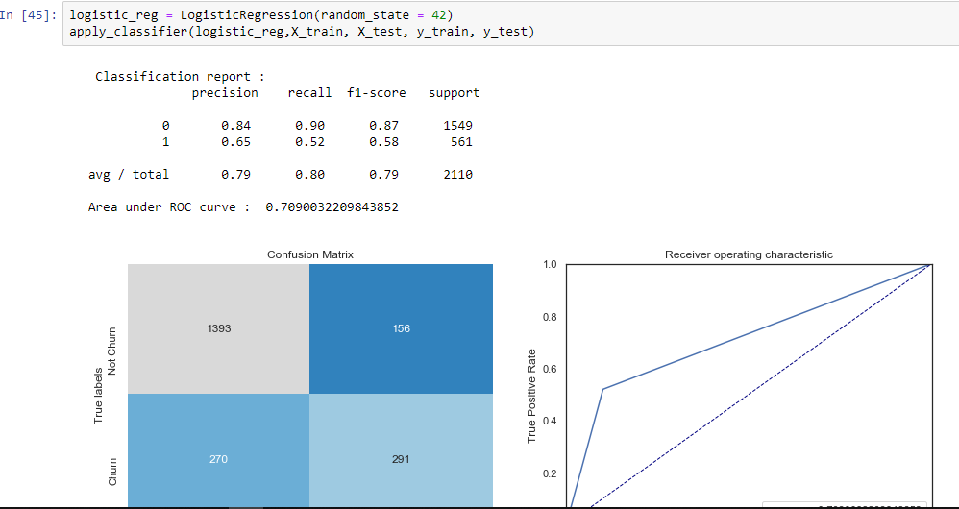
2.LOGISTIC REGRESSION PERFORMANCE REPORT

Slide 21
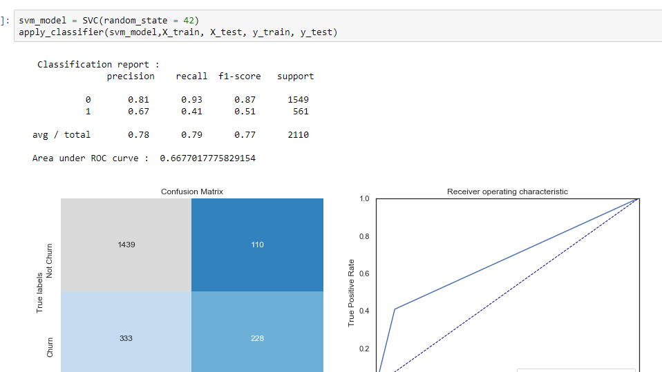
3.SVM PERFORMANCE REPORT

Slide 22
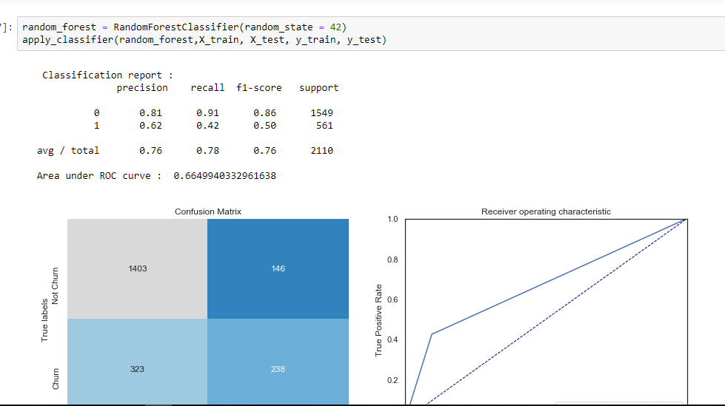
RANDOM FOREST PERFORMANCE REPORT

Slide 23
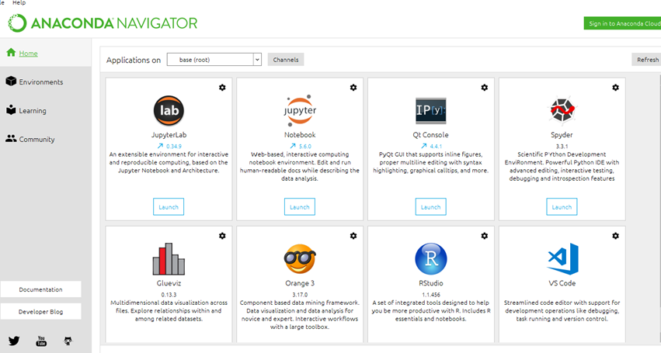
SOFTWARE REQUIREMENT
ANACONDA NAVIGATOR
Anaconda Navigator is a desktop graphical user interface (GUI) included in Anaconda® distribution that allows you to launch applications and easily manage conda packages, environments and channels without using command-line commands. Navigator can search for packages on Anaconda Cloud or in a local Anaconda Repository. It is available for Windows, macOS and Linux

Slide 24
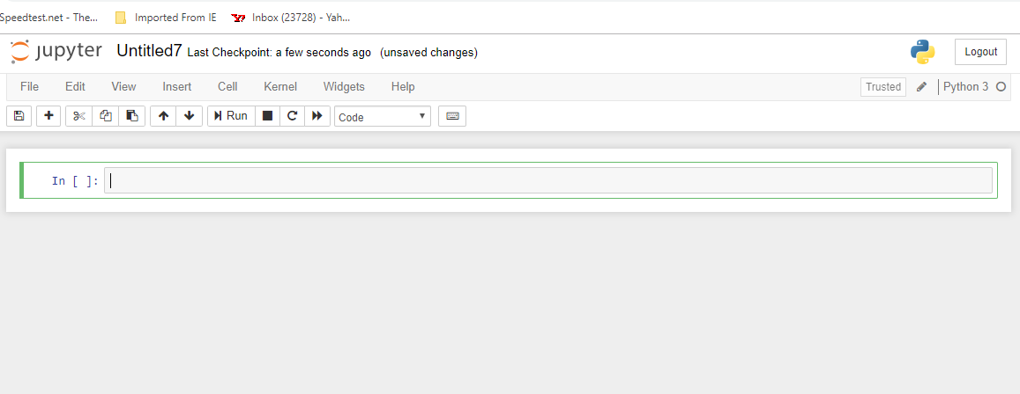
JUPYTER NOTEBOOK
The Jupyter Notebook is an open-source web application that allows you to create and share documents that contain live code, equations, visualizations and narrative text. Uses include: data cleaning and transformation, numerical simulation, statistical modeling, data visualization, machine learning, and much more.

Slide 25
References
[1] Dilip singh;Somdutta;Abinash pujari (2017) Evaluation of ML modelsFor employee Churn prediction
[2] Zhenyu Chen ;Zhipin Fan (2011) Building comprehensible customer churn prediction models
[3] Jas Semrl ;Alexandru Matei(2017) Churn prediction model for effective gym customer retention
[4] Preeti K. Dalvi; Siddhi K.Khandge ;Ashish Deomore; Aditya Bankar ;V. A. Kanade (2016) Analysis of customer churn prediction in telecom industry
[5] Saad Ahmed Qureshi ; Ammar Saleem Rehman ; Ali Mustafa Qamar; Aatif Kamal(2013) . Telecommunication subscribers' churn prediction model using machine learning
[6] Adnan Amin ;Changez Khan ;Imtiaz Ali ;Sajid Anwar(2014) Customer Churn Prediction in Telecommunication Industry: With and without Counter
[7] Alpaydin, E. (2010). Introduction to Machine Learning. London, England: The MIT Press.
[VIII] Archaux, C., Laanaya, H., Martin, A., & Khenchaf, A. (2004). An SVM based Churn Detector in Prepaid Mobile Telephony. IEEE .

Slide 26


