Slide 1

Bulls and Cows
Soroush Saririan

Slide 2
Game Info
In this game the player is selecting a random 4-digit code.
The player is assisted by bulls and cows.
Bulls – A correct number in the correct position
Cows – A correct number

Slide 3
Theory
Entropy is a measure of uncertainty (unit is bits)
The higher the entropy the higher the uncertainty
In this case we have potential solutions for the game
High Entropy – many solutions
Low Entropy – less solutions

Slide 4
Applications of entropy
In data science the use of entropy can be seen in applications such as decision trees
We have the goal to clean and arrange data and by using entropy we can make the individual sets purer. [1]
The application of entropy can also be seen in ml models.
We can use entropy to find the uncertainty in a random variable/outcome of that variable. [1]

Slide 5
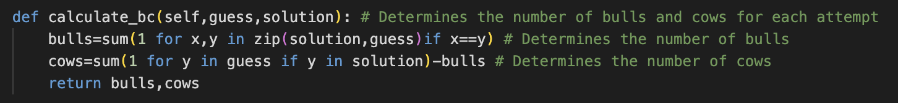
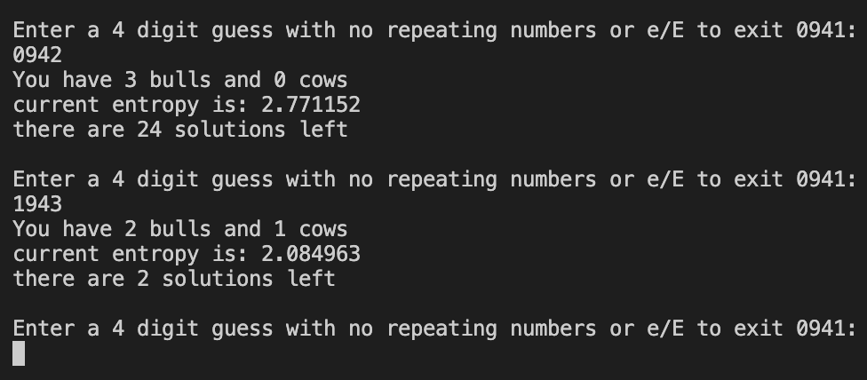
Bulls and Cows

Slide 6
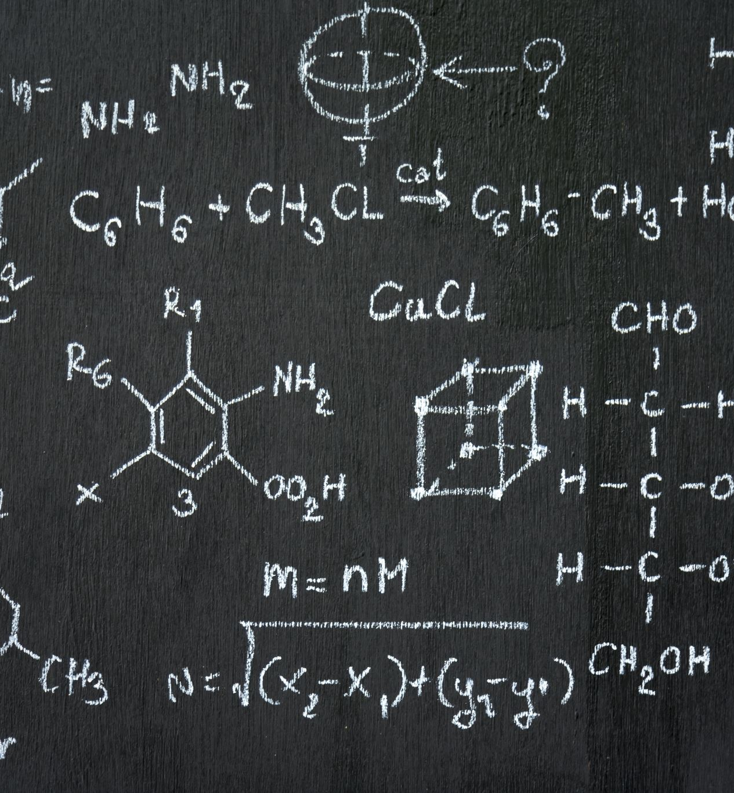
Entropy Calculation
The entropy is calculated with this formula:
H(X) = P(X) * log2(P(X))
Because we are only interested in the value, we use the P(X) and not 1/P(X) in the logarithm.
This value is subtracted over each iteration (or added depending on if bulls/cows are added or removed on that guess)

Slide 7
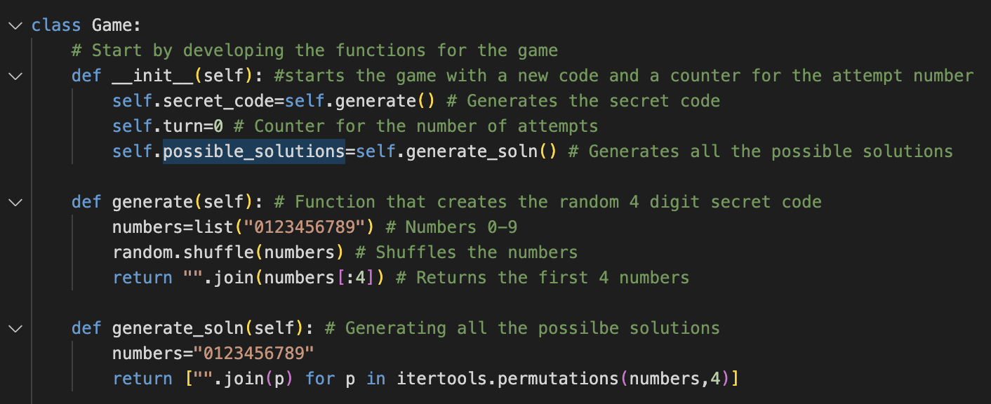
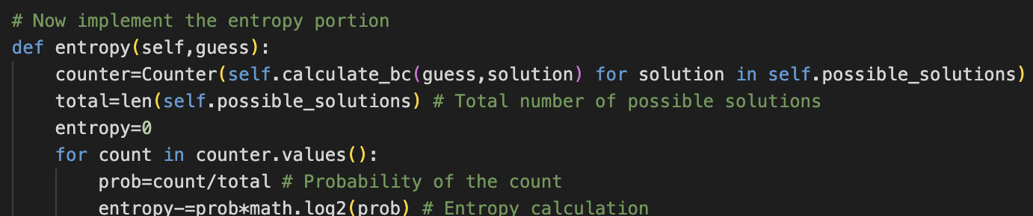
Code Overview
In the initiation process we generate a new random code. We also generate all the possible solutions once again. This is done with the generate_soln() function.
Further down we see the entropy function. This uses the total number of bulls and cows from the calculate_bc() function as well as the possible solutions to find the entropy.

Slide 8

Code Overview Cont.
As seen in the image, the probability is found using the current count of solutions that make the specific number of bulls/cows divided by the total number of solutions that remain.
The entropy therefore reflects the current state and will change dynamically as the game continues to have fewer solutions.

Slide 9
Practical Implications
We can use entropy to reduce the number of guesses for certain tasks.
This can be applied to many real-world tasks.
In our field we can use this for the optimization process in decision making for machine learning.

Slide 10
Citations
[1] ADEKUNLE; #Wolfwords, GOKE. “Entropy; a Method for Data Science & Machine Learning.” Medium, 25 Feb. 2022, thisgoke.medium.com/entropy-a-method-for-data-science-machine-learning-7c3de2c6d82d.

