Slide 1


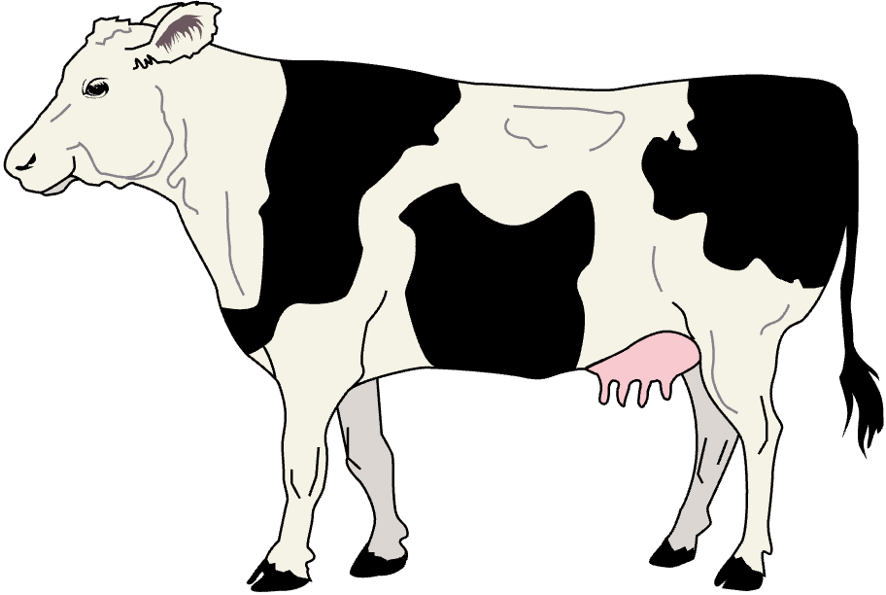



BULLS AND COWS
Soroush Saririan

Slide 2


SALFORD & CO.
GAME
RULES
In this game the player is attempting to guess a 4 digit random number. This number is has digits between 0 - 9 and can not have a repeating answer.
If the player guesses the number correct and the position, they get a bull. If they select the number correctly they get a cow.
Using the bulls and cows the player can then solve for the full number with these clues.

Slide 3

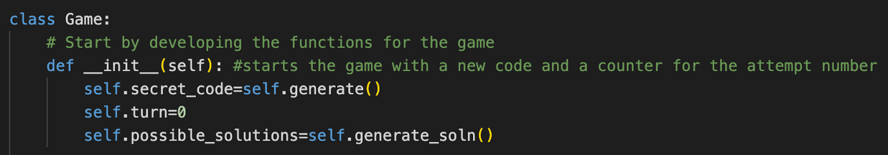
CODE OVERVIEW
The code uses classes and functions to generate the random number, set the rules, calculate bulls/cows, and allow the user to play the game.
When the game starts, a random code is generated. The turn is reset to zero. Finally the possible solutions are generated.

Slide 4
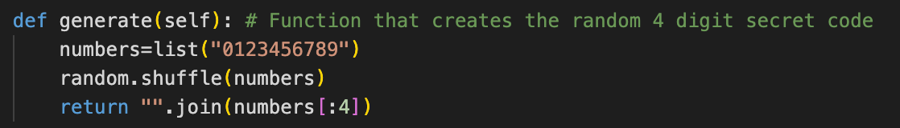
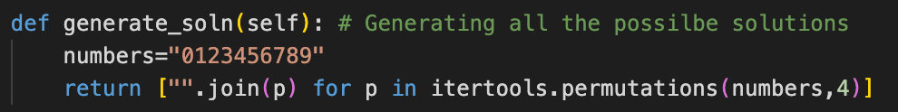
GENERATING NUMBER
Using the generate(self) function, a random four digit number with digits between 0-9 is created. The number is not allowed to have repeating digits as well.
The generate_soln(self) function determines all the possible solutions that exist

Slide 5
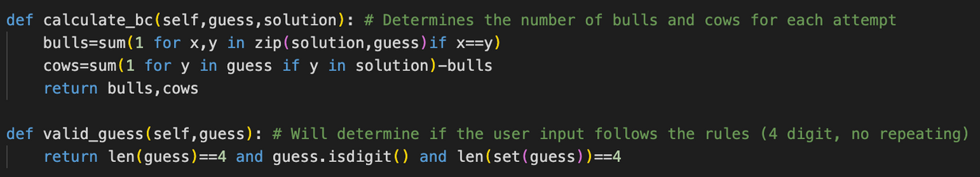
RULES OF GAME
The calculate_bc() function is used to determine the number of bulls and cows. The cows varaible counts the digits that are in both the solution and guess. The bulls variable determines if the value and position are correct.
The valid_guess() function ensures that the user input is a non repeating 4 digit value.

Slide 6
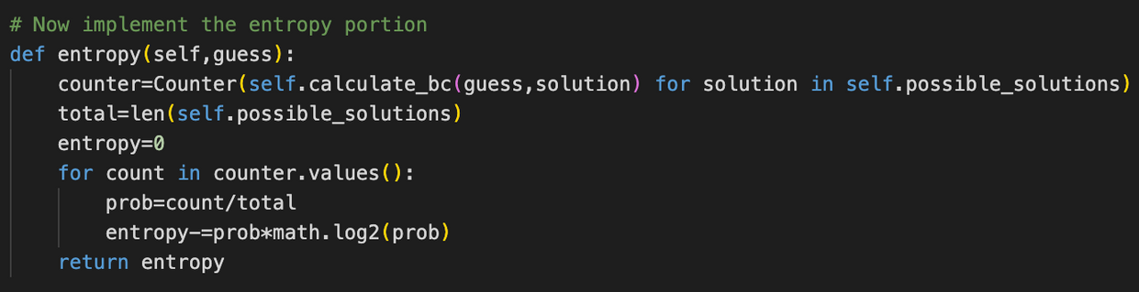
ENTROPY
The entropy() function is used to display the unvertianty of the guess to the user. As the player gets closer to the solution, or if the number of possible solutions reaches zero, the entropy will become less and less. This allows for the user to better select the guess for the random number.

Slide 7
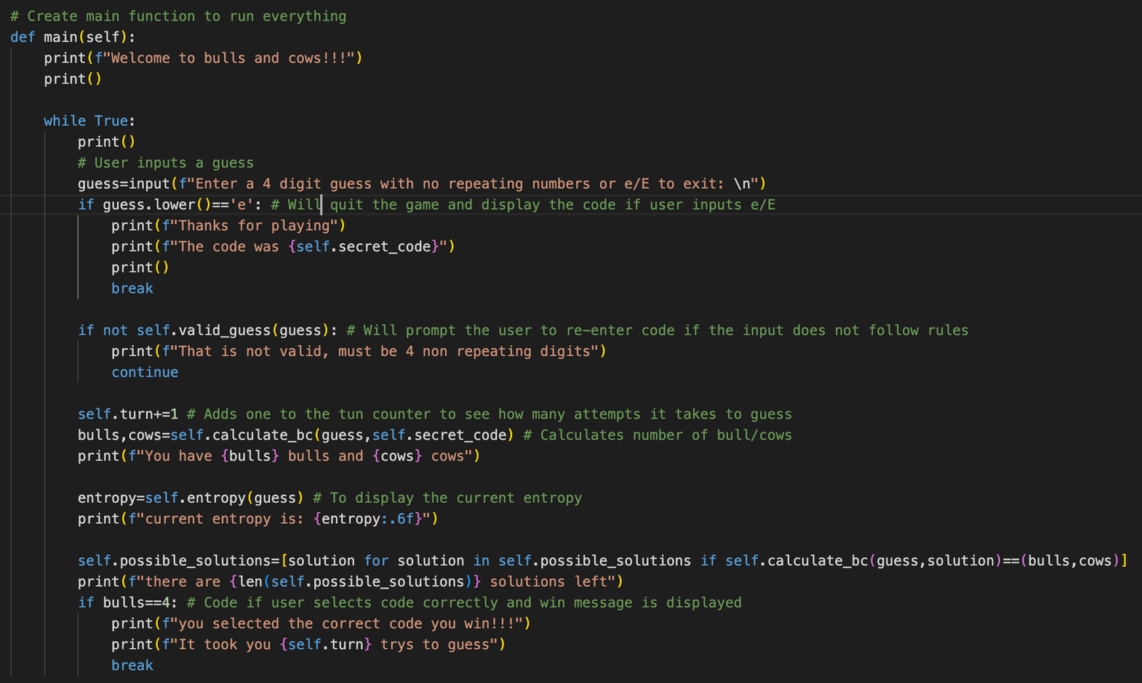
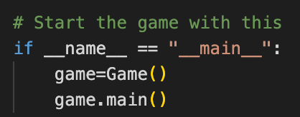
The main function is used to run the game. It starts by giving a welcome message to the user. Then using a while function to run/end the game a user input is accepted. The user can quit by using e/E or input a guess. If the guess is not valid by the rules, the game will display an error and ask for a new input.
=The game then automatically adds a turn for each valid guess, so the player can see how long it takes to guess. For each guess the number of cows/bulls, entropy, and the number of poossible solutions are shown on the terminal.

Slide 8

DEMONSTRATION
THIS DEMO WILL USE A REDUCED NUMBER OF DIGITS (0-3) TO QUICKLY DEMO THE RULES AND GAME FUNCTIONS

