Slide 1
Networking
Computer network A collection of computing devices that are connected in various ways in order to communicate and share resources
Usually, the connections between computers in a network are made using physical wires or cables
  However, some connections are wireless, using radio waves or infrared signals
15-<number>

Slide 2
Networking
The generic term node or host refers to any device on a network
Data transfer rate The speed with which data is moved from one place on a network to another
Data transfer rate is a key issue in computer networks
15-<number>

Slide 3
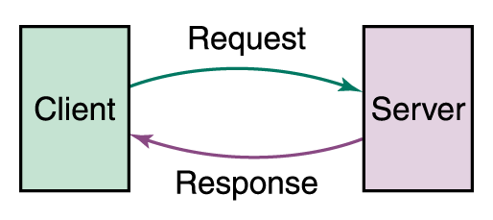
Networking
Computer networks have opened up an entire frontier in the world of computing called the client/server model
Figure 15.1 Client/Server interaction
15-<number>

Slide 4
Networking
File server A computer that stores and manages files for multiple users on a network
Web server A computer dedicated to responding to requests (from the browser client) for web pages
15-<number>

Slide 5
Types of Networks
Local-area network (LAN) A network that connects a relatively small number of machines in a relatively close geographical area
15-<number>

Slide 6
Types of Networks
Various configurations, called topologies, have been used to administer LANs
  Ring topology A configuration that connects all nodes in a closed loop on which messages travel in one direction
  Star topology A configuration that centers around one node to which all others are connected and through which all messages are sent
  Bus topology All nodes are connected to a single communication line that carries messages in both directions
15-<number>

Slide 7
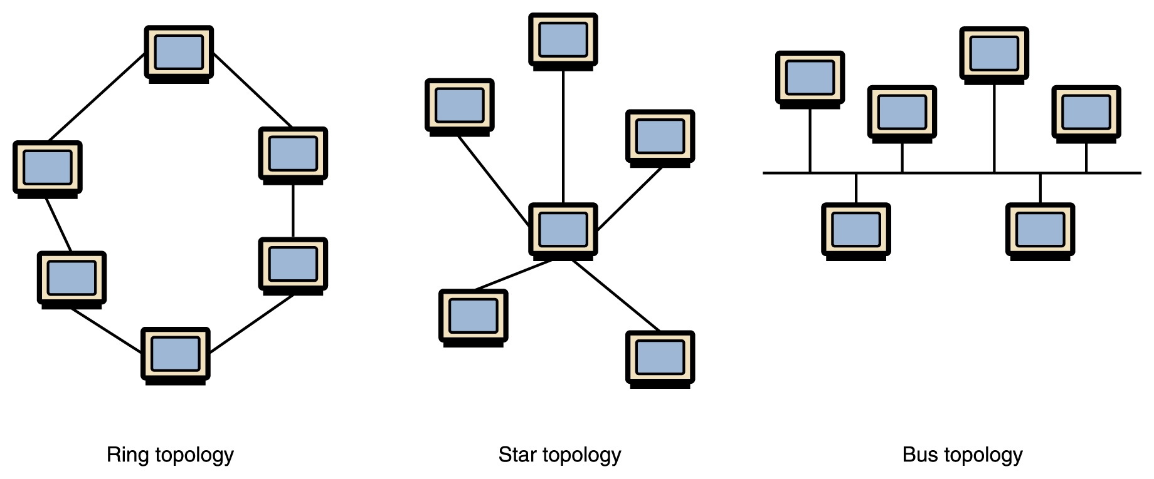
Types of Networks
Figure 15.2 Various network topologies
A bus technology called Ethernet has become the industry standard for local-area networks
15-10

Slide 8
Types of Networks
Wide-area network (WAN) A network that connects two or more local-area networks over a potentially large geographic distance
  Often one particular node on a LAN is set up to serve as a gateway to handle all communication going between that LAN and other networks
Communication between networks is called internetworking
  The Internet, as we know it today, is essentially the ultimate wide-area network, spanning the entire globe
15-<number>

Slide 9
Types of Networks
Metropolitan-area network (MAN) The communication infrastructures that have been developed in and around large cities
15-<number>

Slide 10
So, who owns the Internet?
Well, nobody does. No single person or company owns the Internet or even controls it entirely. As a wide-area network, it is made up of many smaller networks. These smaller networks are often owned and managed by a person or organization. The Internet, then, is really defined by how connections can be made between these networks.
15-<number>

Slide 11
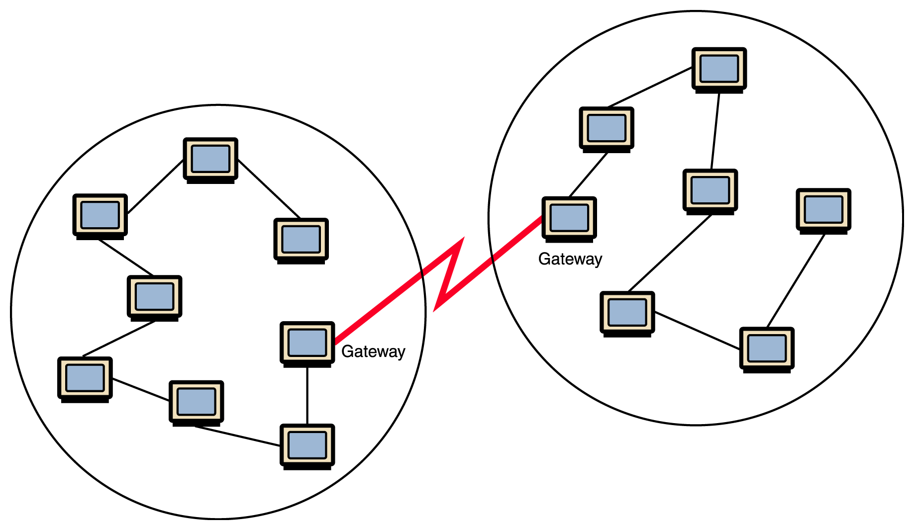
Types of Networks
Figure 15.1 Local-area networks connected across a distance to create a wide-area network
15-<number>

Slide 12
Internet Connections
Internet backbone A set of high-speed networks that carry Internet traffic
These networks are provided by companies such as AT&T, GTE, and IBM
Internet service provider (ISP) A company that provides other companies or individuals with access to the Internet
15-<number>

Slide 13
Internet Connections
There are various technologies available that you can use to connect a home computer to the Internet
  A phone modem converts computer data into an analog audio signal for transfer over a telephone line, and then a modem at the destination converts it back again into data
  A digital subscriber line (DSL) uses regular copper phone lines to transfer digital data to and from the phone company’s central office
  A cable modem uses the same line that your cable TV signals come in on to transfer the data back and forth
15-<number>

Slide 14
Internet Connections
Broadband A connection in which transfer speeds are faster than 128 bits per second
  DSL connections and cable modems are broadband connections
  The speed for downloads (getting data from the Internet to your home computer) may not be the same as uploads (sending data from your home computer to the Internet)
15-<number>

