Slide 1

CST-452 PROJECT
EDUCODE
A MODERN LEARNING PLATFORM
Admin Dashboard, User Management & Interactive Coding Lab
By Sari Saiadi

Slide 2
Project Overview
Problem Statement
Traditional learning platforms lack real-time coding environments, progress tracking, and role-based dashboards.
Solution
EduCode offers:
Interactive coding challenges with execution
Admin, Instructor, and Learner dashboards
Progress tracking with certificates
Key Features
✔ User management (CRUD)
✔ Course enrollment & coding lab
✔ Real-time analytics

Slide 3
Project Overview
Front-end
Tools
React.js + TypeScript
Tailwind CSS, Framer Motion (animations)
Monaco Editor (code editor)
Git, Postman, Figma (UI design)
Backend
Node.js + Express
MySQL (relational DB for structured data)
JWT Authentication

Slide 4
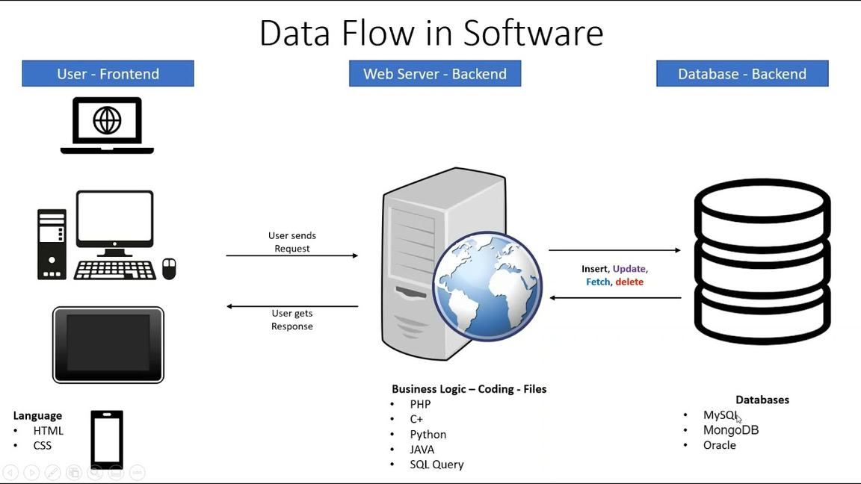
System Architecture
Frontend: Role-specific dashboards (Admin/Learner/Instructor)
Backend: RESTful APIs for courses, users, challenges
Database: Tables for users, courses, progress tracking

Slide 5

Key Features-Admin Dashboard
What it does?
Why it matters
Real-time stats (users, courses, revenue)
Visual charts (growth trends, completion rates)
Security alerts & recent activity logs
Admins gain actionable insights to manage the platform efficiently.

Slide 6
Key Features-User Management
Functionality
Technical Highlights
Filter users by role (Learner/Instructor/Admin)
Edit profiles, verify accounts, delete users
Responsive data table with search
Role-based access control (JWT tokens)

Slide 7
Key Features-Coding Lab
Interactive Coding
Progress Tracking
Write/execute code in JavaScript/Python
Test cases with real-time feedback
Save drafts & reset code
Points for solved challenges
Difficulty tags (Easy/Medium/Hard)

Slide 8
Key Features-Course Management
For Learners
For Instructors/Admin
Enroll in courses
Track progress (%)
View certificates
Create/edit courses
Add coding challenges

Slide 9
Challenges and Solutions
Challenge 1:
Real-time code execution
→ Solution: Backend API to safely run user-submitted code
Challenge 2:
Role-specific dashboards
→ Solution: Dynamic UI rendering based on JWT role claims
Challenge 3:
Progress tracking
→ Solution: MySQL triggers to update completion %

