Slide 1
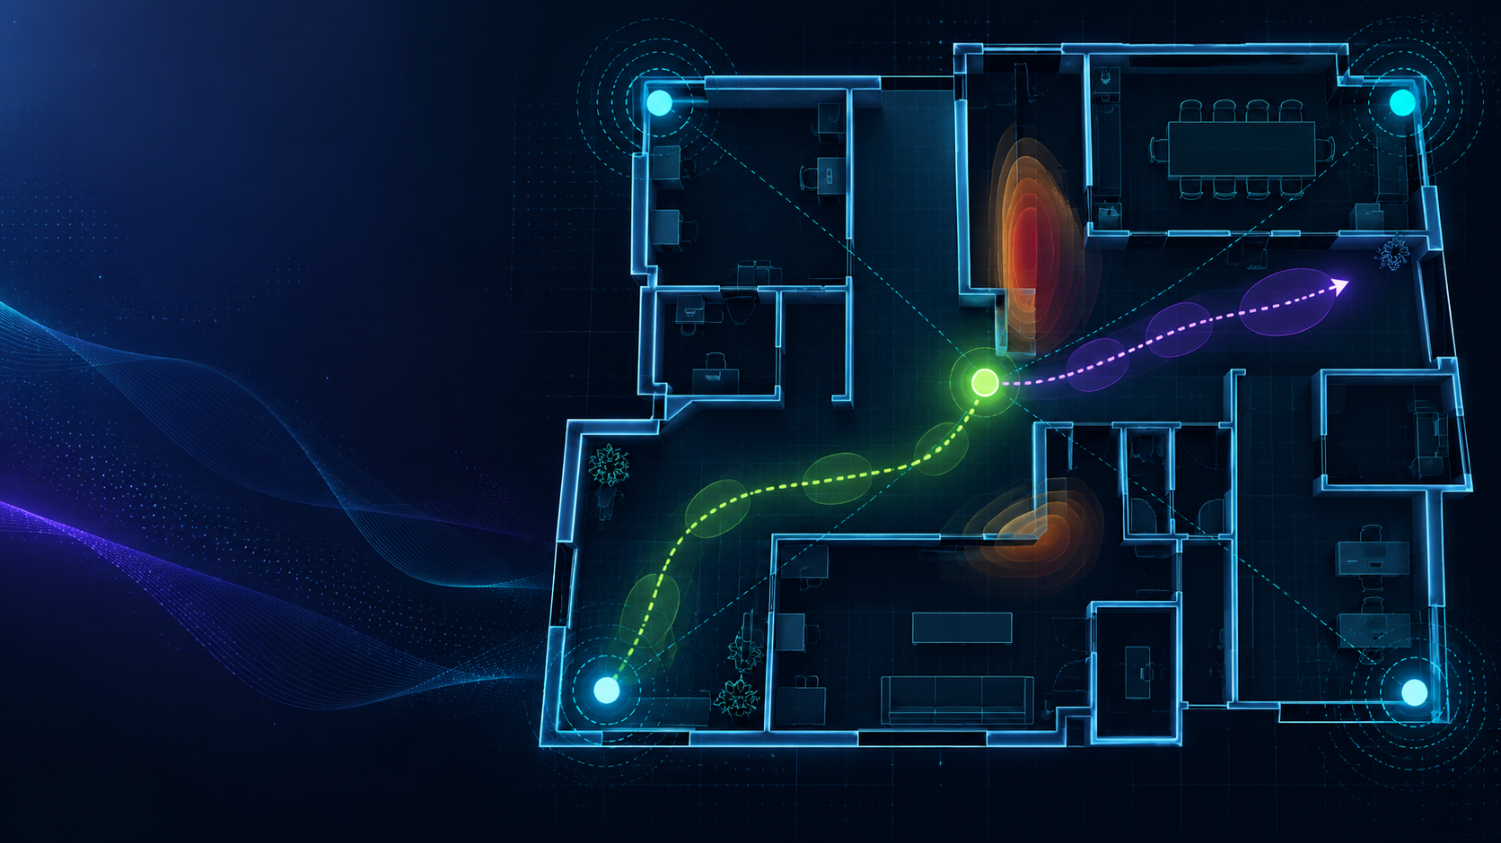
LOCUS AI
Position belongs to evidence.
Reliable indoor positioning when measurements are noisy, anchors are limited, and signals disappear.
AI-Based Indoor Positioning with Sparse Infrastructure and Noisy Measurements
BYTE BENDERS
Sarish Anasane (Team Leader) · Aryan Mokal · Arya Ghate · Arjun Mirje
Notes:
PRESENTER: Sarish Anasane
MAIN POINT: Introduce LOCUS AI and the problem.
SCRIPT: Indoor positioning breaks down when anchors are few, readings are noisy and signals vanish. LOCUS AI gives a position only as far as the evidence supports it.
TRANSITION: Next we show the prototype we already built.
TIME: ~20 s

Slide 2
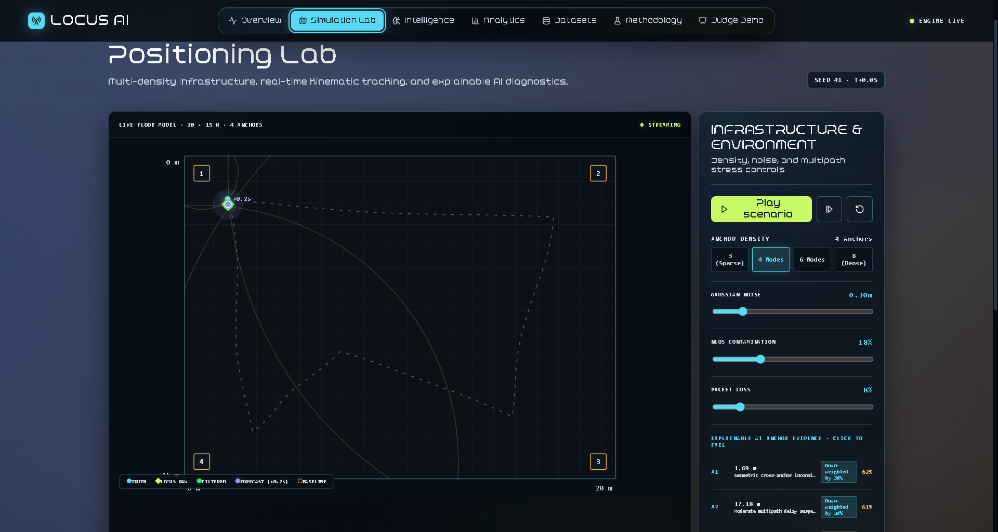
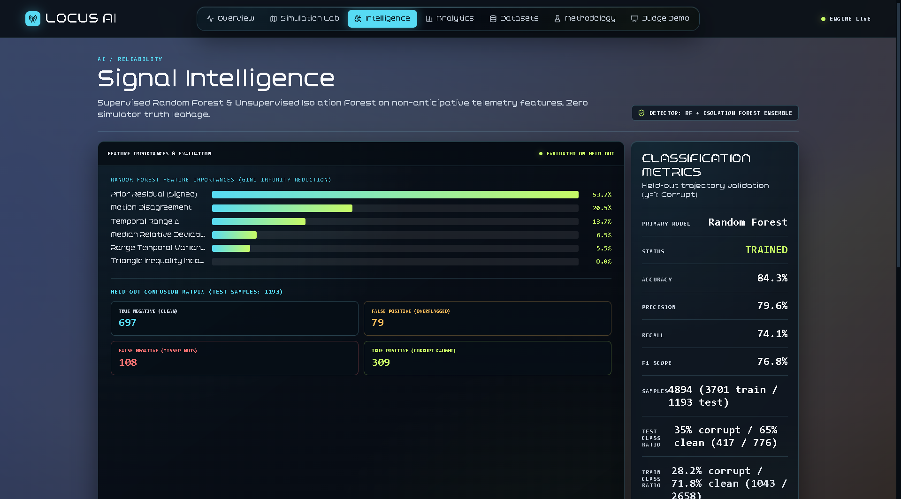
The Current Prototype
CURRENT PROTOTYPE · LIVE DEMO
From measurements to position
RANGE
noisy anchor distances
›
TRUST
reliability from history
›
SOLVE
robust weighted multilateration
›
TRACK
Kalman-style filtering
›
REPORT
position + uncertainty
Controls: 20 × 15 m · 3/4/6/8 anchors · noise · NLOS · packet loss.
Classifier: 84.3% accuracy / 76.8% F1 for unreliable-measurement detection—not position accuracy.
Next: five planned capabilities for the offline round.
Notes:
PRESENTER: Sarish Anasane
MAIN POINT: The core prototype exists and works.
SCRIPT: Anchors give noisy ranges, we judge how trustworthy each is, solve a robust position, smooth it over time and report uncertainty. Now let us see it live: open Simulation Lab, show room, anchors and trajectory, change anchors, noise, NLOS and packet loss, then glance at Intelligence.
TRANSITION: After the demo: here is where we take it next.
TIME: ~90 s incl. 60-75 s live demo

Slide 3
Under the Hood: Models & Data
CURRENT PROTOTYPE · ML + DATASET
The AI layer judges measurement reliability; the positioning pipeline estimates X–Y.
MODEL STACK & POSITIONING PIPELINE
SYNTHETIC DATASET USED BY CURRENT PROTOTYPE
4,894
labelled synthetic measurement samples
RANDOM FOREST
ISOLATION FOREST
Supervised primary classifier
Predicts clean vs. corrupt readings
Unsupervised anomaly detector
Flags unusual telemetry patterns
TRAINING SET
HELD-OUT TEST
3,701 · 75.6%
1,193 · 24.4%
FROM TRUST SCORE TO LOCATION
Label balance (clean vs. corrupt measurements)
TRUST
SOLVE
TRACK
OUTPUT
TRAIN
TEST
Reliability
weighting
›
Weighted
multilateration
›
Kalman-style
temporal filter
›
X–Y +
uncertainty
2,658 clean · 1,043 corrupt
776 clean · 417 corrupt
WHAT THE RANDOM FOREST PAYS ATTENTION TO
RANDOM FOREST · HELD-OUT TEST METRICS
Prior residual (signed)
53.7%
ACCURACY
84.3%
PRECISION
79.6%
Motion disagreement
20.5%
Temporal range change
13.7%
RECALL
F1 SCORE
74.1%
76.8%
Median relative deviation
6.5%
Range temporal variance
5.5%
Triangle inequality inconsistency
0.9%
These metrics classify measurement corruption—not X–Y position accuracy. Dataset is simulator-generated; no external real-world dataset is shown.
CURRENT PROTOTYPE • Synthetic evaluation • Feature importance from the displayed Random Forest model
Notes:
PRESENTER: Sarish Anasane (or the teammate explaining the current prototype)
MAIN POINT: Explain which model detects suspicious measurements, what data it learned from, and how that differs from the position estimator.
SCRIPT: Our current Intelligence layer uses a supervised Random Forest as the primary clean-versus-corrupt measurement classifier, paired with an Isolation Forest anomaly detector. The model was evaluated on synthetic measurement records generated by our simulator—not an external real-world dataset. We have 4,894 labelled samples: 3,701 for training and 1,193 held out for testing. The Random Forest shows 84.3% accuracy and a 76.8% F1 score on that held-out test. These are corruption-classification metrics, not position accuracy. The model assesses measurement reliability; robust weighted multilateration estimates X–Y, and Kalman-style filtering stabilizes the trajectory. The feature chart shows prior residual as the largest current Random Forest feature-importance contribution.
TRANSITION: Now we will show how we plan to extend this foundation with AI Motion Recovery and four other capabilities.
SUGGESTED DURATION: 25–35 seconds.
CAUTION: Do not claim real-world validation or improved X–Y accuracy based on the classifier metrics alone.

Slide 4
AI Motion Recovery
FUTURE CONCEPT · PROPOSED FOR OFFLINE ROUND
When the signal disappears, the trajectory continues, with uncertainty.
A1
SIGNAL-LOSS INTERVAL
A2
WHY IT MATTERS
Predict likely movement during temporary outages
Use recent movement history
Communicate growing uncertainty
Ground truth is hidden from the predictor and used only for evaluation. Concept mockup, no measured results.
LAST MEASURED POSITION
A3
A4
Measured history
Kalman baseline
Proposed AI prediction
Notes:
PRESENTER: Sarish Anasane
MAIN POINT: Keep tracking during signal loss, and be honest about uncertainty.
SCRIPT: When a person walks out of coverage, we do not freeze or invent a measurement. We show the last measured position, a predicted path, and an uncertainty region that grows with time.
TRANSITION: Next: how we will build and prove it.
TIME: ~28 s

Slide 5
AI Motion Recovery
PROPOSED FOR OFFLINE ROUND
How it could work, and how we will prove it
Recent position history
›
Motion features
speed · heading · acceleration
›
Prediction model
Kalman baseline vs GRU
›
Predicted trajectory + uncertainty
WHAT WE WILL TRY
HOW WE WILL PROVE IT
Use estimated X-Y positions and timestamps
Consider reliability and outage duration
Compare maneuver-aware tracking and a trained GRU
Hybrid: blend measurements back in on recovery
Compare against the existing Kalman baseline
Straight paths, turns, speed changes, stops
Short and long outages, unseen trajectories
Mean, median, 90th-percentile error + recovery error
An unexpected turn during a full outage cannot be observed, so confidence must fall rather than pretend the path is known.
Notes:
PRESENTER: Sarish Anasane
MAIN POINT: A fair experiment decides whether learned prediction beats the baseline.
SCRIPT: We start from recent positions, derive speed and heading, and compare Kalman against a GRU on unseen paths and outages. If the GRU does not help, we keep Kalman and say so.
TRANSITION: Next: making radio obstructions visible.
TIME: ~28 s

Slide 6
RF Shadow Mapper
FUTURE CONCEPT · SIMULATED RF ENVIRONMENT
Make invisible radio obstructions visible.
A1
A2
SELECTED PATHS
A1 → tag: crosses a wall, weakened
A3 → tag: clear path
Similar distance, different measurements
Model the radio environment. Investigate unreliable paths.
Simulated attenuation map from known virtual walls. It does not reconstruct real buildings from ordinary Wi-Fi.
A3
A4
Lower attenuation
Stronger
Severe
Notes:
PRESENTER: Sarish Anasane
MAIN POINT: Walls change measurements, so unreliable paths can be recognised.
SCRIPT: Two anchors at similar distances can report very different values because one path crosses a wall. We will simulate this and visualise it as a heatmap. It is a simulated attenuation map, not a claim to rebuild real walls.
TRANSITION: Next: how this feeds the positioning pipeline.
TIME: ~28 s

Slide 7
RF Shadow Mapper
PROPOSED FOR OFFLINE ROUND
From obstructions to better decisions
Floor plan + anchors
›
Simulated radio effects
›
Attenuation heatmap
›
Measurement reliability
›
Localization evaluation
WITHOUT MAP
WITH SIMULATED MAP
EVALUATION PLAN
Reliability from residuals and history only
Wall crossings add evidence of probable NLOS bias
Different wall layouts and noise levels
Trajectories unseen in development
Compare error with vs without map
Initially built on known simulated geometry. Real mapping would need radio measurements and calibration. A heatmap estimates conditions; it is not a physical-wall guarantee.
Can knowledge of the environment make unreliable measurements easier to recognise?
Notes:
PRESENTER: Sarish Anasane
MAIN POINT: Test whether environment knowledge improves reliability decisions.
SCRIPT: We run localization twice, with and without the simulated map, on the same trajectories, and check whether flagging of bad measurements improves. No numbers yet.
TRANSITION: Next: Aryan on placing anchors better.
TIME: ~28 s

Slide 8
Smart Anchor Placement Advisor
FUTURE CONCEPT · LAYOUT OPTIMIZATION
Do not just add more anchors. Find better positions for them.
CURRENT / CANDIDATE LAYOUT
RECOMMENDED LAYOUT
A1
A2
A1
A2
A4
A3
WEAK GEOMETRY
A3
A4
Compare layouts · Evaluate coverage · Optimize anchor geometry · Recommend placement
Same room, same anchor count, same path. Recommendation depends on room, paths, noise and objective.
Notes:
PRESENTER: Aryan Mokal
MAIN POINT: Better positions can beat more anchors.
SCRIPT: With sparse infrastructure, geometry matters. Clustered anchors leave weak zones; spread anchors constrain the position better. The advisor compares layouts for the same anchor budget.
TRANSITION: Next: how recommendations are measured.
TIME: ~28 s

Slide 9
Smart Anchor Placement Advisor
PROPOSED FOR OFFLINE ROUND
Measure before recommending
Candidate layouts
›
Simulated measurements
›
Localization tests
›
Compare results
›
Recommended layout
RESULTS PANEL (CONCEPT)
WHY IT MATTERS
Mean positioning error
—
Better geometry without more anchors
Sparse infrastructure makes placement critical
Same trajectories, noise and anchor budget for fair comparison
90th-percentile error
—
Usable tracking steps (%)
—
Poor-geometry zones
—
Recommended configuration
—
Values appear only after real runs. Nothing shown is measured.
Every recommendation should be backed by measured positioning performance.
Notes:
PRESENTER: Aryan Mokal
MAIN POINT: Recommendations must be earned with evidence.
SCRIPT: We generate candidate layouts, run identical simulated measurements, measure error, uncertainty and coverage, and recommend the layout that wins under the chosen objective.
TRANSITION: Next: Arya on multiple tags.
TIME: ~28 s

Slide 10
Multi-Person Tracking
FUTURE CONCEPT · MULTI-TAG TRACKING
Track multiple tags without mixing their movement histories.
A1
A2
TRACKED TAGS
T01 · Doctor
T01
Tracking
T02 · Nurse
Tracking
T03 · Patient
T03
Signal lost · own state
T02
Labels are example registered tag IDs, not biometric recognition. T03 losing signal does not affect T01 or T02.
A3
A5
A4
Notes:
PRESENTER: Arya Ghate
MAIN POINT: One space, many independent tracks.
SCRIPT: Each tag keeps its own position, history and uncertainty. If one tag loses signal, the others keep tracking. Tags are IDs, not face or biometric recognition.
TRANSITION: Next: how state stays separate and how we evaluate.
TIME: ~28 s

Slide 11
Multi-Person Tracking
PROPOSED FOR OFFLINE ROUND
Independent state, reliable identity
Measurements by tag ID
›
Separate tracking state
›
Independent estimates
›
Multi-tag dashboard
Per-tag state = position + velocity + history + uncertainty + measurement reliability
EVALUATION PLAN
Several virtual tags at once, crossing paths
Different speeds, independent outages
Position error per tag
Track continuity and identity-switch counts
Recovery after measurements return
Example: T01 loses measurements while T02 and T03 keep receiving data. Tag identity is an assigned ID; linking a tag to a person is registration, not biometrics.
Scale from one tracked tag to multiple independently maintained trajectories.
Notes:
PRESENTER: Arya Ghate
MAIN POINT: Separate state per tag prevents cross-contamination.
SCRIPT: We feed each tag only its own measurements and test crossings, mixed speeds and separate outages, counting errors, continuity and identity switches.
TRANSITION: Next: Arjun on the decision layer.
TIME: ~28 s

Slide 12
Intelligent Recovery Mode
FUTURE CONCEPT · ADAPTIVE TRACKING DECISIONS
Different failures need different responses.
MONITORED
DECISION PANEL
NORMAL TRACKING
Measurement availability
Measurement reliability
Available anchors
Anchor geometry
Position uncertainty
Outage duration
MODE: SIGNAL OUTAGE
UNRELIABLE MEASUREMENTS
Reason: no usable measurements
Estimate: motion prediction, not a fresh fix
Confidence: decreasing
Response: predict, widen uncertainty
SIGNAL OUTAGE
POOR ANCHOR GEOMETRY
SIGNAL RECOVERY
Notes:
PRESENTER: Arjun Mirje
MAIN POINT: The system picks a response to match the failure.
SCRIPT: Normal, unreliable readings, outage, weak geometry and recovery each need a different action. Rules are a proposal, not yet implemented.
TRANSITION: Next: how it ties everything together.
TIME: ~28 s

Slide 13
Intelligent Recovery Mode
PROPOSED ARCHITECTURE
An adaptive LOCUS AI
Wireless measurements
›
Reliability assessment
›
Localization
›
Tracking + uncertainty
›
Recovery decision
›
Position report
RF Shadow Mapper
environment context
Anchor Placement
better layouts
AI Motion Recovery
predict during outage
Multi-Person Tracking
state per tag
Intelligent Recovery
chooses strategy
NOT THE SAME FEATURE
HOW WE WILL VALIDATE
AI Motion Recovery predicts movement when measurements vanish
Intelligent Recovery Mode decides which strategy to use
Adaptive vs fixed-baseline tracking
Noise, missing anchors, outages, weak geometry
Report measured gains and limits
LOCUS AI: from noisy measurements to evidence-driven indoor tracking.
Byte Benders | Sarish Anasane · Aryan Mokal · Arya Ghate · Arjun Mirje
Notes:
PRESENTER: Arjun Mirje
MAIN POINT: Recovery Mode decides; Motion Recovery predicts. Close the story.
SCRIPT: Mode picks between normal tracking, down-weighting, prediction or abstaining. All of this is proposed for the offline round and will be validated with measured results.
TRANSITION: Closing line, then Q&A.
TIME: ~40 s incl. closing

