Slide 1
Educational DNA–RNA
Tumour Profiling Pipeline
Building a clinical-grade genomic workflow in the open — and measuring it against an accredited laboratory
[NAME · PROGRAMME] · [COMPANY] · [DATES] · supervisor [NAME]
1 / 18

Slide 2
“What can we understand about a person's disease
by looking at their tumour's genetic material?”
▪ A biopsy is sequenced and a two-page clinical report names a few mutations and the drugs that target them.
▪ What happens in between is invisible: the software is commercial and closed, the thresholds undocumented, the reasoning not shown.
▪ This project builds that chain in the open — then checks it against the real clinical report for the same specimen.
2 / 18

Slide 3
01
Identifying the data
Before any biology: which assay produced these reads?
3 / 18

Slide 4
READ STRUCTURE
The assay is written into the reads
Read 1 [ 12 random bases = molecular barcode ][ fixed adapter ][ patient DNA … ]
Read 2 [ gene-specific primer ][ patient DNA … ]
▪ A position where all four bases occur equally is random; one base at >98 % is synthetic. The transition marks the end of the barcode.
▪ Only ~2,200 distinct sequences start 80 % of Read 2 → a primer-based targeted panel.
▪ Conclusion: anchored multiplex PCR — confirmed afterwards by the clinical report (Archer VariantPlex + FusionPlex).
98.7 %
98.7 %
8 + 10 nt
of DNA reads match the predicted structure
of RNA reads match it
index reads — the adapter kit's signature
4 / 18

Slide 5
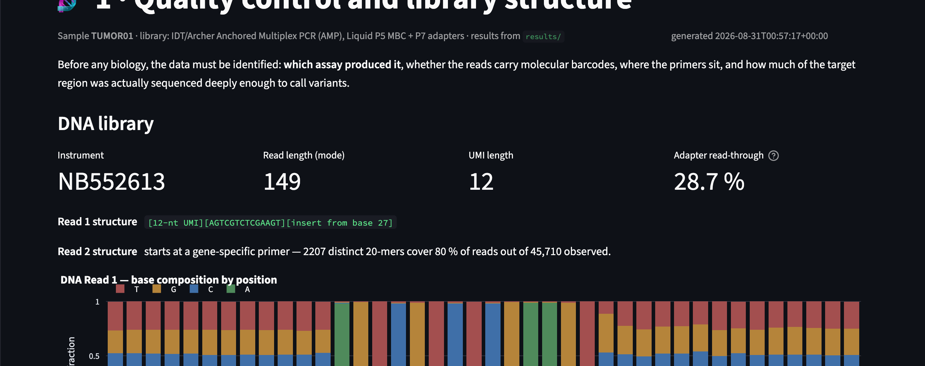
DASHBOARD · QUALITY CONTROL
The barcode is visible in the base composition
Positions 1–12 carry all four bases; positions 13–26 are a single fixed base per position — the adapter. The insert begins at base 27.
5 / 18

Slide 6
02
The pipeline
Split by memory, not by convenience
6 / 18

Slide 7
ARCHITECTURE
Where each step runs
Stage | Tool | Runs on
Read structure, primer inference | project scripts | laptop
Barcode extraction, alignment, deduplication | UMI-tools, BWA-MEM | Galaxy
Primer clipping, coverage | samtools, mosdepth | Galaxy
Somatic calling ×3 | Mutect2, LoFreq, FreeBayes | Galaxy
RNA alignment and fusions | STAR, Arriba | Galaxy
Annotation, tiering, report, dashboard | VEP REST, CIViC, project scripts | laptop
Aligning to the human genome needs ~6 GB (BWA) and ~31 GB (STAR). The machine had 8 GB — so the heavy half runs on the free public Galaxy service and the interpretation locally.
7 / 18

Slide 8
DEDUPLICATION
Counting molecules, not reads
5.7 M
2.9 M
2.09
sequencing reads
unique molecules
molecules per amplicon start
▪ Every molecule from one amplicon starts at the same coordinate, so coordinate-based duplicate marking would collapse them all into one.
▪ With only ~2 distinct molecules per start position, that would discard most of the evidence.
▪ The experiment is a 2.9-million-molecule measurement, not a 5.5-million-read one — and the confidence in every variant follows from the smaller number.
8 / 18

Slide 9
03
Results
Measured against an accredited laboratory
9 / 18

Slide 10
VALIDATION
The pipeline recovered the laboratory's finding
0.281
0.2814
1 / 1
laboratory allele fraction
measured here
reported variants recovered
IDH1 p.Arg132Cys — supported by all three callers. Different aligners, different callers, different reference builds, different deduplication: the same answer to three decimals.
▪ The laboratory used GRCh37 with the vendor's closed software; this pipeline used GRCh38 with three open callers.
▪ Primer clipping alone moved the estimate from 0.2636 to 0.2814 — measured, not assumed.
10 / 18

Slide 11
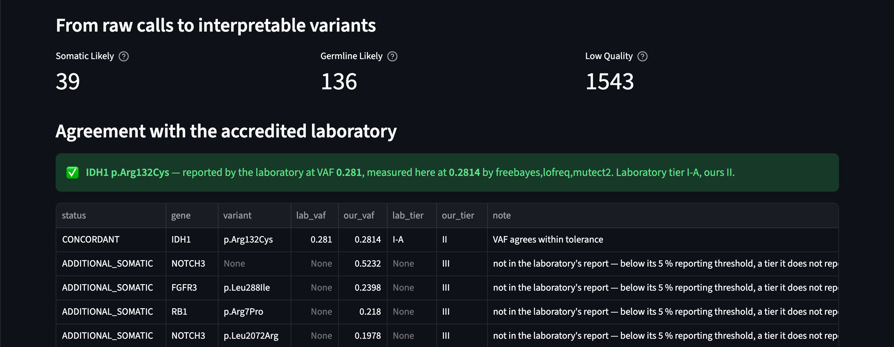
DASHBOARD · VARIANTS
Every call keeps the reason it was classified
39 likely somatic, 136 likely germline, 1,543 with insufficient evidence — nothing is silently deleted.
11 / 18

Slide 12
INTERPRETATION
Where the two disagree
Laboratory: Tier I-A
cited a clinical guideline for this tumour type
This pipeline: Tier II
open evidence exists only for other tumour types
▪ Both are defensible. The tiering rule refuses Tier I on evidence from a different disease — which is what the AMP/ASCO/CAP guideline requires.
▪ The gap measures the uneven tumour-type coverage of free knowledge bases, not a disagreement about biology.
▪ This is the project's clearest argument for why automated tiering needs curated knowledge or expert review.
12 / 18

Slide 13
QUALITY
One artefact with two faces
DNA arm
▪ 58 % of somatic SNVs share one substitution class
▪ Four “independent mutations” within 35 bases in one gene
▪ 23 of 39 candidates flagged
RNA arm
▪ 20 fusions called, 166,694 discarded
▪ FGFR1/2/3 joined in every combination, both orientations
▪ All 20 flagged — the laboratory reported none, and we agree
One mechanism explains both: cross-priming between the amplicons the assay amplifies in a single tube. An unscreened reading would have reported an FGFR2 fusion — the most consequential false positive available in this cancer type.
13 / 18

Slide 14
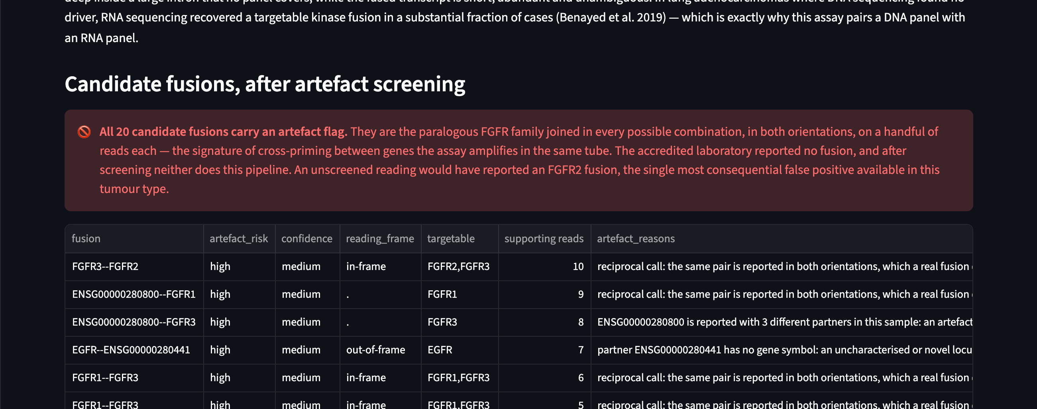
DASHBOARD · RNA
Screening turns twenty candidates into a negative
Each flag names its reason: reciprocal calls, paralogue pairs, joins between two primed panel genes, promiscuous or unnamed partners.
14 / 18

Slide 15
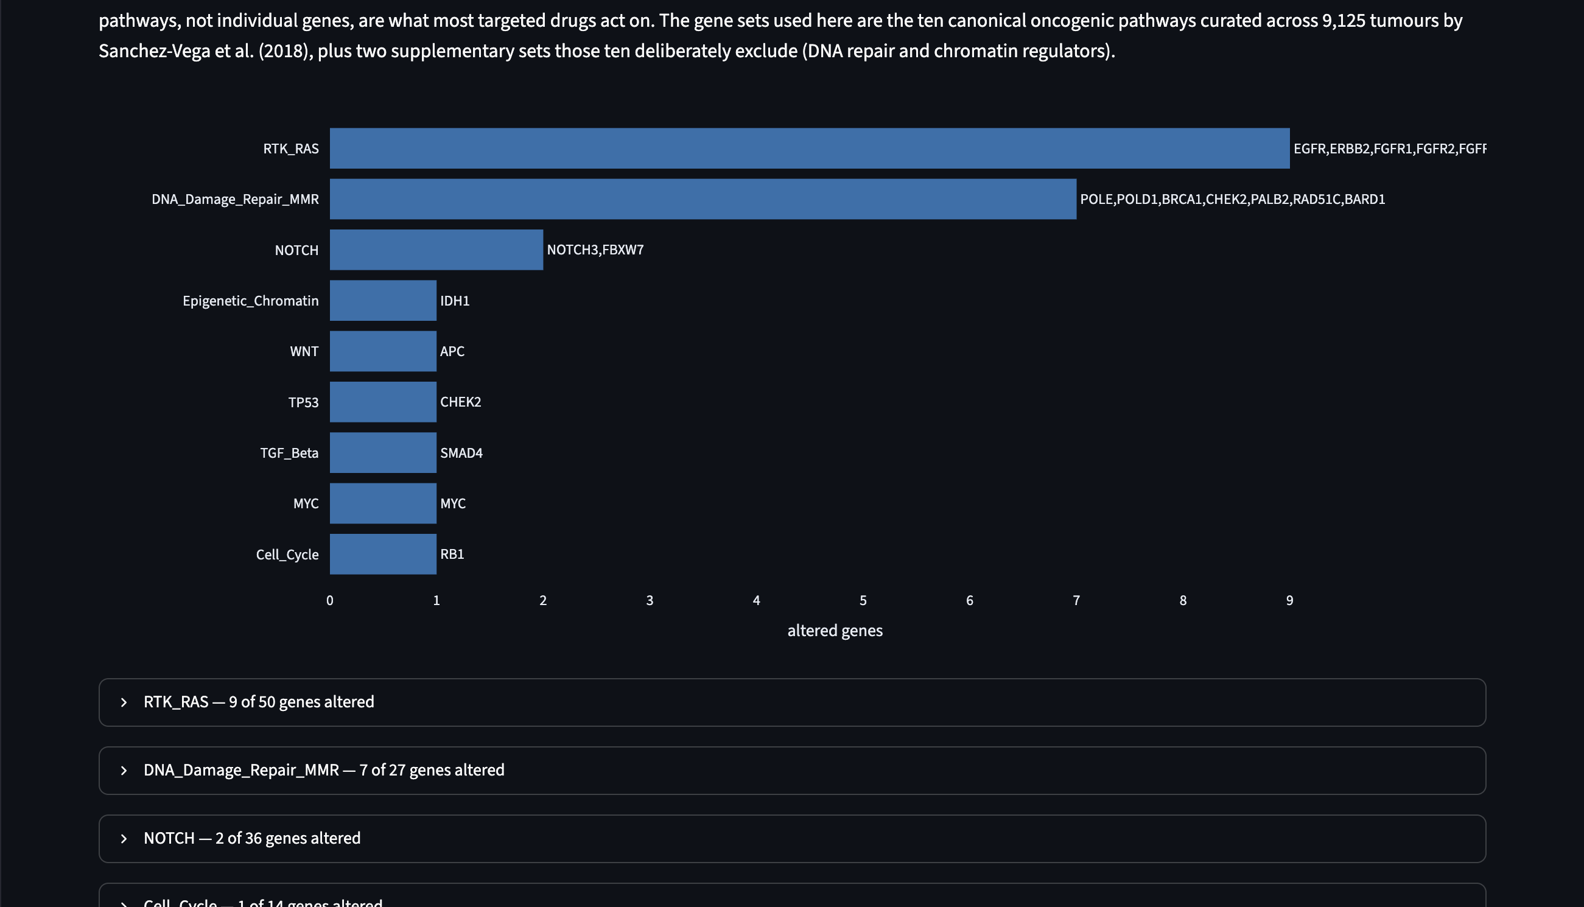
DASHBOARD · PATHWAYS
From a gene list to a picture of the cell
Membership mapping against the ten canonical oncogenic pathways — deliberately not an enrichment analysis, since the gene universe is fixed by the assay.
15 / 18

Slide 16
LIMITS
What this data cannot tell us
▪ Whether a variant is inherited — no normal tissue was sequenced.
▪ Roughly half of the nominal target territory had no coverage at all.
▪ Genes frequently mutated in this cancer type are absent from the panel: a negative there is an untested region, not an absence of mutation.
▪ Mutational burden — 115.18 → 47.12 per Mb after screening; both implausible, and the assessable territory is far too small.
▪ Microsatellite status: not determinable — as the accredited laboratory also concluded.
Stating where the answers stop is what makes this a teaching object rather than a black box.
16 / 18

Slide 17
Deliverables
38
14
6
2
automated tests, run in CI
documentation pages
dashboard pages
execution modes
▪ Reproducible Snakemake + Bioconda pipeline; heavy steps scripted end-to-end on Galaxy.
▪ Synthetic example dataset over a real mini-reference with a truth set — the whole workflow runs and is tested without any patient data.
▪ Public repository with setup instructions, worked examples and educational documentation.
[REPOSITORY URL]
17 / 18

Slide 18
Conclusions
▪ An open pipeline, on a laptop plus a free public service, reproduced an accredited laboratory's finding to three decimal places.
▪ Every disagreement was explicable and measurable: evidence coverage, reporting thresholds, and one identifiable chemistry artefact.
▪ The most useful property is not the agreement but the capacity to say precisely where the answers stop.
Educational output. Not a diagnostic tool, not clinically validated, and not a basis for medical decisions.
18 / 18

