Slide 1
Angular Components
Sarita Lad
DATE

Slide 2
Components
The Component is the main building block of an Angular Application. A Component contains the definition of the View and the data that defines how the View looks and behaves. The Angular Components are plain javascript classes and defined using. @component Decorator. This Decorator provides the component with the View to display & Metadata about the class.
The Component passes the data to the view using a process called Data Binding. This is done by Binding the DOM Elements to component properties. Binding can display component class property values to the user, change element styles, respond to a user event, etc.

Slide 3
What is Component?
The Angular Component is the main building block of an Angular application.
The Component contains the data and user interaction logic that define how the View looks and behaves. A view in Angular refers to a template (HTML).
The Angular Components are plain JavaScript classes defined using the @Component Decorator. This Decorator provides the Component with a View to display and Metadata about the Component.
The Component is responsible for providing the data to the View. Angular uses data binding to get the data from the Component to the View and vice versa. The data binding is achieved using special HTML markup, the Angular Template Syntax. The Component can also get notified when the View changes.
Angular applications can have lots of components. Each Component handles a small part of the UI. These components work together to produce the complete user interface of the application.

Slide 4
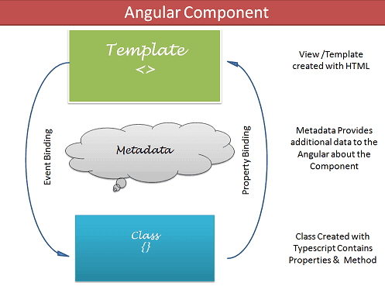
The Components consist of three main building blocks
Template
Class
MetaData

Slide 5
1) Template (View)
The Template defines the layout and content of the View. Without the template, there is nothing for Angular to render to the DOM.
The Templates are only HTML codes and the Angular-specific special HTML markups (known as the Angular Template Syntax).
You can add Angular directives, Angular Pipes & Other Angular Components on the template.
The data to Template comes from the Component, which gets it from an Angular Service. We can keep the Template in sync with the Component using the data binding techniques.
The templates can use Event Binding or two-way data binding to notify the component when the user changes something on the View.
There are two ways you can specify the Template in Angular.
Defining the Template Inline
Provide an external Template

Slide 6
2 ) Class
The Class provides the data & logic to the View. It contains the Typescript code associated with Template (View). We use TypeScript to create the class.
Class Contains the Properties & Methods. The Properties of a class can be bound to the view using Data Binding.
The simple Angular Class
export class AppComponent
{
title : string ="app"
}

Slide 7
3)Metadata
Metadata Provides additional information about the component of Angular. Angular uses this information to process the class. We use the @Component decorator to provide the Metadata to the Component.
@Component decorator
A decorator is a function that adds metadata to a class, its methods & to its properties. The Components are defined with a @Component class decorator.
When Angular sees a class with @Component decorator, it treats the class as a Component.

Slide 8
Important Component metadata properties
Selector
Selector specifies the simple CSS selector. The Angular looks for the CSS selector in the template and renders the component there.
Providers
The Providers are the Angular Services that our component is going to use. The Services provide service to the Components or to the other Services.
Directives
The directives that this component going to use are listed here.
Styles/styleUrls
The CSS styles or style sheets that this component needs. Here we can use either an external stylesheet (using styleUrls) or inline styles (using Styles). The styles used here are specific to the component
template/templateUrl
The HTML template that defines our View. It tells Angular how to render the Component’s view. The templates can be inline (using a template) or we can use an external template (using a templateUrl). The Component can have only one template. You can either use an inline template or an external template, and not both.

Slide 9
What is Angular Data Binding?
Data binding is a technique, where the data stays in sync between the component and the view. Whenever the user updates the data in the view, Angular updates the component. When the component gets new data, the Angular updates the view.
1 One way binding
To bind data from component to view, we make use of Interpolation & Property Binding.
A ) Interpolation allows us to include expressions as part of any string literal, which we use in our HTML. The angular evaluates the expressions into a string and replaces it in the original string and updates the view. You can use interpolation wherever you use a string literal in the view
{{ templateExpression }}
The content inside the double braces is called Template Expression
B )Property binding
The Property binding allows us to bind HTML element property to a property in the component. Whenever the value of the component changes, the Angular updates the element property in the View. You can set the properties such as class, href, src, textContent, etc using property binding. You can also use it to set the properties of custom components or directives (properties decorated with @Input).

Slide 10
The Property Binding uses the following Syntax
[binding-target]=”binding-source”
<p [style.color]="getColor()">Hello I am in red color</p>
<p [style.color]="getColor()"
[style.font-size.px]="'20'"
[style.background-color]="status=='error' ? 'white': 'blue'">
paragraph with multiple styles
</p>
<div [ngClass]="'primary big'">This is an example of ngClass binding</div>
<div [ngStyle]="{'font-size':getSize()}">This is an example of ngStyle binding</div>

Slide 11
C:Event Binding
Event binding allows us to bind events such as keystroke, clicks, hover, touche, etc to a method in component. It is one way from view to component. By tracking the user events in the view and responding to it, we can keep our component in sync with the view. For Example, when the user changes to an input in a text box, we can update the model in the component, run some validations, etc. When the user submits the button, we can then save the model to the backend server.
The Angular event binding consists of two parts
1 2 3 | (target-event)="TemplateStatement"
We enclose the target event name in parentheses on the left side
Assign it to a template statement within a quote on the right side

Slide 12
Template reference variable
We can also make use of the template reference variable to pass the value instead of $event.
In the template
<h2>Template Reference Variable</h2>
<input #el (input)="handleInput1(el)">
<p>You have entered {{val}}</p>
Source Code
1 2 3 4 5 6 7 | val=""; handleInput1(element) { this.val=element.value; }

Slide 13
$event Payload
DOM Events carries the event payload. I.e the information about the event. We can access the event payload by using $event as an argument to the handler function.
<input (input)="handleInput($event)">
<p>You have entered {{value}}</p>
And in the component
value=""
handleInput(event) {
this.value = (event.target as HTMLInputElement).value;
}
The properties of a $event object vary depending on the type of DOM event. For example, a mouse event includes different information than an input box editing event.

Slide 14
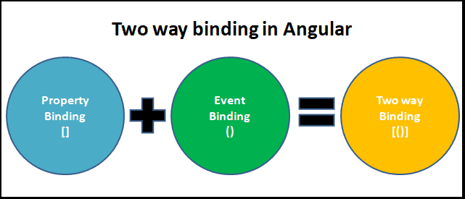
ngModel & Two way Data binding in Angular
The ngModel is a built-in directive and is part of the FormsModule. The Two-way binding uses the syntax [()]
What is Two way data binding?
Two way data binding means that changes made to our model in the component are propagated to the view and that any changes made in the view are immediately updated in the underlying component data.
The two way data binding is nothing but both property binding & event binding applied together. Property Binding is one way from component to view. The event binding is one way from view to component. If we combine both we will get the Two-way binding.

Slide 15
Two-way binding syntax
The above example uses the event & property binding combination to achieve the two-way binding. But Angular does provide a way to achieve the two-way binding using the syntax [()]. Note that both square & parentheses are used here. This is now known as Banana in a box syntax.
Syntax:
<someElement [(someProperty)]="value"></someElement>

Slide 16
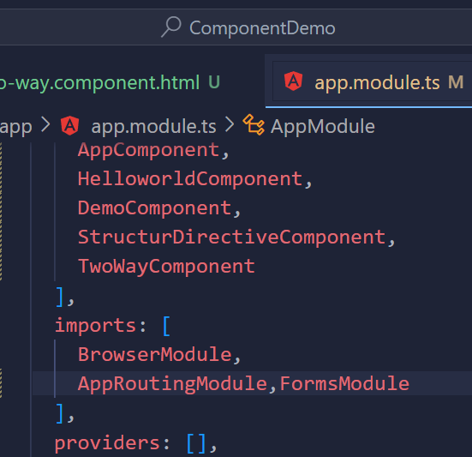
ngModel Example:
Step 1 Import FormsModule in App.Module.ts and in component
Step 2 : Add it in imports list of App.Modules.ts as shown in pic
Step 3: write code as follows
<div class="jumbotron">
<h2>Example 2</h2>
<input type="text" name="value" [(ngModel)]="Teachername">
<p> You entered {{Teachername}}</p>
<button (click)="clearValue()">Clear</button>
</div>
Source Code :
Teachername="";
clearValue() {
this.Teachername="";
}

Slide 17
ng generate Command
The ng generate command is used to generate and/or modify file based on schematic.
ng generate <schematic> [options]
ng g <schematic> [options]
Parameter Explanation:
<schematic >: It specifies the schematic or collection:schematic which you want to generate. It can take one of the following sub-commands.
appShell
application
class
component
directive
enum
guard
interface
library
module
pipe
service
serviceWorker
universal

Slide 18
Thank You

