Slide 1
Blazor
Sarita Lad
DATE

Slide 2
Blazor Introduction
Blazor project structure
Blazor fundamentals
Blazor Components
Blazor Model Class
Blazor Hosting Models
Routing
Event Handling
Data Binding
Blazor Event Callback
Identity Setup in Blazor
Authentication
Security & Identity

Slide 3
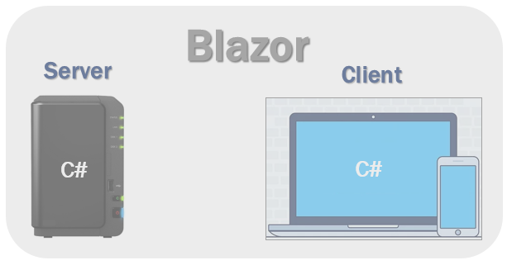
What is Blazor?
Blazor is a feature of ASP.NET for building interactive web UIs using C# instead of JavaScript. It's real .NET running in the browser on WebAssembly.
Well, we can and that's exactly why we use Blazor. With Blazor we can now build interactive web UIs using C# instead of JavaScript. C# code can be executed both on the server and in the client browser. This means existing .Net developers can reuse their c# skills rather than learning new JavaScript frameworks and their huge learning curve.

Slide 4
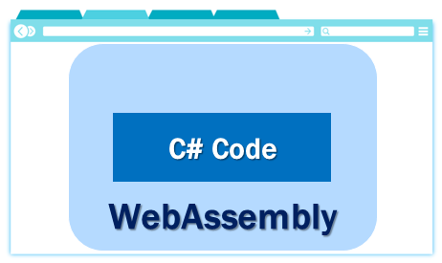
How can a browser execute C# code?
Blazor can run C# code directly in the browser, using WebAssembly. It runs in the same security sandbox as JavaScript frameworks like Angular, React, Vue etc. Not just C#, in fact, we can run any type of code in the browser using WebAssembly.
(-Interoperability)
WebAssembly is based on open web standards. So it is a native part of all modern browsers including mobile browsers. This means for the blazor application to work, there is no need to install any special plugin like back in the days of silver light and flash.

Slide 5
Blazor hosting models
Blazor offers 2 hosting models.
Blazor Server
Blazor WebAssembly
1 Blazor Server Hosting Model:-
This is also called the server hosting model and in this model, the application is executed on the server from within an ASP.NET Core application. Between the client and the server, a SignalR connection is established.When an event occurs on the client such as a button click, for example, the information about the event is sent to the server over the SignalR connection.
The server handles the event and for the generated HTML a diff (difference) is calculated. The entire HTML is not sent back again to the client, it's only the diff that is sent to the client over the established SignalR connection. The browser then updates the UI. Blazor embraces the single page application architecture which rewrites the same page dynamically in response to the user action. Since only the diff is applied to update the UI, the application feels faster and more responsive to the user.

Slide 6
2 Blazor WebAssembly (js-interopability)
This is also called the client-side hosting model and in this model, the application runs directly in the browser on WebAssembly. So, everything the application needs i.e the compiled application code itself, it's dependencies and the .NET runtime are downloaded to the browser.
We use the Blazor WebAssembly App template, to create a Blazor application with the client-side hosting model.
It is the Javascript InterOp responsible to execute the code:
The dotnet Runtime executes the C# code which is downloaded and then it is converted into js code , which is supported by the Browser.
It is just like we execute C PLUS PLUS code in dotnet by using COM interoperability . Here the Blazor.webAssembly.js is the interoperOP responsible to convert C# code into Javascript code.

Slide 7
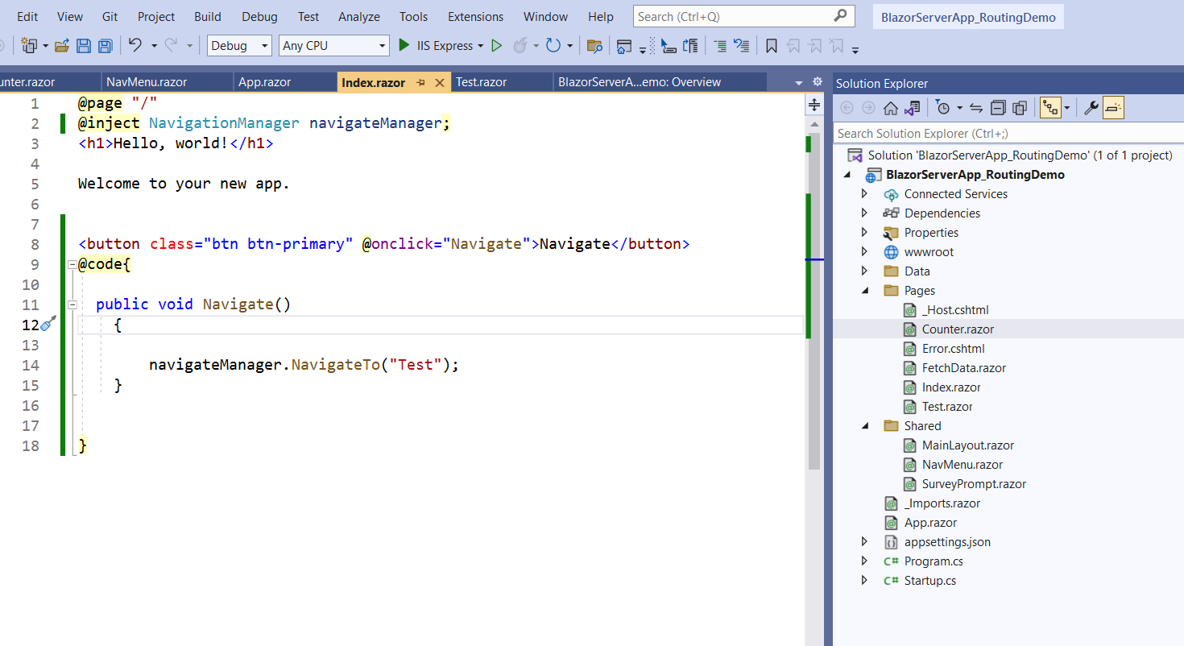
Blazor project structure

Slide 8
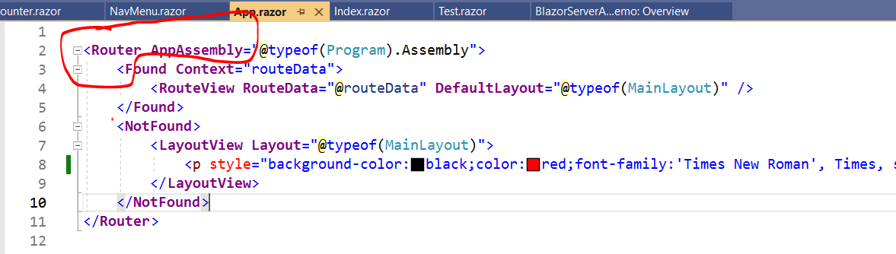
Routing in Blazor :App.Razor Component
This is the root component of the application. It uses the built-in Router component and sets up client-side routing. It is this Router component that intercepts browser navigation and renders the page that matches the requested address. The Router uses the Found property to display the content when a match is found. If a match is not found, the NotFound property is used to display the message - Sorry, there's nothing at this address.

Slide 9
Pages folder
This folder contains the _Host razor page and the routable components that make up the Blazor app. The components have the .razor extension.
Index component (Index.razor) – Rendered when we navigate to the root application URL.
Counter component (Counter.razor) – Rendered when we navigate to the path /counter.
FetchData component (FetchData.razor) – Rendered when we navigate to the path /fetchdata.
Error component (Error.razor) – Rendered when an unhandled exception occurs in the blazor app.

Slide 10
Shared folder
As the name implies, contains the shared components
MainLayout component (MainLayout.razor)
The application's main layout component
NavMenu component (NavMenu.razor)
_Imports.razor
wwwroot/index.html [Only in Blazor WebAssembly Template ]
This is the root page in a Blazor WebAssembly project and is implemented as an html page.

Slide 11
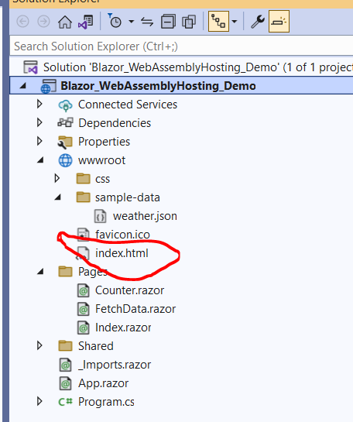
wwwroot/index.html
This is the root page in a Blazor WebAssembly project and is implemented as an html page. When a first request hits the application, it is this page, that is initially served. It has the standard HTML, HEAD and BODY tags. It specifies where the root application component App.razor should be rendered. You can find this App.razor root component in the root project folder

Slide 12
This index.html page also loads the blazor WebAssembly JavaScript file (_framework/blazor.webassembly.js). It is this file that is responsible for downloading
The compiled blazor application, it's dependencies and the .NET runtime
It also initializes the runtime to run the blazor app in the browser
Startup.cs
This file is present only in the Blazor Server project. As the name implies it contains the applications's startup logic. The Startup class contains the following two methods.
ConfigureServices - Configures the applications DI i.e dependency injection services.
AddServerSideBlazor()
Configure - Configures the app's request processing pipeline.

Slide 13
Pages/_Host.cshtml
This is the root page of the application and is specified by calling MapFallbackToPage("/_Host") method.
It is implemented as a razor page.
It is this page, that is initially served when a first request hits the application. It has the standard HTML, HEAD and BODY tags. It also specifies where the root application component, App component (App.razor) must be rendered.
Finally, it also loads the blazor.server.js JavaScript file, which sets up the real-time SignalR connection between the server and the client browser. This connection is used to exchange information between the client and the server. SignalR, is a great framework for adding real-time web functionality to apps.

Slide 14
Pages/_Host.cshtml-------→ present only in server model
This is the root page of the application and is specified by calling MapFallbackToPage("/_Host") method. It is implemented as a razor page.
It is this page, that is initially served when a first request hits the application. It has the standard HTML, HEAD and BODY tags. It also specifies where the root application component, App component (App.razor) must be rendered. Finally, it also loads the blazor.server.js JavaScript file, which sets up the real-time SignalR connection between the server and the client browser. This connection is used to exchange information between the client and the server. SignalR, is a great framework for adding real-time web functionality to apps.

Slide 15
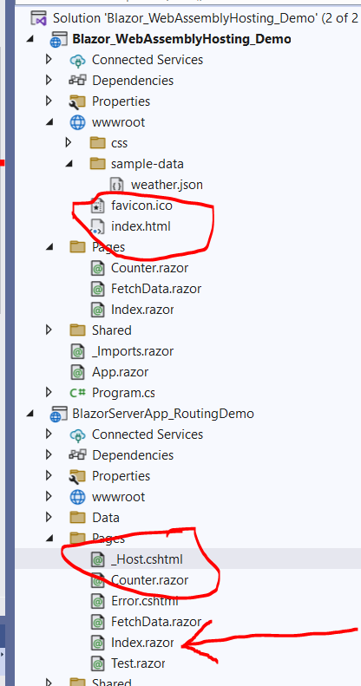
Difference between 2 project structures

Slide 16
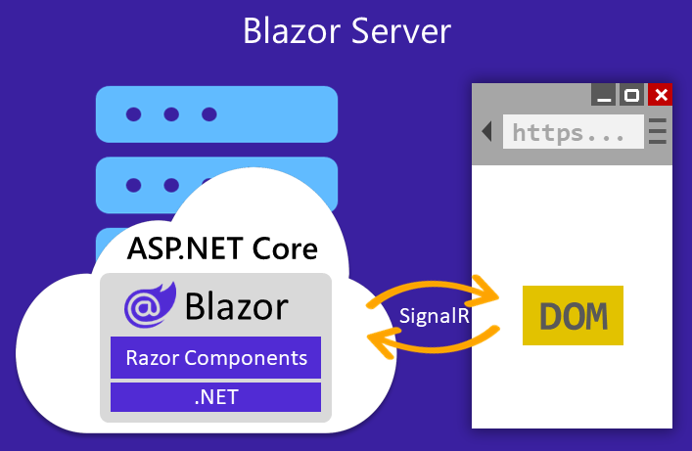
Blazor Server hosting model
On the client, the Blazor script (blazor.server.js) establishes the SignalR connection with the server. The script is served to the client-side app from an embedded resource in the ASP.NET Core shared framework. The client-side app is responsible for persisting and restoring app state as required.
The server handles the event and for the generated HTML a diff (difference) is calculated. The entire HTML is not sent again to the client, it's only the diff that is sent to the client over the SignalR connection. The browser then updates the UI. Since only the diff is applied to update the UI, the application feels faster and more responsive to the user.

Slide 17
The Blazor Server hosting model offers several benefits:
Download size is significantly smaller than a Blazor WebAssembly app, and the app loads much faster.
The app takes full advantage of server capabilities, including the use of .NET Core APIs.
.NET Core on the server is used to run the app, so existing .NET tooling, such as debugging, works as expected.
Thin clients are supported. For example, Blazor Server apps work with browsers that don't support WebAssembly and on resource-constrained devices.
The app's .NET/C# code base, including the app's component code, isn't served to clients.
The Blazor Server hosting model has the following limitations:
Higher latency usually exists. Every user interaction involves a network hop.
There's no offline support. If the client connection fails, the app stops working.
Scaling apps with many users requires server resources to handle multiple client connections and client state.
An ASP.NET Core server is required to serve the app. Serverless deployment scenarios aren't possible, such as serving the app from a Content Delivery Network (CDN).
We recommend using the Azure SignalR Service for Blazor Server apps. The service allows for scaling up a Blazor Server app to a large number of concurrent SignalR connections.

Slide 18
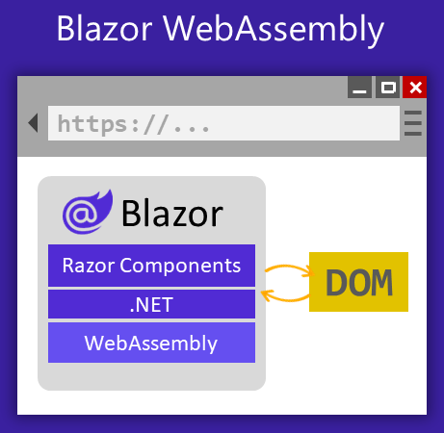
When the Blazor WebAssembly app is created for deployment without a backend ASP.NET Core app to serve its files, the app is called a standalone Blazor WebAssembly app. When the app is created for deployment with a backend app to serve its files, the app is called a hosted Blazor WebAssembly app.
The blazor.webassembly.js script is provided by the framework and handles:
Downloading the .NET runtime, the app, and the app's dependencies.
Initialization of the runtime to run the app.

Slide 19
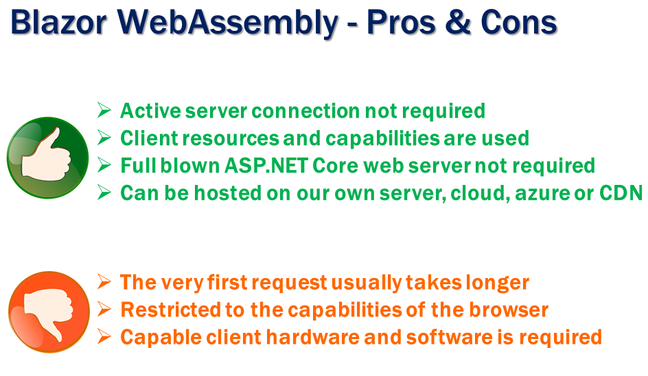
An ASP.NET Core web server isn't required to host the app. Serverless deployment scenarios are possible, such as serving the app from a Content Delivery Network (CDN).

Slide 20
Performance improvement
1 Blazor WebAssembly includes support for trimming unused code from .NET Core framework libraries.2 When a Blazor WebAssembly app is published, the output is statically compressed during publish to reduce the app's size and remove the overhead for runtime compression. The .NET compiler further precompresses a Blazor WebAssembly app for a smaller app payload.
3 caching all assemblies in browser.

Slide 21
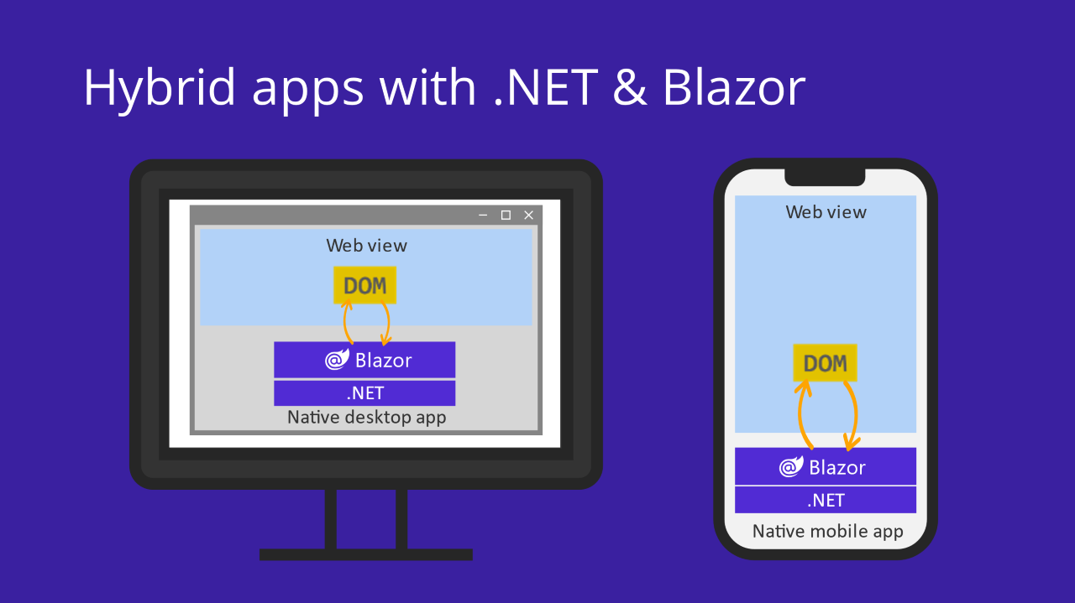
Blazor Hybrid
Blazor can also be used to build native client apps using a hybrid approach. Hybrid apps are native apps that leverage web technologies for their functionality. In a Blazor Hybrid app, Razor components run directly in the native app (not on WebAssembly) along with any other .NET code and render web UI based on HTML and CSS to an embedded Web View control through a local interop channel.

Slide 22
Blazor Hybrid App
Blazor Hybrid apps can be built using different .NET native app frameworks, including .NET MAUI, WPF, and Windows Forms. Blazor provides BlazorWebView controls for adding Razor components to apps built with these frameworks.
Using Blazor with .NET MAUI offers a convenient way to build cross-platform Blazor Hybrid apps for mobile and desktop,
Blazor integration with WPF and Windows Forms can be a great way to modernize existing apps.
Blazor Hybrid apps combine the benefits of the web, native apps, and the .NET platform.

Slide 23
The Blazor Hybrid hosting model offers several benefits:
Reuse existing components that can be shared across mobile, desktop, and web.
Leverage web development skills, experience, and resources.
Apps have full access to the native capabilities of the device.
The Blazor Hybrid hosting model has the following limitations:
Separate native client apps must be built, deployed, and maintained for each target platform.
Native client apps usually take longer to find, download, and install than accessing a web app in a browser.

Slide 24
Component in Blazor
A component's name must start with an uppercase character:
Components are implemented using a combination of C# and HTML markup in Razor component files with the .razor file extension.
ComponentBase defines component properties and methods for basic functionality
Razor syntax
Components use Razor syntax. Two Razor features are extensively used by components, directives and directive attributes.
Directives: Change the way component markup is parsed or functions.
For example, the @page directive specifies a routable component with a route template and can be reached directly by a user's request in the browser at a specific URL.
Directive attributes: Change the way a component element is parsed or functions.
For example, the @bind directive attribute for an <input> element binds data to the element's value.

Slide 25
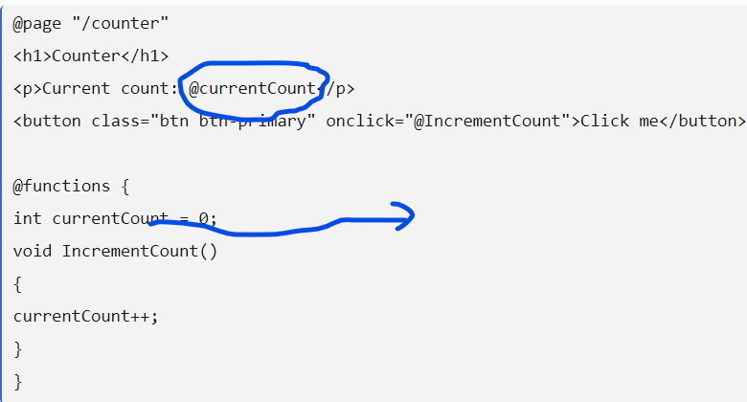
One-way data binding
One-way data binding in Blazor is the process of rendering the View as per the value in the Model. Sometime the Model can be just a property or a simple variable.

Slide 26
Blazor Data Binding : One-way, Two-way and Event Binding
As Blazor is an SPA framework, it supports features like components, one-way & two-way data binding etc. An application built with Blazor, runs completely in the browser. Blazor supports 3 kinds of data binding
One-way data binding
Two-way data binding
Event binding

Slide 27
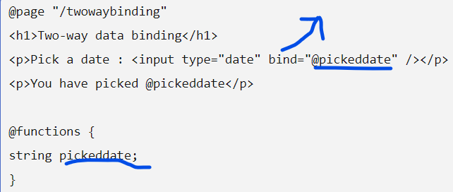
Two-way data binding
In two-way data binding, any changes in the Model gets reflected in the View and similarly any changes in the View gets reflected in the View automatically. This is done using attribute bind

Slide 28
ASP.NET Core Blazor cascading values and parameters
Cascading values and parameters provide a convenient way to flow data down a component hierarchy from an ancestor component to any number of descendent components
Chained Bind – Binding between Parent & Child components
Chained Bind is a custom two-way Data Binding between Parent and Child Razor Components. Here, a binding of a child razor component’s property is done

Slide 29
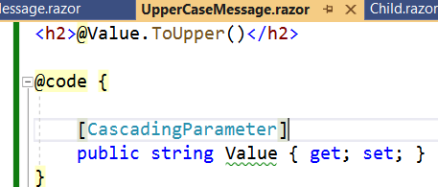
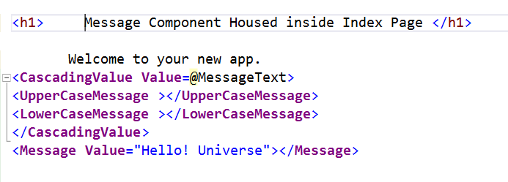
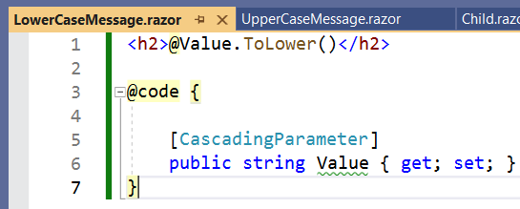
we explicitly set a parameter value from the parent component. This means if we want to pass a value to, say, ten components, we must set a parameter of all the ten components. In such cases Cascading Parameters and Cascading Values come handy
Index.razor.

Slide 30
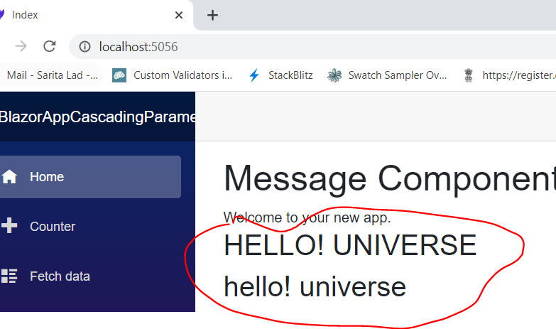

Slide 31
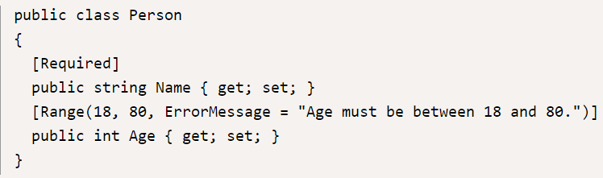
Validation in Blazor
The DataAnnotationsValidator is the standard validator type in Blazor. Adding this component within an EditForm component will enable form validation based on .NET attributes descended from System.ComponentModel.DataAnnotations.ValidationAttribute.
First, create a model we can edit, and decorate its properties with some data annotations for validation.

Slide 32
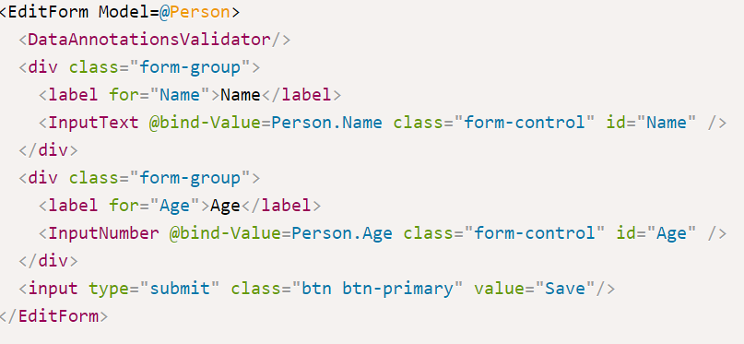
Adding validation
Add a DataAnnotationsValidator component inside the EditForm component.

Slide 33
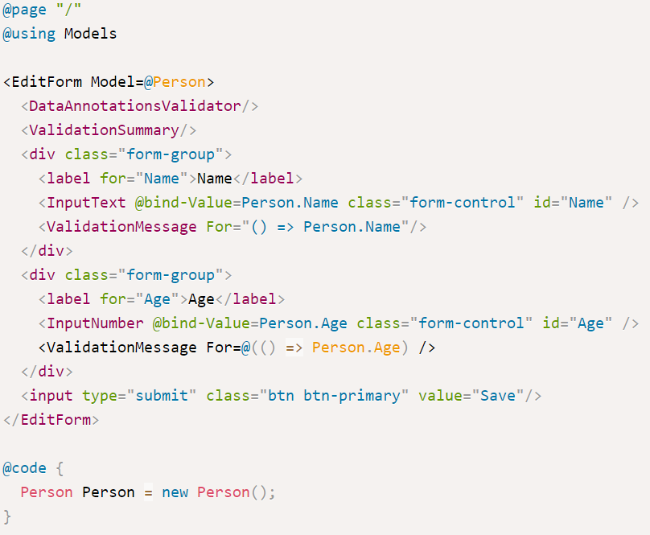
Displaying validation error messages
Validation error messages can be displayed to the user in two ways. We can add a ValidationSummary to show a comprehensive list of all errors in the form. We can also use the ValidationMessage component to display error messages for a specific input on the form. These components are not mutually exclusive, so it is possible to use both at the same time.

Slide 34
Event Binding
Blazor’s latest version now supports events to a greater extent as compared to the earlier version which was limited to just onclick, onchange and onkeypress events. The attribute for event in an HTML element starts with “on” and follows the format on. The delegate typed value of the attribute is treated as an event handler. Blazor supports following event arguments :
UIEventArgs
UIChangeEventArgs
UIKeyboardEventArgs
UIMouseEventArgs

Slide 35
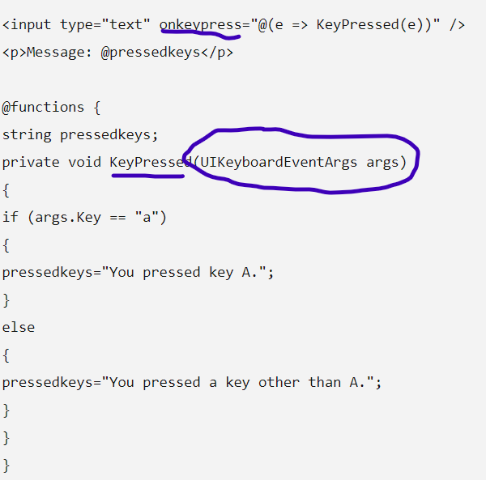
Example : onKeyPressed
Let’s see how to capture values on event via event arguments.

Slide 36
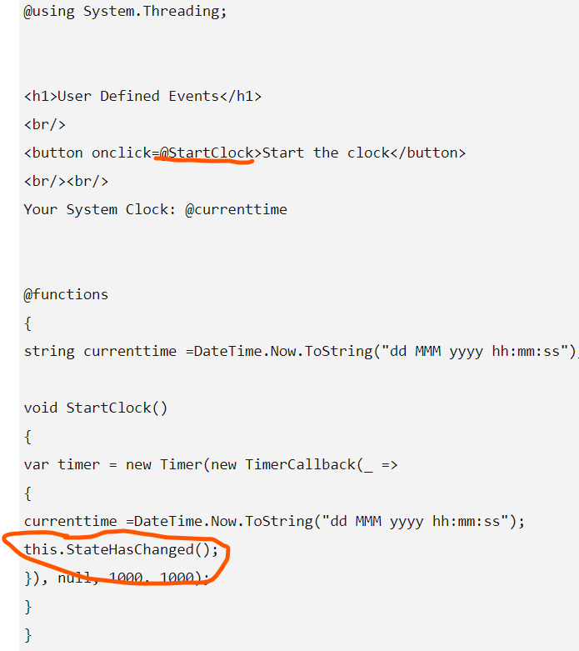
User-defined events
Example
While developing a single page application, you might sometime need to define your own event. In such cases, you may need to manually trigger the UI refresh. To do that, we need to call BlazorComponent.StateHasChanged.

Slide 37
Router & Route template
The routing process is usually carried out by a router and Blazor is equipped with a client-side router. The <router> component is responsible for the routing task and is used by the root component in App.cshtml file, available for configuring.
RouteAttribute (Microsoft.AspNetCore.Blazor.Components.RouteAttribute) defines a route template and can be used in two ways i.e,
1 using @Page directive for the cshtml pages
2 using attributes in components which are written in pure C#
Example : @page "/counter"
Components written in pure C# may use attribute for defining the route template in the following manner.
[RouteAttribute("/CounterBusiness")]

Slide 38
Route Parameters
Route parameters help in sending a parameter to the components while they are being accessed. The parameters are defined in the route template enclosed in a pair of curly brackets as in the following example:
Example :
@page "/welcome-back/{youngman}"
In Blazor, it needs a property with the same name as the parameter defined in the route template
We need to add an [Parameter] attribute to the property

Slide 39
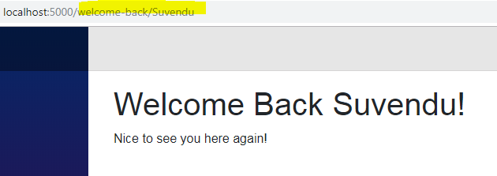
@page "/welcome"
@page "/welcome-back/{youngman}"
<h1>Welcome Back @yourname </h1>
<p>Nice to see you here again! </p>
@functions{
private string _ youngman;
[Parameter]
private string youngman
{
get {
return _ youngman ==null ? string.Empty : _ yougman +"!";
}
set { _ youngman = value;}
}
}

Slide 40
Life Cycle of Component in Blazor:
Component lifecycle events:
If the component is rendering for the first time on a request:
Create the component's instance.
Perform property injection. Run SetParametersAsync.
Call OnInitialized{Async}. If an incomplete Task is returned, the Task is awaited and then the component is rerendered.
Call OnParametersSet{Async}. If an incomplete Task is returned, the Task is awaited and then the component is rerendered.
Render for all synchronous work and complete Tasks.

Slide 41
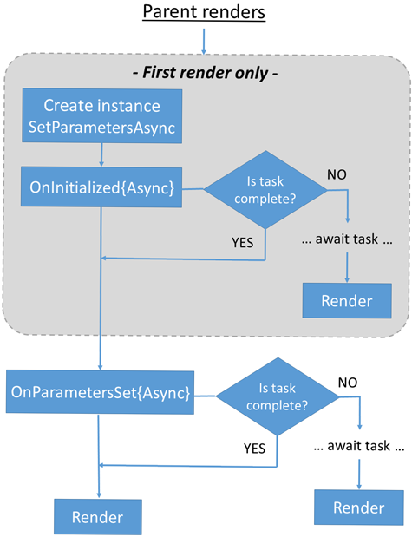
A parent component renders before its children components because rendering is what determines which children are present. If synchronous parent component initialization is used, the parent initialization is guaranteed to complete first. If asynchronous parent component initialization is used, the completion order of parent and child component initialization can't be determined because it depends on the initialization code running.

Slide 42
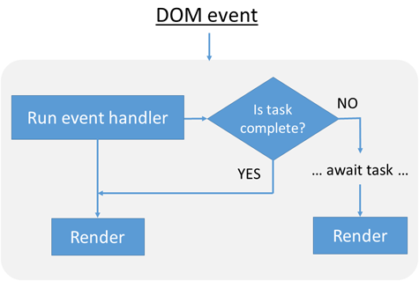
Document Object Model (DOM) event processing:
The event handler is run.
If an incomplete Task is returned, the Task is awaited and then the component is rerendered.
Render for all synchronous work and complete Tasks.

Slide 43
Dynamically-rendered ASP.NET Core Razor components
Use the built-in Dynamic Component component to render components by type.
Dynamic Component can render a component based on a user selection from ex: a dropdown list or button click.
componentType specifies the type.
parameters specifies component parameters to pass to the componentType component.

Slide 44
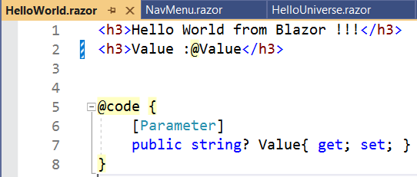
Dynamic Component :Rendered from mainComponent
<button @onclick="OnHelloWorldClick">Hello World!</button>
<DynamicComponent Type="@dyncompType" Parameters="@dyncompParams"/>
public void OnHelloWorldClick()
{
dyncompParams = new Dictionary<string, object>()
{
{"Value","This is a value for Hello World component." }
};
dyncompType = typeof(HelloWorld);
}

Slide 45
Lazy load assemblies in ASP.NET Core Blazor WebAssembly
1 Blazor WebAssembly app startup performance can be improved by waiting to load app assemblies until the assemblies are required, which is called lazy loading.
Blazor's Router component designates the assemblies that Blazor searches for routable components and is also responsible for rendering the component for the route where the user navigates. The Router component's OnNavigateAsync method is used in conjunction with lazy loading to load the correct assemblies for endpoints that a user requests.
Logic is implemented inside OnNavigateAsync to determine the assemblies to load with LazyAssemblyLoader. Options for how to structure the logic include:
Conditional checks inside the OnNavigateAsync method.
A lookup table that maps routes to assembly names, either injected into the component or implemented within the @code block.

Slide 46
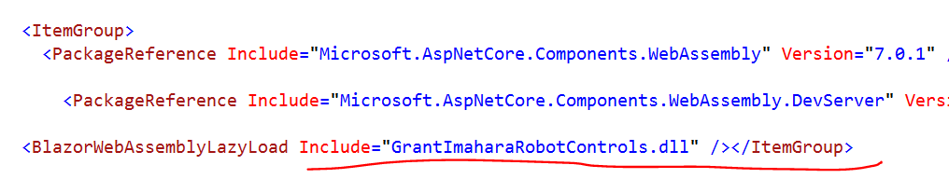
Lazy Loading
Project file configuration
Mark assemblies for lazy loading in the app's project file (.csproj) using the BlazorWebAssemblyLazyLoad item. Use the assembly name with the .dll extension. The Blazor framework prevents the assembly from loading at app launch.

Slide 47
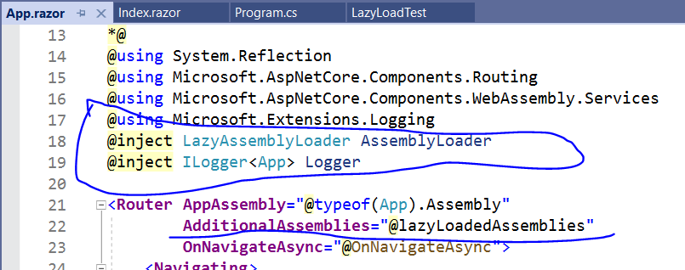
Router component configuration
The Blazor framework automatically registers a singleton service for lazy loading assemblies in client-side Blazor WebAssembly apps†, LazyAssemblyLoader. The LazyAssemblyLoader.LoadAssembliesAsync method:
Uses JS interop to fetch assemblies via a network call.
Loads assemblies into the runtime executing on WebAssembly in the browser.

Slide 48
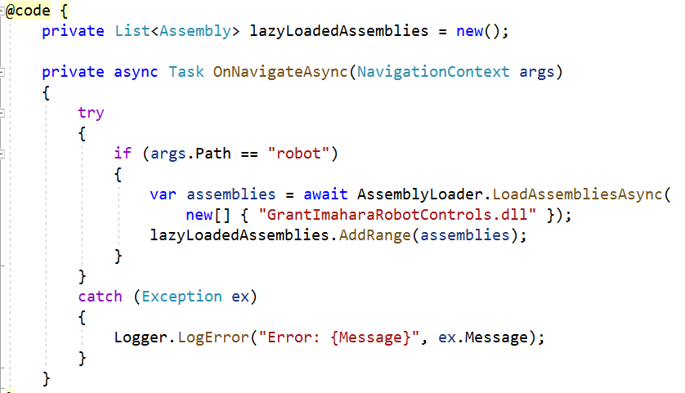
The namespace for Microsoft.AspNetCore.Components.WebAssembly.Services is specified.
The LazyAssemblyLoader service is injected (AssemblyLoader).
The {PATH} placeholder is the path where the list of assemblies should load. The example uses a conditional check for a single path that loads a single set of assemblies.
The {LIST OF ASSEMBLIES} placeholder is the comma-separated list of assembly filename strings, including their .dll extensions (for example, "Assembly1.dll", "Assembly2.dll").

Slide 49
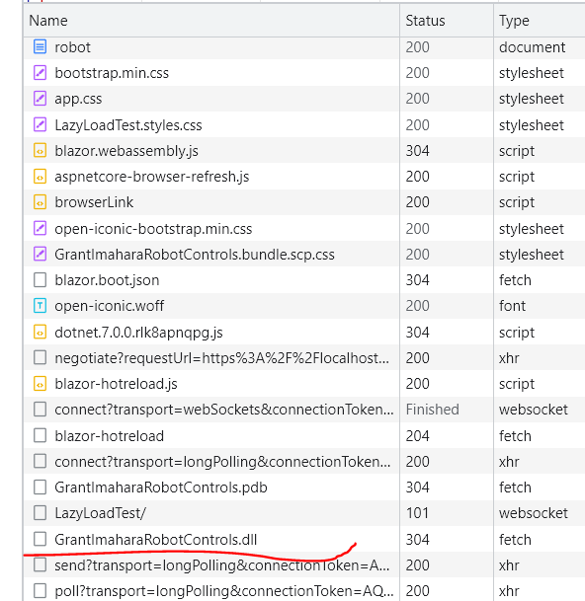
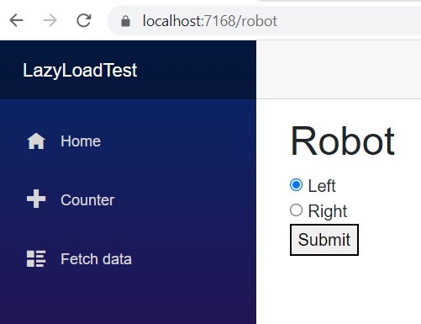
Lazy loaded assembly Gran….

Slide 50
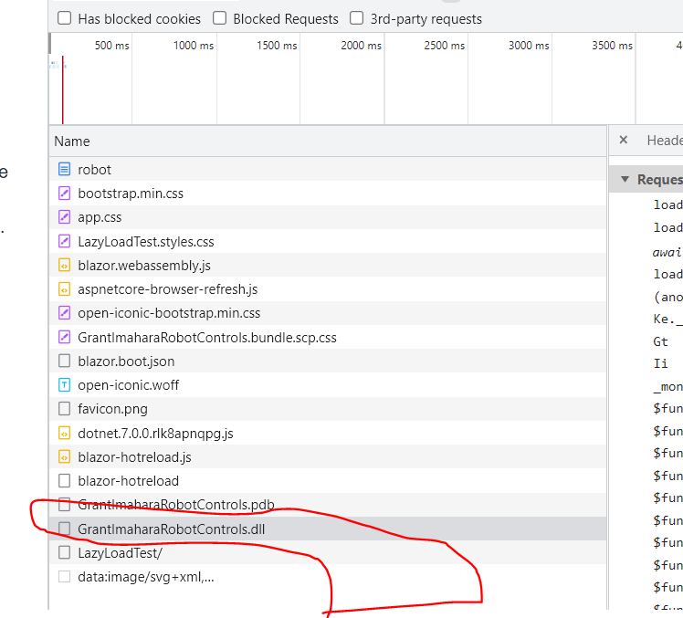
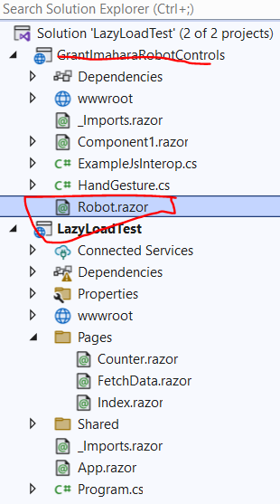

Slide 51
ASP.NET Core Blazor Progressive Web Application (PWA)
A Blazor Progressive Web Application (PWA) is a single-page application (SPA) that uses modern browser APIs and capabilities to behave like a desktop app.
Blazor WebAssembly is a standards-based client-side web app platform, so it can use any browser API, including PWA APIs required for the following capabilities:
Working offline and loading instantly, independent of network speed.
Running in its own app window, not just a browser window.
Being launched from the host's operating system start menu, dock, or home screen.
Receiving push notifications from a backend server, even while the user isn't using the app.
Automatically updating in the background.

Slide 52
What is meant by word Progressive?
The word progressive is used to describe these apps because:
A user might first discover and use the app within their web browser like any other SPA.
Later, the user progresses to installing it in their OS and enabling push notifications.
STEP 1 :.Net CLI command to create Progressive Web App:
dotnet new blazorwasm -o MyBlazorPwa –pwa
STEP 2: COPY FOLLOWING LINK TO HEAD SECTION OF INDEX.HTML IN wwwroot folder
STEP 3:COPY FOLLOWING SCRIPT FILE TO LAST LINE IN INDEX.HTML IN wwwroot folder
<script>navigator.serviceWorker.register('service-worker.js');</script>

Slide 53
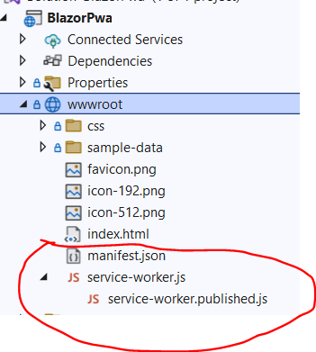
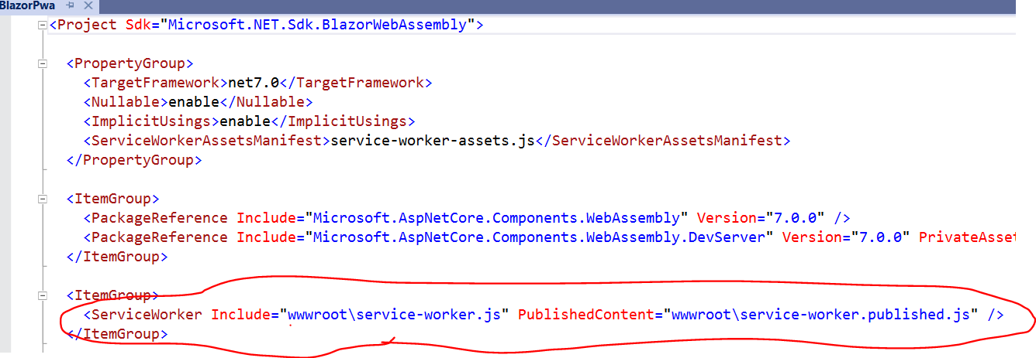
Project fIle ServiceWorker added
In wwwroot folder
manifest.json
Service-worker.js
Service-worker-published.js added

Slide 54
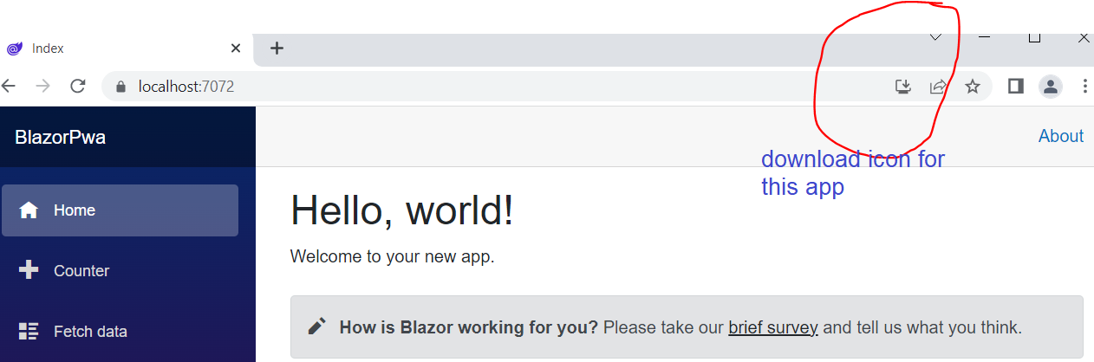
Output : installer icon for standalone of wpa

Slide 55
Thank You

