Slide 1
Middleware
Sarita Lad
DATE

Slide 2
Middleware ?
What are the ASP.NET Core Middleware Components?
The ASP.NET Core Middleware Components are the software components (technically components are nothing but the C# Classes) that are assembled into the application pipeline to handle the HTTP Requests and Responses. Each middleware component in ASP.NET Core Application performs the following tasks.

Slide 3
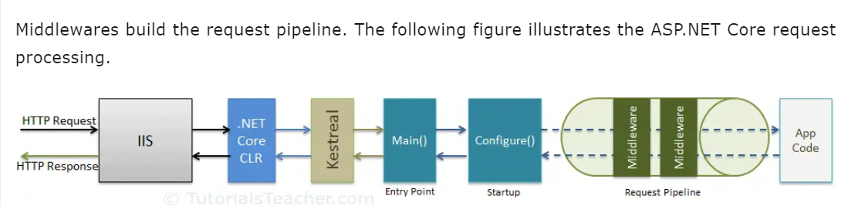

Slide 4
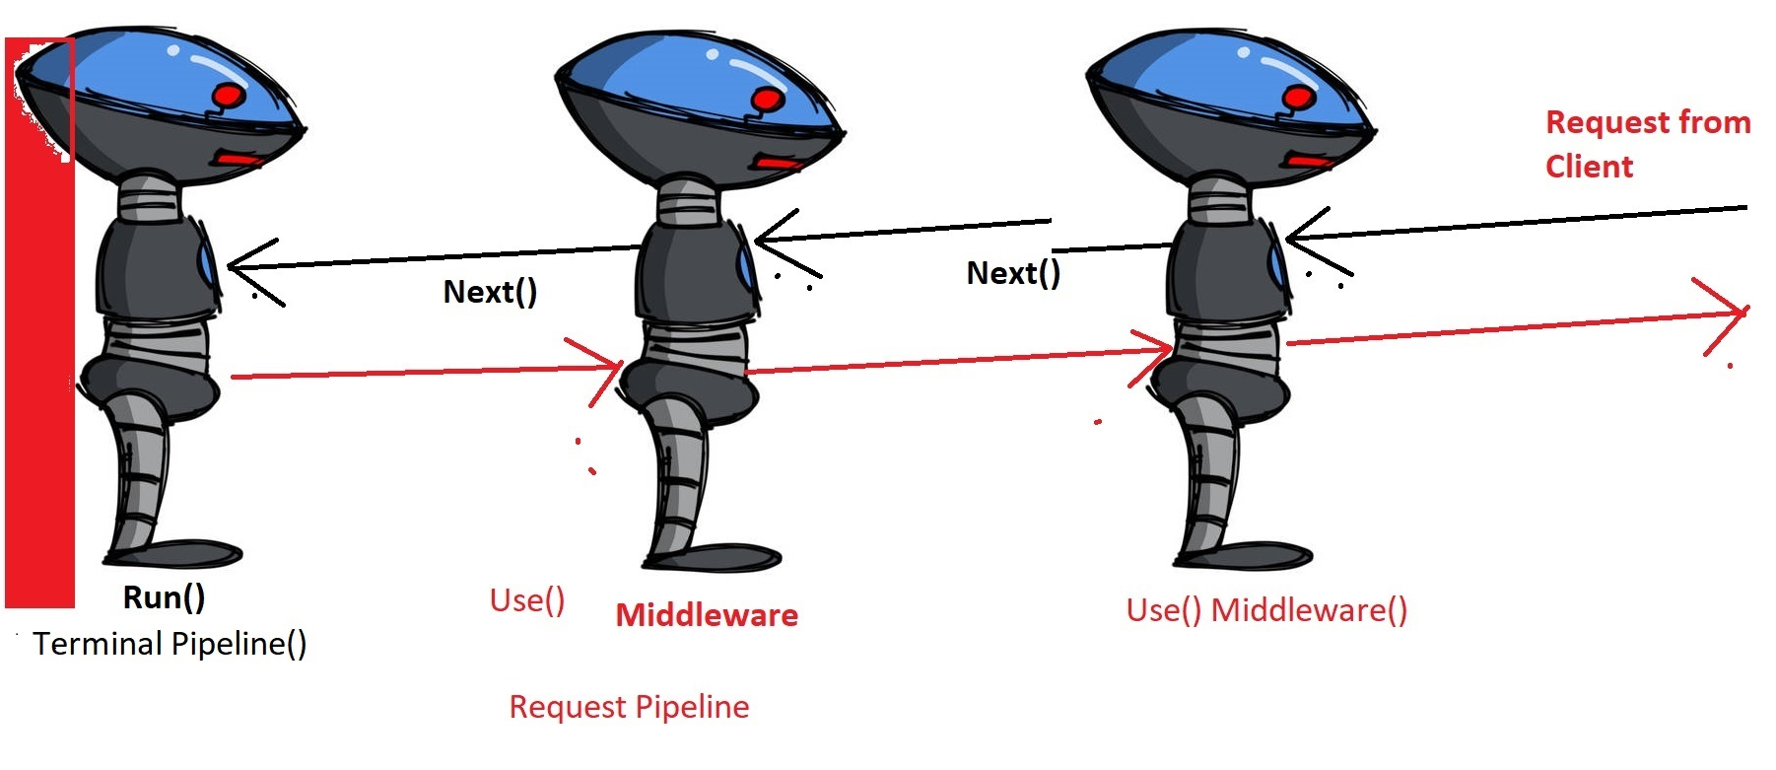

Slide 5
What are the types of middleware in NET Core?
Middleware | Description
Routing | Adds routing capabilities for MVC or web form
Session | Adds support for user session.
StaticFiles | Adds support for serving static files and directory browsing.
Diagnostics | Adds support for reporting and handling exceptions and errors.

Slide 6
UseStaticFiles() Middleware
What does UseStaticFiles () middleware do?
Static File Middleware (UseStaticFiles) returns static files and short-circuits further request processing

Slide 7
Middleware vs HttpModule and HttpHandler
We as ASP.NET developers are quite familiar with HttpHandler and HttpModules but with this new version of ASP.NET, they are gone. They are replaced with a new better, cleaner and easy to implement approach called “Middleware“. You can think of Middleware is a combination of HttpHandler and HttpModule.

Slide 8
Middleware vs HttpModule and HttpHandler
HttpModule | Middleware
HttpModules are configured via web.config or global.asax | Middleware are configured via code rather than web.config. ASP.NET Core 1.0 has Startup.cs file (entry point for application) where middlewares are added.
As a developer, you don’t have control on their order of execution. As order of modules is mainly based on application life cycle events. | Unlike modules, you are in full control of what get’s executed and in what order. As they are executed in the order in which they are added.
The execution order remains same for requests and responses. | Order of middleware for responses is the reverse from that for requests.
HttpModules helps you to attach code specific to a application events. | Middleware is independent of these events.
HttpModules are tied to System.web. | Middlewares are host independent.

Slide 9
Middleware vs HttpModule and HttpHandler
Built-in Middleware
ASP.NET Core 1.0 is shipped with the following Middleware components.
Authentication | Provides authentication support.
CORS | Configures Cross-Origin Resource Sharing.
Routing | Define and constrain request routes.
Session | Provides support for managing user sessions.
Routing | Provides support for serving static files, and directory browsing.
Diagnostics | Includes support for error pages and runtime information.

Slide 10
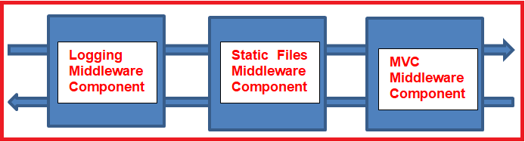
What is Middleware?
Configure() method in ASP.NET Core Startup class
The Configure method is a place where we can configure the application request pipeline for our asp.net core application using the IApplicationBuilder instance that is provided by the built-in IoC container.
ASP.NET Core introduced the middleware components to define a request pipeline, which will be executed on every request. You include only those middleware components which are required by your application and thus increase the performance of your application.

Slide 11
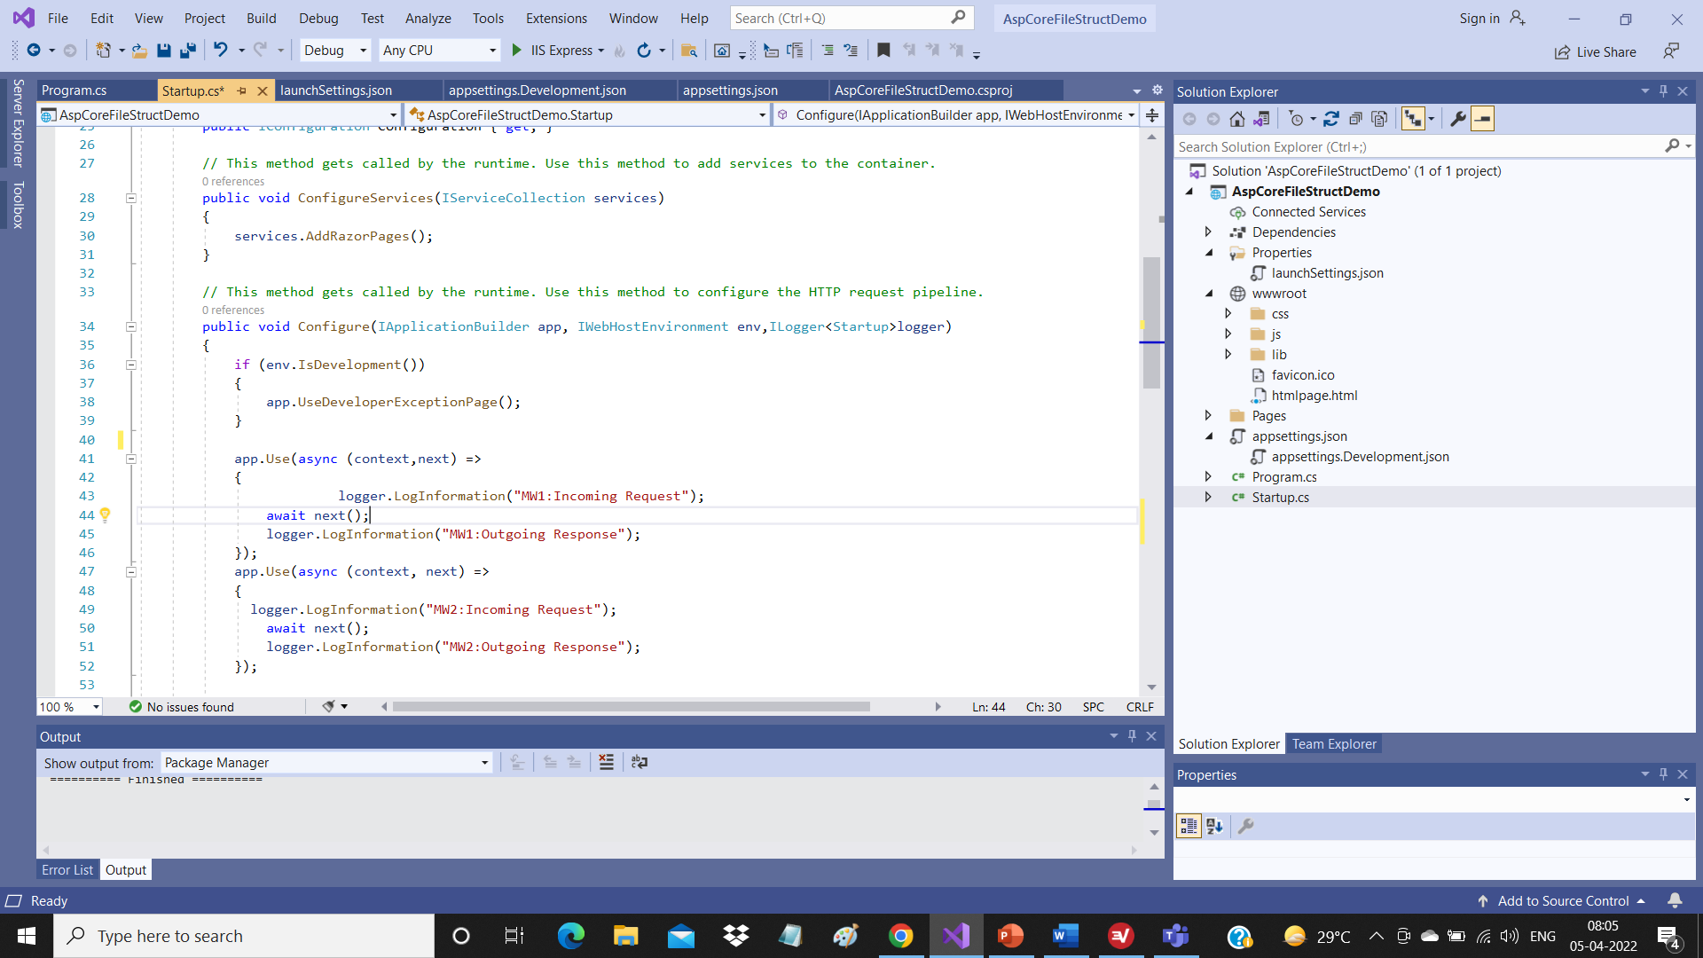
What is the Execution Order of Middleware Components in ASP.NET Core Application?
The ASP.NET Core middleware components are executed in the same order as they are added to the pipeline. So, we need to take care when adding the middleware components to the request processing pipeline.
As per your application’s business requirements, you may add any number of Middleware components. For example, if you are developing a static web application with some static HTML pages and images, then you may require only “StaticFiles” middleware components in the request processing pipeline.
But, if you are developing a secure dynamic data-driven web application then you may require several middleware components such as Logging Middleware, Authentication middleware, Authorization middleware, MVC middleware, etc.

Slide 12
What are Request Delegates in ASP.NET Core?
In ASP.NET Core, Request delegates are used to build the request pipeline i.e. request delegates are used to handle each incoming HTTP request. In ASP.NET Core, you can configure the Request delegates using the Run, Map, and Use extension methods. You can specify a request delegate using an in-line anonymous method (called in-line middleware) or you can specify the request delegates using a reusable class. These reusable classes and in-line anonymous methods are called middleware or middleware components. Each middleware component in the request processing pipeline is responsible for invoking the next component in the pipeline or short-circuiting the pipeline by not calling the next middleware component.

Slide 13
What is the use of the Use and Run method in ASP.NET Core Web Application?
In ASP.NET Core, you can use the “Use” and “Run” extension methods to register the Inline Middleware component into the Request processing pipeline. The “Run” extension method allows us to add the terminating middleware (the middleware which will not call the next middleware components in the request processing pipeline). On the other hand, the “Use” extension method allows us to add the middleware components which may call the next middleware component in the request processing pipeline.
As you can see, in the configure method, three middleware components are registered in the request processing pipeline using the IApplicationBuilder instance i.e. app. They are as follows
UseDeveloperExceptionPage() Middleware component
UseRouting()
UseEndpoints() Middleware component

Slide 14
DeveloperExceptionPage Middleware Component:
As you can see, within the configure method, the UseDeveloperExceptionPage() middleware component is registered into the pipeline and this middleware component will come into the picture only when the hosting environment is set to “development”. This middleware component is going to execute when there is an unhandled exception occurred in the application and since it is in development mode, it is going to show you the culprit line of code.
UseRouting() Middleware Component:
This middleware component is used to add Endpoint Routing Middleware to the request processing pipeline i.e. it will map the URL (or incoming HTTP Request) to a particular resource. We will discuss this in detail in our Routing articles.
UseEndpoints() Middleware Component:
In this middleware, the routing decisions are going to be taken using the Map extension method. Following is the default implementation of UseEndpoints middleware components. In the MapGet extension method, we have specified the URL pattern like “/”. This means the domain name only. So, any request with only the domain name is going to be handle by this middleware.

Slide 15
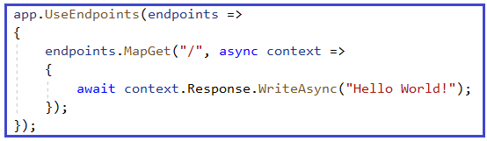
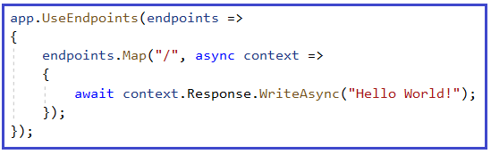
What is the difference between MapGet and Map method?
The MapGet method is going to handle the GET HTTP Requests whereas the Map method is going to handle all types of HTTP requests such as GET, POST, PUT, & DELETE, etc.

Slide 16
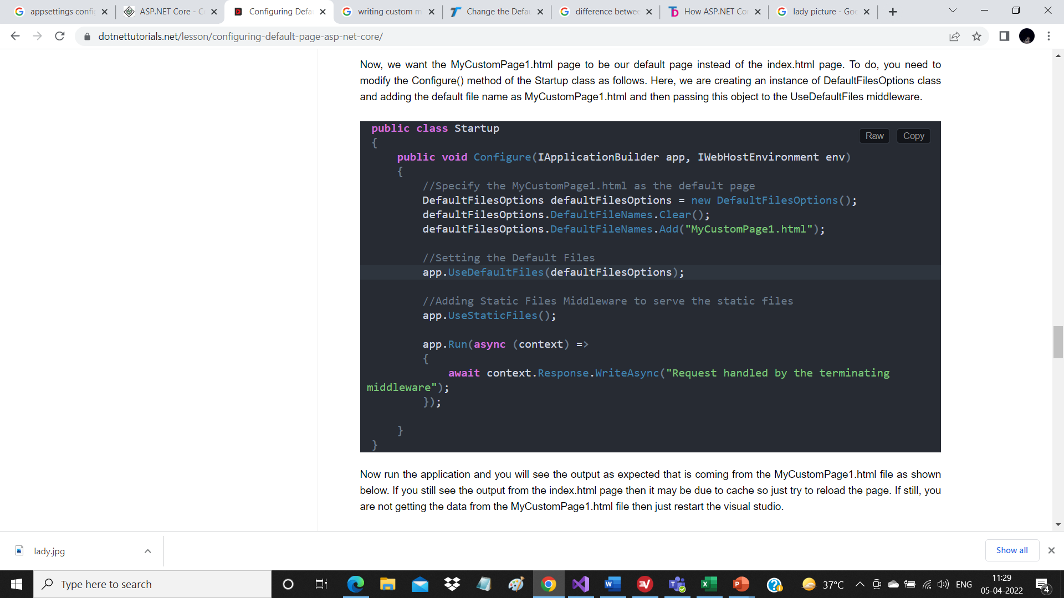
How to set Custom HTML Page as the Default Page?
The UseDefaultFiles() middleware will search the wwwroot folder for the following files.
index.htm
index.html
default.htm
default.html
Setting MyCustomPage1.html as Default Page:

Slide 17
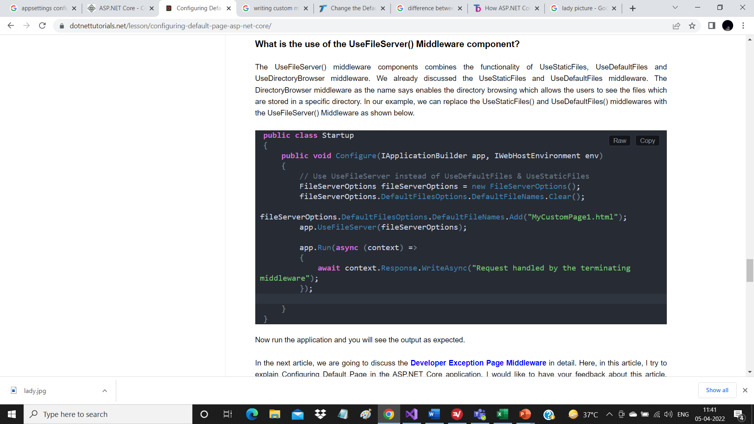
What is the use of the UseFileServer() Middleware component?
The UseFileServer() middleware components combines the functionality of UseStaticFiles, UseDefaultFiles and UseDirectoryBrowser middleware. We already discussed the UseStaticFiles and UseDefaultFiles middleware. The DirectoryBrowser middleware as the name says enables the directory browsing which allows the users to see the files which are stored in a specific directory. In our example, we can replace the UseStaticFiles() and UseDefaultFiles() middlewares with the UseFileServer() Middleware as shown below.

Slide 18
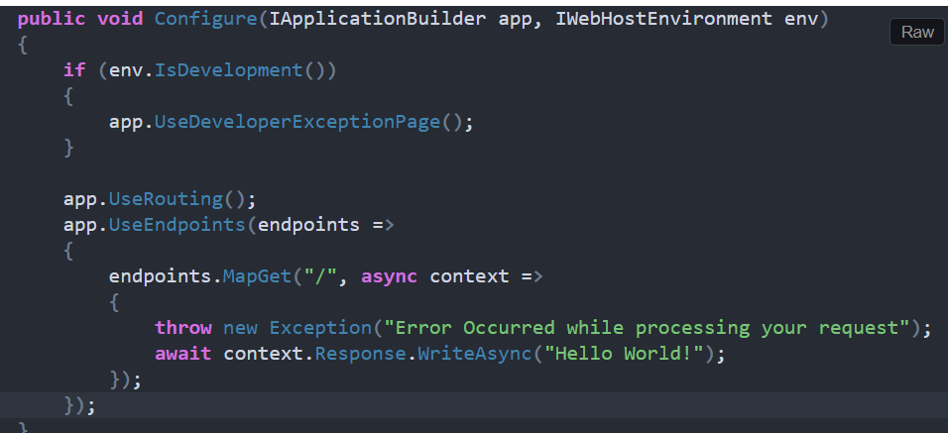
Developer Exception Page Middleware in ASP.NET Core Application
https://dotnettutorials.net/lesson/developer-exception-page-middleware-asp-net-core/
If you want your application to display a page that shows the detailed information about the unhandled exception, then you need to configure the Developer Exception Page middleware in the request processing pipeline. To do so, modify the Configure() method of the Startup class as shown below to add the Developer Exception Page middleware which will handle the unhandled exception that occurred in your application.

Slide 19
Stack: The Stack tab gives the information of stack trace which indicated where exactly the exception occurred, the file name, and the line number that causes the exception.
Query: The Query tab gives information about the query strings.
Cookies: The Cookies tab displays the information about the cookies set by the request.
Header: The Header tab gives information about the headers which is sent by the client when makes the request.
Route: The Route tab gives information about the Route Pattern and Route HTTP Verb type of the method, etc.

Slide 20
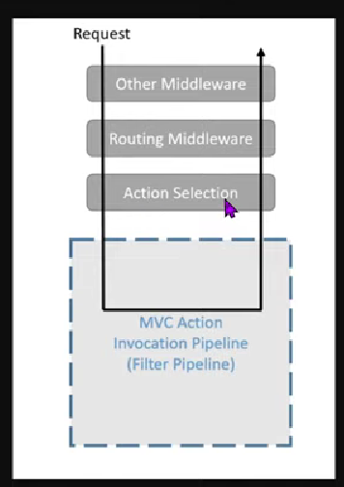
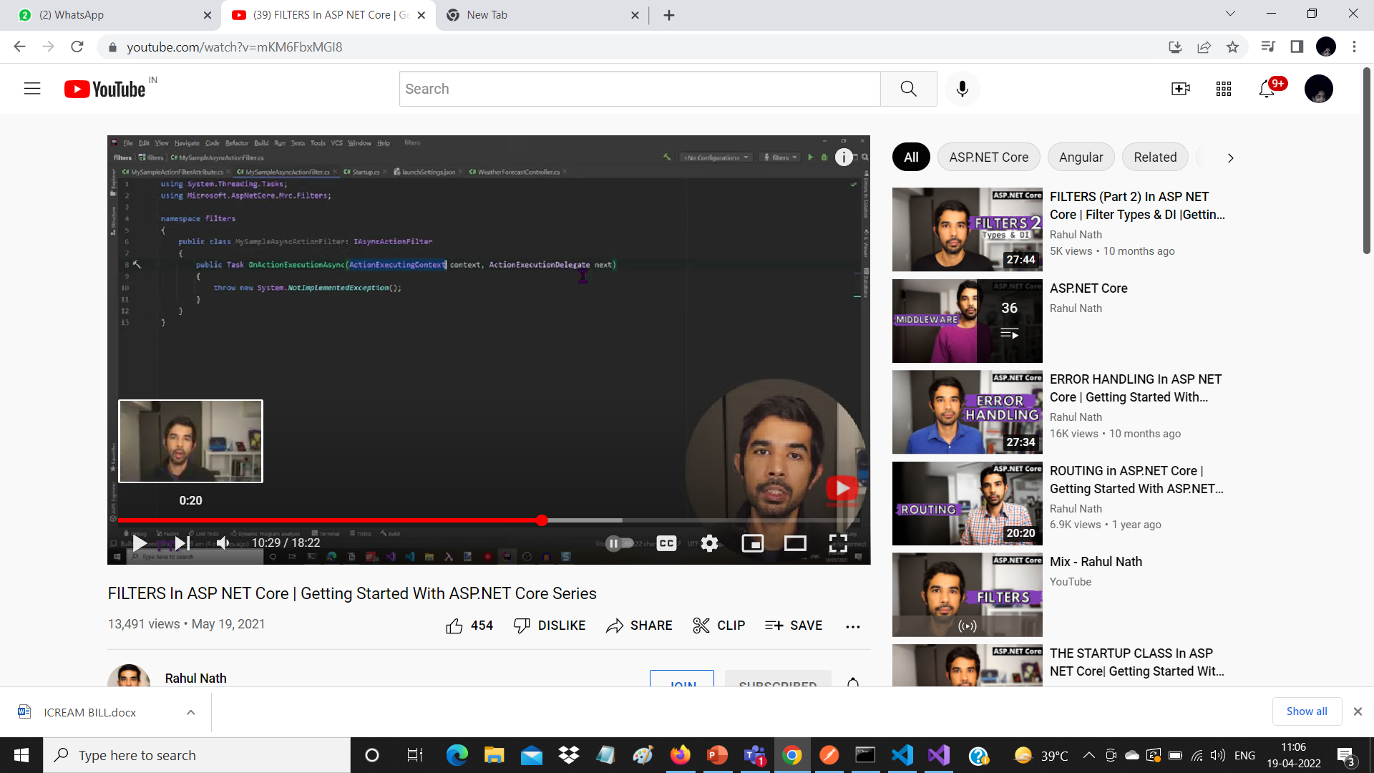
ActionFilter runs before and after the action
We have to register the custom filter oin Startup File configure Serviecs
1 Action Filter added globally
2 On ControllerLevel
3 On ActionLevel
For 2nd and 3rd , we have to inherite the custom Filter from Attribute class.
The filters are of 2 categories
1 Synchronous
2 Asynchronous

Slide 21
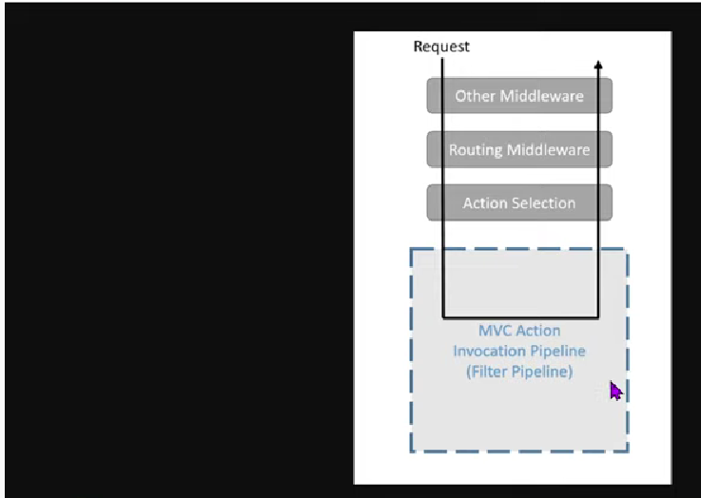
Multiple Filters can be applied for controllers and actions

Slide 23
Thank You

