Slide 1
What is RestFul WEBAPI service?

Slide 2
What is Rest?
REST stands for Representational State Transfer, a term coined by Roy Fielding in 2000. It is an architecture style for designing loosely coupled applications over HTTP, that is often used in the development of web services. REST does not enforce any rule regarding how it should be implemented at lower level, it just put high level design guidelines and leave you to think of your own implementation.
REST in Web API stands for REpresentation State Transfer. REST is the combination of a couple of principles that must be followed by the Web API. REST Principles examples –
URL Structure
HTTP Verbs
Status Code
Stateless,
We can implement Rest using any technology ex : Java, dotnet or NodeJs

Slide 3
Why to choose Web API over WCF?
Web API uses all features of HTTP such as URIs, request/response headers, caching, versioning, various content formats, etc.
One does not have to define or explain any extra config setting for different devices in Web API.
Web API uses different text formats including XML because of which it is faster and more preferred for lightweight services.
Web API also supports MVC features whereas WCF does not support MVC features.
Web API provides more flexibility as compared to WCF.
Web API uses standard security like token authentication, basic authentication, etc., to provide secure service whereas WCF uses WS-I standard to provide secure service.

Slide 4
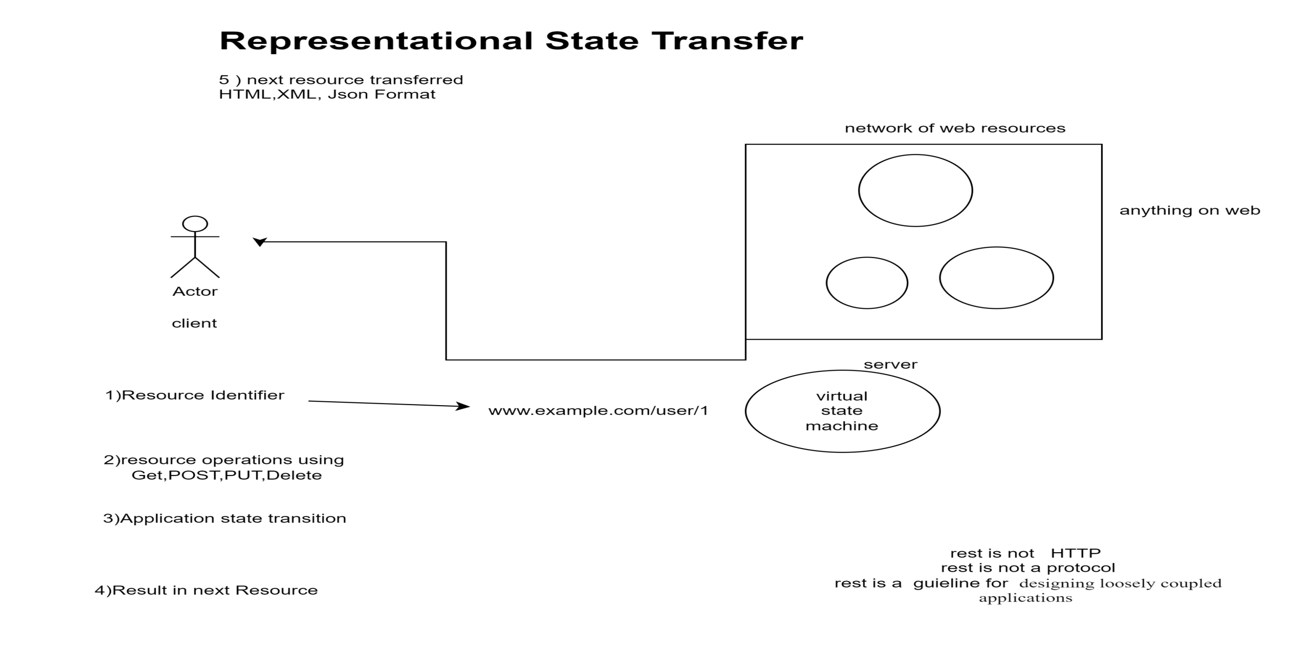

Slide 5
Why rest?
REST technology is generally preferred to the more robust Simple Object Access Protocol (SOAP) technology because REST uses less bandwidth, simple and flexible making it more suitable for internet usage. It’s used to fetch or give some information from a web service. All communication done via REST API uses only HTTP request.

Slide 6
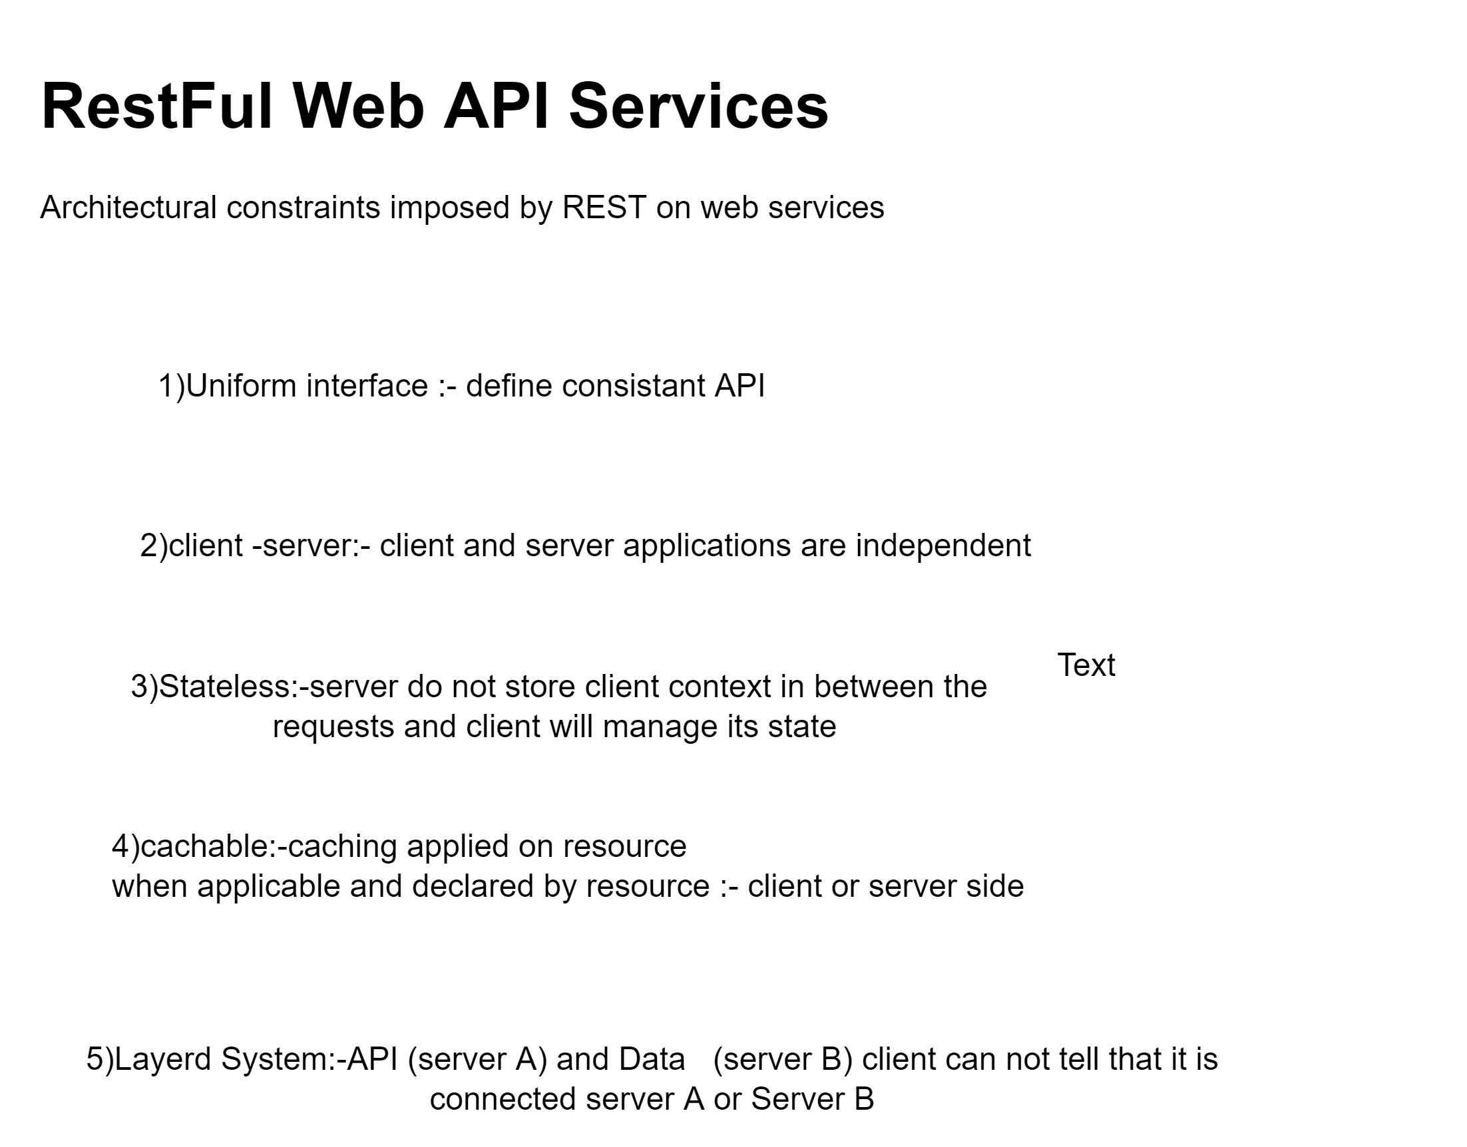
6)Code on Demand:-It is an optional feature. According to this, servers can also provide executable code to the client

Slide 7
What Are RESTful Web Services?
RESTful web services are built to work best on the Web. Representational State Transfer (REST) is an architectural style that specifies constraints, such as the uniform interface, that if applied to a web service induce desirable properties, such as performance, scalability, and modifiability, that enable services to work best on the Web.
In the REST architectural style, data and functionality are considered resources and are accessed using Uniform Resource Identifiers (URIs), typically links on the Web.
The resources are acted upon by using a set of simple, well-defined operations. The REST architectural style constrains an architecture to a client/server architecture and is designed to use a stateless communication protocol, typically HTTP. In the REST architecture style, clients and servers exchange representations of resources by using a standardized interface and protocol.

Slide 8
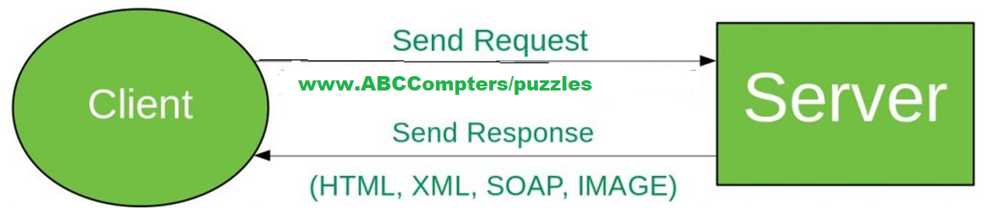
Working: A request is sent from client to server in the form of a web URL as HTTP GET or POST or PUT or DELETE request. After that, a response comes back from the server in the form of a resource which can be anything like HTML, XML, Image, or JSON. But now JSON is the most popular format being used in Web Services.

Slide 9
In HTTP there are five methods that are commonly used in a REST-based Architecture i.e., POST, GET, PUT, PATCH, and DELETE. These correspond to create, read, update, and delete (or CRUD) operations respectively. There are other methods which are less frequently used like OPTIONS and HEAD.
GET: The HTTP GET method is used to read (or retrieve) a representation of a resource. In the safe path, GET returns a representation in XML or JSON and an HTTP response code of 200 (OK). In an error case, it most often returns a 404 (NOT FOUND) or 400 (BAD REQUEST).
POST: The POST verb is most often utilized to create new resources. In particular, it’s used to create subordinate resources. That is, subordinate to some other (e.g. parent) resource. On successful creation, return HTTP status 201, returning a Location header with a link to the newly-created resource with the 201 HTTP status.

Slide 10
http verbs:
PUT: It is used for updating the capabilities. However, PUT can also be used to create a resource in the case where the resource ID is chosen by the client instead of by the server. In other words, if the PUT is to a URI that contains the value of a non-existent resource ID. On successful update, return 200 (or 204 if not returning any content in the body) from a PUT. If using PUT for create, return HTTP status 201 on successful creation. PUT is not safe operation but it’s idempotent.
PATCH: It is used to modify capabilities. The PATCH request only needs to contain the changes to the resource, not the complete resource. This resembles PUT, but the body contains a set of instructions describing how a resource currently residing on the server should be modified to produce a new version. This means that the PATCH body should not just be a modified part of the resource, but in some kind of patch language like JSON Patch or XML Patch. PATCH is neither safe nor idempotent.
DELETE: It is used to delete a resource identified by a URI. On successful deletion, return HTTP status 200 (OK) along with a response body.

Slide 11
What is HttpResponseMessage?
A HttpResponseMessage allows us to work with the HTTP protocol (for example, with the headers property) and unifies our return type. In simple words an HttpResponseMessage is a way of returning a message/data from your action.
Syntax or Structure of HttpResponseMessage
public HttpResponseMessage ActionName(parameter(s))
{
return //status with data (or) status (or) data
}

Slide 12
Why to return a HttpResponseMessage?
Let's create a simple get method that will return the Employee data for the id provided.
public Employee GetEmployee(int id)
{
return EmployeeContext.Employees.Where(e => e.Id == id).FirstOrDefault();
}
As you can see, the method above is fulfilling the requirement; it is returning the Employee details for the Id provided. But what if no such employee exists for the Id provided, it will return the null value with success response. Rather it would be more efficient if we return 404 error, with message like “Employee not found”.

Slide 13
// GetEmployee action
public HttpResponseMessage GetEmployee(int id)
{
Employee emp = EmployeeContext.Employees.Where(e => e.Id == id).FirstOrDefault();
if (emp != null)
{
return Request.CreateResponse<Employee>(HttpStatusCode.OK, emp);
}
else
{
return Request.CreateErrorResponse(HttpStatusCode.NotFound, " Employee Not Found");
}
}

Slide 14
HttpResponseMessge using try catch
public HttpResponseMessage GetEmployee(int id)
{
try {
Employee emp = EmployeeContext.Employees.Where(e => e.Id == id).FirstOrDefault();
if (emp != null)
{
return Request.CreateResponse<Employee>(HttpStatusCode.OK, emp);
}
else
{
return Request.CreateErrorResponse(HttpStatusCode.NotFound, " Employee Not Found");
} } catch (Exception ex)
{
// Log exception code goes here
return Request.CreateErrorResponse(HttpStatusCode.InternalServerError, "Error occured while executing GetEmployee”);
}
}

Slide 15
HttpStatus Code
The Status-Code element in a server response, is a 3-digit integer where the first digit of the Status-Code defines the class of response and the last two digits do not have any categorization role. There are 5 values for the first digit:
S.N. Code and Description
1 1xx: Informational It means the request has been received and the process is continuing.
2 2xx: Success It means the action was successfully received, understood, and accepted.
3 3xx: Redirection It means further action must be taken in order to complete the request.
4 4xx: Client Error It means the request contains incorrect syntax or cannot be fulfilled.
5 5xx: Server Error It means the server failed to fulfill an apparently valid request.

Slide 16
HTTP status codes are extensible and HTTP applications are not required to understand the meaning of all the registered status codes. Given below is a list of all the status codes.
Message | Description
100 Continue | Only a part of the request has been received by the server, but as long as it has not been rejected, the client should continue with the request.
101 Switching Protocols | The server switches protocol.
1xx: Information

Slide 17
2xx: Successful
Message | Description
200 OK | The request is OK.
201 Created | The request is complete, and a new resource is created .
202 Accepted | The request is accepted for processing, but the processing is not complete.
203 Non-authoritative Information | The information in the entity header is from a local or third-party copy, not from the original server.
205 Reset Content | The browser should clear the form used for this transaction for additional input.

Slide 18
3xx: Redirection
Message | Description
300 Multiple Choices | A link list. The user can select a link and go to that location. Maximum five addresses .
301 Moved Permanently | The requested page has moved to a new url .
302 Found | The requested page has moved temporarily to a new url .
303 See Other | The requested page can be found under a different url .
304 Not Modified | This is the response code to an If-Modified-Since or If-None-Match header, where the URL has not been modified since the specified date.
305 Use Proxy | The requested URL must be accessed through the proxy mentioned in the Location header.
306 Unused | This code was used in a previous version. It is no longer used, but the code is reserved.
307 Temporary Redirect | The requested page has moved temporarily to a new url.

Slide 19
4xx: Client Error
Message | Description
400 Bad Request | The server did not understand the request.
401 Unauthorized | The requested page needs a username and a password.
402 Payment Required | You can not use this code yet.
403 Forbidden | Access is forbidden to the requested page.
404 Not Found | The server can not find the requested page.
405 Method Not Allowed | The method specified in the request is not allowed.
406 Not Acceptable | The server can only generate a response that is not accepted by the client.
407 Proxy Authentication Required | You must authenticate with a proxy server before this request can be served.
408 Request Timeout | The request took longer than the server was prepared to wait.
409 Conflict | The request could not be completed because of a conflict.
410 Gone | The requested page is no longer available .
411 Length Required | The "Content-Length" is not defined. The server will not accept the request without it .
412 Precondition Failed | The pre condition given in the request evaluated to false by the server.
413 Request Entity Too Large | The server will not accept the request, because the request entity is too large.

Slide 20
5xx: Server Error
Message | Description
500 Internal Server Error | The request was not completed. The server met an unexpected condition.
501 Not Implemented | The request was not completed. The server did not support the functionality required.
502 Bad Gateway | The request was not completed. The server received an invalid response from the upstream server.
503 Service Unavailable | The request was not completed. The server is temporarily overloading or down.
504 Gateway Timeout | The gateway has timed out.
505 HTTP Version Not Supported | The server does not support the "http protocol" version.

Slide 21
HTTP - Header Fields

Slide 22
media type formatters
In web API, media type formatters are classes that are responsible for serialization data. Here, serialization generally means a process of translating data into a format that can be transmitted and reconstructed later. Because of serializing request/response data, Web API can understand request data format in a better way and send data in a format that the client expects. It simply specifies data that is being transferred among client and server in HTTP response or request.
Internet Media Types
A media type, also called a MIME type, identifies the format of a piece of data. In HTTP, media types describe the format of the message body. A media type consists of two strings, a type and a subtype. For example:
text/html
image/png
application/json

Slide 23
When an HTTP message contains an entity-body, the Content-Type header specifies the format of the message body. This tells the receiver how to parse the contents of the message body.
For example, if an HTTP response contains a PNG image, the response might have the following headers.
HTTP/1.1 200 OK
Content-Length: 95267
Content-Type: image/png
When the client sends a request message, it can include an Accept header. The Accept header tells the server which media type(s) the client wants from the server. For example:
Accept: text/html,application/xhtml+xml,application/xml
This header tells the server that the client wants either HTML, XHTML, or XML.

Slide 24
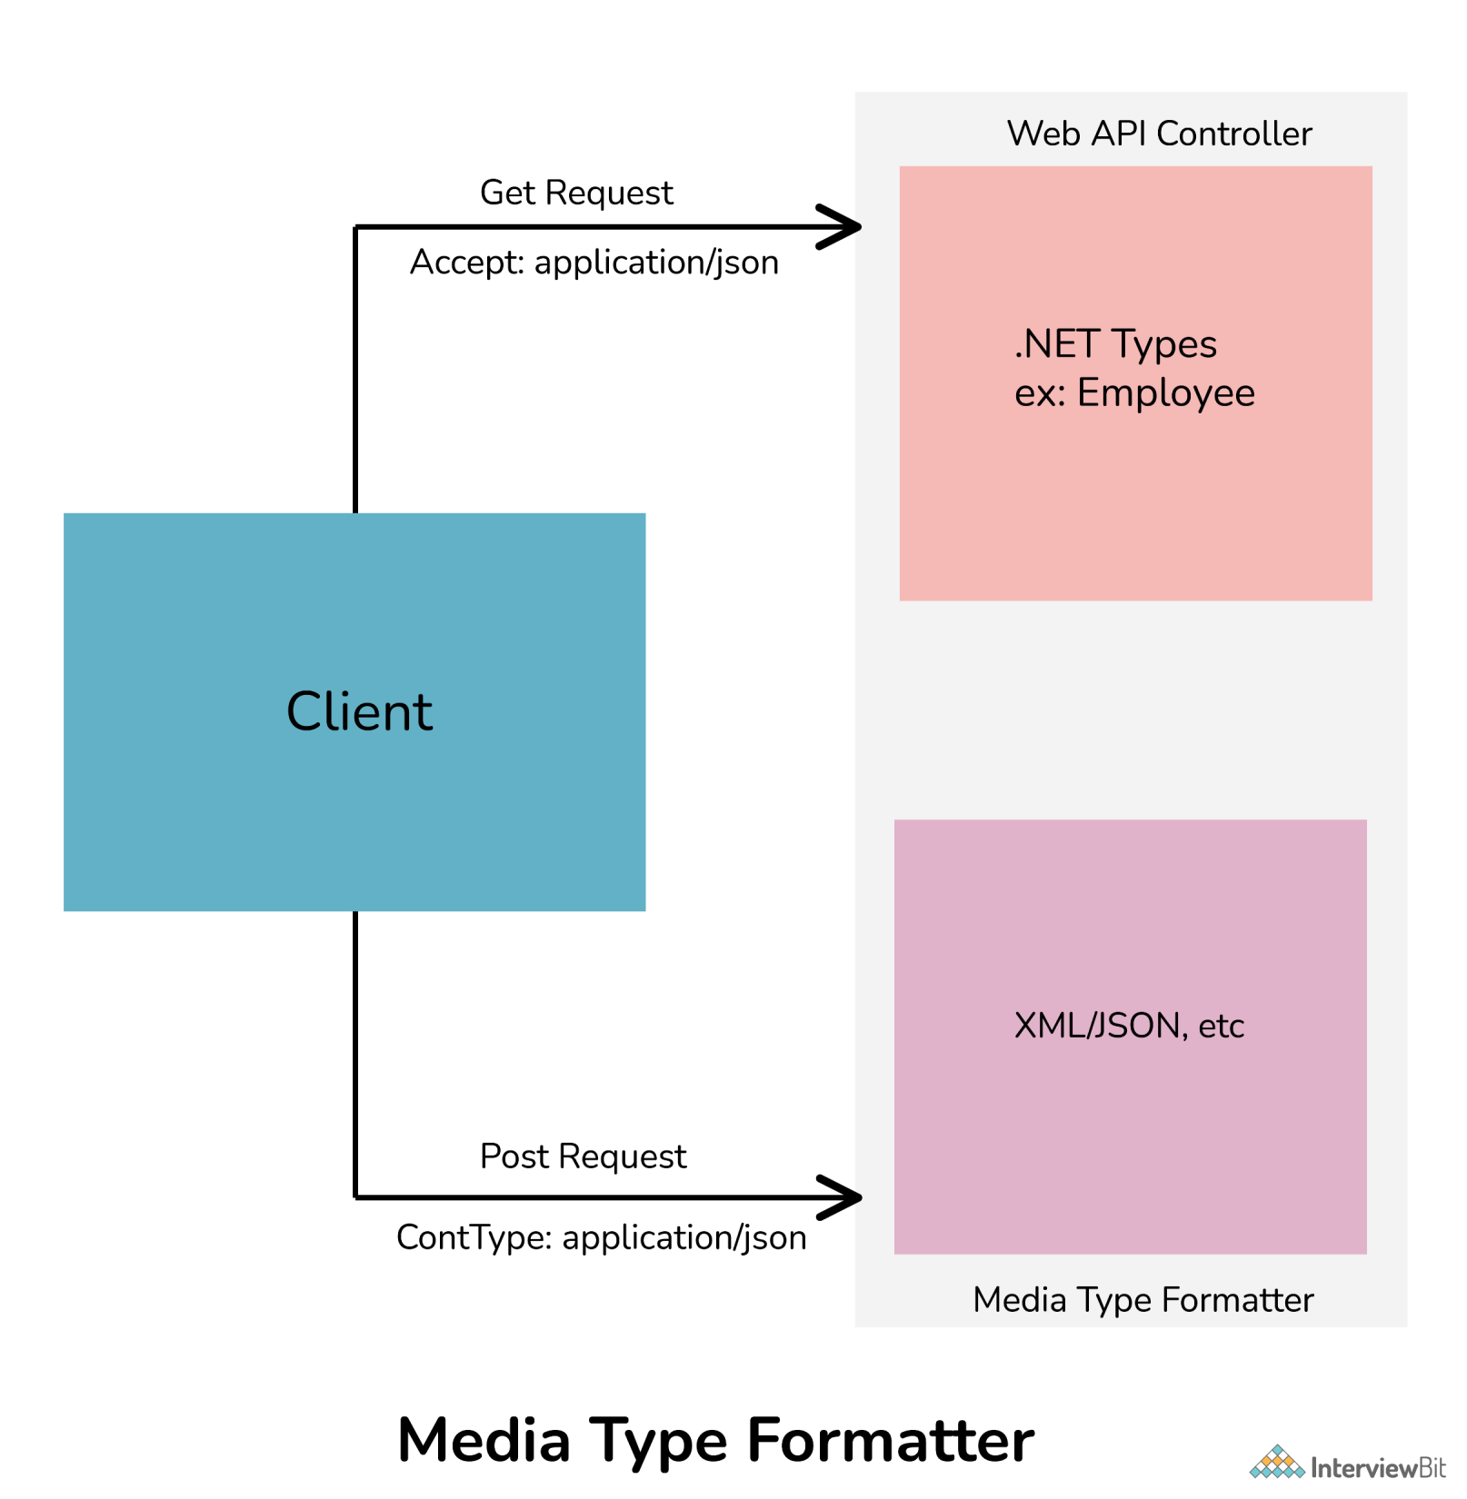

Slide 25
Media Type Formatter Class | MIME Type | Description
JsonMediaTypeFormatter | application/json, text/json | Handles JSON format
XmlMediaTypeFormatter | application/xml, text/json | Handles XML format
FormUrlEncodedMediaTypeFormatter | application/x-www-form-urlencoded | Handles HTM form URL-encoded data
JQueryMvcFormUrlEncodedFormatter | application/x-www-form-urlencoded | Handles model-bound HTML form URL-encoded data

Slide 26
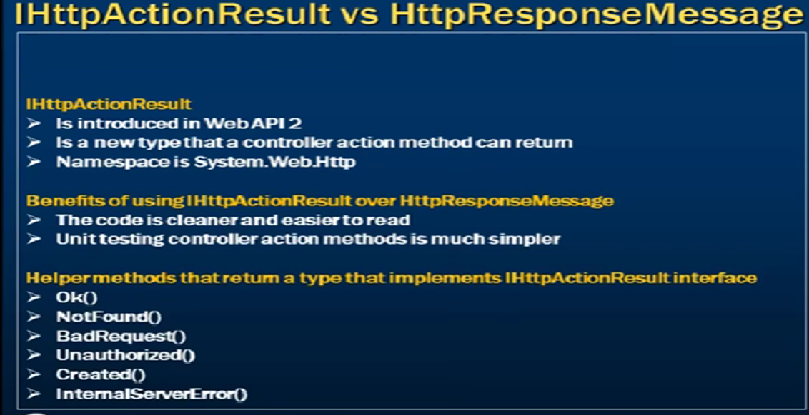

Slide 27
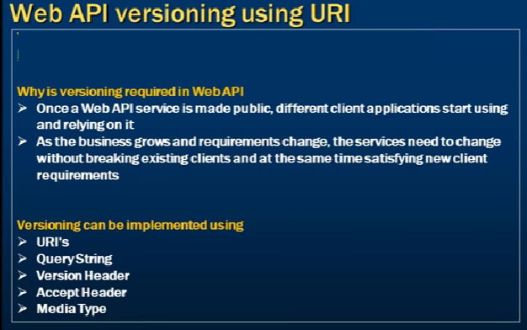

Slide 28
Routing in WebAPI
Sarita Lad
DATE

Slide 29
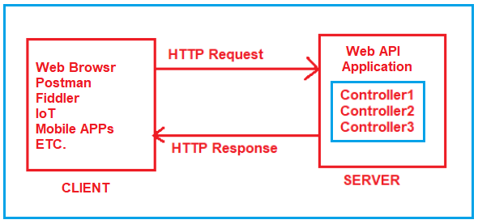
What is Routing in ASP.NET Core?
It is important that we need to understand is, how the application will come to know which request will be mapped to which controller action method. Basically, the mapping between the URL and resource is nothing but the concept or Routing.

Slide 30
For the Routing Concept in ASP.NET Core Web API, we generally set some URLs for each resource. When we run the application, then it will create the Route table and the Route table will contain the mapping information between the URL and the Resource. So, when we are sending a request from the client to the server, then the application will check the URL in the Route table and if it found an exact, then the application will forward the request to that particular resource else it will throw an error saying resource not found.
We can access any resource using a unique URL in ASP.NET Core Web API Application. It is also possible that a resource can have multiple unique URLs. But multiple resources can not have the same URL and if you do so, then the application gets confused to invoke which action method and as a result, you will get an ambiguity error.
So, the ASP.NET Core Framework maps the incoming HTTP Requests i.e. URLs to the action methods of Controllers based on the routes that are configured for your application. In ASP.NET Core, it is also possible to configure multiple routes, and also it is possible to set some specific configurations such as default values, constraints, message handlers, etc

Slide 31
How to enable Routing in ASP.NET Core Web API?
Adding ASP.NET Core Web API Service:
When we create aspnet Core WebAPI – new Project :
Add following Service in IOC container:
public void ConfigureServices(IServiceCollection services)
{
services.AddControllers();
}
we need to add the following two middleware components to the HTTP Request processing Pipeline.
UseRouting(): The UseRouting Middleware only enables the Routing for your application. This will not map any URL to any resource.
UseEndpoints(): This middleware will map the URL to the resource. But the most important point that you need to remember is, the action methods are not only the resource that you can map. You can also map static file resources to a URL. But here we are only focusing on ASP.NET Core Web API and hence we are going to map the URL to action methods.

Slide 32
Configuring the Routing Middlewares in ASP.NET Core:
if we want to configure any middleware then we need to configure the same inside the Configure method of the Startup class. So, let us modify the Configure method of the Startup class as shown below to configure the UseRouting and UseEndpoints Middlewares which will enable Routing as well as the mapping between the URL and Resource. As you can see in the below code within the UseEndpoints Middleware we write MapControllers which will actually set the mapping between URL and Controller action method. So, the Map controller will act as a bridge between the HTTP Request and the Controllers.
public void Configure(IApplicationBuilder app, IWebHostEnvironment env)
{
if (env.IsDevelopment())
{
app.UseDeveloperExceptionPage();
}
app.UseRouting();
app.UseEndpoints(endpoints =>
{
endpoints.MapControllers();
}); }

Slide 33
In ASP.NET Core Application, we have two ways to define the Routing i.e. Conventional Based and Attribute-Based Routing. And Attribute Routing is the most preferred way of defining routes in ASP.NET Core Web API Application and hence, we are only going to focus on Attribute Routing in this course.
[Route("api/[controller]")]
[ApiController]
public class EmployeeController : ControllerBase
{
}
Using the Route Attribute, we can define the Routes in ASP.NET Core Application either at the Controller level or at the action method level. Before using the Route Attribute lets us have a look at the signature of the Route Attribute. The following image shows the definition of the Route Attribute.

Slide 34
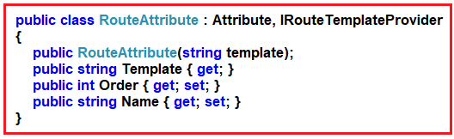
As you can see in the above image, Route Attribute is basically a class inherited from the Attribute class and IRouteTemplateProvider interface. The Constructor of the RouteAttribute class takes the template as an input parameter which is nothing but the URL that you are excepting from the client and it cannot be null.

Slide 35
Adding Attribute Routing in ASP.NET Core Web Application:
Now let us add two action methods within the EmployeeController class. Now, don’t concentrate on the return type and the data that we are returning from the action method, rather concentrate on the Routing concept. We want to invoke the GetAllEmployees method with the URL /Emp/All and GetEmployeeById method with the URL /Emp/ById. To achieve this, we can use the Route Attribute and decorate the action GetAllEmployees and GetEmployeeById method as [Route(“Emp/All”)] and [Route(“Emp/ById”)] respectively. So, modify the EmployeeController class as shown below.

Slide 36
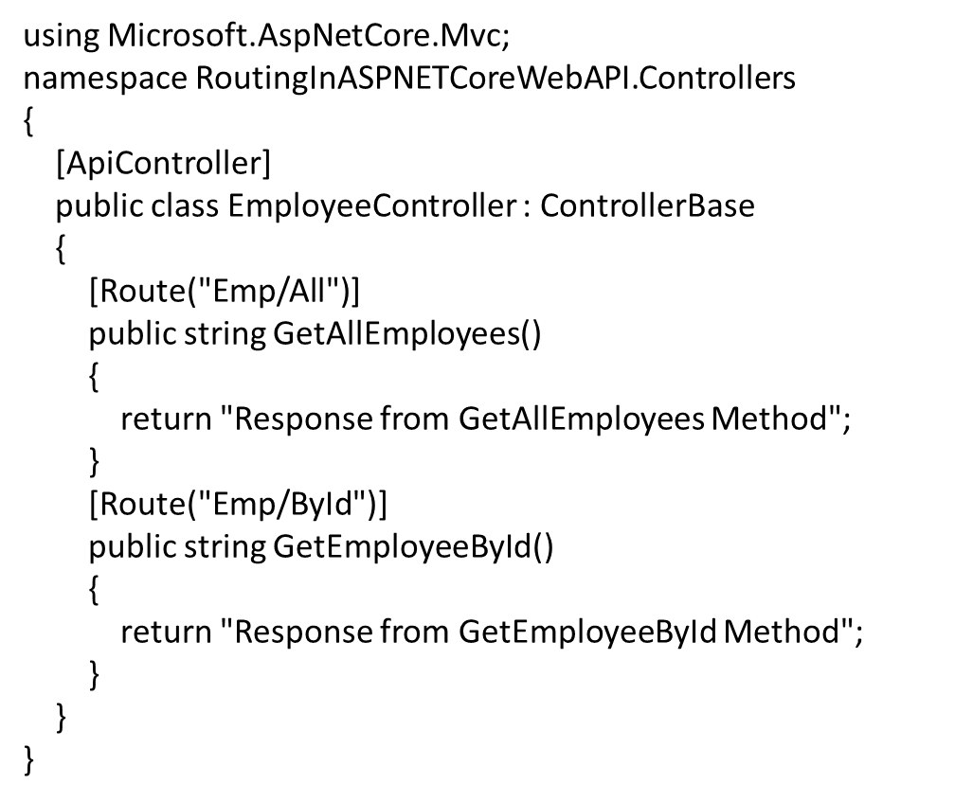

Slide 37
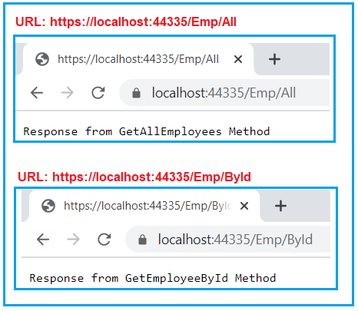

Slide 38
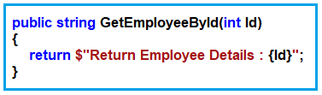
Working with Variables in ASP.NET Core Web API Routing:
When working with Real-time Restful services, then we need to deal with dynamic values like getting Order Details by Id, Get Employee details by Id, Get books by Author, etc. Let us see how we can handle the variables in the Routes in ASP.NET Core Web API Application.
For example, we have multiple employees and we want to fetch one employee detail by its Id. Then how we can get the Id values? The URL is the only place that is going to give us the Id value. So, we need to define one parameter to take the Id value within the method signature as shown in the below image
In ASP.NET Core Web Application, if you want to pass anything as a variable then you need to use curly braces {} and inside the curly braces, you need to give the name of the parameter your method accepting. In our example, the GetEmployeeById method takes the Id parameter, so we need to pass the Id within the curly braces of the Route attribute as shown in the below image.

Slide 39
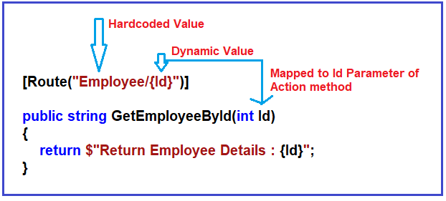

Slide 40
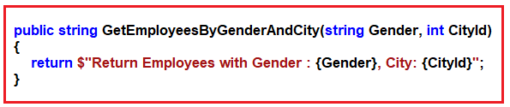
Passing Multiple dynamic Values in ASP.NET Core Web API Routing:
Now let us understand how to pass multiple dynamic values using the Route attribute. Now we need to fetch all the employees by Gender and City. Here, we want the Gender to be Male or Female i.e. as a string value and intentionally, we want to City Id value i.e. an integer value. So, we will create one action method which takes two parameters, one of which is Gender, and the order one is CityId as shown in the below image.

Slide 41
[Route("Employee/Gender/{Gender}/City/{CityId}")]
public string GetEmployeesByGenderAndCity(string Gender, int CityId)
{
return $"Return Employees with Gender : {Gender}, City: {CityId}";
}

Slide 42
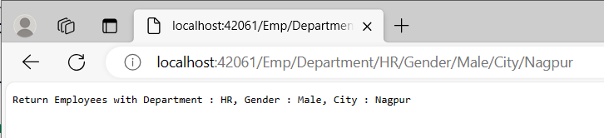
How to pass Multiple Query Strings in ASP.NET Core Web API?
Let us understand how to pass multiple query strings with an example. In a real-time application, when you implement a search functionality, you generally accept multiple search parameters to filter out the data, Let say, we want employee city, gender, and department to filter out the number of employees to be returned. Then, in that case, our action method accepting three parameters. So, modify the SearchEmployees method of the Employee Controller class as shown below.
[Route("Emp/Department/{Department}/Gender/{Gender}/City/{City}")]
public string SearchEmployees(string Department, string Gender, string City)
{
return $"Return Employees with Department : {Department}, Gender : {Gender}, City : {City}";
}

Slide 43
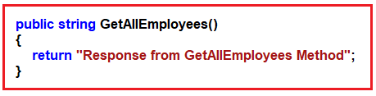
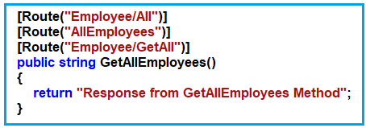
Multiple URLs for a Single Resource using Routing
Now we want to access the above resource with three different URLs such as Employee/All, AllEmployees, Employee/GetAll, then how we can do this? If this is our requirement, then we need to decorate the GetAllEmployees action method with three different Route attributes as shown in the below image.

Slide 44
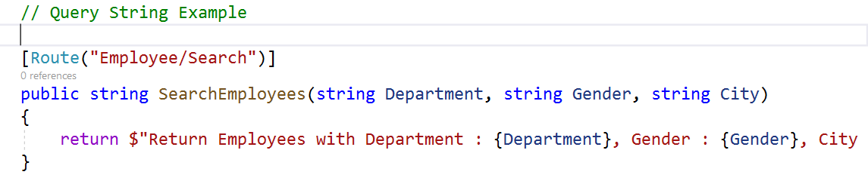
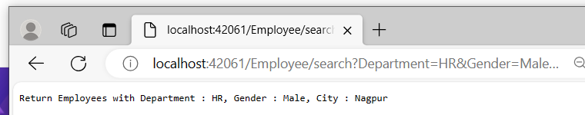
Working with Query Strings in ASP.NET Core Web API Routing

Slide 45
What are Tokens in ASP.NET Core Attribute Routing?
Token Replacement is a new feature available in ASP.NET Core and it was not available in .NET Frameworks like ASP.NET MVC and ASP.NET Web API. The meaning of token replacement is, we can replace the value of the controller and action method dynamically.
In ASP.NET Core Web API Application, the Route Attribute support token replacement. It means we can enclose the token (i.e. controller and action) within a pair of square braces ([]). The tokens (i.e. [controller] and [action]) are then replaced with the values of controller and action method name where the route is defined.

Slide 46
using Microsoft.AspNetCore.Mvc;
namespace RoutingInASPNETCoreWebAPI.Controllers
{
[ApiController]
[Route("[controller]")]
public class EmployeeController : ControllerBase
{
[Route("[action]")]
public string GetAllEmployees()
{
return "Response from GetAllEmployees Method";
}
[Route("[action]")]
public string GetAllDepartment()
{
return "Response from GetAllDepartment Method";
}
}
}

Slide 47
using Microsoft.AspNetCore.Mvc;
namespace RoutingInASPNETCoreWebAPI.Controllers
{
[ApiController]
[Route("[controller]/[action]")]
public class EmployeeController : ControllerBase
{
public string GetAllEmployees()
{
return "Response from GetAllEmployees Method";
}
public string GetAllDepartment()
{
return "Response from GetAllDepartment Method";
}
}
}

Slide 48
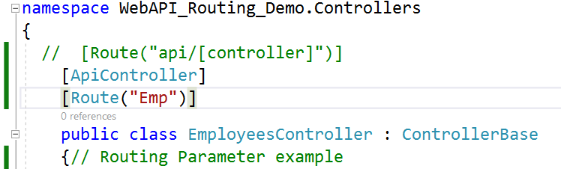
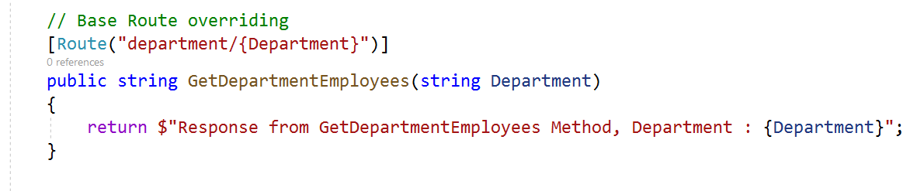
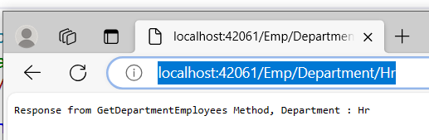
Base Route in ASP.NET Core Web API Routing

Slide 49
How to override the Controller level Route Attribute at the action method level?
In ASP.NET Core Application, you can override the Controller level Route Attribute at the action method level by using the ~ (tilde) symbol. So, modify the GetAllDepartment action method as shown below to use the tilde symbol to override the route defined at the employee controller.
[Route("~/department/all")]
public string GetAllDepartment()
{
return "Response from GetAllDepartment Method";
}

Slide 50
Route Constraints in ASP.NET Core Web API
Type: int, double, bool, float, datetime, etc
Min: min(number)
Max: max(number)
Range: range(10. 15)
Alpha: alpha
MinLength: minlength(5)
MaxLength: maxlength(10)
Length: length(10)
Required: required
Regex: regex(expression)
The Route Constraints in ASP.NET Core Web API Attribute Routing are nothing but a set of rules that can be applied to routing parameters to restrict how the parameters in the route template are matched. The syntax to use Route Constraints is: {parameter:constraint}

Slide 51
Alpha constraint in ASP.NET Core Web API:
If you want any parameter to accept only alphabets (a to z characters) values then you need to specify the alpha constraint. So, let us decorate the GetEmployeeDetails method which takes string parameters with the following Route Attribute.
[Route(“{EmployeeName:alpha}”)]
Here, alpha stands for uppercase or lowercase alphabet characters. So, changes the GetEmployeeDetails method which takes the string parameter as shown below.
[Route("{EmployeeName:alpha}")]
public string GetEmployeeDetails(string EmployeeName)
{
return $"Response from GetEmployeeDetails Method, EmployeeName : {EmployeeName}";
}

Slide 52
Max(Number) constraint in ASP.NET Core Web API:
Along with the min constraint, you can also specify the max constraint in ASP.NET Core Web API. The max constraint also takes one parameter which is used to specify the max value that can be applied to the parameter. For example, if you want the EmployeeId in the URL should not to be greater than 1000, then you can use the max constraint as shown below.
[Route("{EmployeeId:int:max(1000)}")]
public string GetEmployeeDetails(int EmployeeId)
{
return $"Response from GetEmployeeDetails Method, EmployeeId : {EmployeeId}";

Slide 53
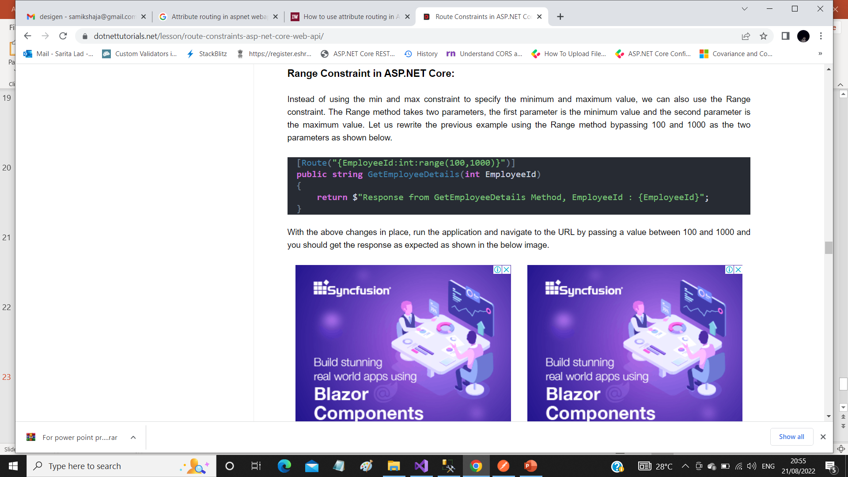

Slide 54
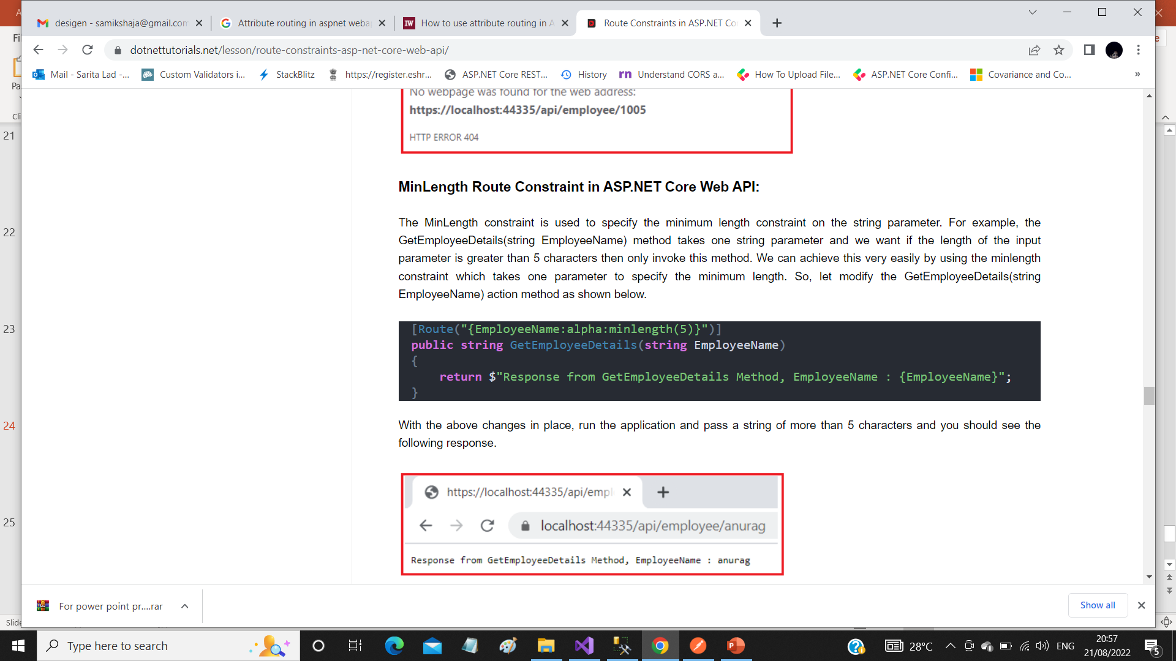

Slide 55
Thank You

