Slide 1
what are the features of WEB API?
ASP.NET Web API is a framework for building HTTP services that can be accessed from any client including browsers and mobile devices. It is an ideal platform for building RESTful applications on the .NET Framework.
It is used to provide an interface for websites and client application,It can also be used to access data from the database and save data
It supports different text formats such as XML, JSON, etc.
From a business point of view, web API is more applicable for UI/UX, increases interest in the company’s product and services, increases website traffic.
All of the mentioned

Slide 2
Test Web API
In the previous section, we created our first simple Web API project. Now we will learn how to test Web API locally to check request & response during development.
We can use the following third party tools for testing Web API.
Fiddler
Postman

Slide 3
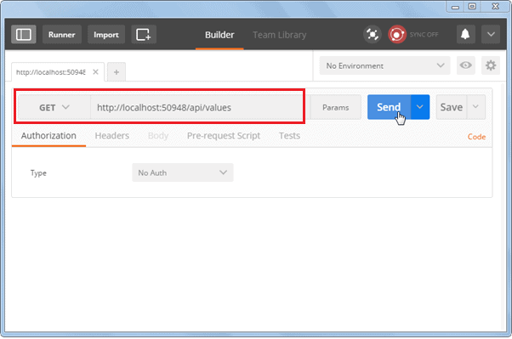

Slide 4
The HTTP verbs comprise a major portion of our “uniform interface” constraint and provide us the action counterpart to the noun-based resource. The primary or most-commonly-used HTTP verbs (or methods, as they are properly called) are POST, GET, PUT, PATCH, and DELETE. These correspond to create, read, update, and delete (or CRUD) operations, respectively. There are a number of other verbs, too, but are utilized less frequently. Of those less-frequent methods, OPTIONS and HEAD are used more often than others.
Below is a table summarizing recommended return values of the primary HTTP methods in combination with the resource URIs:
HTTP verbs
Retrieve a single item (GET/2): select single
Retrieve a list of items (GET): select All
Create an item (POST) to insert record
Update an item (PUT) : to update
Delete an item (DELETE)

Slide 5
HTTP Verb | CRUD | Entire Collection (e.g. /customers) | Specific Item (e.g. /customers/{id})
POST | Create | 201 (Created), 'Location' header with link to /customers/{id} containing new ID. | 404 (Not Found), 409 (Conflict) if resource already exists..
GET | Read | 200 (OK), list of customers. Use pagination, sorting and filtering to navigate big lists. | 200 (OK), single customer. 404 (Not Found), if ID not found or invalid.
PUT | Update/Replace | 405 (Method Not Allowed), unless you want to update/replace every resource in the entire collection. | 200 (OK) or 204 (No Content). 404 (Not Found), if ID not found or invalid.
PATCH | Update/Modify | 405 (Method Not Allowed), unless you want to modify the collection itself. | 200 (OK) or 204 (No Content). 404 (Not Found), if ID not found or invalid.
DELETE | Delete | 405 (Method Not Allowed), unless you want to delete the whole collection—not often desirable. | 200 (OK). 404 (Not Found), if ID not found or invalid.

Slide 6
Action Method Return Type
In the previous section, you learned about parameter binding with Web API action method. Here, you will learn about the return types of action methods which in turn will be embedded in the Web API response sent to the client.
The Web API action method can have following return types.
Void
Primitive type or Complex type
HttpResponseMessage
IHttpActionResult

Slide 7
