Slide 1
Pipe in angular 2
Sarita Lad
DATE

Slide 2
Angular Pipes :
Angular Pipes takes data as input and formats or transform the data to display in the template. We use them to change the appearance of the data before presenting it to the user. The most common use case of pipes is displaying the dates in the correct format as per the user’s locale.

Slide 3
Angular Pipes :
Angular Pipes Syntax
Expression | pipeOperator[:pipeArguments]
Pipes Provided by Angular
CurrencyPipe
DatePipe
DecimalPipe
JsonPipe
LowerCasePipe
UpperCasePipe
PercentPipe
SlicePipe
AsyncPipe
Where
Expression: is the expression, which you want to transform | : is the Pipe Character pipeOperator : name of the Pipe pipeArguments: arguments to the Pipe

Slide 4
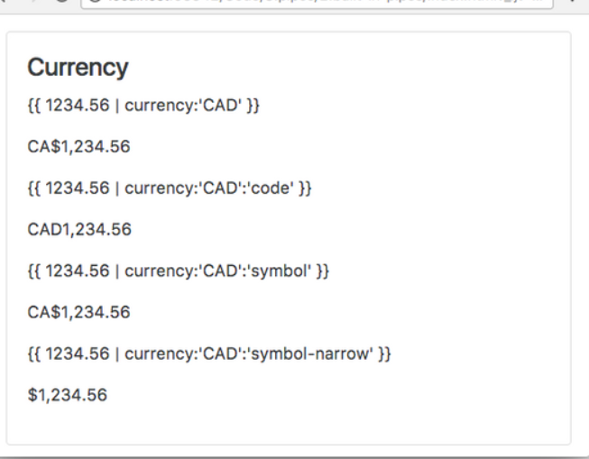
Angular Pipes :Currency Pipe
This pipe is used for formatting currencies. Its first argument is an abbreviation of the currency type (e.g. “EUR”, “USD”, and so on), like so:
{{ 1234.56 | currency:'CAD' }}
The above prints out CA$1,234.56.
If instead of the abbreviation of CA$ we want the currency symbol to be printed out we pass as a second parameter the string symbol-narrow, like so:
Copy{{ 1234.56 | currency:"CAD":"symbol-narrow" }}

Slide 5
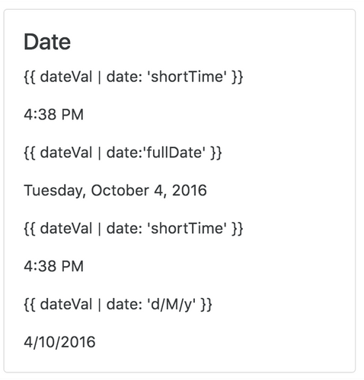
Angular Pipes :DatePipe
This pipe is used for the transformation of dates. The first argument is a format string, like so:
Example:
<p>{{ dateVal | date: 'shortTime' }}</p>
<p>{{ dateVal | date: 'fullDate' }}</p>
<p>{{ dateVal | date: 'd/M/y' }}</p>

Slide 6
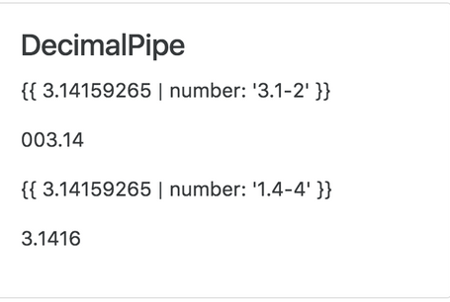
Angular Pipes :DecimalPipe
This pipe is used for transformation of decimal numbers.
The first argument is a format string of the form ”{minIntegerDigits}. {minFractionDigits}-{maxFractionDigits}”, like so:
Example:
<p>{{ 3.14159265 | number: '3.1-2' }}</p>
<p>{{ 3.14159265 | number: '1.4-4' }}</p>

Slide 7
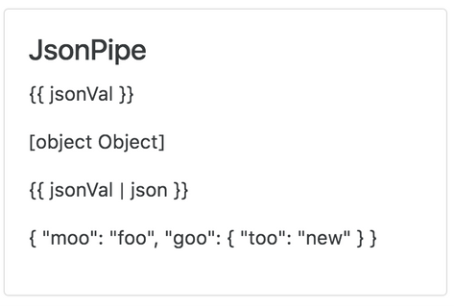
Angular Pipes :JsonPipe
This transforms a JavaScript object into a JSON string, like so:
Example:
<p>{{ jsonVal | json }}</p>

Slide 8
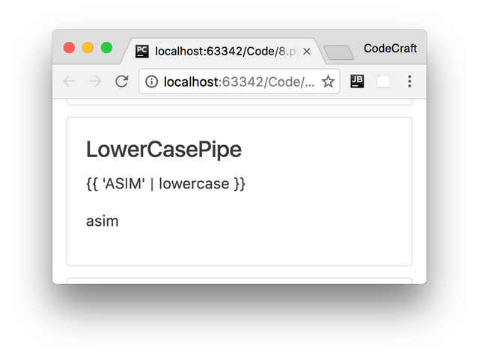
Angular Pipes :LowerCasePipe
This transforms a string to lowercase, like so:
Example:
<p>{{ 'ASIM' | lowercase }}</p>

Slide 9
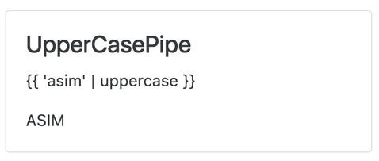
Angular Pipes :UpperCasePipe
This transforms a string to uppercase, like so:
Example:
<p>{{ 'asim' | uppercase }}</p>
<p>{{ ‘Sarita' | uppercase }}</p>

Slide 10
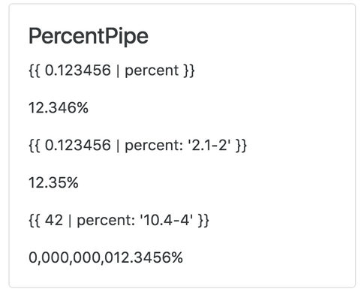
Angular Pipes :PercentPipe
Formats a number as a percent, like so:
Example:
Percent can be passed a format string similar to the format passed to the DecimalPipe.
<p>{{ 0.123456 | percent }}</p>
<p>{{ 0.123456 | percent: '2.1-2' }}</p>
<p>{{ 0.123456 | percent : "10.4-4" }}</p>

Slide 11
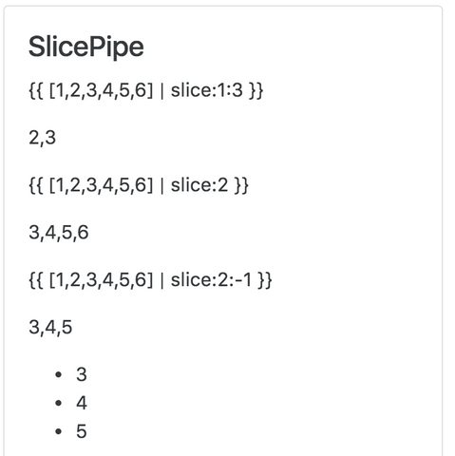
Angular Pipes :SlicePipe
This returns a slice of an array. The first argument is the start index of the slice and the second argument is the end index.
If either indexes are not provided it assumes the start or the end of the array and we can use negative indexes to indicate an offset from the end, like so:
Example:
<p>{{ [1,2,3,4,5,6] | slice:1:3 }}</p>
<p>{{ [1,2,3,4,5,6] | slice:2 }}</p>
<p>{{ [1,2,3,4,5,6] | slice:2:-1 }}</p>

Slide 12
Angular Pipes :AsyncPipe
This pipe accepts an observable or a promise and lets us render the output of an observable or promise without having to call then or subscribe.
We are going to take a much deeper look at this pipe at the end of this section.

Slide 13
Angular Pipes :Chaining Pipe
toDate | date | uppercase

Slide 14
Custom Pipe in Angular:
To create a Custom Pipe, first, You need to follow these steps
Create a pipe class
Decorate the class with @pipe decorator.
Give a name to the pipe in the name meta data of the @pipe decorator. We will use this name in the template.
The pipe class must implement the PipeTransform interface. The interfaces contain only one method transform.
The first parameter to the transform method is the value to be transferred. The transform method must transform the value and return the result. You can add any number of additional arguments to the transform method.
Declare the pipe class in the Angular Module (app.module.ts)
Use the custom pipe just as you use other pipes.

Slide 15
Thank You

