Slide 1
LINQ ARCHITECTURE
C#
vb
OTHER LANG.
.Net Language Integrated Query
LINQ to Objects
LINQ to DataSet
LINQ to Entitities
LINQ to XML
XML
Objects
In Memory
Relational

Slide 2
Features of Language Integerated Query
LINQ offers a consistent model for working with data across various kinds of data sources and formats.
A uniform way to access and manage data irrespective of data sources.
And it is Integrated feature in .Net language
1 Compile time syntax checking and intelli sense available
Standard Query operators available which help in traversal , filter and projection operation in the code.
LINQ API:
System.Linq namespaces provide classes and interfaces
System.Data.Linq contains classes that support interaction with relational data in SQL Server db
System.XML.Linq namespace contains classes for working with XML data.

Slide 3
Query Operators
Functionality | Operators
Projection | Select,SelectMany
Restriction | Where
Ordering | OrderBy,ThenBy
Grouping | GroupBy
Quantifiers | Any ,All
Partitioning | Take,Skip,TakeWhile,SkipWhile
Sets | Distinct,Union,and Intersect,Except
Elements | First,FirstOrDefault,ElementAt
Aggregation | Count,Sum,Min,Max,Average

Slide 4
General Syntax of LINQ Query
var result = from p in datasource
select p;
Example :
var result = from p in products
new select p.Id,p.Name,p.Quantity,p.price;

Slide 5
Skip,SkipWhile,Take,TakeWhile
Method | Description
Skip | Skips elements up to a specified position starting from the first element in a sequence.
SkipWhile | Skips elements based on a condition until an element does not satisfy the condition. If the first element itself doesn't satisfy the condition, it then skips 0 elements and returns all the elements in the sequence.
Take | Takes elements up to a specified position starting from the first element in a sequence.
TakeWhile | Returns elements from the first element until an element does not satisfy the condition. If the first element itself doesn't satisfy the condition then returns an empty collection.

Slide 6
LINQ to In Memory Objects
Int [] Numbers={10,20,30,3,45,23,7,67,35};
Var result= from n in Numbers where n < 5
orderBy n
Select n;

Slide 7
DataContext Class:Object Relational Mapping
ORM class: System.Data.Linq.DataContext

Slide 8
What are the Categories of LINQ? Operators?
In LINQ, the operators are divided into the following categories:
Projection Operators
Ordering Operators
Filtering Operators
Set Operators
Quantifier Operators
Grouping Operators
Partitioning Operators
Equality Operators
Element Operators
Conversion Operators
Concatenation Operators
Aggregation Operators
Generation Operators
Join Operators
Custom Sequence Operators

Slide 9
What are Projection Methods or Operators available in LINQ? There are two methods available in projection
Select
SelectMany

Slide 10
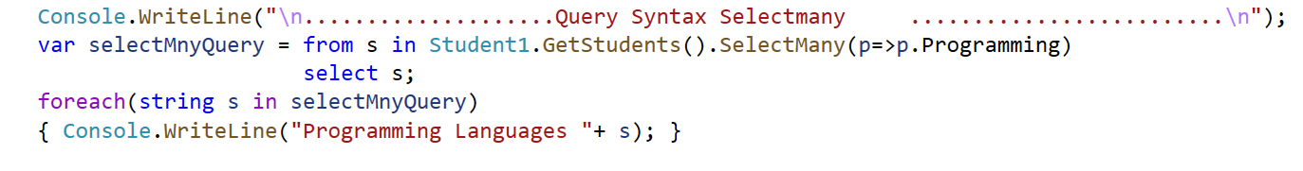
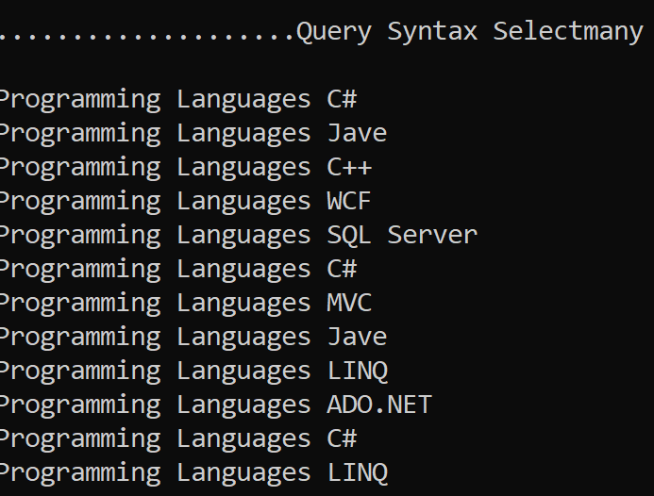
What is Linq SelectMany?
That means the SelectMany operator combines the records from a sequence of results and then converts it into one result.

Slide 11
What is Filtering?
Filtering is nothing but the process to get only those elements from a data source that satisfied the given condition. It is also possible to fetch the data from a data source with more than one condition as per our business requirement.
There are two methods provided by LINQ in C# which are used for filtering. They are as follows
Where
OfType
The “where” always expects at least one condition and we can specify the condition(s) using predicates. The conditions can be written using the following symbols
==, >=, <=, &&, ||, >, <, etc.

Slide 12
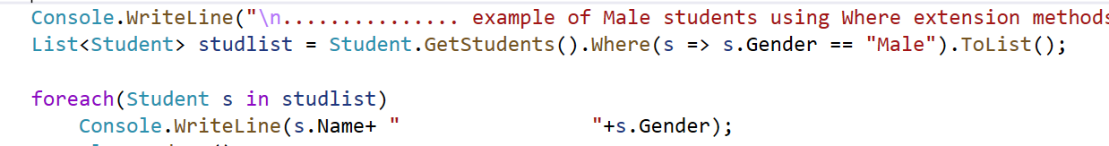
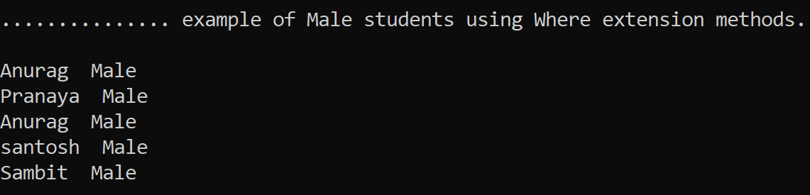
Example:

Slide 13
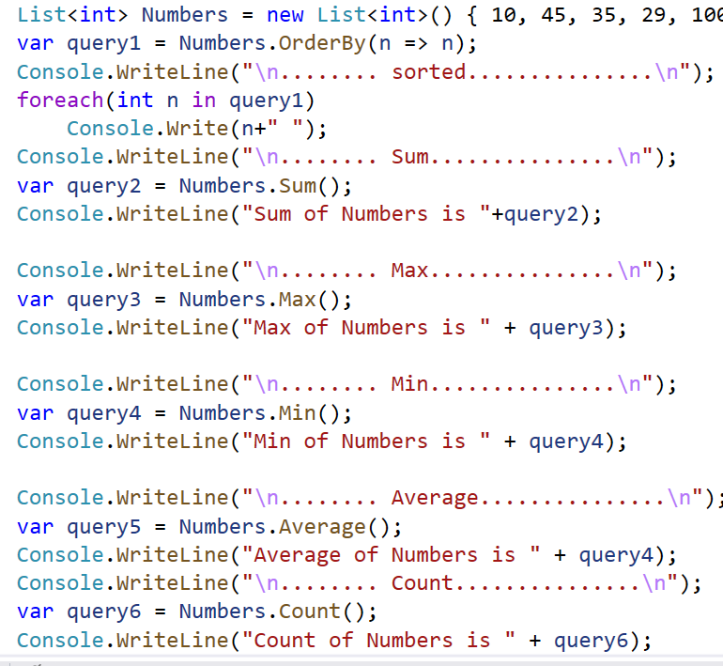
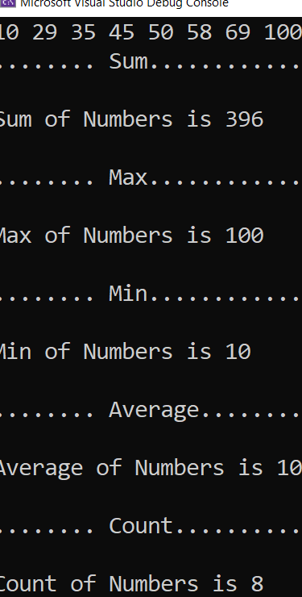
Methods For Aggregate Function

Slide 14
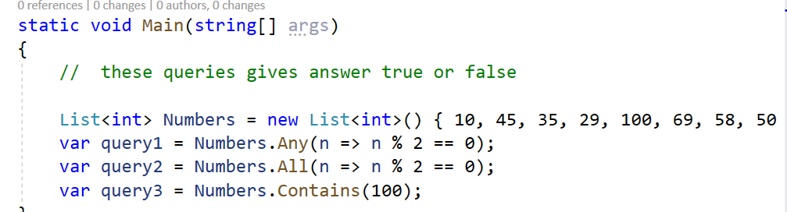
What are the LINQ Quantifier? Operations?
We need to use the LINQ Quantifier Operators on a data source when we want to check if some or all of the elements of that data source satisfy a condition or not

Slide 15
First Method in Linq:
The Linq First Method is used to return the first element from a data source. If the data source is empty, then this method will throw an exception.
Whenever the data source is empty or if the specified condition does not return any data, then we will get the InvalidOperationException

Slide 16
FirstOrDefault Method in Linq:
The Linq FirstOrDefault method exactly does the same thing as the First method except that this method does not throw Invalid Operation Exception instead it returns the default value based on the data type of the element.

Slide 17
TakeWhile()
TakeWhile(<predicate>) method
TakeWhile() behaves similarly to the Take() method except that instead of taking the first n elements of a sequence, it "takes" all of the initial elements of a sequence that meet the criteria specified by the predicate, and stops on the first element that doesn't meet the criteria. It then returns a new sequence containing all the "taken" elements.
List<int> ints = new List<int> { 1, 2, 4, 8, 4, 2, 1 }; // Will contain { 1, 2, 4 }
IEnumerable<int> result = ints.TakeWhile(theInt => theInt < 5);

Slide 18
SkipWhile()
SkipWhile(<predicate>) method
Just as Skip() is the spiritual opposite of Take(), SkipWhile() is the opposite of TakeWhile(). SkipWhile() "skips" the initial elements of a sequence that meet the criteria specified by the predicate and returns a new sequence containing the first element that doesn't meet the criteria as well as any elements that follow.
the predicate is provided as a delegate method that takes a single element of type T and returns a bool indicating whether or not the passed-in element should be "skipped".
List<int> ints = new List<int> { 1, 2, 4, 8, 4, 2, 1 };
// Will contain { 4, 8, 4, 2, 1 }
IEnumerable<int> result = ints.SkipWhile(theInt => theInt != 4);

Slide 19
Single Method in Linq:
The Linq Single Method is used to returns a single element from a data source or you can say from a sequence
This method simply returns the only element from a sequence. If the data source is empty or if the data source contains more than one element, then it throws an exception.

Slide 20
SingleOrDefault Method in Linq:
Both Single and SingleOrDefault methods in Linq are used to returns a single element from a sequence.
But if the sequence is empty or if no element is satisfied with the given condition, then the Single method will throw an exception while the SingleOrDefault method will not throw an exception instead it returns a default value.

