Slide 1
.NET Core
Sarita Lad
DATE

Slide 2
What is .net core?
.NET Core is a new version of .NET Framework, which is a free, open-source, general-purpose development platform maintained by Microsoft. It is a cross-platform framework that runs on Windows, macOS, and Linux operating systems.
.NET Core is written from scratch to make it modular, lightweight, fast, and cross-platform Framework. It includes the core features that are required to run a basic .NET Core app. Other features are provided as NuGet packages, which you can add it in your application as needed. In this way, the .NET Core application speed up the performance, reduce the memory footprint and becomes easy to maintain.

Slide 3
Why .NET Core?
Today, it's common to have an application that runs across devices; a backend on the web server, admin front-end on windows desktop, web, and mobile apps for consumers. So, there is a need for a single framework that works everywhere. So, considering this, Microsoft created .NET Core. The main objective of .NET Core is to make .NET Framework open-source, cross-platform compatible that can be used in a wide variety of verticals, from the data center to touch-based devices.

Slide 4
.NET Core Characteristics
Open-source Framework: .NET Core is an open-source framework maintained by Microsoft and available on GitHub under MIT and Apache 2 licenses. It is a .NET Foundation project
Cross-platform: .NET Core runs on Windows, macOS, and Linux operating systems. There are different runtime for each operating system that executes the code and generates the same output.
Consistent across Architectures: Execute the code with the same behavior in different instruction set architectures, including x64, x86, and ARM.
Wide-range of Applications: Various types of applications can be developed and run on .NET Core platform such as mobile, desktop, web, cloud, IoT, machine learning, microservices, game, etc.
Supports Multiple Languages: You can use C#, F#, and Visual Basic programming languages to develop .NET Core applications. You can use your favorite IDE, including Visual Studio 2017/2019, Visual Studio Code, Sublime Text, Vim, etc.

Slide 5
.NET Core Characteristics
Modular Architecture: .NET Core supports modular architecture approach using NuGet packages. There are different NuGet packages for various features that can be added to the .NET Core project as needed. Even the .NET Core library is provided as a NuGet package. The NuGet package for the default .NET Core application model is Microsoft.NETCore.App.
This way, it reduces the memory footprint, speeds up the performance, and easy to maintain.
CLI Tools: .NET Core includes CLI tools (Command-line interface) for development and continuous-integration.
Flexible Deployment: .NET Core application can be deployed user-wide or system-wide or with Docker Containers.
Compatibility: Compatible with .NET Framework and Mono APIs by using .NET Standard specification.

Slide 6
.NET Core Characteristics
.NET Core 3.x applications only run on .NET Core Framework.
.NET Core 2.x applications run on .NET Core as well as .NET Framework.

Slide 7
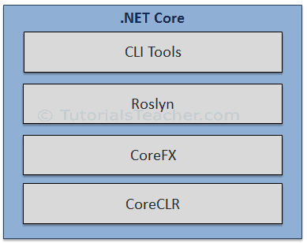
.NET Core Composition
The .NET Core Framework composed of the following parts:
CLI Tools: A set of tooling for development and deployment.
Roslyn: Language compiler for C# and Visual Basic
CoreFX: Set of framework libraries.
CoreCLR: A JIT based CLR (Command Language Runtime).

Slide 8
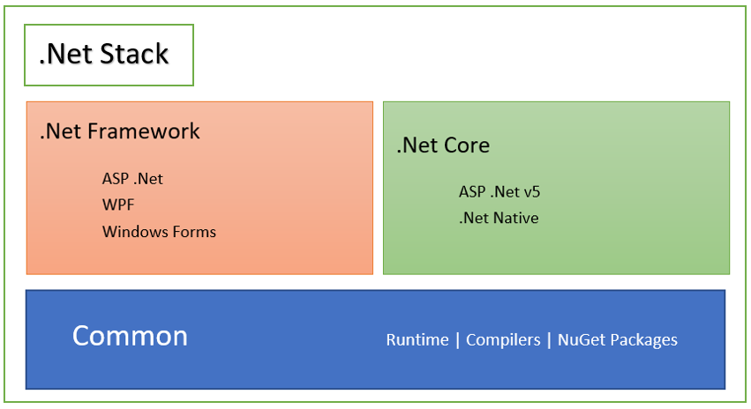
What is .NET Core Details
.Net Core has been designed keeping in mind various needs and purposes, focusing on Web Development, Windows Phone Development, and Windows Store Apps Development. .Net Core is a subset of the .Net Framework.
This is where .Net Core sits in the .Net Stack. The various .Net Frameworks and libraries, till date, use the common runtime libraries, compilers, and NuGet Packages. They build their own platform-specific libraries on top of these common packages. The Common libraries contain the definitions for primitive stuff such as data types. This hardly changes and is thus the base for all .Net stack frameworks.

Slide 9
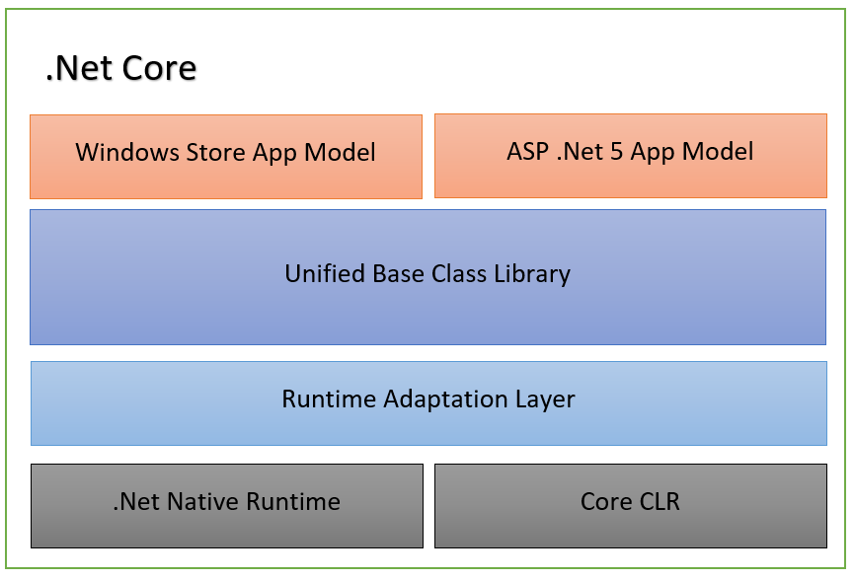
Key Terminologies in the Architecture of .NET Core
Core CLR: Core CLR is the Common Language Runtime optimized for multiplatform and cloud-based deployments. This, along with .Net Native Runtime, forms the foundation of all .Net based platforms.
.Net Native Runtime: Also referred to as Managed Runtime, .Net Native Runtime contains the native windows based libraries. This also contains Ahead Of Time (AOT) compilation instead of the erstwhile Just In Time (JIT) compilation. This improves the performance of the applications. The .Net Native Runtime and the Core CLR are the layers that contain implementations of primitive types as well as generic collections in .Net. These layers hardly change and are constant throughout the various .Net stacks. The various .Net stack APIs, thus, share the same implementations.
Unified BCL: The Unified Base Class Library, also referred to as CoreFX, consists of the basic and fundamental classed that form the core of the .Net Core platform.
App Models: On top of the BCL, sit the various App Models that developers leverage to develop platform-specific applications. Currently, .Net Core has the ASP .Net Model for web development and Windows Store Model for windows application development.

Slide 10
Power of NuGet
.Net core Framework, is delivered as a set of NuGet packages in contrast to single package of .net Framework.So it has been factored, modularized and shipped as several NuGet packages.
Reasons behind this modularity are as follows:
NuGet allows delivering .Net Core in an agile fashion. Any upgrade to any .Net Core feature can simply be consumed by upgrading the NuGet package.
This has generalized the dependencies in your applications. Now there are no assembly references, libraries, and third-party NuGet references. They are all NuGet now. So, if any third-party NuGet package required a higher version of the System.Collections library, it will prompt you to upgrade the corresponding System. Collections NuGet package and you are done. It really becomes very simple.
The modular approach of .Net Core ensures that each application deploys only the packages that they need. No extra baggage.

Slide 11
Thank You

