Slide 1
Cross-site Scripting (XSS)
Sarita Lad
DATE

Slide 2
Cross-site Scripting (XSS)
Cross-site Scripting (XSS) is a client-side code injection attack. The attacker aims to execute malicious scripts in a web browser of the victim by including malicious code in a legitimate web page or web application. The actual attack occurs when the victim visits the web page or web application that executes the malicious code. The web page or web application becomes a vehicle to deliver the malicious script to the user’s browser. Vulnerable vehicles that are commonly used for Cross-site Scripting attacks are forums, message boards, and web pages that allow comments.
A web page or web application is vulnerable to XSS if it uses unsanitized user input in the output that it generates. This user input must then be parsed by the victim’s browser. XSS attacks are possible in VBScript, ActiveX, Flash, and even CSS. However, they are most common in JavaScript, primarily because JavaScript is fundamental to most browsing experiences.

Slide 3
Is Your Website or Web Application Vulnerable to Cross-site Scripting?
Cross-site Scripting vulnerabilities are one of the most common web application vulnerabilities. The OWASP organization (Open Web Application Security Project) lists XSS vulnerabilities in their OWASP Top 10 2017 document as the second most prevalent issue.
Fortunately, it’s easy to test if your website or web application is vulnerable to XSS and other vulnerabilities by running an automated web scan using the Acunetix vulnerability scanner, which includes a specialized XSS scanner module. Take a demo and find out more about running XSS scans against your website or web application. An example of how you can detect blind XSS vulnerabilities with Acunetix is available in the following article: How to Detect Blind XSS Vulnerabilities.

Slide 4
“Isn’t Cross-site Scripting the User’s Problem?”
If an attacker can abuse an XSS vulnerability on a web page to execute arbitrary JavaScript in a user’s browser, the security of that vulnerable website or vulnerable web application and its users has been compromised. XSS is not the user’s problem like any other security vulnerability. If it is affecting your users, it affects you.
Cross-site Scripting may also be used to deface a website instead of targeting the user. The attacker can use injected scripts to change the content of the website or even redirect the browser to another web page, for example, one that contains malicious code.

Slide 5
What Can the Attacker Do with JavaScript?
Malicious JavaScript has access to all the objects that the rest of the web page has access to. This includes access to the user’s cookies. Cookies are often used to store session tokens. If an attacker can obtain a user’s session cookie, they can impersonate that user, perform actions on behalf of the user, and gain access to the user’s sensitive data.
JavaScript can read the browser DOM and make arbitrary modifications to it. Luckily, this is only possible within the page where JavaScript is running.
JavaScript can use the XMLHttpRequest object to send HTTP requests with arbitrary content to arbitrary destinations.
JavaScript in modern browsers can use HTML5 APIs. For example, it can gain access to the user’s geolocation, webcam, microphone, and even specific files from the user’s file system. Most of these APIs require user opt-in, but the attacker can use social engineering to go around that limitation.

Slide 6
How Cross-site Scripting Works
There are two stages to a typical XSS attack:
To run malicious JavaScript code in a victim’s browser, an attacker must first find a way to inject malicious code (payload) into a web page that the victim visits.
After that, the victim must visit the web page with the malicious code. If the attack is directed at particular victims, the attacker can use social engineering and/or phishing to send a malicious URL to the victim.
For step one to be possible, the vulnerable website needs to directly include user input in its pages. An attacker can then insert a malicious string that will be used within the web page and treated as source code by the victim’s browser. There are also variants of XSS attacks where the attacker lures the user to visit a URL using social engineering and the payload is part of the link that the user clicks.

Slide 7
The following is a snippet of server-side pseudocode that is used to display the most recent comment on a web page:
print "<html>"
print "<h1>Most recent comment</h1>“
print database.latestComment
print "</html>"
The above script simply takes the latest comment from a database and includes it in an HTML page. It assumes that the comment printed out consists of only text and contains no HTML tags or other code. It is vulnerable to XSS, because an attacker could submit a comment that contains a malicious payload, for example:
<script>doSomethingEvil();</script>
The web server provides the following HTML code to users that visit this web page:
<html>
<h1>Most recent comment</h1>
<script>doSomethingEvil();
</script>
</html>

Slide 8
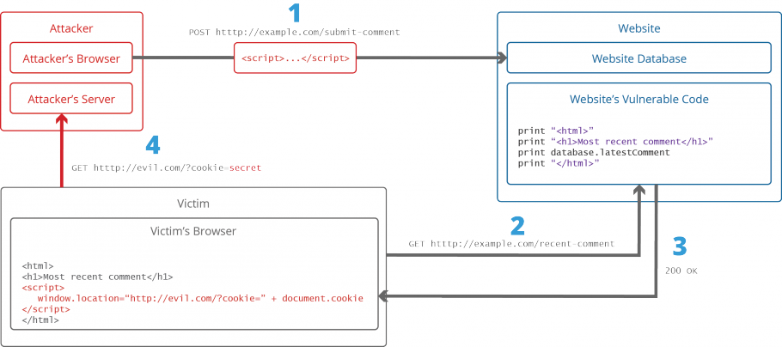
Stealing Cookies Using XSS
Criminals often use XSS to steal cookies. This allows them to impersonate the victim. The attacker can send the cookie to their own server in many ways. One of them is to execute the following client-side script in the victim’s browser:

Slide 9


How to Prevent XSS
To keep yourself safe from XSS, you must sanitize your input. Your application code should never output data received as input directly to the browser without checking it for malicious code.
Step 1: Train and maintain awareness
To keep your web application safe, everyone involved in building the web application must be aware of the risks associated with XSS vulnerabilities. You should provide suitable security training to all your developers, QA staff, DevOps, and SysAdmins. You can start by referring them to this page.
Step 2: Don’t trust any user input
Treat all user input as untrusted. Any user input that is used as part of HTML output introduces a risk of an XSS. Treat input from authenticated and/or internal users the same way that you treat public input.

Slide 10
Slides

Slide 11


Step 3: Use escaping/encoding
Use an appropriate escaping/encoding technique depending on where user input is to be used: HTML escape, JavaScript escape, CSS escape, URL escape, etc. Use existing libraries for escaping, don’t write your own unless absolutely necessary.
Step 4: Sanitize HTML If the user input needs to contain HTML, you can’t escape/encode it because it would break valid tags. In such cases, use a trusted and verified library to parse and clean HTML. Choose the library depending on your development language, for example, HtmlSanitizer for .NET or SanitizeHelper for Ruby on Rails.

Slide 12
Thank You

