Slide 1
Swagger UI
Sarita Lad
DATE

Slide 2
Configuring and Using Swagger UI in ASP.NET Core Web API
The Need for Documenting our API
Developers who consume our API may try to solve important business problems with it. Hence it is very important for them to understand how to use our API effectively. This is where API documentation comes into the picture.
The API documentation is the process of giving instructions about how to effectively use and integrate an API. Hence it can be thought of as a concise reference manual containing all the information required to work with the API, with details about the functions, classes, return types, arguments, and more, supported by tutorials and examples.

Slide 3
Swagger/Open API
Swagger is a language-agnostic specification for describing REST APIs. The Swagger is also referred to as OpenAPI. It allows us to understand the capabilities of a service without looking at the actual implementation code.
Swagger minimizes the amount of work needed while integrating an API. Similarly, it also helps API developers to document their APIs quickly and accurately.
Swagger Specification
Swagger Specification is an important part of the Swagger flow. By default, a document named swagger.json is generated by the Swagger tool which is based on our API. It describes the capabilities of our API and how to access it via HTTP.

Slide 4
Swagger UI
Swagger UI offers a web-based UI that provides information about the service. This is built using the Swagger Specification and embedded inside the Swashbuckle package and hence it can be hosted in our ASP.NET Core app using middlewares.

Slide 5
Integrating Swagger UI into our Applications
We can use the Swashbuckle package to easily integrate Swagger into our .NET Core Web API projects. It will generate the Swagger specification for our project. Additionally, the Swagger UI is also contained within Swashbuckle.
There are three main components in the Swashbuckle package:
Swashbuckle.AspNetCore.Swagger: This contains the Swagger object model and the middleware to expose SwaggerDocument objects as JSON.
Swashbuckle.AspNetCore.SwaggerGen: A Swagger generator that builds SwaggerDocument objects directly from our routes, controllers, and models.
Swashbuckle.AspNetCore.SwaggerUI: An embedded version of the Swagger UI tool. It interprets Swagger JSON to build a rich, customizable experience for describing the web API functionality.

Slide 6
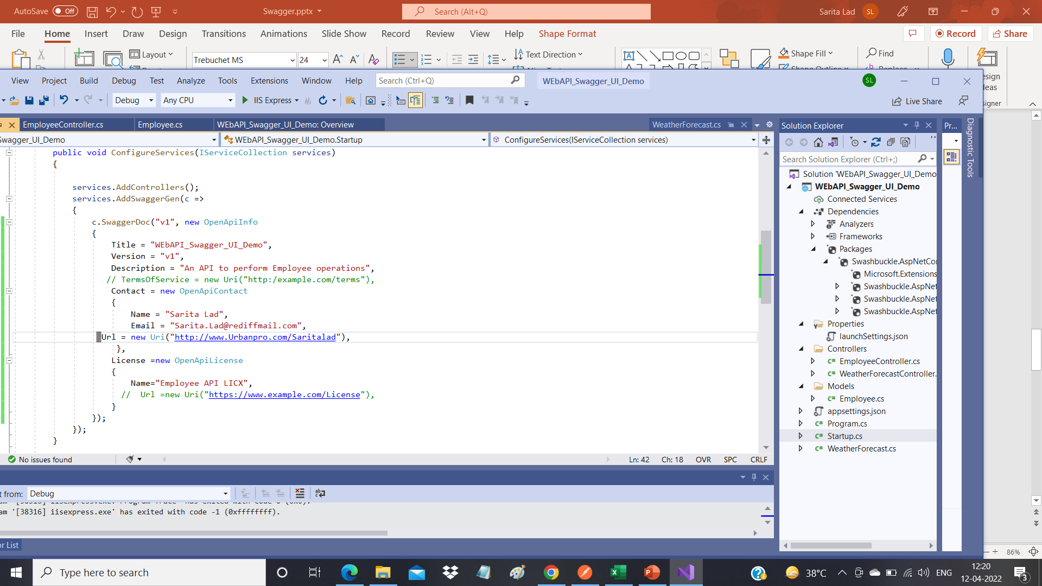
Customised Swagger code in startUp File

Slide 7
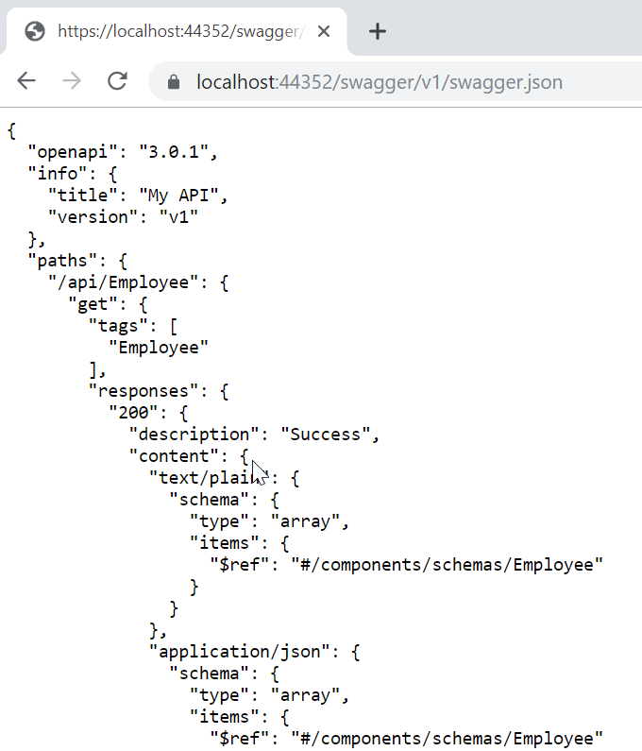
Swagger UI
When You run the app and navigate to https://localhost:<port>/swagger/v1/swagger.json. We can see that a document describing the endpoints is generated:

Slide 8
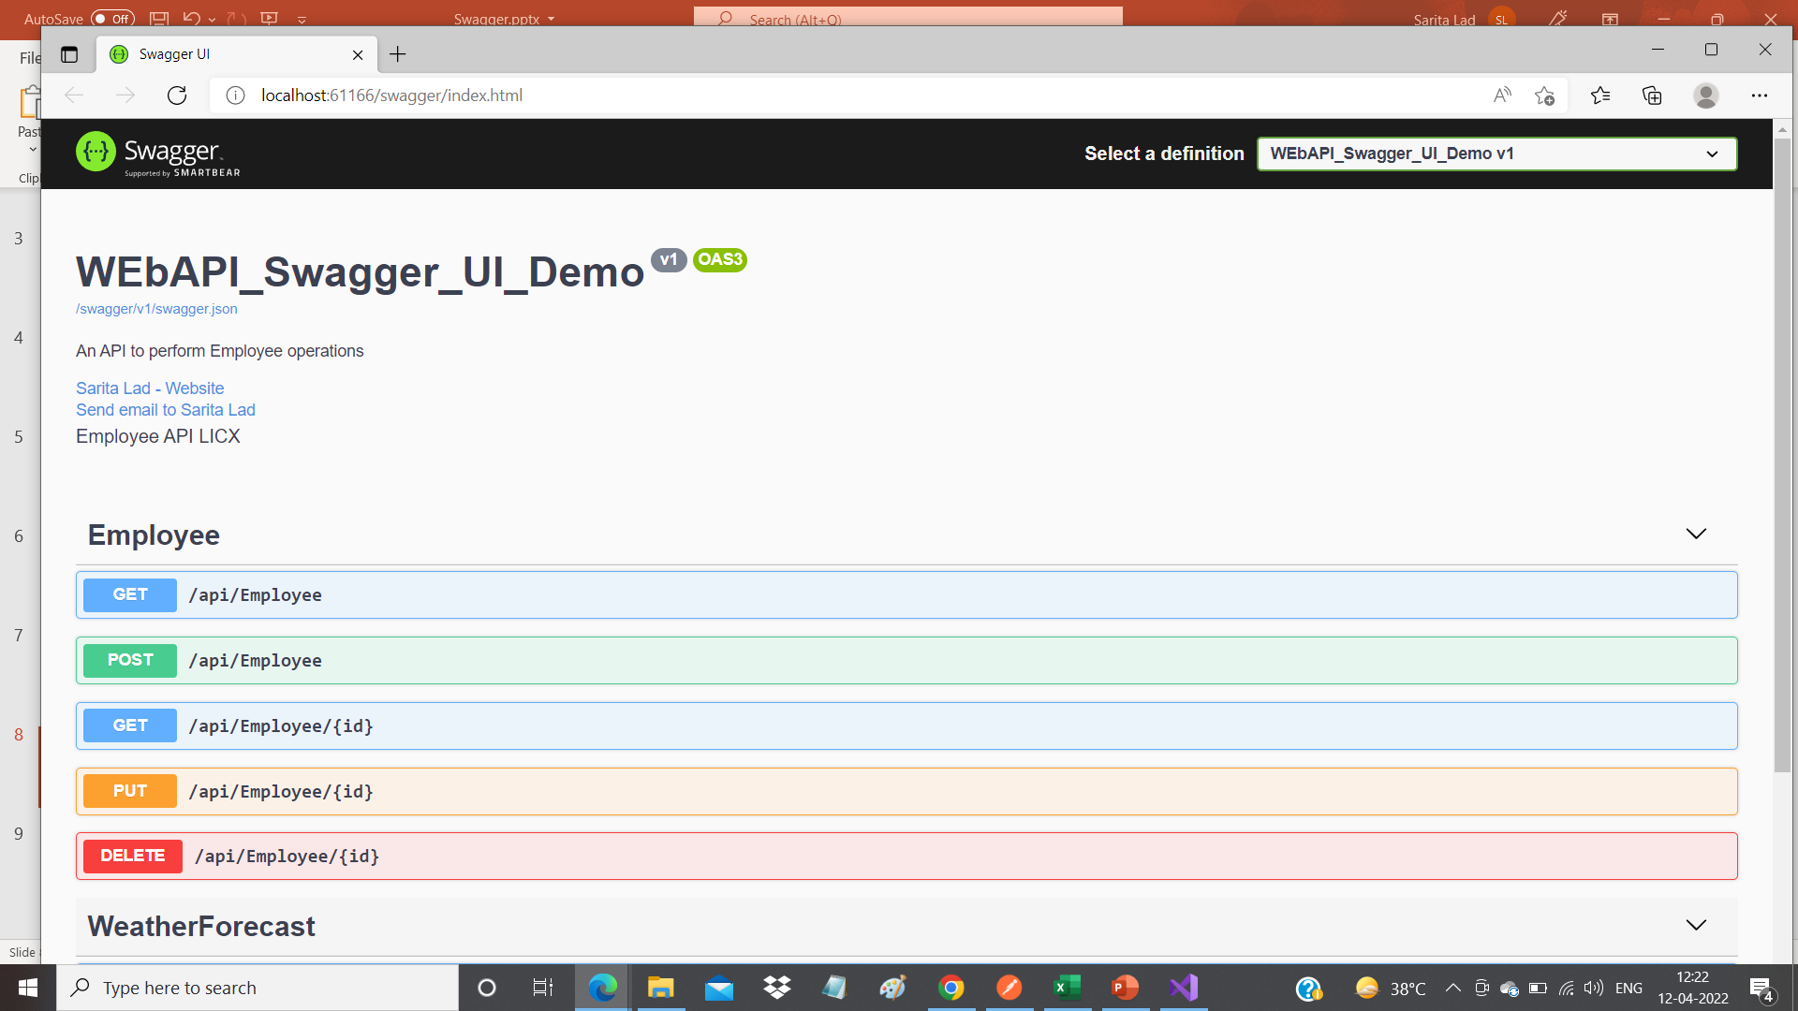
Slides

Slide 9
Thank You

