Slide 1
Introduction to Angular 2 version 12.0
Sarita Lad
31 march 2022

Slide 2
Angular history
Angular 1 / Angular JS was released in October 2010,
Prior to its release, a Google employee by the name of Miško Hevery, was developing a side project. This side project was to help make building web applications easier for a couple internal projects he was working on. This side project later became known as AngularJS (Angular because of the < > in HTML).
React JS , A JS Library used was developed by Facebook as a open source in 2013 . This was a component based , modular and highly reusable for faster development.
Component based architecture became most popular in tech community . And then Google improved their JS Framework in 2016 and named it as Angular 2.

Slide 3
Slides
features of Angular 2
Cross-Platform. With Angular, you can develop progressive web applications (PWA). ...
High Speed & Optimum Performance. ...
Angular Applications for Everyone. ...
MVC Architecture. ...
Efficient Two-Way Data Binding. ...
Less Code Framework. ...
Angular CLI (Command Line Interface) ...
CDK and Angular Material.

Slide 4
Slides
Key features of Angular 2
Components − The earlier version of Angular had a focus of Controllers but now has changed the focus to having components over controllers. Components help to build the applications into many modules. This helps in better maintaining the application over a period of time.
TypeScript − The newer version of Angular is based on TypeScript. This is a superset of JavaScript and is maintained by Microsoft.
Services − Services are a set of code that can be shared by different components of an application. So for example if you had a data component that picked data from a database, you could have it as a shared service that could be used across multiple applications.

Slide 5
What is Angular 2 ?
In the world of web development, Angular is a popular term that we come across. It is an open-source front-end application development platform.
Angular is a web application development platform that has made the life of developers simple.
It has combined declarative templates (meaning that we simply state what we want to be bound and used and let the framework figure out the rest), dependency injection (a technique where one object has delegated the responsibility of handling the dependencies of another), end-to-end tooling, & integrated best practices to ease development problems.
It also helps us build applications that reside on the web, our mobiles, or our desktops.

Slide 6
Slides
What is Angular CLI?
Angular CLI stands for the ‘command line interface’. It is an interface used to scaffold and develop Angular apps using node.js style modules.
It handles all the common tedious tasks in addition to providing us with a scalable project structure.
One of the advantages of using Angular CLI is that the time needed for installing and configuring the necessary dependencies and wiring everything together reduces significantly.

Slide 7
Grammar :naming convensions:
1. File structure conventions
The guideline uses the shortcut hero.component.ts|html|css|spec to represent those various files. Using this shortcut makes this guide’s file structures easier to read and more terse.
2. Single responsibility
A class should have one and only one reason to change meaning that a class should have only one job.
Do define one thing such as a service or component per file
One component per file makes it far easier to read, maintain, and avoid collisions with teams in source control.
3. Naming
3.1 Naming conventions are hugely important to maintainability and readability. The recommended pattern is feature.type.ts.
3.2 Separate filenames with dots and dashes
Do use conventional type names including .service, .component, .pipe, .module, and .directive. Invent additional type names if you must but take care not to create too many.
3.3 Symbols and file names
Do use upper camel case for class names.
Do match the name of the symbol to the name of the file.
Do give the filename the conventional suffix (such as .component.ts, .directive.ts, .module.ts, .pipe.ts, or .service.ts) for a file of that type.

Slide 8
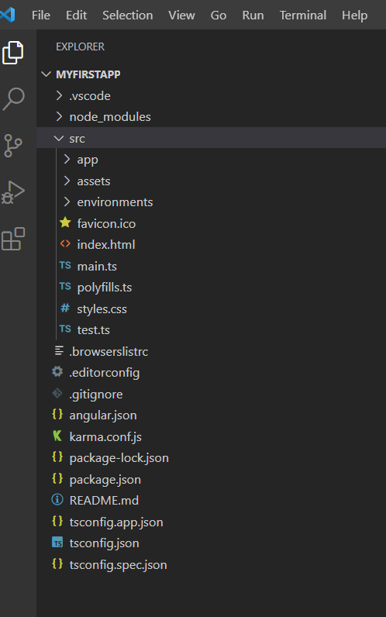
Basic Structure Of An Angular Application
node_modules folder
This folder is generated when we run "npm install" command. This folder contains third-party libraries and files. All these files are bundled in our project together.
app folder
Contains "modules" and "components" for our Angular application.
It basically has,
app.component.css - Contains the CSS code for the component.
app.component.html - HTML file pointing to the app component. It is a template for the angular application.
app.component.spec.ts - Unit testing file associated with app component. It can be generated using "ng test" command.
app.component.ts - Entire functional logic is written in this file.
app.module.ts - TypeScript file holds all dependencies. Here we will use "NgModule" and define the Bootstrap component when loading the application.
assets folder
Here we will keep resources such as images, styles, icons, etc.
environments folder
It contains the environment configuration constants that help while building the angular application. It has environment.ts and environment.prod.ts. These configurations are used in angular.json file.
index.html
Basic HTML file.
main.ts
The starting point of our application. It bootstraps/starts the AppModule from the app.module.ts file.
polyfills.ts
This file is used to compile our TypeScript to specific JavaScript methods. Provides compatibility support for Browser versions.

Slide 9
continued
styles.css
Global CSS file.
tests.ts
It is the main test file. When we run the "ng test" command, this file is taken into consideration.
.browserslistrc file
Browser compatibility and versions are mentioned in this file. This configuration is pointed to in our package.json file.
.editorconfig
This file deals with consistency in code editors to organize some basics such as indentation and whitespaces. More like code formatting.
angular.json
This file defines the structure of our application. It includes settings associated with our application. Also, we can specify the environments on this file. For example, development, production, etc.
karma.conf.js
This is the configuration file for the Karma Test Runner. It is used in Unit Testing.
package.json
This is the npm configuration file. All the dependencies mentioned in this file. We can modify dependency versions as per our need on this file.
package-lock.json
Whenever we change something on the node_modules or package.json, this file will be generated. It is associated with npm.
tsconfig.app.json
This configuration file overrides the tsconfig.json file with relevant app-specific configurations.
tsconfig.base.json
This file has been introduced in Angular 10+. It has the same configuration as compared to tsconfig.json file.
tsconfig.json
TypeScript compiler configuration file. This is responsible for compiling TypeScript to JavaScript so that the browser will understand.
tsconfig.spec.json
This file overrides the tsconfig.json file with app-specific unit test configurations while running the "ng test" command.
tslint.json
tslint.json is a static analysis tool. This file keeps track of the TypeScript code for readability, maintainability, and functionality errors.

Slide 10

With this great framework and great project structure, there’s a complex flow going behind the scenes. To understand the working in a better way and making the debugging of it easier, it is necessary to understand the flow of the angular app when it is in the development mode.
1. ANGULAR.JSON File
ANGULAR.JSON is the file which has various properties and configuration of your Angular project. This is the file which is first referred by the builder to look for all the paths and configurations and to check which is the main file. I have generated an angular MyFirstApp app by the CLI. Inside the angular.json file of this project, under the build section, you can see the options object as follows

Slide 11
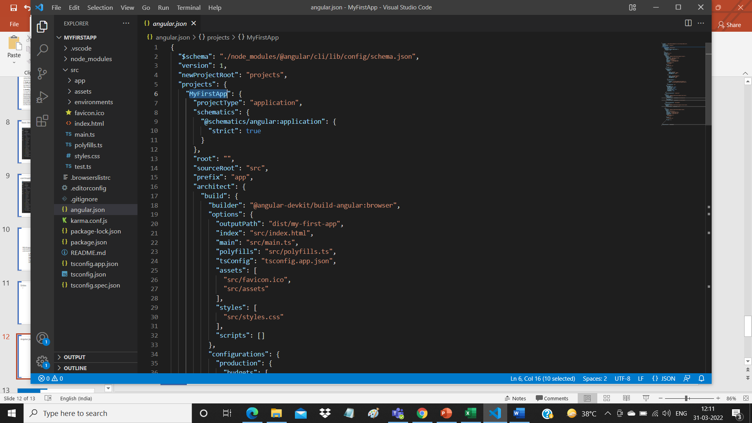
angular.json File
It has a reference to the main.ts file which tells the builder to start the app from there.

Slide 12
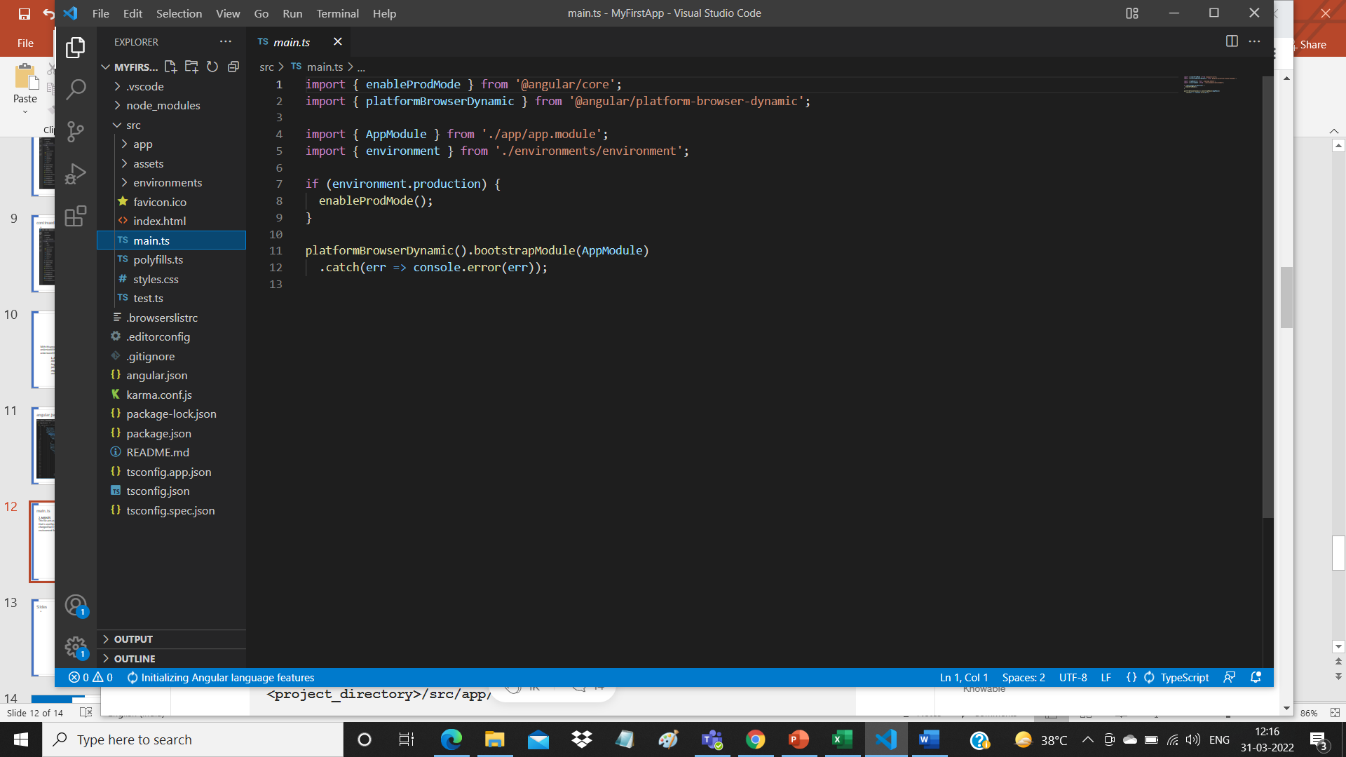
main.ts
2. MAIN.TS
This file acts as the entry point of the application. This entry point is defined in the internals of webpack that is used by Angular to support the modular functionality. The path/name of the main file can be changed but it should also be changed in angular.json file. Main.ts helps in creating the browser environment for the application to run. This is done by:
After this, main.ts file calls the function bootstrapModule(AppModule) which tells the builder to bootstrap the app.
platformBrowserDynamic().bootstrapModule(AppModule)

Slide 13
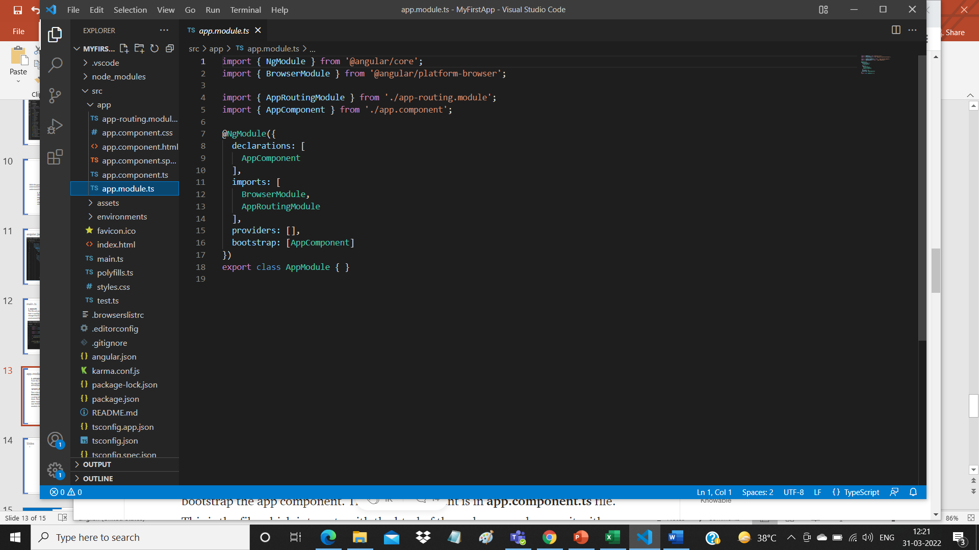
app.module.ts
3. APP.MODULE.TS
From the main.ts file, it is very clear that we are bootstrapping the app with AppModule. This AppModule is defined in APP.MODULE.TS file which is found in
<project_directory>/src/app/app.module.ts
This is the module, created with the @NgModule decorator, which has declarations of all the components we are creating within the app module so that angular is aware of them. Here, we also have imports array where we can import other modules and use in our app. Below is an example of app.module.ts file with a test component declared and two modules imported.

Slide 14
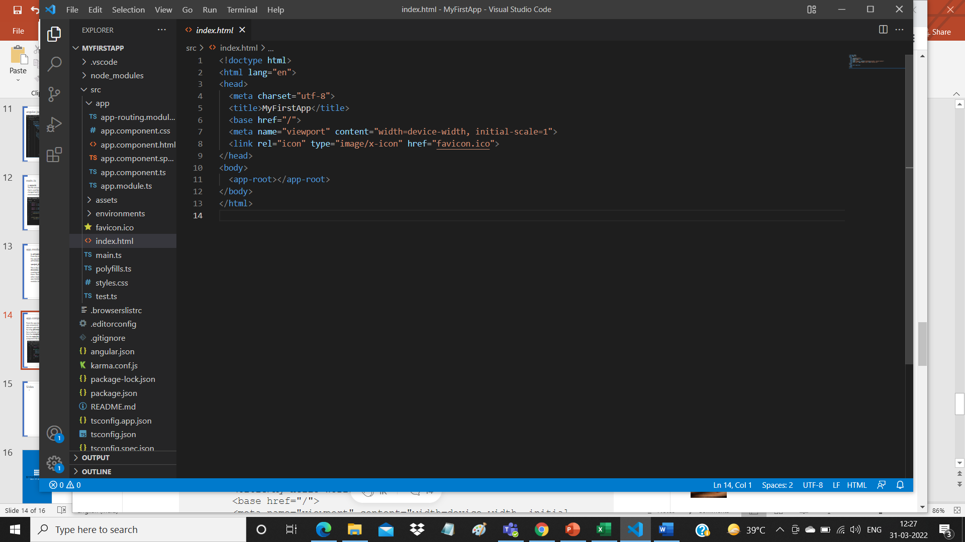
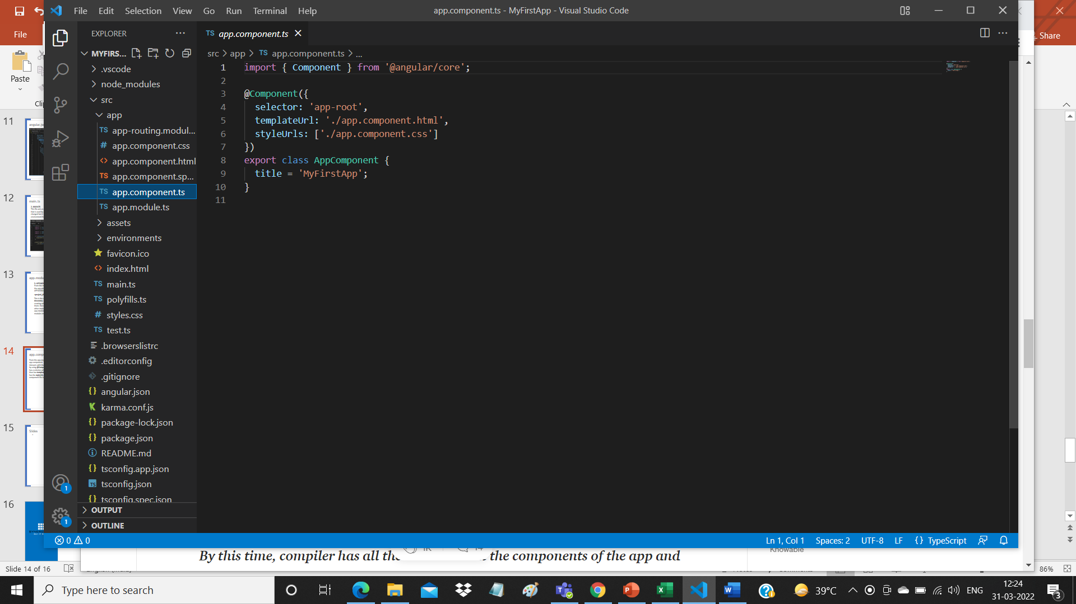
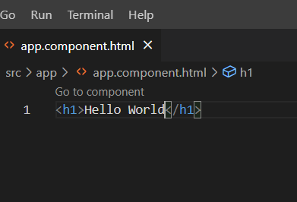
app.component.ts
From the app.module.ts file above, we can clearly see that the module asks to bootstrap the app component. This app component is in app.component.ts file. This is the file which interacts with the html of the webpage and serves it with the data. The component is made by using @Component decorator which is imported from @angular/core. The component has a selector, which is like a custom html tag which we can use to call that component. It then has template or templateUrl which contains the html of the page to be displayed. It also has the styleUrls array where component specific style sheets can be placed. This is how a component file looks

Slide 15
Thank You
This is all about How Angular works!!!

