Slide 1
INTRODUTION TO HTML
Explained By:
Sarbjit Kaur.
Lecturer, Department of Computer Application,
PGG.C.G., Sector: 42, Chandigarh

Slide 2
HTML CONTENTS
INTRODUCTION OF HTML
OBJECTIVE OF HTML
WORLD WIDE WEB
HTML TOOLS
HTML TERMINOLGY
HOW TO CREATE AN HTML DOCUMENT
S A V I N G A N D V I E W I N G A H T M L DOCUMENT
TEXT TEGS
SPECIAL CHARTACTER
ADVANTAGES OF HTML
DISADVANTAGES OF HTML

Slide 3
INTRODUCTION OF HTML
HTML is a language for describing web pages.
HTML stands for Hyper Text Markup Language
HTML is not a programming language, it is a markup language
A markup language is a set of markup tags
HTML uses markup tags to describe web pages

Slide 4
INTRODUCTION OF HTML
HTML (Hypertext Markup Language) is used to create document on the World Wide Web. It is simply a collection of certain key words called ‘Tags’ that are helpful in writing the document to be displayed using a browser on Internet.
It is a platform independent language that can be used on any platform such as Windows, Linux, Macintosh, and so on. To display a document in web it is essential to mark-up the different e l eme n t s ( h e a d i n g s , p a r a g r a p h s , t a b l e s , a n d s o o n ) o f t h e document with the HTML tags. To view a mark-up document u s e r h a s t o o p e n t h e d o c u m e n t i n a b r o w s e r . A b r o w s e r understands and interpret the HTML tags, identifies the structure of the document (which part are which) and makes decision about presentation (how the parts look) of the document.
HTML also provides tags to make the document look attractive using graphics, font size and colors. User can make a link to the other document or the different section of the same document by creating Hypertext Links also known as Hyperlinks

Slide 5
OBJECTIVE OF HTML
create, save and view a HTML document
format a web page using section heading tags
describe Ordered and Unordered lists
explain graphics in HTML document
describe hypertext links and making text/image link

Slide 6
WORLD WIDE WEB
The World Wide Web (abbreviated as WWW or W3 and commonly known as the Web)is a system of interlinked hypertext documents accessed via the Internet. With a web browser, one can view web pages that may contain text, images, videos, and other multimedia and navigate between them via hyperlinks.

Slide 7
HTML TOOLS
There are two tools of HTML.
HTML Editor: it is the program that one uses to create and save HTML documents. They fall into two categories:
- Text based or code based which allows one to see the HTML code as one is creating a document.e.g. Notepad.
- Netscape composer

Slide 8
HTML TOOLS
b) Web Browser: it is the program that one uses to view and test the HTML documents. They translate Html encoded files into text,image,sounds and other features user see. Microsoft Internet Explorer,Netscape,Mosaic Chrome are examples of browsers that enables user to view text and images and many more other World Wide Web featueres.They are software that must be installed on user computer.

Slide 9
HTML TERMINOLGY
Some commonly used terms in HTML are:
a)Tag: Tags are always written within angles brackets. it is a piece of text is used to identify an element so that the browser realizes how to display its contents.e.g.<HTML> tag indicates the start of an HTML document .HTML tag can be two types. They are:-
-Paired Tags :A tag is said to be a paired tag if text is placed between a tag and its companions tag.In paired tag ,the first tag is referred to as opening tag and the second tag is referred to as closing tag.
-Unpaired Tags: An unpaired tag does not have a companion tag .unpaired tag also known as singular or Stand-Alone tags.e.g:<br>,<hr> etc.

Slide 10
HTML TERMINOLGY
b) Attribute: Attribute is the property of an tag that specified in the opening angle brackets. It supplies additional information like color,size,home font-style etc to the browser about a tag. E.g. most of the common attributes are height, color,width,src,border,align etc.
c) DTD: Document Type Definition is a collection of rules written in standard Generalized Markup Language(SGML).HTML is define in terms of its DTDS. All the details of HTML tags, entities and related document structure are defined in the DTDS.
d) ELEMENT: Element is the component of a document’s structure such as a title, a paragraph or a list. It can include an opening and a closing tag and the contents within it.

Slide 11
HOW TO CREATE AN HTML DOCUMENT
The essential tags that are required to create a HTML document are:
<HTML>.............</HTML>
<HEAD>.............</HEAD>
<BODY>.............</BODY>

Slide 12
HTML Tag <HTML>
The <HTML> tag encloses all other HTML tags and associated text within your document. It is an optional tag. You can create an HTML document that omits these tags, and your browser can still read it and display it. But it is always a good form to include the start and stop tags.The format is:
<HTML>
Your Title and Document (contains text with HTML tags) goes here
</HTML>
Most HTML tags have two parts, an opening tag and closing tag. The closing tag is the same as the opening tag, except for the slash
mark e.g. </HTML>. The slash mark is always used in closing tags.

Slide 13
An HTML document has two distinct parts HEAD and BODY
<HTML>
<HEAD>
.............
.............
.............
</HEAD>
<BODY>
.............
.............
.............
</BODY>
</HTML>

Slide 14
HEAD Tag <HEAD>
HEAD tag comes after the HTML start tag. It contains TITLE tag to give the document a title that displays on the browsers title bar at the top. The Format is:
<HEAD>
<TITLE>
Your title goes here
</TITLE>
</HEAD>

Slide 15
BODY Tag <BODY>
The BODY tag contains all the text and graphics of the document with all the HTML tags that are used for control and formatting of the page.The Format is:
<BODY>
Your Document goes here
</BODY>
An HTML document, web page can be created using a text editor,
Notepad or WordPad. All the HTML documents should have the
extension .htm or html. It require a web browser like Internet
Explorer or Netscape Navigator/Communicator to view the
document.

Slide 16
Attributes used with <BODY>
BGCOLOR: u s e d t o s e t t h e b a c k g r o u n d c o l o r f o r t h e document Example:
<BODY BGCOLOR="yellow">
Your document text goes here.
</BODY>
TEXT: used to set the color of the text of the document Example:
<BODY TEXT="red">Introduction to HTML:: 77
Document text changed to red color
</BODY>
Document text changed to red color

Slide 17
Attributes used with <BODY>
MARGINS: set the left hand/right hand margin of the document LEFTMARGIN: set the left hand margin of the document Example:
<BODY LEFTMARGIN="60">
This document is indented 60 pixels from the left hand side
of the page.
</BODY>
TOPMARGIN: set the left hand margin of the document Example:
<BODY TOPMARGIN="60">
This document is indented 60 pixels from the top of the page.
</BODY>

Slide 18
Attributes used with <BODY>
BACKGROUND: It is used to point to an image file (the files with an extension .gif, .jpeg) that will be used as the background of the document. The image file will be tiled across the document. Example:
<BODY BACKGROUND="filename.gif">
Your document text goes here
</BODY>

Slide 19
Follow the steps to create and view in browser
Step-1: O p e n t e x t e d i t o r N o t e p a d ( c l i c k o n Star t→ A l l Programs→ Accessories Notepad)
Step-2: Enter the following lines of code:
<HTML>
<HEAD>
<TITLE>
My first Page
</TITLE>
</HEAD>
<BODY>
WELCOME TO MY FIRST WEB PAGE
</BODY>
</HTML>

Slide 20
S A V I N G A N D V I E W I N G A H T M L DOCUMENT
Step-3: Save the file as myfirstpage.html (go to File-Save As give File name: myfirstpage.html-choose save as type: All Files-click save)
Step-4: Viewing document in web browser (open Internet Explorer-click on File-Open-Browse-select the file myfirstpage.html-click open-click ok

Slide 21
TEXT TEGS
Text tag are dividing into two categories as:
-Character-level tags and attributes which applies to formatting of individual letters or words.
-Paragraph level tags and attributes which apply
=To formatting of sections of text.

Slide 22
Character Formatting Tag
The character formatting tags are used to specify how a particular text should be displayed on the screen to distinguish certain characters within the document.

Slide 23
The most common character formatting tags are
Boldface <B>: displays text in BOLD
Example: Welcome to the <B> Internet World </B>
Output: Welcome to the Internet World
Italics <I>: displays text in Italic
Example: Welcome to the <I> Internet World </I>
Output: Welcome to the Internet World
Subscript <SUB>: displays text in Subscript
Superscript <SUP>: displays text in Superscript
Small <SMALL>: displays text in smaller font as compared to normal font
Big <BIG>: displays text in larger font as compared to normal font
Underline<U>specifies that the enclosed text be underline
Example:<U> hello</u>
Output: hello

Slide 24
Font Colors and Size:<FONT>
By using <FONT> Tag one can specify the colors, size of the text. Example:
<FONT> Your text goes here </FONT>
Attributes of <FONT> are:
- COLOR: Sets the color of the text that will appear on the
screen. It can be set by giving the value as #rr0000 for red (in RGB hexadecimal format), or by name. Example: <FONT COLOR="RED"> Your text goes here </FONT>

Slide 25
Font Colors and Size:<FONT
SIZE: Sets the size of the text, takes value between 1 and
7, default is 3. Size can also be set relative to default size
for example; SIZE=+X, where X is any integer value and it will add with the default size.
Example:
<FONT SIZE=5> Font Size changes to 5 </FONT>
FACE: Sets the normal font type, provided it is installed on the user’s machine.
Example:
<FONT FACE="ARIAL"> the text will be displayed in Arial</FONT>

Slide 26
An HTML document formatText.html shows the use of
Character Formatting Tags.
<HTML>
<HEAD>
<TITLE>
Use of Character Formatting Text Tags
</TITLE>
</HEAD>
<BODY>
<H1><I> Welcome to the world of Internet</I></H1>
It is a
<FONT COLOR="BLUE" SIZE="4">
<U>Network of Networks</U>
</FONT>
</BODY>
</HTML>

Slide 27
OUTPUT
Welcome to the world of Internet
It is a Network of Networks

Slide 28
MARQUEE TAG
This tag is used text horizontally across the screen.it is mainly used to deliver a specfic message to the visitor or to scroll Ads on a page.
Example: <marquee> hello world></marquee>

Slide 29
Attributes of marquee tag
Attribute | Value | Description
behavior | scroll slide alternate | Defines the type of scrolling.
bgcolor | rgb(x,x,x) #xxxxxx colorname | Deprecated − Defines the direction of scrolling the content.
direction | up down left right | Defines the direction of scrolling the content.
height | pixels or % | Defines the height of marquee.
hspace | pixels | Specifies horizontal space around the marquee.
loop | number | Specifies how many times to loop. The default value is INFINITE, which means that the marquee loops endlessly.
scrolldelay | seconds | Defines how long to delay between each jump.
scrollamount | number | Defines how how far to jump.
width | pixels or % | Defines the width of marquee.
vspace | pixels | Specifies vertical space around the marquee.

Slide 30
paragraph Formatting Tag
Paragraph level formatting applies to formatting of an entire portion of text unlike character level tags where only individual letters or words are formatted.

Slide 31
The most common paragraph formatting tags are
Using paragraph tag: <P>
T h i s t a g < P > i n d i c a t e s a p a r a g r a p h ,u s e d t o s e p a r a t e two paragraphs with a blank line.
Example:
<P> Welcome to the world of HTML </P>
<P> First paragraph. Text of First paragraph goes here</P>
Attribute | Value | Description
align | left right center justify | Specifies text alignment within a paragraph.

Slide 32
Using Line Break Tag: <BR>
The empty tag <BR> is used, where the text needs to start from a new line and not continue on the same line. To get every sentence on a new line, it is necessary to use a line break.
Example:
<BODY>National Institute of Open Schooling <BR>
B-31B, Calipash Colony <BR>
New Delhi-110048</BODY>
Output:
National Institute of Open Schooling
B-31B, Calipash Colony
New Delhi-11004

Slide 33
Using Preformatted Text Tag: <PRE>
<PRE> tag can be used, where it requires total control over s p a c i n g a n d l i n e b r e a k s s u c h a s t y p i n g a p o e m . B r o w s e r preserves your space and line break in the text written inside the tag.
Example:
<PRE>
National Institute of Open Schooling
B-31B, Kailash Colony
New Delhi-110048
</PRE>
Output:
National Institute of Open Schooling
B-31B, Kailash Colony
New Delhi-11004

Slide 34
An HTML document control.html shows the use of <P>,
<BR> and <PRE>
<HTML>
<HEAD>
<TITLE>
Use of Paragraph, Line break and preformatted text Tag
</TITLE>
</HEAD>
<BODY>
HTML Tutorial
<P>
HTML stands for Hypertext Markup Language
It is used for creating web page. It is very simple
and easy to learn.

Slide 35
An HTML document control.html shows the use of <P>,
<BR> and <PRE>
</P>
<P>
HTML stands for Hypertext Markup Language.<BR>
It is used for creating web page. It is very simple<BR>
and easy to learn.<BR>
</P>
<PRE>
HTML stands for Hypertext Markup Language
It is used for creating web page. It is very simple
and easy to learn.
</PRE>
</BODY>
</HTML>

Slide 36
OUTPUT
HTML Tutorial
HTML stands for Hypertext Markup Language. It is used for creating web page. It is very simple and easy to learn.
HTML stands for Hypertext Markup Language.
It is used for creating web page. It is very simple
and easy to learn.
HTML stands for Hypertext Markup Language.
It is used for creating web page. It is very simple
and easy to learn.

Slide 37
Using Horizontal Rule Tag: <HR>
An empty tag <HR> basically used to draw lines and horizontal rules. It can be used to separate two sections of text.
Example:
<BODY>
Your horizontal rule goes here. <HR>
The rest of the text goes here.
</BODY>
Output:
Your horizontal rule goes here.
The rest of the text goes her

Slide 38
<HR> accepts following attributes
SIZE: Determines the thickness of the horizontal rule. The value is given as a pixel value.
Example: <HR SIZE="3">
WIDTH: Specifies an exact width of HR in pixels, or arelative width as percentage of the document width.
Example: <HR WIDTH="50%">, horizontal rule a width a 50 percent of the page width.
ALIGN: Set the alignment of the rule to LEFT, RIGHT and CENTER. It is applicable if it is not equal to width of the page.
NOSHADE: If a solid bar is required, this attribute is used; it specifies that the horizontal rule should not be shaded at all.
COLOR: Set the color of the Horizontal rule.
Example: <HR COLOR="BLUE“>
Example of <HR> with its attribute:
<HR ALIGN=' 'CENTER' ' WIDTH=' '50%' ' SIZE=' '3" NOSHADE
COLOR="BLUE“>

Slide 39
HEADING: <H1>.............<H6>tags
HTML has six header tags <H1>, <H2>...........<H6> used to specify section headings. Text with header tags is displayed in larger and bolder fonts than the normal body text by a web browser. Every .header leaves a blank line above and below it when displayed in browse.

Slide 40
Example: An HTML document, headings.html shows the different section headings
.
<HTML>
<HEAD>
<TITLE>
Section Heading
</TITLE>
</HEAD>
<BODY>
<H1> This is Section Heading 1 </H1>
<H2> This is Section Heading 2 </H2>
<H3> This is Section Heading 3 </H3>
<H4> This is Section Heading 4 </H4>
<H5> This is Section Heading 5 </H5>
<H6> This is Section Heading 6 </H6>
</BODY>
</HTML>

Slide 41
Viewing output of HTML document headings.html in browse
This is Section Heading 1
This is Section Heading 2
This is Section Heading 3
This is Section Heading 4
This is Section Heading 5
This is Section Heading 6

Slide 42
SPECIAL CHARTACTER
There are certain special characters that can be used while creating document.Following are some special character:
Symbols Entity
©, ® &copy, &reg
¼, ½, ¾ &frac14, &frac12, &frac34
÷, <, >, ≤,≥ &divide, &lt, &gt, &le, &ge
& &amp
♣ ♠ ♥ &spades, &clubs, &hearts
All these special character must be ended with a semicolon;

Slide 43
Example:
<PRE>
The copyright symbol is: &COPY;
The registered rank is: &REG;
</PRE>
Output:
The copyright symbol is:©
The registered rank is:®

Slide 44
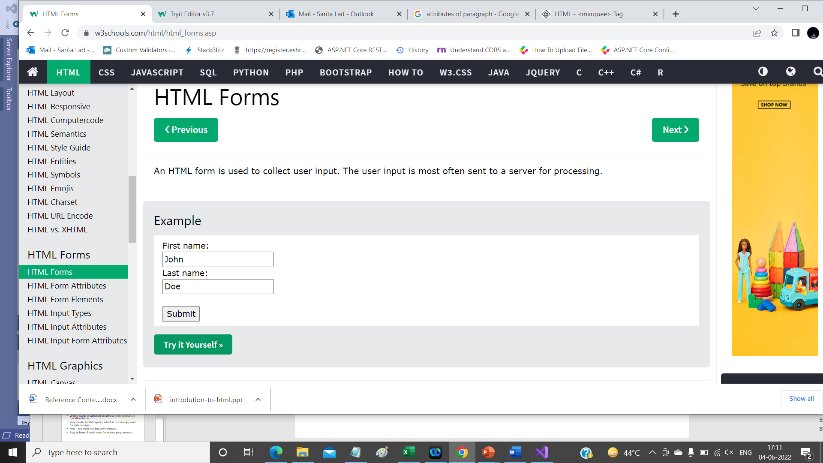
HTML Form
<form action="/action_page.php">
<label for="fname">First name:</label><br>
<input type="text" id="fname" name="fname" value="John"><br>
<label for="lname">Last name:</label><br>
<input type="text" id="lname" name="lname" value="Doe"><br><br>
<input type="submit" value="Submit">
</form>

Slide 45
The HTML <form> Elements
The HTML <form> element can contain one or more of the following form elements:
<input>
<label>
<select>
<textarea>
<button>
<fieldset>
<legend>
<datalist>
<output>
<option>
<optgroup>

Slide 46
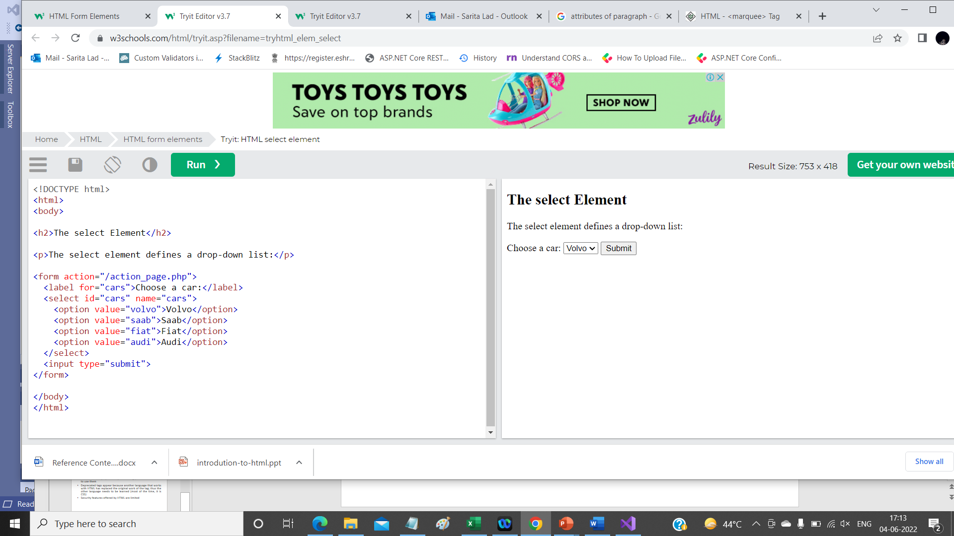
<label for="cars">Choose a car:</label>
<select id="cars" name="cars" size="4" multiple>
<option value="volvo">Volvo</option>
<option value="saab">Saab</option>
<option value="fiat">Fiat</option>
<option value="audi">Audi</option>
</select>

Slide 47
ADVANTAGES OF HTML
Easy to use
Loose syntax (although, being too flexible will not comply with standards).
Supported on almost every browser, if not all browsers.
Widely used; established on almost every website, if not all websites.
Very similar to XML syntax, which is increasingly used for data storage.
Free - You need not buy any software.
Easy to learn & code even for novice programmers.

Slide 48
DISADVANTAGES OF HTML
It cannot produce dynamic output alone, since it is a static language
Sometimes, the structuring of HTML documents is hard to grasp
You have to keep up with deprecated tags, and make sure not to use them
Deprecated tags appear because another language that works with HTML has replaced the original work of the tag; thus the other language needs to be learned (most of the time, it is CSS)
Security features offered by HTML are limited

