Slide 1
Normalization of RDBMS
Sarita Lad
DATE

Slide 2
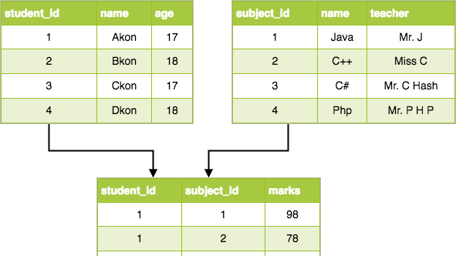

Slide 3
Normalization of Database
Database Normalization is a technique of organizing the data in the database. Normalization is a systematic approach of decomposing tables to eliminate data redundancy(repetition) and undesirable characteristics like Insertion, Update and Deletion Anomalies. It is a multi-step process that puts data into tabular form, removing duplicated data from the relation tables.
Normalization is used for mainly two purposes,
Eliminating redundant(useless) data.
Ensuring data dependencies make sense i.e data is logically stored.

Slide 4
Normalization Rule
Normalization rules are divided into the following normal forms:
First Normal Form
Second Normal Form
Third Normal Form
BCNF
Fourth Normal Form
Fifth Normal Form

Slide 5
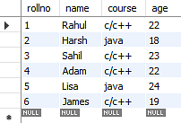
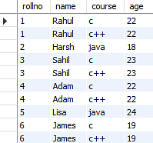
First Normal Form (1NF)
For a table to be in the First Normal Form, it should follow the following 4 rules:
It should only have single(atomic) valued attributes/columns.
Values stored in a column should be of the same domain
All the columns in a table should have unique names.
And the order in which data is stored, does not matter.

Slide 6
Second Normal Form (2NF)
For a table to be in the Second Normal Form,
It should be in the First Normal form.
And, it should not have Partial Dependency.
 | student_id | subject_id | marks | teacher
1 | 10 | 1 | 70 | Java Teacher
2 | 10 | 2 | 75 | C++ Teacher
3 | 11 | 1 | 80 | Java Teacher
we need student_id + subject_id to uniquely identify any row as a primary key
but the teacher's name only depends on subject, hence the subject_id, and has nothing to do with student_id.
This is Partial Dependency, where an attribute in a table depends on only a part of the primary key and not on the whole key.

Slide 7
How to remove Partial Dependency?
The simplest solution is to remove columns teacher from Score table and add it to the Subject table. Hence, the Subject table will become:
subject_id | subject_name | teacher
1 | Java | Java Teacher
2 | C++ | C++ Teacher
3 | Php | Php Teacher
And our Score table is now in the second normal form, with no partial dependency.
score_id | student_id | subject_id | marks
1 | 10 | 1 | 70
2 | 10 | 2 | 75
3 | 11 | 1 | 80

Slide 8
Third Normal Form (3NF)
Third Normal Form is an upgrade to Second Normal Form. When a table is in the Second Normal Form and has no transitive dependency, then it is in the Third Normal Form.
Requirements for Third Normal Form
For a table to be in the third normal form,
It should be in the Second Normal form.
And it should not have Transitive Dependency.
In the Score table, we need to store some more information, which is the exam name and total marks, so let's add 2 more columns to the Score table.
score_id | student_id | subject_id | marks | exam_name | total_marks

Slide 9
What is Transitive Dependency?
With exam_name and total_marks added to our Score table, it saves more data now. Primary key for our Score table is a composite key, which means it's made up of two attributes or columns → student_id + subject_id.
the column total_marks depends on exam_name as with exam type the total score changes.
But, exam_name is just another column in the score table. It is not a primary key or even a part of the primary key, and total_marks depends on it.
This is Transitive Dependency. When a non-prime attribute depends on other non-prime attributes rather than depending upon the prime attributes or primary key.

Slide 10
How to remove Transitive Dependency?
Take out the columns exam_name and total_marks from Score table and put them in an Exam table and use the exam_id wherever required.
score_id student_id subject_id marks exam_id
exam_id | exam_name | total_marks
1 | Workshop | 200
2 | Mains | 70
3 | Practicals | 30

Slide 11
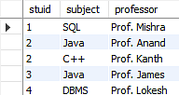
Boyce-Codd Normal Form (BCNF)
For a table to satisfy the Boyce-Codd Normal Form, it should satisfy the following two conditions:
It should be in the Third Normal Form.
And, for any dependency A → B, A should be a super key.
2Secondly, every Right-Hand Side (RHS) attribute of the functional dependencies should depend on the super key of that particular table.
The subject table follows these conditions:
Each student can enroll in multiple subjects.
Multiple professors can teach a particular subject.
For each subject, it assigns a professor to the student.
In the above table, studid and subject together form the primary key because using studid and subject; you can determine all the table columns.
Another important point to be noted here is that one professor teaches only one subject, but one subject may have two professors.
Which exhibit there is a dependency between subject and professor, i.e. subject depends on the professor's name.

Slide 12
The table is in 1st Normal form
The table also satisfies the 2nd Normal Form, as there is no Partial Dependency.
And, there is no Transitive Dependency; hence, the table also satisfies the 3rd Normal Form.
This table follows all the Normal forms except the Boyce Codd Normal Form.
As you can see stuid, and subject forms the primary key, which means the subject attribute is a prime attribute.
However, there exists yet another dependency - professor → subject.
BCNF does not follow in the table as a subject is a prime attribute, the professor is a non-prime attribute.
To transform the table into the BCNF, you will divide the table into two parts. One table will hold stuid which already exists and the second table will hold a newly created column profid.
dependency - professor → subject
Subject depends on Professor
BCNF does not follow in the table as a subject is a prime attribute, the professor is a non-prime attribute
Prime attribute should not depend on non-prime attribute.

Slide 13
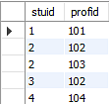
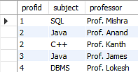
To transform the table into the BCNF, you will divide the table into two parts. One table will hold stuid which already exists and the second table will hold a newly created column profid.

Slide 14
Fifth Normal Form
Fifth normal form (5NF)
A relation is in 5NF if it is in 4NF and not contains any join dependency and joining should be lossless.
5NF is satisfied when all the tables are broken into as many tables as possible in order to avoid redundancy.
5NF is also known as Project-join normal form (PJ/NF).
SUBJECT | LECTURER | SEMESTER
Computer | Anshika | Semester 1
Computer | John | Semester 1
Math | John | Semester 1
Math | Akash | Semester 2
Chemistry | Praveen | Semester 1

Slide 15
In the above table, John takes both Computer and Math class for Semester 1 but he doesn't take Math class for Semester 2. In this case, combination of all these fields required to identify a valid data.
Suppose we add a new Semester as Semester 3 but do not know about the subject and who will be taking that subject so we leave Lecturer and Subject as NULL. But all three columns together acts as a primary key, so we can't leave other two columns blank.
So to make the above table into 5NF, we can decompose it into three relations P1, P2 & P3:
SEMESTER | SUBJECT
Semester 1 | Computer
Semester 1 | Math
Semester 1 | Chemistry
Semester 2 | Math
SUBJECT | LECTURER
Computer | Anshika
Computer | John
Math | John
Math | Akash
Chemistry | Praveen
SEMSTER | LECTURER
Semester 1 | Anshika
Semester 1 | John
Semester 1 | John
Semester 2 | Akash
Semester 1 | Praveen

Slide 16
Constraints in SQL

Slide 17
SQL - Constraints
Constraints are the rules that we can apply on the type of data in a table. That is, we can specify the limit on the type of data that can be stored in a particular column in a table using constraints.
The available constraints in SQL are:
NOT NULL: This constraint tells that we cannot store a null value in a column. That is, if a column is specified as NOT NULL then we will not be able to store null in this particular column any more.
UNIQUE: This constraint when specified with a column, tells that all the values in the column must be unique. That is, the values in any row of a column must not be repeated.
PRIMARY KEY: A primary key is a field which can uniquely identify each row in a table. And this constraint is used to specify a field in a table as primary key.

Slide 18
FOREIGN KEY: A Foreign key is a field which can uniquely identify each row in a another table. And this constraint is used to specify a field as Foreign key.
CHECK: This constraint helps to validate the values of a column to meet a particular condition. That is, it helps to ensure that the value stored in a column meets a specific condition.
DEFAULT: This constraint specifies a default value for the column when no value is specified by the user.

Slide 19
DDl-DML-DQL-DCL-TCL

Slide 20
Data Definition Language(DDL) is a subset of SQL and a part of DBMS(Database Management System). DDL consist of Commands to commands like CREATE, ALTER, TRUNCATE and DROP. These commands are used to create or modify the tables in SQL.
Syntax –
Syntax to add a column to an existing table.
ALTER TABLE table_name
ADD column_name datatype;
Syntax –
CREATE TABLE table_name
(
column_1 datatype,
column_2 datatype,
column_3 datatype,
....
);
TRUNCATE :
This command is used to remove all rows from the table, but the structure of the table still exists.
Syntax –
Syntax to remove an existing table.
TRUNCATE TABLE table_name;
Syntax –
Syntax to drop an existing table.
DROP TABLE table_name;

Slide 21
DML Commands in SQL Insert:
List of DML commands:
INSERT : It is used to insert data into a table.
UPDATE: It is used to update existing data within a table.
DELETE : It is used to delete records from a database table.
Only values: First method is to specify only the value of data to be inserted without the column names.
INSERT INTO table_name VALUES (value1, value2, value3,…);
table_name: name of the table.
value1, value2,.. : value of first column, second column,… for the new record
Column names and values both: In the second method we will specify both the columns which we want to fill and their corresponding values as shown below:
INSERT INTO table_name (column1, column2, column3,..) VALUES ( value1, value2, value3,..);
table_name: name of the table.
column1: name of first column, second column …
value1, value2, value3 : value of first column, second column,… for the new record

Slide 22
DML Commands in SQL Update:
Syntax:
UPDATE table_name SET [column_name1= value1,...column_nameN = valueN] [WHERE CONDITION]

Slide 23
DML Commands in SQL delete:
Syntax:
DELETE FROM table_name [WHERE condition];

Slide 24
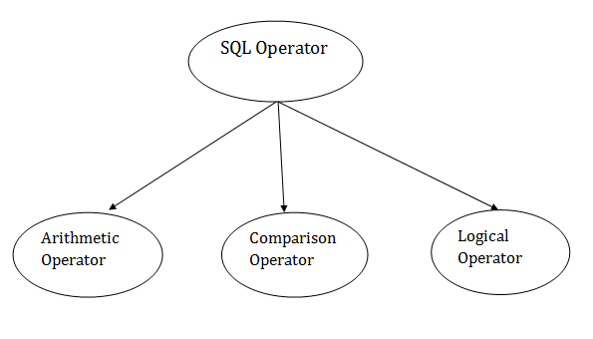
DQL Commands in SQL select:
Syntax:
SELECT expressions
FROM TABLES
WHERE conditions;
Built-in Functions in SQL
Code Snippet
1 USE world;
2 SELECT name
3 FROM city
4 WHERE CountryCode = “AFG”
5 ORDER BY name
6 LIMIT 3

Slide 25
SQL Arithmetic Operators
Operator | Description | Example
+ | It adds the value of both operands. | a+b will give 30
- | It is used to subtract the right-hand operand from the left-hand operand. | a-b will give 10
* | It is used to multiply the value of both operands. | a*b will give 200
/ | It is used to divide the left-hand operand by the right-hand operand. | a/b will give 2
% | It is used to divide the left-hand operand by the right-hand operand and returns reminder. | a%b will give 0

Slide 26
SQL Comparison Operators:
Operator | Description | Example
= | It checks if two operands values are equal or not, if the values are queal then condition becomes true. | (a=b) is not true
!= | It checks if two operands values are equal or not, if values are not equal, then condition becomes true. | (a!=b) is true
<> | It checks if two operands values are equal or not, if values are not equal then condition becomes true. | (a<>b) is true
> | It checks if the left operand value is greater than right operand value, if yes then condition becomes true. | (a>b) is not true
< | It checks if the left operand value is less than right operand value, if yes then condition becomes true. | (a<b) is true
>= | It checks if the left operand value is greater than or equal to the right operand value, if yes then condition becomes true. | (a>=b) is not true
<= | It checks if the left operand value is less than or equal to the right operand value, if yes then condition becomes true. | (a<=b) is true
!< | It checks if the left operand value is not less than the right operand value, if yes then condition becomes true. | (a!=b) is not true
!> | It checks if the left operand value is not greater than the right operand value, if yes then condition becomes true.

Slide 27
SQL Logical Operators
Operator | Description
ALL | It compares a value to all values in another value set.
AND | It allows the existence of multiple conditions in an SQL statement.
ANY | It compares the values in the list according to the condition.
BETWEEN | It is used to search for values that are within a set of values.
IN | It compares a value to that specified list value.
NOT | It reverses the meaning of any logical operator.
OR | It combines multiple conditions in SQL statements.
EXISTS | It is used to search for the presence of a row in a specified table.
LIKE | It compares a value to similar values using wildcard operator.

Slide 28
Joins in Sql

Slide 29
SQL: JOINS
SQL JOINS are used to retrieve data from multiple tables. A SQL JOIN is performed whenever two or more tables are listed in a SQL statement.
There are 4 different types of SQL joins:
SQL INNER JOIN (sometimes called simple join)
SQL LEFT OUTER JOIN (sometimes called LEFT JOIN)
SQL RIGHT OUTER JOIN (sometimes called RIGHT JOIN)
SQL FULL OUTER JOIN (sometimes called FULL JOIN)

Slide 30
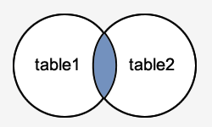
The SQL INNER JOIN
would return the records where table1 and table2 intersect.
Syntax
The syntax for the INNER JOIN in SQL is:
SELECT columns
FROM table1
INNER JOIN table2
ON table1.column = table2.column;
SELECT customers.customer_id, orders.order_id, orders.order_date
FROM customers
INNER JOIN orders
ON customers.customer_id = orders.customer_id
ORDER BY customers.customer_id;

Slide 31
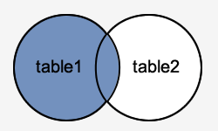
SQL LEFT OUTER JOIN
This type of join returns all rows from the LEFT-hand table specified in the ON condition and only those rows from the other table where the joined fields are equal (join condition is met).
Syntax
The syntax for the LEFT OUTER JOIN in SQL is:
SELECT columns
FROM table1
LEFT [OUTER] JOIN table2
ON table1.column = table2.column;

Slide 32
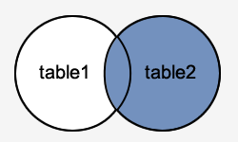
SQL RIGHT OUTER JOIN
This type of join returns all rows from the RIGHT-hand table specified in the ON condition and only those rows from the other table where the joined fields are equal (join condition is met).
Syntax
The syntax for the RIGHT OUTER JOIN in SQL is:
SELECT columns
FROM table1
RIGHT [OUTER] JOIN table2
ON table1.column = table2.column;

Slide 33
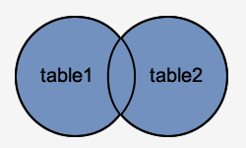
SQL FULL OUTER JOIN
This type of join returns all rows from the LEFT-hand table and RIGHT-hand table with NULL values in place where the join condition is not met.
Syntax
The syntax for the SQL FULL OUTER JOIN is:
SELECT columns
FROM table1
FULL [OUTER] JOIN table2
ON table1.column = table2.column;

Slide 34
Equi join and non equi joins
Equi Join and Non-Equi Joins are types of Inner Joins. Equi Join in SQL is used to retrieve data from multiple tables using an equality condition with the WHERE clause. Non-Equi in SQL is used to retrieve data from multiple tables using any other operator except the equality condition.

Slide 35
Cross Join or Cartesian Join
the cartesian product is really a cross-join which returns all the rows in all the tables listed in a query: each row in the first table is paired with all the rows in the second table. This happens when there is no relationship defined between the two tables.
The syntax of the CROSS JOIN in SQL will look like the below syntax:
SELECT ColumnName_1,
ColumnName_2,
ColumnName_N
FROM [Table_1]
CROSS JOIN [Table_2]

Slide 36
Stored Procedure and function

Slide 37
Stored Procedures
Stored procedures are a collection of Transact-SQL statements stored within the database. They are used to encapsulate oft-used queries, such as conditional statements, loops, and other powerful programming features.
CREATE PROCEDURE
CREATE PROCEDURE procedure_name 2AS 3sql_statement 4GO;
EXECUTE schemaname.procedurename;

Slide 38
create procedure getEmployeeName
@empid INT,
@empname varchar(50) out
as
begin
select @empname = name
from employee
where emplyeeid = @empid;
end

Slide 39
Creating user-defined functions
USE schooldb
GO
CREATE FUNCTION getFormattedDate
(
@DateValue AS DATETIME
)
RETURNS VARCHAR(MAX)
AS
BEGIN
RETURN
DATENAME(DW, @DateValue)+ ', '+
DATENAME(DAY, @DateValue)+ ' '+
DATENAME(MONTH, @DateValue) +', '+
DATENAME(YEAR, @DateValue)
END
SELECT
name,
[dbo].[getFormattedDate](DOB)
FROM student

Slide 40
SQL User Defined Functions Syntax
CREATE FUNCTION Name(@Parameter_Name Data_type,
.... @Parameter_Name Data_type
)
RETURNS Data_Type
AS
BEGIN
-- Function_Body
RETURN Data
END
Return_Type:
Data Type: Please specify the data type of return value. For example, VARCHAR, INT, FLOAT, etc.
Data: Please specify the return value, and it should match the Data Type. It can be a single value or Table
Name: You can specify any name you wish to give other than the system reserved keywords. Please try to use meaningful names so that you can identify them easily.
@Parameter_Name: Every method accepts zero or more parameters; it completely depends upon the user requirements. While declaring the parameters don’t forget the appropriate data type. For example (@name VARCHAR(50), @number INT)
Function_Body: Any query, or any complex mathematical calculations you want to implement in this particular method.

Slide 41
Advantages of UDFs
The SQL Server User defined functions prevent us from writing the same logic multiple times.
Within the Database, you can create the method once, and call it n number of times.
SQL functions reduce the compilation time of query by catching the execution plan and reusing them.
This UDF can help us to separate the complex calculations from the regular query so that we can understand and debug the query quicker and better.
It reduces the network traffic because of its cache plan
They also used in WHERE Clause as well. By this, we can limit the number of rows sent to the client.

Slide 42
SubQueries

Slide 43
A subquery is a query that is nested inside a SELECT , INSERT , UPDATE , or DELETE statement, or inside another subquery.
Types of SQL Subqueries
We have various subqueries; some of them are as follows:
1. Single Row Subquery
Returns zero or one row in results.
2. Multiple Row Subquery
Returns one or more rows in results.
3. Multiple Column Subqueries
Returns one or more columns
4. Correlated Subqueries
Returns one or more columns according to the main or the outer query, thus called a correlated subquery.

Slide 44
Rules to Use Subqueries in SQL
We need to follow some rules while writing SQL Subqueries. We will discuss the rules below:
Subqueries need to be enclosed in the Where clause and can be used with Insert, Update, Delete, and Select statements.
We can use comparison operators for example: <, >, > =, < =, !=, IN , Between for the subqueries.
The subquery is always executed first and then the main query.
Subquery should be enclosed within parentheses.
Subqueries are always to the right of the comparison operators.
We can’t use Order By clause in the subquery; instead, we can use the Group By clause.
We should use single-row operators with single-row subqueries and vice versa.
We can’t use Between clause with a subquery, but we can use Between in a subquery.

Slide 45
Example 1: Let us find the second highest salary of the employee in DataFlair. Query:
SELECT emp_id, MAX(salary) AS salary
FROM dataflair_emp1
WHERE salary < (SELECT MAX(salary)
FROM dataflair_emp1);
Update Statement with Subquery
Example 2: Let us increase the salary of Senior Manager to 35000. Query:
UPDATE dataflair_emp1
SET salary=35000
WHERE emp_id = ( SELECT emp_id
FROM dataflair_emp1
WHERE post='Sr.Manager');
select * from dataflair_emp1;

Slide 46
Delete Statement with Subquery
Example 3: Let us delete the employee with the age = 25. Query:
DELETE FROM dataflair_emp1
WHERE emp_id IN ( SELECT emp_id
FROM dataflair_emp2
WHERE age=25);
select * from dataflair_emp1;
SELECT
employee_id,
first_name,
last_name,
salary
FROM
employees
WHERE
salary > (SELECT
AVG(salary)
FROM
employees);

Slide 47
Plain SubQuery:
First, you can execute the subquery that returns the average salary of all employees independently.
SELECT
AVG(salary)
FROM
employees;
Code language: SQL (Structured Query Language) (sql)
Second, the database system needs to evaluate the subquery only once.
Third, the outer query makes use of the result returned from the subquery. The outer query depends on the subquery for its value. However, the subquery does not depend on the outer query. Sometimes, we call this subquery is a plain subquery.
Unlike a plain subquery, a correlated subquery is a subquery that uses the values from the outer query. Also, a correlated subquery may be evaluated once for each row selected by the outer query. Because of this, a query that uses a correlated subquery may be slow.
A correlated subquery is also known as a repeating subquery or a synchronized subquery.

Slide 48
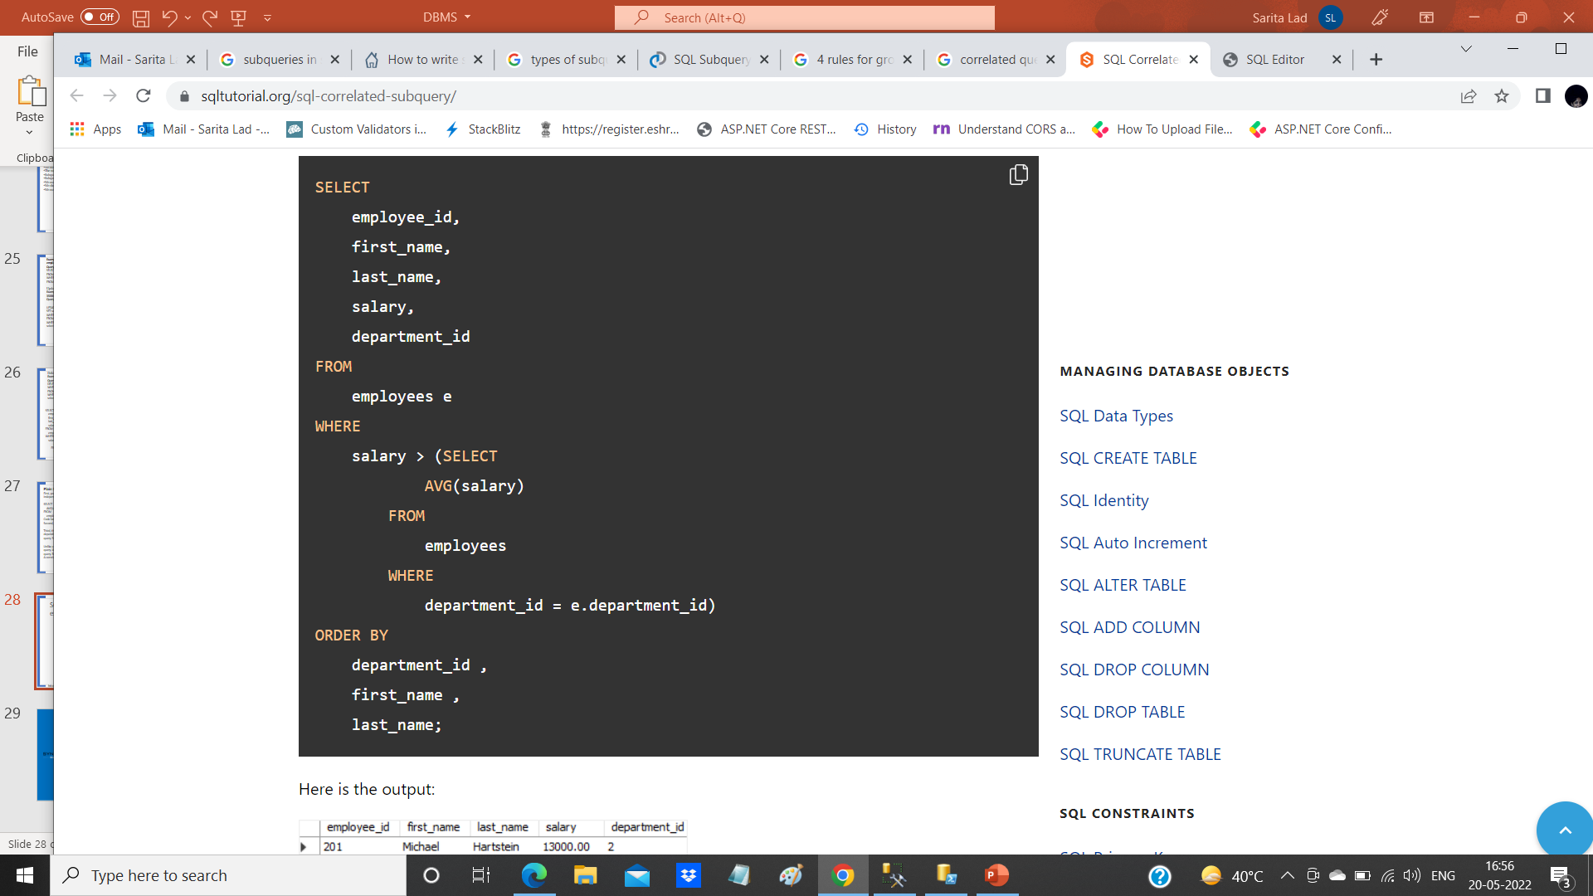
SQL correlated subquery in the WHERE clause example
https://www.sqltutorial.org/sql-correlated-subquery/

Slide 49
the outer query is:
SELECT employee_id, first_name, last_name, salary, department_id FROM employees e WHERE salary > ...
and the correlated subquery is:
salary > (SELECT AVG(salary) FROM employees WHERE department_id = e.department_id)

Slide 50
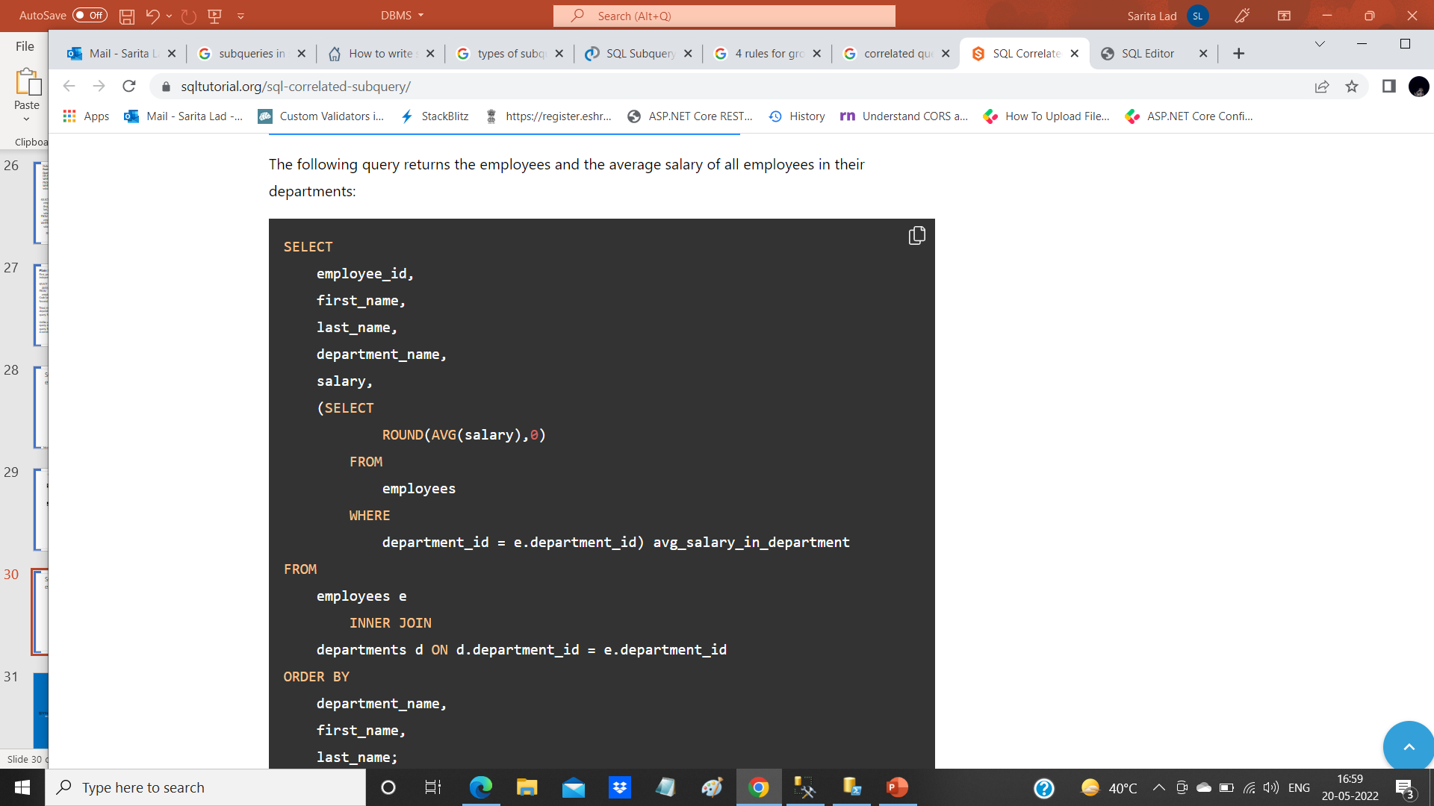
SQL correlated subquery in the SELECT clause example

Slide 51
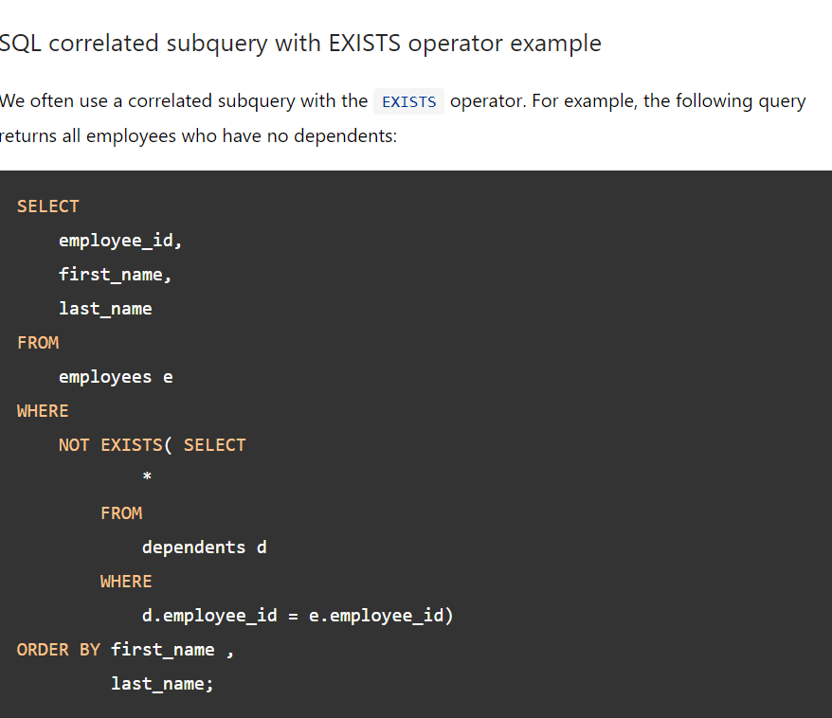
SQL correlated subquery with EXISTS operator example
We often use a correlated subquery with the EXISTS operator. For example, the following query returns all employees who have no dependents:

Slide 52
Difference between delete and truncate
SQL Delete | SQL Truncate
Delete command is useful to delete all or specific rows from a table specified using a Where clause | The truncate command removes all rows of a table. We cannot use a Where clause in this.
It is a DML command | It is a DDL command.
SQL Delete command places lock on each row requires to delete from a table. | SQL Truncate command places a table and page lock to remove all records.
Delete command logs entry for each deleted row in the transaction log. | The truncate command does not log entries for each deleted row in the transaction log.
Delete command is slower than the Truncate command. | It is faster than the delete command.
It removes rows one at a time. | It removes all rows in a table by deallocating the pages that are used to store the table data
It retains the identity and does not reset it to the seed value. | Truncate command reset the identity to its seed value.
It requires more transaction log space than the truncate command. | It requires less transaction log space than the truncate command.
You require delete permission on a table to use this | You require Alter table permissions to truncate a table.
You can use the Delete statement with the indexed views. | You cannot use the truncate command with the indexed views.
Delete command retains the object statistics and allocated space. | Truncate deallocates all data pages of a table. Therefore, it removes all statistics and allocated space as well.
Delete command can activate a trigger as well. Delete works on individual rows and delete the data. Therefore, it activates a trigger. | The truncate command cannot activate a trigger. The trigger is activated if any row modification takes place. In this command, SQL Server deallocates all pages, so it does not activate a trigger.
Delete command removes the rows matched with the where clause. It also does not remove the columns, indexes, constraints, schema | The truncate command only removes all rows of a table. It does not remove the columns, indexes, constraints, and schema.

Slide 53
transaction
A transaction is the logical work unit that performs a single activity or multiple activities in a database. Transactions may consist of a single read, write, delete, or update operations or a combination of these.
Properties:
Atomicity: The entire of the operations that are included by the transaction performed successfully. Otherwise, all operations are canceled at the point of the failure and all the previous operations are rolled back
Consistency: This property ensures that all the data will be consistent after a transaction is completed according to the defined rules, constraints, cascades, and triggers
Isolation: All transactions are isolated from other transactions
Durable: The modification of the commited transactions becomes persist in the database

Slide 54
Modes of the Transactions in SQL Server
Autocommit Transaction mode is the default transaction for the SQL Server. In this mode, each T-SQL statement is evaluated as a transaction and they are committed or rolled back according to their results. The successful statements are committed and the failed statements are rolled back immediately
Implicit transaction mode enables to SQL Server to start an implicit transaction for every DML statement but we need to use the commit or rolled back commands explicitly at the end of the statements
Explicit transaction mode provides to define a transaction exactly with the starting and ending points of the transaction

Slide 55
The following table illustrates the structure of the explicit transactions in SQL Server.
BEGIN TRANSACTION | The starting point of the transaction
SQL commands | DML and SELECT statements
COMMIT TRANSACTION or ROLLBACK TRANSACTION | Apply data changing to the database or Erase data changing to the database

Slide 56
Save Points in Transactions
Savepoints can be used to rollback any particular part of the transaction rather than the entire transaction. So that we can only rollback any portion of the transaction where between after the save point and before the rollback command. To define a save point in a transaction we use the SAVE TRANSACTION syntax and then we add a name to the save point. Now, let’s illustrates an example of savepoint usage. When we execute the following query, only the insert statement will be committed and the delete statement will be rolled back.

Slide 57
Difference between truncate and delete
Delete statement removes the records one by one and it logs each entry into the transaction log. It is a DML statement.
SQL Delete statement does not reset the identity values in a table. We can use DBCC CHECKIDENT to check current identity value and manually set a new identity value for the identity column.
DBCC CHECKIDENT('Employee', RESEED,500)
We can roll back a transaction using the delete statement. Let’s use a delete statement with BEGIN Transaction.
1 2 3 | BEGIN TRANSACTION; DELETE FROM [SQLShackDemo].[dbo].[Employee] WHERE EmpID = 1010;
1 | Rollback transaction

Slide 58
Thank You

