Slide 1
DBMS and SQL Server
Sarita Lad
DATE

Slide 2
Database Models and Normalization

Slide 3
DBMS Database Models
A Database model defines the logical design and structure of a database and defines how data will be stored, accessed and updated in a database management system. While the Relational Model is the most widely used database model, there are other models too:
Hierarchical Model
Network Model
Entity-relationship Model
Relational Model

Slide 4
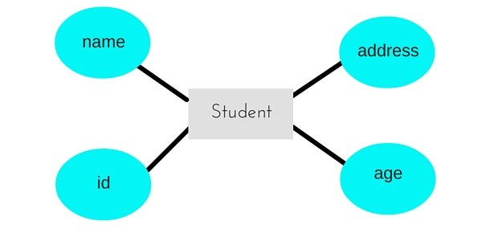
Entity-relationship Model
In this database model, relationships are created by dividing object of interest into entity and its characteristics into attributes.
Different entities are related using relationships.
E-R Models are defined to represent the relationships into pictorial form to make it easier for different stakeholders to understand.

Slide 5
Relational Model
In this model, data is organized in two-dimensional tables and the relationship is maintained by storing a common field.
This model was introduced by E.F Codd in 1970, and since then it has been the most widely used database model, in fact, we can say the only database model used around the world.
The basic structure of data in the relational model is tables. All the information related to a particular type is stored in rows of that table.
Tables are also known as relations in relational model.

Slide 6
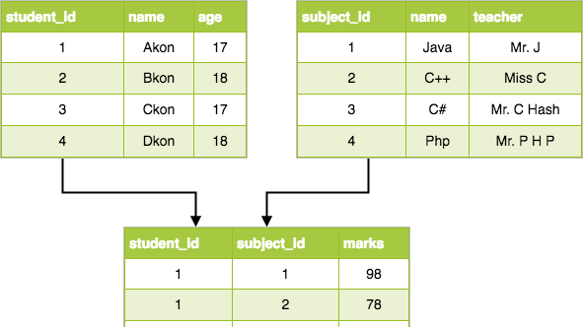

Slide 7
Data types (Transact-SQL)
In SQL Server, each column, local variable, expression, and parameter has a related data type. A data type is an attribute that specifies the type of data that the object can hold: integer data, character data, monetary data, date and time data, binary strings, and so on.
Data type | Description | Max size | Storage
char(5) | Fixed width character string | 8,000 characters | Defined width
varchar(5) | Variable width character string | 8,000 characters | 2 bytes + number of chars
varchar(max) | Variable width character string | 1,073,741,824 characters | 2 bytes + number of chars
text | Variable width character string | 2GB of text data | 4 bytes + number of chars
nchar | Fixed width Unicode string | 4,000 characters | Defined width x 2
nvarchar | Variable width Unicode string | 4,000 characters
nvarchar(max) | Variable width Unicode string | 536,870,912 characters
ntext | Variable width Unicode string | 2GB of text data
binary(n) | Fixed width binary string | 8,000 bytes
varbinary | Variable width binary string | 8,000 bytes
varbinary(max) | Variable width binary string | 2GB
image | Variable width binary string | 2GB

Slide 8
Numeric Data Types
Data type | Description | Storage
bit | Integer that can be 0, 1, or NULL
tinyint | Allows whole numbers from 0 to 255 | 1 byte
smallint | Allows whole numbers between -32,768 and 32,767 | 2 bytes
int | Allows whole numbers between -2,147,483,648 and 2,147,483,647 | 4 bytes
bigint | Allows whole numbers between -9,223,372,036,854,775,808 and 9,223,372,036,854,775,807 | 8 bytes
decimal(p,s) | Fixed precision and scale numbers.Allows numbers from -10^38 +1 to 10^38 –1. The p parameter indicates the maximum total number of digits that can be stored (both to the left and to the right of the decimal point). p must be a value from 1 to 38. Default is 18. The s parameter indicates the maximum number of digits stored to the right of the decimal point. s must be a value from 0 to p. Default value is 0 | 5-17 bytes
numeric(p,s) | Fixed precision and scale numbers.Allows numbers from -10^38 +1 to 10^38 –1. The p parameter indicates the maximum total number of digits that can be stored (both to the left and to the right of the decimal point). p must be a value from 1 to 38. Default is 18. The s parameter indicates the maximum number of digits stored to the right of the decimal point. s must be a value from 0 to p. Default value is 0 | 5-17 bytes
smallmoney | Monetary data from -214,748.3648 to 214,748.3647 | 4 bytes
money | Monetary data from -922,337,203,685,477.5808 to 922,337,203,685,477.5807 | 8 bytes
float(n) | Floating precision number data from -1.79E + 308 to 1.79E + 308.The n parameter indicates whether the field should hold 4 or 8 bytes. float(24) holds a 4-byte field and float(53) holds an 8-byte field. Default value of n is 53. | 4 or 8 bytes
real | Floating precision number data from -3.40E + 38 to 3.40E + 38 | 4 bytes

Slide 9
Date and Time Data Types
Data type | Description | Storage
datetime | From January 1, 1753 to December 31, 9999 with an accuracy of 3.33 milliseconds | 8 bytes
datetime2 | From January 1, 0001 to December 31, 9999 with an accuracy of 100 nanoseconds | 6-8 bytes
smalldatetime | From January 1, 1900 to June 6, 2079 with an accuracy of 1 minute | 4 bytes
date | Store a date only. From January 1, 0001 to December 31, 9999 | 3 bytes
time | Store a time only to an accuracy of 100 nanoseconds | 3-5 bytes
datetimeoffset | The same as datetime2 with the addition of a time zone offset | 8-10 bytes
timestamp | Stores a unique number that gets updated every time a row gets created or modified. The timestamp value is based upon an internal clock and does not correspond to real time. Each table may have only one timestamp variable

Slide 10
Other Data Types
Data type | Description
sql_variant | Stores up to 8,000 bytes of data of various data types, except text, ntext, and timestamp
uniqueidentifier | Stores a globally unique identifier (GUID)
xml | Stores XML formatted data. Maximum 2GB
cursor | Stores a reference to a cursor used for database operations
table | Stores a result-set for later processing

Slide 11
What is RDBMS (Relational Database Management System)
RDBMS stands for Relational Database Management System.
All modern database management systems like SQL, MS SQL Server, IBM DB2, ORACLE, My-SQL, and Microsoft Access are based on RDBMS.
It is called Relational Database Management System (RDBMS) because it is based on the relational model introduced by E.F. Codd.
How it works
Data is represented in terms of tuples (rows) in RDBMS.
A relational database is the most commonly used database. It contains several tables, and each table has its primary key.
Due to a collection of an organized set of tables, data can be accessed easily in RDBMS.
Brief History of RDBMS
From 1970 to 1972, E.F. Codd published a paper to propose using a relational database model.
RDBMS is originally based on E.F. Codd's relational model invention.

Slide 12
DDL,DML,DQL And DCL
The queries to deal with relational database can be categories as:
Data Definition Language: It is used to define the structure of the database. e.g; CREATE TABLE, ADD COLUMN, DROP COLUMN and so on.
Create, alter, add drop
Data Manipulation Language: It is used to manipulate data in the relations. e.g.; INSERT, DELETE, UPDATE and so on.
Data Query Language: It is used to extract the data from the relations.
DCL :Data Control Language : It is used to control the access of database using Commit , RollBack and Grant keyword , Permission is granted to read, write , update or delete for different users .

Slide 13
Basic Concepts of ER Model in DBMS
To understand about the ER Model, we must understand about:
Entity and Entity Set
What are Attributes? And Types of Attributes.
Keys
Relationships
An Entity is generally a real-world object which has characteristics and holds relationships in a DBMS.
If a Student is an Entity, then the complete dataset of all the students will be the Entity Set
https://www.studytonight.com/

Slide 14
ER Model: Attributes
If a Student is an Entity, then student's roll no., student's name, student's age, student's gender etc will be its attributes.
An attribute can be of many types, here are different types of attributes defined in ER database model:
Simple attribute: The attributes with values that are atomic and cannot be broken down further are simple attributes. For example, student's age.
Composite attribute: A composite attribute is made up of more than one simple attribute. For example, student's address will contain, house no., street name, pincode etc.
Derived attribute: These are the attributes which are not present in the whole database management system, but are derived using other attributes. For example, average age of students in a class.
Single-valued attribute: As the name suggests, they have a single value.
Multi-valued attribute: And, they can have multiple values.

Slide 15
ER Model: Keys
If the attribute roll no. can uniquely identify a student entity, amongst all the students, then the attribute roll no. will be said to be a key.
Following are the types of Keys:
Super Key
Candidate Key
Primary Key
Super Key
Super Key is defined as a set of attributes within a table that can uniquely identify each record within a table. Super Key is a superset of Candidate key.
Candidate Key
It is an attribute or a set of attributes that can act as a Primary Key for a table to uniquely identify each record in that table.

Slide 16
A candidate key can never be NULL or empty. And its value should be unique.
There can be more than one candidate keys for a table.
A candidate key can be a combination of more than one columns(attributes).
Primary Key
Primary key is a candidate key that is most appropriate to become the main key for any table. It is a key that can uniquely identify each record in a table.
Composite Key
Key that consists of two or more attributes that uniquely identify any record in a table is called Composite key.
Secondary or Alternative key
The candidate key which are not selected as primary key are known as secondary keys or alternative keys.
Non-key Attributes
Non-key attributes are the attributes or fields of a table, other than candidate key attributes/fields in a table.

Slide 17
Normalization of Database
Database Normalization is a technique of organizing the data in the database. Normalization is a systematic approach of decomposing tables to eliminate data redundancy(repetition) and undesirable characteristics like Insertion, Update and Deletion Anomalies. It is a multi-step process that puts data into tabular form, removing duplicated data from the relation tables.
Normalization is used for mainly two purposes,
Eliminating redundant(useless) data.
Ensuring data dependencies make sense i.e data is logically stored.

Slide 18
Normalization Rule
Normalization rules are divided into the following normal forms:
First Normal Form
Second Normal Form
Third Normal Form
BCNF
Fourth Normal Form
Fifth Normal Form

Slide 19
First Normal Form (1NF)
For a table to be in the First Normal Form, it should follow the following 4 rules:
It should only have single(atomic) valued attributes/columns.
Values stored in a column should be of the same domain
All the columns in a table should have unique names.
And the order in which data is stored, does not matter.

Slide 20
Second Normal Form (2NF)
For a table to be in the Second Normal Form,
It should be in the First Normal form.
And, it should not have Partial Dependency.
score_id | student_id | subject_id | marks | teacher
1 | 10 | 1 | 70 | Java Teacher
2 | 10 | 2 | 75 | C++ Teacher
3 | 11 | 1 | 80 | Java Teacher
we need student_id + subject_id to uniquely identify any row as a primary key
but the teacher's name only depends on subject, hence the subject_id, and has nothing to do with student_id.
This is Partial Dependency, where an attribute in a table depends on only a part of the primary key and not on the whole key.

Slide 21
How to remove Partial Dependency?
The simplest solution is to remove columns teacher from Score table and add it to the Subject table. Hence, the Subject table will become:
subject_id | subject_name | teacher
1 | Java | Java Teacher
2 | C++ | C++ Teacher
3 | Php | Php Teacher
And our Score table is now in the second normal form, with no partial dependency.
score_id | student_id | subject_id | marks
1 | 10 | 1 | 70
2 | 10 | 2 | 75
3 | 11 | 1 | 80

Slide 22
Third Normal Form (3NF)
Third Normal Form is an upgrade to Second Normal Form. When a table is in the Second Normal Form and has no transitive dependency, then it is in the Third Normal Form.
Requirements for Third Normal Form
For a table to be in the third normal form,
It should be in the Second Normal form.
And it should not have Transitive Dependency.
In the Score table, we need to store some more information, which is the exam name and total marks, so let's add 2 more columns to the Score table.
score_id | student_id | subject_id | marks | exam_name | total_marks

Slide 23
What is Transitive Dependency?
With exam_name and total_marks added to our Score table, it saves more data now. Primary key for our Score table is a composite key, which means it's made up of two attributes or columns → student_id + subject_id.
the column total_marks depends on exam_name as with exam type the total score changes.
But, exam_name is just another column in the score table. It is not a primary key or even a part of the primary key, and total_marks depends on it.
This is Transitive Dependency. When a non-prime attribute depends on other non-prime attributes rather than depending upon the prime attributes or primary key.

Slide 24
How to remove Transitive Dependency?
Take out the columns exam_name and total_marks from Score table and put them in an Exam table and use the exam_id wherever required.
score_id student_id subject_id marks exam_id
exam_id | exam_name | total_marks
1 | Workshop | 200
2 | Mains | 70
3 | Practicals | 30

Slide 25
Boyce-Codd Normal Form (BCNF)
For a table to satisfy the Boyce-Codd Normal Form, it should satisfy the following two conditions:
It should be in the Third Normal Form.
And, for any dependency A → B, A should be a super key.
The second point sounds a bit tricky, right? In simple words, it means, that for a dependency A → B, A cannot be a non-prime attribute, if B is a prime attribute.
student_id | subject | professor
101 | Java | P.Java
101 | C++ | P.Cpp
102 | Java | P.Java2
103 | C# | P.Chash
104 | Java | P.Java

Slide 26
How to satisfy BCNF?
To make this relation(table) satisfy BCNF, we will decompose this table into two tables, student table and professor table.
Below we have the structure for both the tables.
Student Table
And, Professor Table
And now, this relation satisfy Boyce-Codd Normal Form. In the next tutorial we will learn about the Fourth Normal Form.
student_id | p_id
101 | 1
101 | 2
and so on...
p_id | professor | subject
1 | P.Java | Java
2 | P.Cpp | C++
and so on...

Slide 27
Fifth Normal Form
Fifth normal form (5NF)
A relation is in 5NF if it is in 4NF and not contains any join dependency and joining should be lossless.
5NF is satisfied when all the tables are broken into as many tables as possible in order to avoid redundancy.
5NF is also known as Project-join normal form (PJ/NF).
SUBJECT | LECTURER | SEMESTER
Computer | Anshika | Semester 1
Computer | John | Semester 1
Math | John | Semester 1
Math | Akash | Semester 2
Chemistry | Praveen | Semester 1

Slide 28
In the above table, John takes both Computer and Math class for Semester 1 but he doesn't take Math class for Semester 2. In this case, combination of all these fields required to identify a valid data.
Suppose we add a new Semester as Semester 3 but do not know about the subject and who will be taking that subject so we leave Lecturer and Subject as NULL. But all three columns together acts as a primary key, so we can't leave other two columns blank.
So to make the above table into 5NF, we can decompose it into three relations P1, P2 & P3:
SEMESTER | SUBJECT
Semester 1 | Computer
Semester 1 | Math
Semester 1 | Chemistry
Semester 2 | Math
SUBJECT | LECTURER
Computer | Anshika
Computer | John
Math | John
Math | Akash
Chemistry | Praveen
SEMSTER | LECTURER
Semester 1 | Anshika
Semester 1 | John
Semester 1 | John
Semester 2 | Akash
Semester 1 | Praveen

Slide 29
Difference between truncate and delete
Delete statement removes the records one by one and it logs each entry into the transaction log. It is a DML statement.
SQL Delete statement does not reset the identity values in a table. We can use DBCC CHECKIDENT to check current identity value and manually set a new identity value for the identity column.
DBCC CHECKIDENT('Employee', RESEED,500)
We can roll back a transaction using the delete statement. Let’s use a delete statement with BEGIN Transaction.
1 2 3 | BEGIN TRANSACTION; DELETE FROM [SQLShackDemo].[dbo].[Employee] WHERE EmpID = 1010;
1 | Rollback transaction

Slide 30
DDl-DML-DQL-DCL-TCL

Slide 31
Data Definition Language(DDL) is a subset of SQL and a part of DBMS(Database Management System). DDL consist of Commands to commands like CREATE, ALTER, TRUNCATE and DROP. These commands are used to create or modify the tables in SQL.
Syntax –
Syntax to add a column to an existing table.
ALTER TABLE table_name
ADD column_name datatype;
Syntax –
CREATE TABLE table_name
(
column_1 datatype,
column_2 datatype,
column_3 datatype,
....
);
TRUNCATE :
This command is used to remove all rows from the table, but the structure of the table still exists.
Syntax –
Syntax to remove an existing table.
TRUNCATE TABLE table_name;
Syntax –
Syntax to drop an existing table.
DROP TABLE table_name;

Slide 32
DML Commands in SQL Insert:
List of DML commands:
INSERT : It is used to insert data into a table.
UPDATE: It is used to update existing data within a table.
DELETE : It is used to delete records from a database table.
Only values: First method is to specify only the value of data to be inserted without the column names.
INSERT INTO table_name VALUES (value1, value2, value3,…);
table_name: name of the table.
value1, value2,.. : value of first column, second column,… for the new record
Column names and values both: In the second method we will specify both the columns which we want to fill and their corresponding values as shown below:
INSERT INTO table_name (column1, column2, column3,..) VALUES ( value1, value2, value3,..);
table_name: name of the table.
column1: name of first column, second column …
value1, value2, value3 : value of first column, second column,… for the new record

Slide 33
DML Commands in SQL Update:
Syntax:
UPDATE table_name SET [column_name1= value1,...column_nameN = valueN] [WHERE CONDITION]

Slide 34
DML Commands in SQL delete:
Syntax:
DELETE FROM table_name [WHERE condition];

Slide 35
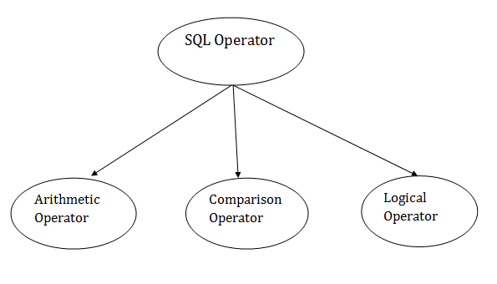
DQL Commands in SQL select:
Syntax:
SELECT expressions
FROM TABLES
WHERE conditions;
Built-in Functions in SQL
Code Snippet
1 USE world;
2 SELECT name
3 FROM city
4 WHERE CountryCode = “AFG”
5 ORDER BY name
6 LIMIT 3

Slide 36
SQL Arithmetic Operators
Operator | Description | Example
+ | It adds the value of both operands. | a+b will give 30
- | It is used to subtract the right-hand operand from the left-hand operand. | a-b will give 10
* | It is used to multiply the value of both operands. | a*b will give 200
/ | It is used to divide the left-hand operand by the right-hand operand. | a/b will give 2
% | It is used to divide the left-hand operand by the right-hand operand and returns reminder. | a%b will give 0

Slide 37
SQL Comparison Operators:
Operator | Description | Example
= | It checks if two operands values are equal or not, if the values are queal then condition becomes true. | (a=b) is not true
!= | It checks if two operands values are equal or not, if values are not equal, then condition becomes true. | (a!=b) is true
<> | It checks if two operands values are equal or not, if values are not equal then condition becomes true. | (a<>b) is true
> | It checks if the left operand value is greater than right operand value, if yes then condition becomes true. | (a>b) is not true
< | It checks if the left operand value is less than right operand value, if yes then condition becomes true. | (a<b) is true
>= | It checks if the left operand value is greater than or equal to the right operand value, if yes then condition becomes true. | (a>=b) is not true
<= | It checks if the left operand value is less than or equal to the right operand value, if yes then condition becomes true. | (a<=b) is true
!< | It checks if the left operand value is not less than the right operand value, if yes then condition becomes true. | (a!=b) is not true
!> | It checks if the left operand value is not greater than the right operand value, if yes then condition becomes true.

Slide 38
SQL Logical Operators
Operator | Description
ALL | It compares a value to all values in another value set.
AND | It allows the existence of multiple conditions in an SQL statement.
ANY | It compares the values in the list according to the condition.
BETWEEN | It is used to search for values that are within a set of values.
IN | It compares a value to that specified list value.
NOT | It reverses the meaning of any logical operator.
OR | It combines multiple conditions in SQL statements.
EXISTS | It is used to search for the presence of a row in a specified table.
LIKE | It compares a value to similar values using wildcard operator.

Slide 39
Joins in Sql

Slide 40
SQL: JOINS
SQL JOINS are used to retrieve data from multiple tables. A SQL JOIN is performed whenever two or more tables are listed in a SQL statement.
There are 4 different types of SQL joins:
SQL INNER JOIN (sometimes called simple join)
SQL LEFT OUTER JOIN (sometimes called LEFT JOIN)
SQL RIGHT OUTER JOIN (sometimes called RIGHT JOIN)
SQL FULL OUTER JOIN (sometimes called FULL JOIN)

Slide 41
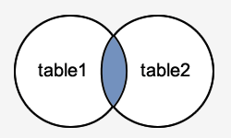
The SQL INNER JOIN
would return the records where table1 and table2 intersect.
Syntax
The syntax for the INNER JOIN in SQL is:
SELECT columns
FROM table1
INNER JOIN table2
ON table1.column = table2.column;
SELECT customers.customer_id, orders.order_id, orders.order_date
FROM customers
INNER JOIN orders
ON customers.customer_id = orders.customer_id
ORDER BY customers.customer_id;

Slide 42
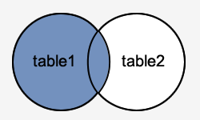
SQL LEFT OUTER JOIN
This type of join returns all rows from the LEFT-hand table specified in the ON condition and only those rows from the other table where the joined fields are equal (join condition is met).
Syntax
The syntax for the LEFT OUTER JOIN in SQL is:
SELECT columns
FROM table1
LEFT [OUTER] JOIN table2
ON table1.column = table2.column;

Slide 43
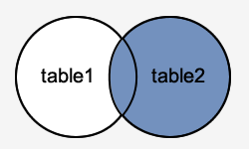
SQL RIGHT OUTER JOIN
This type of join returns all rows from the RIGHT-hand table specified in the ON condition and only those rows from the other table where the joined fields are equal (join condition is met).
Syntax
The syntax for the RIGHT OUTER JOIN in SQL is:
SELECT columns
FROM table1
RIGHT [OUTER] JOIN table2
ON table1.column = table2.column;

Slide 44
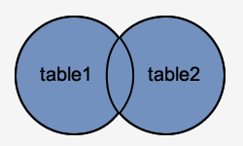
SQL FULL OUTER JOIN
This type of join returns all rows from the LEFT-hand table and RIGHT-hand table with NULL values in place where the join condition is not met.
Syntax
The syntax for the SQL FULL OUTER JOIN is:
SELECT columns
FROM table1
FULL [OUTER] JOIN table2
ON table1.column = table2.column;

Slide 45
Equi join and non equi joins
Equi Join and Non-Equi Joins are types of Inner Joins. Equi Join in SQL is used to retrieve data from multiple tables using an equality condition with the WHERE clause. Non-Equi in SQL is used to retrieve data from multiple tables using any other operator except the equality condition.

Slide 46
Cross Join or Cartesian Join
the cartesian product is really a cross-join which returns all the rows in all the tables listed in a query: each row in the first table is paired with all the rows in the second table. This happens when there is no relationship defined between the two tables.
The syntax of the CROSS JOIN in SQL will look like the below syntax:
SELECT ColumnName_1,
ColumnName_2,
ColumnName_N
FROM [Table_1]
CROSS JOIN [Table_2]

Slide 47
Constraints in SQL

Slide 48
SQL - Constraints
Constraints are the rules that we can apply on the type of data in a table. That is, we can specify the limit on the type of data that can be stored in a particular column in a table using constraints.
The available constraints in SQL are:
NOT NULL: This constraint tells that we cannot store a null value in a column. That is, if a column is specified as NOT NULL then we will not be able to store null in this particular column any more.
UNIQUE: This constraint when specified with a column, tells that all the values in the column must be unique. That is, the values in any row of a column must not be repeated.
PRIMARY KEY: A primary key is a field which can uniquely identify each row in a table. And this constraint is used to specify a field in a table as primary key.

Slide 49
FOREIGN KEY: A Foreign key is a field which can uniquely identify each row in a another table. And this constraint is used to specify a field as Foreign key.
CHECK: This constraint helps to validate the values of a column to meet a particular condition. That is, it helps to ensure that the value stored in a column meets a specific condition.
DEFAULT: This constraint specifies a default value for the column when no value is specified by the user.

Slide 50
Stored Procedure and function

Slide 51
Stored Procedures
Stored procedures are a collection of Transact-SQL statements stored within the database. They are used to encapsulate oft-used queries, such as conditional statements, loops, and other powerful programming features.
CREATE PROCEDURE
1 CREATE PROCEDURE procedure_name
2 AS
3 sql_statement
4 GO;
EXECUTE schemaname.procedurename;

Slide 52
create procedure getEmployeeName
@empid INT,
@empname varchar(50) out
as
begin
select @empname = name
from employee
where emplyeeid = @empid;
end

Slide 53
Creating user-defined functions
USE schooldb
GO
CREATE FUNCTION getFormattedDate
(
@DateValue AS DATETIME
)
RETURNS VARCHAR(MAX)
AS
BEGIN
RETURN
DATENAME(DW, @DateValue)+ ', '+
DATENAME(DAY, @DateValue)+ ' '+
DATENAME(MONTH, @DateValue) +', '+
DATENAME(YEAR, @DateValue)
END
SELECT
name,
[dbo].[getFormattedDate](DOB)
FROM student

Slide 54
Difference between function and SP
A stored procedure may have arguments that are IN, OUT, or INOUT. Functions may only have IN arguments.
A procedure may have one or more SELECT queries (or other statements that have results), and these create result sets readable by the client that called the procedure. Functions cannot have result sets like this.
Functions have a scalar return value. Procedures do not have a return value.

Slide 55
SubQueries

Slide 56
A subquery is a query that is nested inside a SELECT , INSERT , UPDATE , or DELETE statement, or inside another subquery.
Types of SQL Subqueries
We have various subqueries; some of them are as follows:
1. Single Row Subquery
Returns zero or one row in results.
2. Multiple Row Subquery
Returns one or more rows in results.
3. Multiple Column Subqueries
Returns one or more columns
4. Correlated Subqueries
Returns one or more columns according to the main or the outer query, thus called a correlated subquery.

Slide 57
Rules to Use Subqueries in SQL
We need to follow some rules while writing SQL Subqueries. We will discuss the rules below:
Subqueries need to be enclosed in the Where clause and can be used with Insert, Update, Delete, and Select statements.
We can use comparison operators for example: <, >, > =, < =, !=, IN for the subqueries.
The subquery is always executed first and then the main query.
Subquery should be enclosed within parentheses.
Subqueries are always to the right of the comparison operators.
We can’t use Order By clause in the subquery; instead, we can use the Group By clause.
We should use single-row operators with single-row subqueries and vice versa.
We can’t use Between clause with a subquery, but we can use Between in a subquery.

Slide 58
Example 1: Let us find the second highest salary of the employee in DataFlair. Query:
SELECT emp_id, MAX(salary) AS salary
FROM dataflair_emp1
WHERE salary < (SELECT MAX(salary)
FROM dataflair_emp1);
Update Statement with Subquery
Example 2: Let us increase the salary of Senior Manager to 35000. Query:
UPDATE dataflair_emp1
SET salary=35000
WHERE emp_id = ( SELECT emp_id
FROM dataflair_emp1
WHERE post='Sr.Manager');
select * from dataflair_emp1;

Slide 59
Delete Statement with Subquery
Example 3: Let us delete the employee with the age = 25. Query:
DELETE FROM emp1
WHERE emp_id IN ( SELECT emp_id
FROM emp2
WHERE age=25);
select * from dataflair_emp1;
SELECT
employee_id,
first_name,
last_name,
salary
FROM
employees
WHERE
salary > (SELECT
AVG(salary)
FROM
employees);

Slide 60
Plain SubQuery:
First, you can execute the subquery that returns the average salary of all employees independently.
SELECT
AVG(salary)
FROM
employees;
Code language: SQL (Structured Query Language) (sql)
Second, the database system needs to evaluate the subquery only once.
Third, the outer query makes use of the result returned from the subquery. The outer query depends on the subquery for its value. However, the subquery does not depend on the outer query. Sometimes, we call this subquery is a plain subquery.
Unlike a plain subquery, a correlated subquery is a subquery that uses the values from the outer query. Also, a correlated subquery may be evaluated once for each row selected by the outer query. Because of this, a query that uses a correlated subquery may be slow.
A correlated subquery is also known as a repeating subquery or a synchronized subquery.

Slide 61
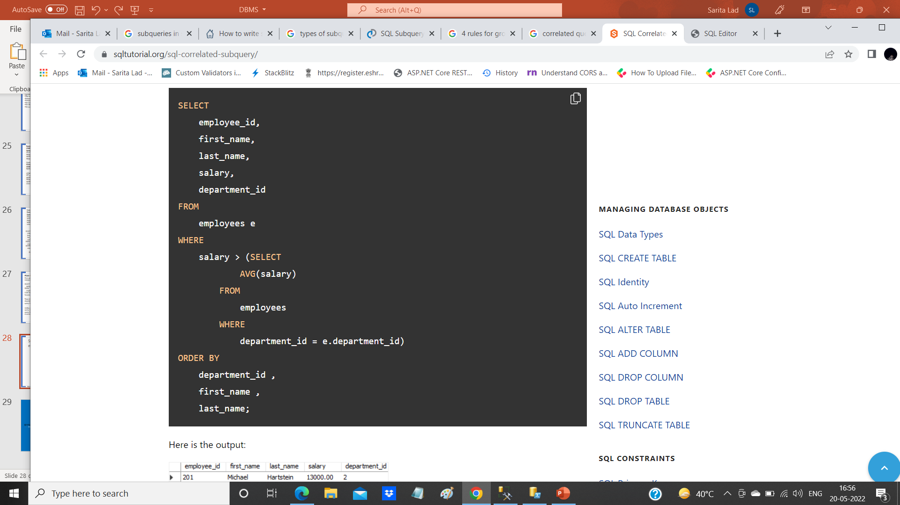
SQL correlated subquery in the WHERE clause example
https://www.sqltutorial.org/sql-correlated-subquery/

Slide 62
the outer query is:
SELECT employee_id, first_name, last_name, salary, department_id FROM employees e WHERE salary > ...
and the correlated subquery is:
salary > (SELECT AVG(salary) FROM employees WHERE department_id = e.department_id)

Slide 63
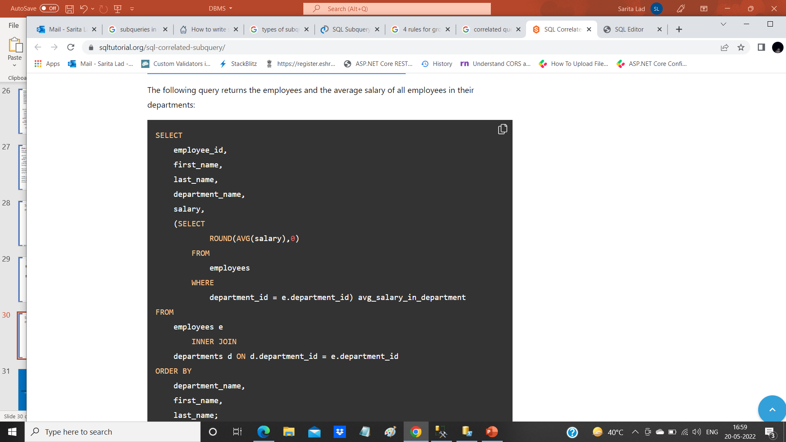
SQL correlated subquery in the SELECT clause example

Slide 64
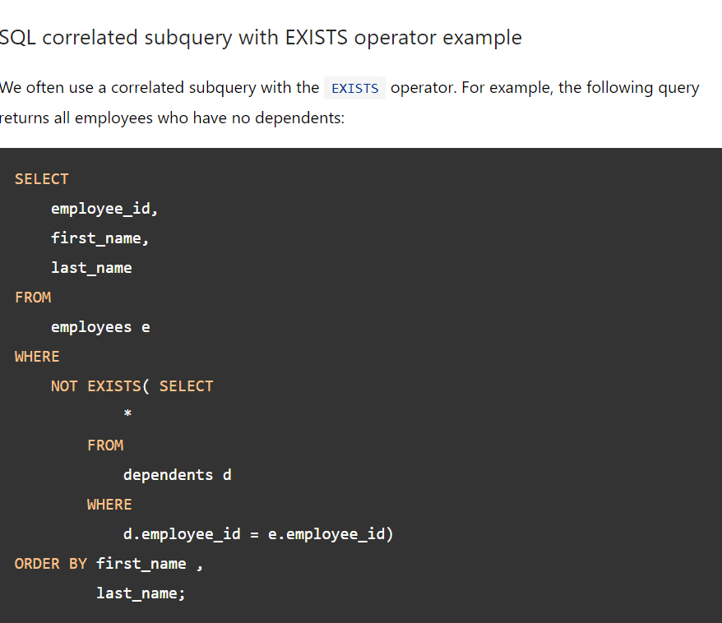
SQL correlated subquery with EXISTS operator example
We often use a correlated subquery with the EXISTS operator. For example, the following query returns all employees who have no dependents:

Slide 65
Difference between delete and truncate
SQL Delete | SQL Truncate
Delete command is useful to delete all or specific rows from a table specified using a Where clause | The truncate command removes all rows of a table. We cannot use a Where clause in this.
It is a DML command | It is a DDL command.
SQL Delete command places lock on each row requires to delete from a table. | SQL Truncate command places a table and page lock to remove all records.
Delete command logs entry for each deleted row in the transaction log. | The truncate command does not log entries for each deleted row in the transaction log.
Delete command is slower than the Truncate command. | It is faster than the delete command.
It removes rows one at a time. | It removes all rows in a table by deallocating the pages that are used to store the table data
It retains the identity and does not reset it to the seed value. | Truncate command reset the identity to its seed value.
It requires more transaction log space than the truncate command. | It requires less transaction log space than the truncate command.
You require delete permission on a table to use this | You require Alter table permissions to truncate a table.
You can use the Delete statement with the indexed views. | You cannot use the truncate command with the indexed views.
Delete command retains the object statistics and allocated space. | Truncate deallocates all data pages of a table. Therefore, it removes all statistics and allocated space as well.
Delete command can activate a trigger as well. Delete works on individual rows and delete the data. Therefore, it activates a trigger. | The truncate command cannot activate a trigger. The trigger is activated if any row modification takes place. In this command, SQL Server deallocates all pages, so it does not activate a trigger.
Delete command removes the rows matched with the where clause. It also does not remove the columns, indexes, constraints, schema | The truncate command only removes all rows of a table. It does not remove the columns, indexes, constraints, and schema.

Slide 66
SQL Trigger
Trigger: A trigger is a stored procedure in database which automatically invokes whenever a special event in the database occurs. For example, a trigger can be invoked when a row is inserted into a specified table or when certain table columns are being updated.
Syntax:
create trigger [trigger_name]
[before | after]
{insert | update | delete}
on [table_name]
[for each row]
[trigger_body]
BEFORE and AFTER of Trigger:
BEFORE triggers run the trigger action before the triggering statement is run. AFTER triggers run the trigger action after the triggering statement is run.

Slide 67
Thank You

