Slide 1



Azure Services
Azure IaaS
Azure PaaS
Azure SaaS
av

Slide 2
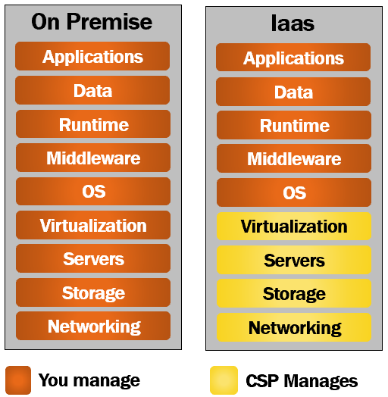
Azure Services
IaaS
av

Slide 3
Azure Services
IaaS
Cloud service provide host infrastructure at their end
Customer will use this infrastructure on demand
CSP is responsible for managing , setting up and securing data center
Customer has control which OS wants to install, which SQL wants to install etc..
av

Slide 4
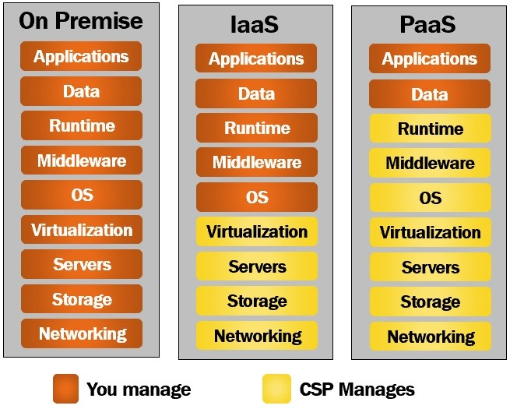
Azure Services
PaaS
av

Slide 5
Azure Services
PaaS
Provides a platform of development of software applications.
Layer on top of IaaS
Customer need to focus on applications and data.
Customer need not to bother about OS patches , updates, failover etc.
Developing web app which connects to SQL
Web Server
SQL server
Team requires to manage those servers
av

Slide 6
Azure Services
PaaS Advantages
Reduce Financial Risk
Reduce Development time
Save time in purchasing , configuring and setting up our own development environment
Global Support
Any one can access resources globally.
Affordability
With Pay As you Go model, working on development software is affordable
Deployment Speed increased
Auto Scaling based on demand
av

Slide 7
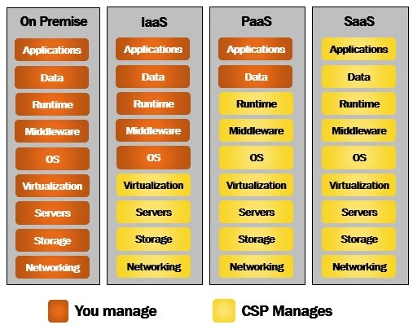
Azure Services
SaaS
av
Example: Email service, Storage services, Video streaming service

Slide 8







Key Azure PaaS Services
Application Services
Data Services
Integration Services
Azure App Service, Azure Functions, and Azure Logic Apps enable the development and deployment of scalable web, mobile, and serverless applications.
Azure SQL Database, Azure Cosmos DB, and Azure Storage provide robust and flexible data storage and management solutions.
Azure API Management (APIM) and Azure Integration Services facilitate seamless connectivity and data exchange between applications and systems.

Slide 9

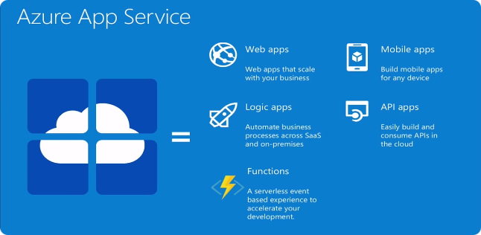
Azure App Service
1
Fully Managed Platform
2
Seamless Deployment
Supports multiple deployment options, including GitHub, Azure DevOps, and Docker containers.
Azure App Service handles the infrastructure, scaling, and management of web, mobile, and API applications.
3
Scalability and High Availability
Automatically scales up or down based on demand, ensuring optimal performance and reliability.

Slide 10

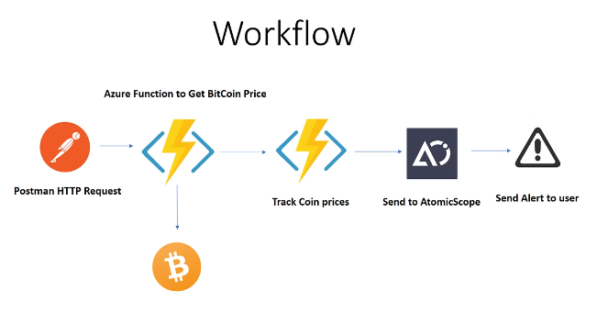
Azure Functions
1
Serverless Computing
Azure Functions enables the execution of small, event-driven pieces of code (functions) without the need to manage servers.
2
Scalable and Cost-Effective
Azure Functions automatically scales to meet demand and charges only for the resources used, making it a cost-effective solution.
3
Flexible Integration
Azure Functions can be easily integrated with other Azure services, such as Azure Cosmos DB and Azure Storage, to build comprehensive solutions.

Slide 11


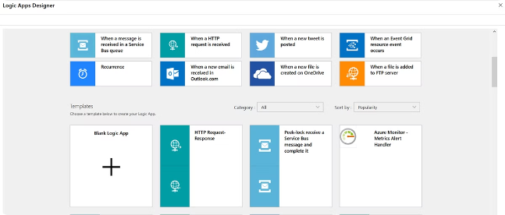

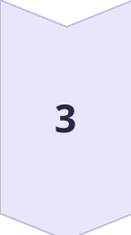
Azure Logic Apps
Workflow Automation
Azure Logic Apps enable the creation of automated workflows that integrate with various cloud services and on-premises systems.
Connectors and Templates
Logic Apps provides a wide range of pre-built connectors and templates, allowing developers to quickly build complex integrations.
Scalable and Reliable
Logic Apps automatically scales to handle increasing workloads and ensures reliable delivery of messages and data.

Slide 12

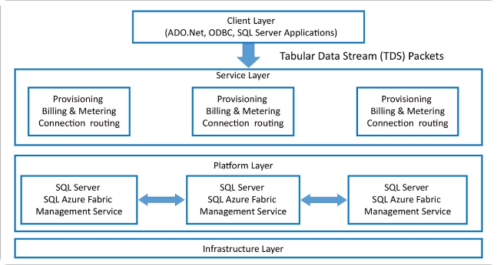
Azure SQL Database
Fully Managed Database
Scalable and Resilient
Azure SQL Database is a fully managed, intelligent, and secure database service that simplifies database management.
Azure SQL Database can be scaled up or down based on demand, ensuring optimal performance and availability.
Advanced Security and Compliance
Hybrid Connectivity
Azure SQL Database can be integrated with on-premises databases, enabling hybrid cloud solutions.
Azure SQL Database offers enterprise-grade security features and compliance with various industry standards.

Slide 13
Azure API Management (APIM)
API Lifecycle Management
Developer Portal
Security and Governance
Azure APIM provides a comprehensive platform for creating, publishing, and managing APIs, enabling businesses to securely expose their services to partners and developers.
APIM's developer portal offers a self-service experience, allowing developers to discover, learn, and interact with available APIs.
APIM enforces security policies, rate limits, and access control to protect APIs and ensure compliance with organizational and industry standards.

Slide 14



Slide 15
Selecting SQL Database
Deployment Model
Single Database:represents fully managed database, suitable for modern cloud app and microservice.
Elastic Pools: it is a collection of single databases with shared set of resources. (CPU, memory)
Purchasing Model
Vcore Model:We can choose the number of vcores for SQL database. It is only option which supports saving licence costs using Azure Hybrid benefits
DTU Model: (Database Transaction Unit)
It provided mixed measures for CPU , Memory, and I/O resources

Slide 16
SQL Command
CREATE TABLE Employee (Id int NOT NULL IDENTITY(1,1) , Name nvarchar(50), Email nvarchar(50), Department nvarchar(100), PRIMARY KEY (Id))
Insert into Employee values('Virat','virat.k@gmail.com','Sports’)
SELECT *FROM Employee
DELETE FROM Employee WHERE Id = '1'

Slide 17
Key Vault
@Microsoft.KeyVault({referenceString})
https://myvault.vault.azure.net/secrets/mysecret/ or https://myvault.vault.azure.net/secrets/mysecret/ec96f02080254f109c51a1f14cdb1931
@Microsoft.KeyVault(https://company-dev-kv.vault.azure.net/secrets/dbconnectionstring)

Slide 18
Azure Function
Function is serverless compute like logic apps. We can create long running flows using durable functions.
Durable function
it is an extension of Azure functions, where we can write stateful functions in serverless compute environment.
We can define stateful workflows by writing orchestrator functions

Slide 19
There are 4 types of durable functions
1. Orchestrator Functions: [OrchestrationTrigger]
2. Activity Functions:[ActivityTrigger]
3. Entity Functions: [EntityTrigger]
4. Client Functions.: It can be HttpTrigger or any Trigger function. This Calls the Orchestrator Function and OF calls ACtivity and Entity function.
Types Durable Function

Slide 20
Orchestrator Functions
It describes , how actions are executed and the order in which actions inside functions gets executed.
An Orchestration function can have many different types of actions like
Activity Functions
Sub-Orchestration functions
Http Actions
Timers
Waiting for external events..etc..
Types Durable Function
Orchestrator Function

Slide 21
Activity Functions
It is basic unit of work inside durable function.
Each activity can be responsible for dedicated task and then result of each of them can be collected in durable function.
The Durable Task Framework guarantees that each called activity function will be executed at least once during an orchestration's execution.
Function chaining example
Types Durable Function
Activity Function

Slide 22
Entity Function
Also called stateful entities or durable entities.
It has special trigger type Entity Trigger.
It can be invoked from client functions and orchestration functions.
Entity functions also manage state explicitly(means we no need to manage it using flow control)
Aggregate application pattern is example of this .
Aggregate Application Pattern
If we want to aggregate data from multiple source and do operations on it, then using stateless function it becomes very difficult in terms of managing concurrency control.
For ex. If we have counter and that is accessible to multiple client and if more than one clients are increasing it then concurrence control will be problem.
Types Durable Function
Entity Function

Slide 23
Client Function
Any non-orchestrator function can be Client function.
We use client function to trigger orchestrator function or entity function.
It used durable client output binding.
[DurableClient] IDurableOrchestrationClient starter
Types Durable Function
Client Function

Slide 24
API Management
<policies>
<inbound>
<base />
<set-backend-service base-url="https://prod-52.eastus.logic.azure.com:443/workflows/e89aa823e10648218b592af83decfa5d/triggers" />
<rewrite-uri template="/When_a_HTTP_request_is_received/paths/invoke?api-version=2016-10-01&amp;sp=%2Ftriggers%2FWhen_a_HTTP_request_is_received%2Frun&amp;sv=1.0&amp;sig=dmsdLjXBzPB1QhsL8bfymOQNqM0qCJSYNknOVnAGrlM" />
</inbound>
<backend>
<base />
</backend>
<outbound>
<base />
</outbound>
<on-error>
<base />
</on-error>
</policies>

Slide 25
Retrieve from named value
Put the varuable in {{}}
<set-url>{{callback urll}}</set-url>

