Slide 1
Git and Git Hub
Sarita Lad
DATE

Slide 2
What is DevOps?
DevOps—the amalgamation of development (Dev) and operations (Ops) teams—is an organizational approach that enables faster development of applications and easier maintenance of existing deployments. By enabling organizations to create stronger bonds between Dev, Ops and other stakeholders in the company, DevOps promotes shorter, more controllable iterations through the adoption of best practices, automation and new tools. DevOps is not a technology per se, but it covers everything from the organisation to culture, processes and tooling. Initial steps usually include Continuous integration and continuous delivery (CI/CD), real-time monitoring, incident response systems and collaboration platforms.
DevOps emphasizes people (and culture), and seeks to improve collaboration between operations and development teams. DevOps implementations utilize technology— especially automation tools that can leverage an increasingly programmable and dynamic infrastructure from a life cycle perspective.”

Slide 3
Importantly, the meaning of DevOps has broadened to be an umbrella term for the processes, culture, and mindset used to shorten the software development life cycle, using fast feedback loops to deliver features, fixes, and updates more frequently.
Benefits of DevOps
Maximizes Efficiency with Automation
Optimizes the Entire Business
Improves Speed and Stability of Software Development and Deployment
Gets You to Focus on What Matters Most: People

Slide 4
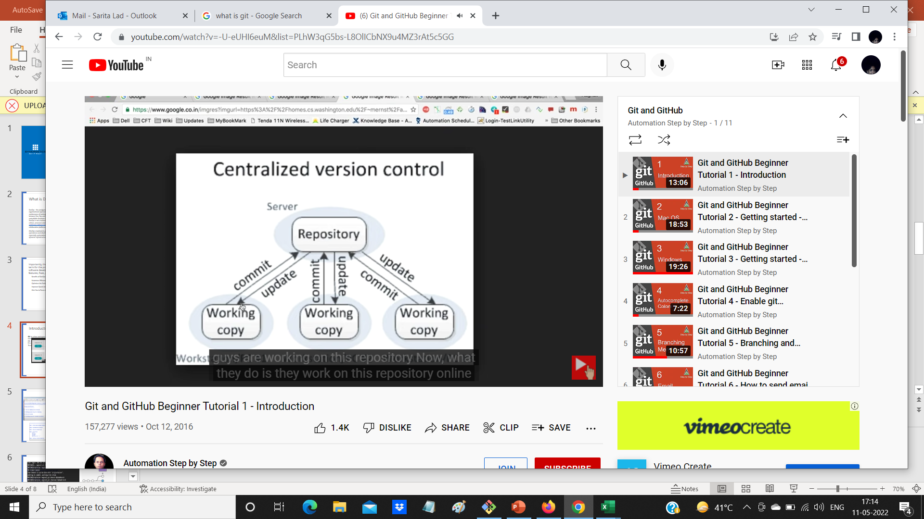
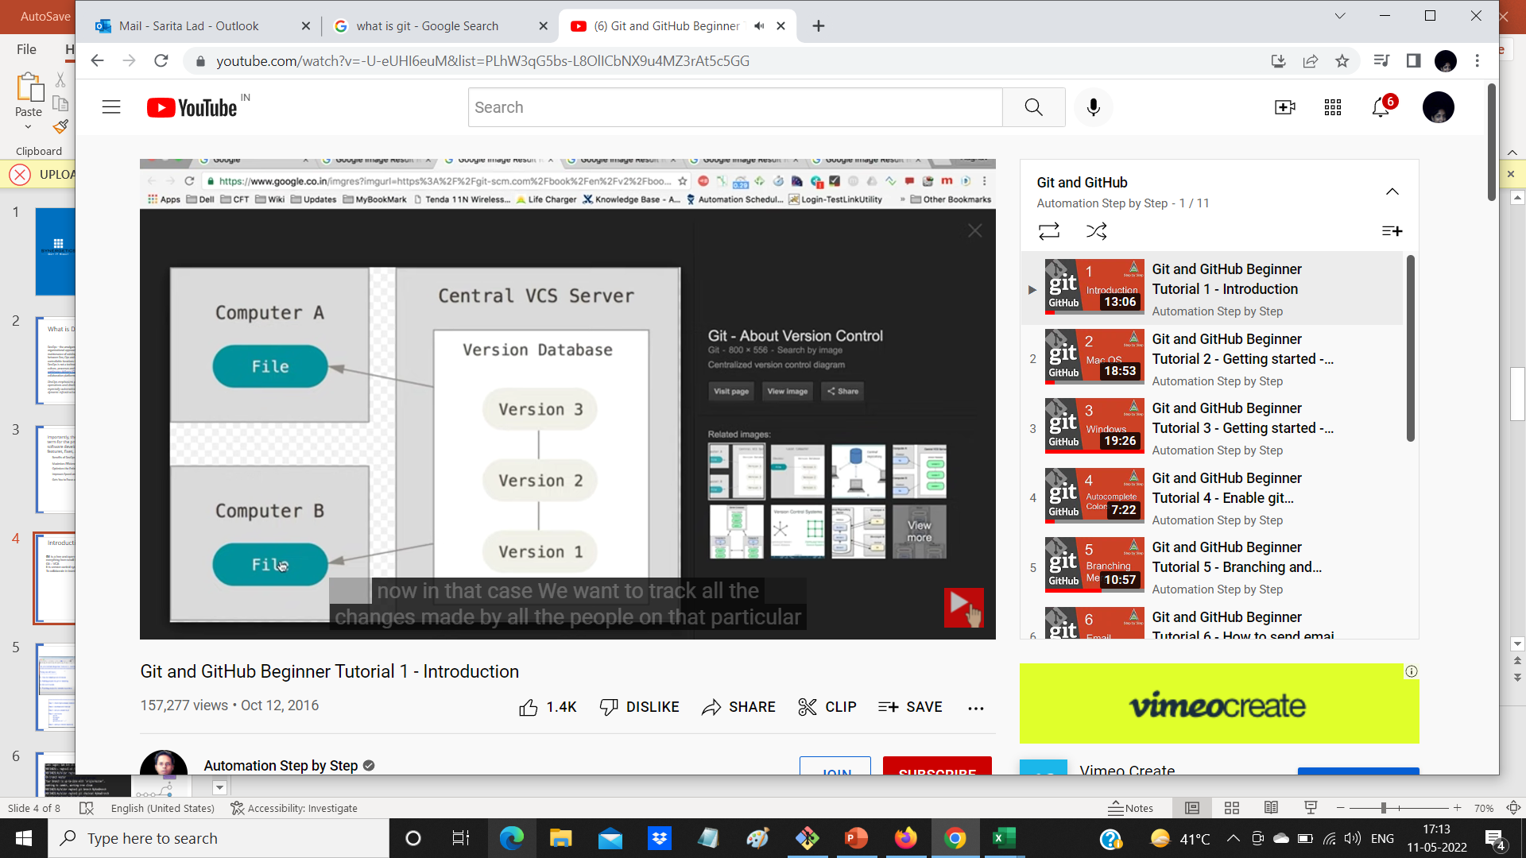
Introduction to git and github
Centralized Version Control System:
Disadvantage
1 Team members need to be continuously connected with this Centralized Repository
2 if something goes wrong in central repository , then it is a loss for all at once.

Slide 5
Today we will learn
1 What is GIT?
2 What is GitHUB?
3 Is GIT related to GITHUB ?
4 A simple workflow
GIT is a version control system
1 -to track changes in files/folders
2 - to collaborate in teams

Slide 6
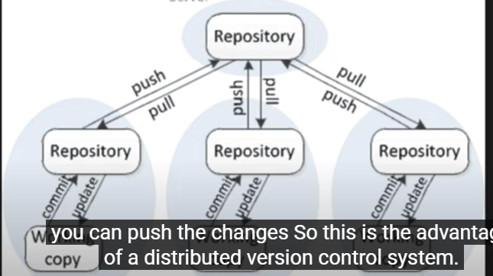
1 Git is Distributed Version Control System
Git is a free and open source distributed version control system designed to handle everything from small to very large projects with speed and efficiency.
Git – VCS
It is version control system : to track changes in files and folders,
To collaborate in teams
2 GITHUB is a website to upload your Repository online
Github provides
1 – backup of your work
2 – visual interface to your repository
3 – makes collaboration easier

Slide 7
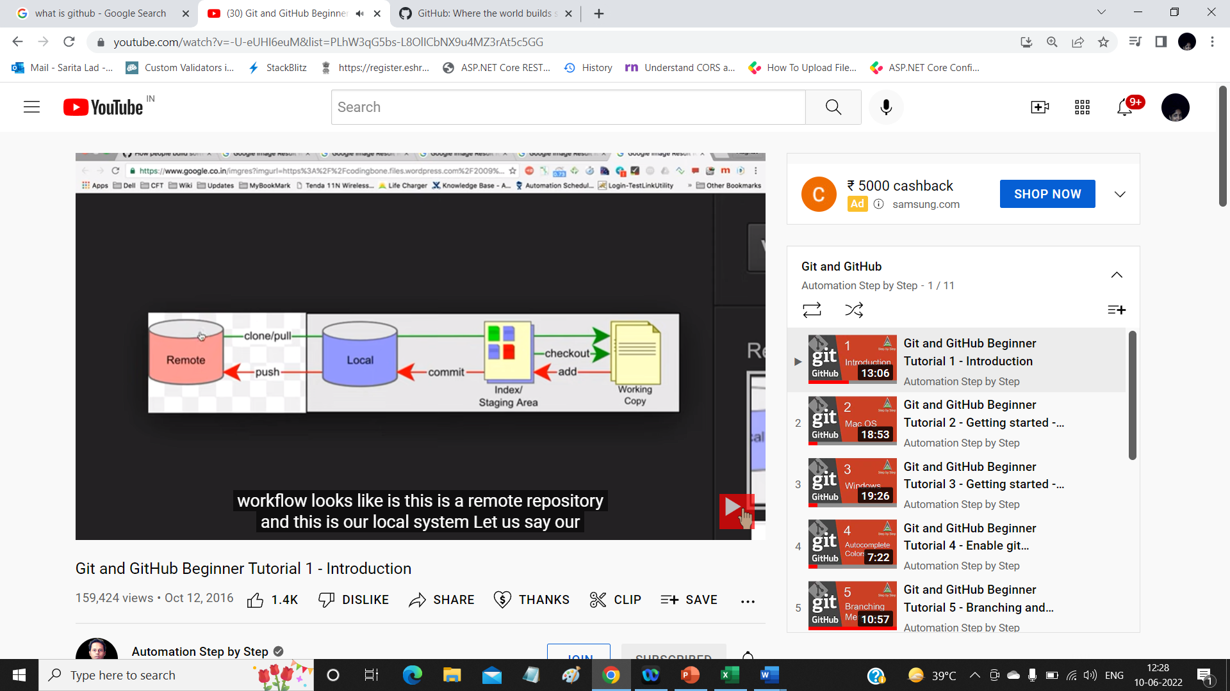
Is Git related to GitHub?
Git != GitHub
Let us see WorkFlow of git .

Slide 8
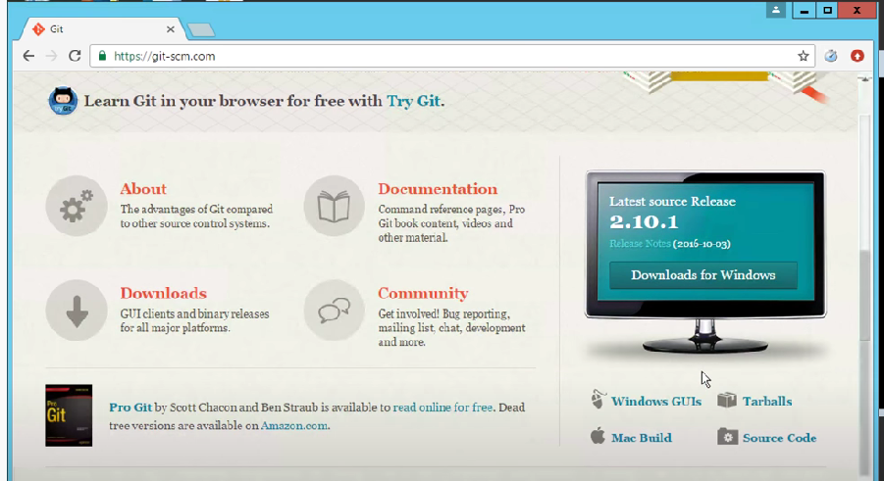
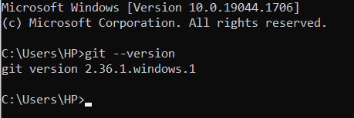
Workflow of working with git:
1 How to download git on windows
2 adding project to git for tracking
3 Git commands
4 Pushing project to remote repository

Slide 9
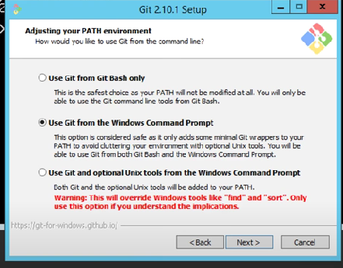
Steps to work on git
create a new repository on the command line
1 from command promp
in c:\desktop\ MyProject folder \>git init
2 git config --global user.email "saritalad@synergetics-india.com"
3 git config --global user.name "saritaAtSynergetics“
4 git status
5 git Add test1.txt
4 git commit –m “added test1.txt”
5 Adding to remote Repository
git remote add origin https://github.com/saritalad/synergeticsreposistory.git
6 git push –u origin master

Slide 10
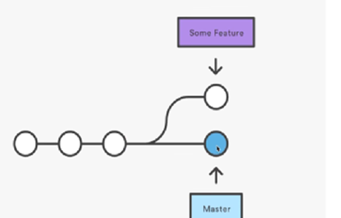
What are BRANCHES ?
How to create a branch
How to checkout branch
How to merge branch to master
How to delete branch local and remote
What are BRANCHES ?
Step 1 : git branch branchname
Step 2 : git checkout branchname
Step3 : add files ()
Step 4 : git add .
Step 5: git commit –m “new files added
Step 6 :git push –u origin branchname
We can see new branch added remotely

Slide 11
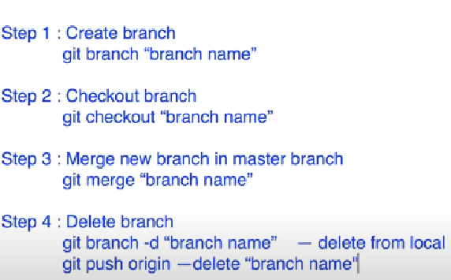
How to merge Branch?
1 git branch -d devops remove from local
2 git push origin --delete devops remove from remote

Slide 12

Notification email from github

Slide 13
Thank You

