Slide 1
What is ADO.NET?
ADO.NET uses a multilayer architecture that mainly has a few concepts, for instance Connection, Reader, Command, Adapter and Dataset objects. ADO.NET introduced data providers that are a set of special classes to access a specific database, execute SQL commands and retrieve data. The Data providers are extensible
ADO.NET provides the following two types of classes objects:
Connection-based: They are the data provider objects such as Connection, Command, DataAdapter, and DataReader. They execute SQL statements and connect to a database.
Content-based: They are found in the System.Data namespace and includes DataSet, DataColumn, DataRow, and DataRelation. They are completely independent of the type of data source.

Slide 2
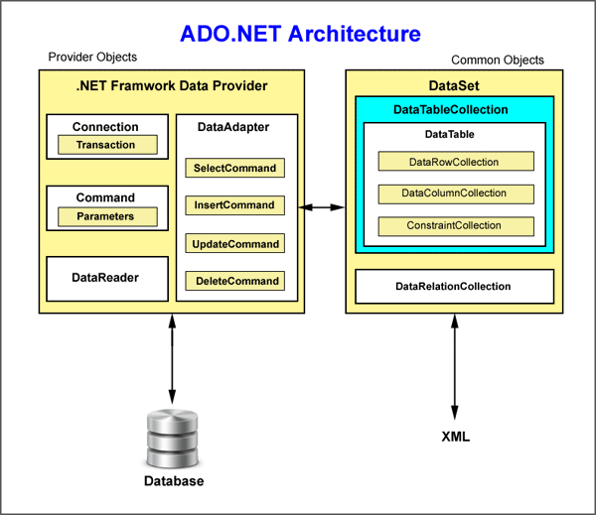

Slide 3
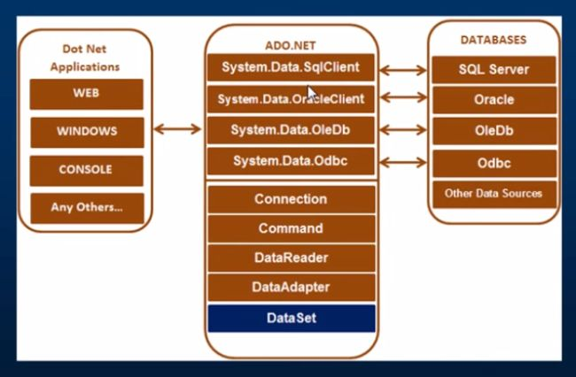

Slide 4
ADO.NET Namespaces
Namespaces | Description
System.Data | Contains the definition for columns,relations,tables,database,rows,views and constraints.
System.Data.SqlClient | Contains the classes to connect to a Microsoft SQL Server database such as SqlCommand, SqlConnection, and SqlDataAdapter.
System.Data.Odbc | Contains classes required to connect to most ODBC drivers. These classes include OdbcCommand and OdbcConnection.
System.Data.OracleClient | Contains classes such as OracleConnection and OracleCommand required to connect to an Oracle database.

Slide 5
Connection Strings
You need to supply a connection string in the Connection class object. The connection string is a series of name/value settings separated by semicolons (;). A connection string requires a few pieces of information such as the location of the database, the database name, and the database authentication mechanism.
This connection is used to connect to the Master database on the current computer using integrated security (indicating the currently logged-in Windows user can access the database).
string conString = "Data Source=localhost;Initial Catalog=Master;Integrated Security=SSPI";
string conString = "Data Source=localhost;Database=Master;user id=sa;password=sa";
Command and Data Reader Classes
The Command Class allows performing any data definition tasks such as creating and altering tables and databases, retrieving, updating and deleting of records. The Command object used to execute SQL queries can be inline text or a Stored Procedure.

Slide 6
Properties and Methods of the SqlConnection Class
tem | Description
Properties
ConnectionString | Contains the database connection string
ConnectionTimeout | Contains the timeout for the connection in seconds
Database | Contains the name of the database to connect to
DataSource | Contains the name of the connected server
PacketSize | Contains the size of packets used to communicate with the server
ServerVersion | Contains the version of SQL that the server is running
State | Contains the state of the connection
WorkstationId | Contains the NetBIOS identifier of the machine hosting the Web form
Methods
BeginTransaction() | Places the connection into a transaction and returns the newly created SqlTransaction object
ChangeDatabase() | Enables the developer to change to a different database programmatically
Close() | Closes the connection to the current database
CreateCommand() | Returns a new command object
Open() | Opens the connection to the database

Slide 7
Properties and Methods of the Sqlcommand Class
Item | Description
Properties
CommandText | Contains the text of a SQL query
CommandTimeout | Contains the length of the timeout of a query, in seconds
CommandType | Specifies the type of command to be executed
Connection | Specifies the connection to the database
Parameters | Specifies a collection of parameters for the SQL query
Transaction | Specifies a transaction object, which enables developers to run queries in a transaction
Methods
Cancel() | Cancels the running query
CreateParameter() | Returns a new SQL parameter
ExecuteNonQuery() | Executes the CommandText property against the database and does not return a result set
ExecuteReader() | Executes the CommandText property and returns data in a DataReader object
ExecuteScalar() | Executes the CommandText property and returns a single value
ExecuteXmlReader() | Executes the CommandText property and returns data in an XMLDataReader object
ResetCommandTimeout() | Resets the CommandTimeout property for the query

Slide 8
Properties and Methods of the SqlDataReader Class
Close() | Closes the SqlDataReader object
Property | Description
Depth | It is used to get a value that indicates the depth of nesting for the current row.
FieldCount | It is used to get the number of columns in the current row.
HasRows | It is used to get a value that indicates whether the SqlDataReader contains one or more rows.

Slide 9
SqlDataAdapter class
PROPERTY | DESCRIPTION
DeleteCommand | Represents a DELETE statement or stored procedure for deleting records from the data source
InsertCommand | Represents an INSERT statement or stored procedure for inserting a new record to The data source
SelectCommand | Represents a SELECT statement or stored procedure can be used to select records from a data source
UpdateCommand | Represents an UPDATE statement or stored procedure for Updating recording in a data source
TableMappings | Represents a collection of mappings between actual data source table and a DataTable object
OleDbDataAdapter Command Properties with Examples
PROPERTY | EXAMPLE
SelectCommand | cmd.SelectCommand.CommandText = "SELECT * FROM Orders ORDER BY Price";
DeleteCommand | TheDataSetCommand.DeleteCommand.CommandText = "DELETE FROM orders WHERE LastName = 'Smith' ";
InsertCommand | TheDataSetCommand.InsertCommand.CommandText = "INSERT INTO Orders VALUE (25, 'Widget1', 'smith')";
UpdateCommand | TheDataSetCommand.UpdateCommand.CommandText = "UPDATE Orders SET ZipCode = '34956' WHERE OrderNum = 14";

Slide 10
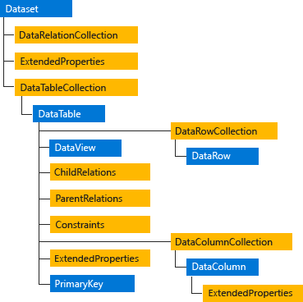
DataSet:
The ADO.NET DataSet is explicitly designed for data access independent of any data source. As a result, it can be used with multiple and differing data sources, used with XML data, or used to manage data local to the application. The DataSet contains a collection of one or more DataTable objects consisting of rows and columns of data, and also primary key, foreign key, constraint, and relation information about the data in the DataTable objects. For more information, see DataSets, DataTables, and DataViews.

Slide 11
Choosing a DataReader or a DataSet
f you do not require the functionality provided by the DataSet, you can improve the performance of your application by using the DataReader to return your data in a forward-only, read-only manner. Although the DataAdapter uses the DataReader to fill the contents of a DataSet (see Populating a DataSet from a DataAdapter), by using the DataReader, you can boost performance because you will save memory that would be consumed by the DataSet, and avoid the processing that is required to create and fill the contents of the DataSet.
When you decide whether your application should use a DataReader (see Retrieving Data Using a DataReader) or a DataSet (see DataSets, DataTables, and DataViews), consider the type of functionality that your application requires. Use a DataSet to do the following:
Cache data locally in your application so that you can manipulate it. If you only need to read the results of a query, the DataReader is the better choice.
Remote data between tiers or from an XML Web service.
Interact with data dynamically such as binding to a Windows Forms control or combining and relating data from multiple sources.
Perform extensive processing on data without requiring an open connection to the data source, which frees the connection to be used by other clients.
The Fill method uses the DataReader object implicitly to return the column names and types that are used to create the tables in the DataSet, and the data to populate the rows of the tables in the DataSet. Tables and columns are only created if they do not already exist; otherwise Fill uses the existing DataSet schema. Column types are created as .NET Framework types according to the tables in Data Type Mappings in ADO.NET. Primary keys are not created unless they exist in the data source and DataAdapter.MissingSchemaAction is set to MissingSchemaAction.AddWithKey. If Fill finds that a primary key exists for a table, it will overwrite data in the DataSet with data from the data source for rows where the primary key column values match those of the row returned from the data source. If no primary key is found, the data is appended to the tables in the DataSet. Fill uses any mappings that may exist when you populate the DataSet (see DataAdapter DataTable and DataColumn Mappings).

Slide 12
DataTable
A datatable is an in-memory representation of a single database table. You can think of it as having columns and rows in the same way. The DataTable is a central object in the ADO.NET library. Other objects that use the DataTable include the DataSet and the DataView.
Look at MSDN The DataTable class for more details.
DataView
A dataview is a view on a datatable, a bit like a sql view. It allows you to filter and sort the rows - often for binding to a windows form control.
Additionally, a DataView can be customized to present a subset of data from the DataTable. This capability allows you to have two controls bound to the same DataTable, but showing different versions of the data. For example, one control may be bound to a DataView showing all of the rows in the table, while a second may be configured to display only the rows that have been deleted from the DataTable. The DataTable also has a DefaultView property which returns the default DataView for the table.

