Slide 1








Codility Lesson 3 Time Complexity

Slide 2
Agenda
Asymptomatic Analysis
Complexities
Time Complexities
Time Complexity types
Complexity Improvement
Task-I: Jumping of Frog
Task-II: PermMissingElement
Task-III: TapeEquillibrium
Complexities of Data Structure
Complexities of Sorting
Complexities of Searching

Slide 3
Asymptomatic Analysis
Computing the running time of any operation in mathematical units of computation.
It is to conclude the best case, average case, and worst-case scenario of an algorithm.
Notations
Big Oh Notation (O): Formal way to express the upper bound of an algorithm's running time. It measures the worst-case time complexity or the longest amount of time an algorithm can possibly take to complete.
Omega Notation(Ω): Formal way to express the lower bound of an algorithm's running time. It measures the best-case time complexity or the best amount of time an algorithm can possibly take to complete.
Theta Notation(θ): Formal way to express both the lower bound and the upper bound of an algorithm's running time.

Slide 4
Complexities
Order of Magnitude to compare algorithms for their run-time performances.
Time Complexity
Amount of memory needed to perform computations. Difficult to calculate. With different set of tools
Space Complexity

Slide 5
Time Complexity
It helps in comparing algorithms for their run-time performances.
A measure of number of primitive (Dominant: Arithmetic and Assignment) operations
These operations may be executed different number of times for different input values from user.
The measure is represented as Big-O factor like O(n).
Complexity specifies order of Magnitude within which program will perform operations.
If complexity is n or 2.n or c.n or n/2, it is always represented as O(n) to represent Order of Magnitude.
int expression = a * b * c; // Complexity O(3) == O(1) i.e. Two multiplications and one assignment.
for(int i=0; i<n; i++){ // It’s a Dominant Operation: The operation is arithmetic and executed ‘n’ times
sum += i; // The operation is executed N times. Complexity O(n).
}
* Dominant Operations: Operations performed largest number of times.

Slide 6
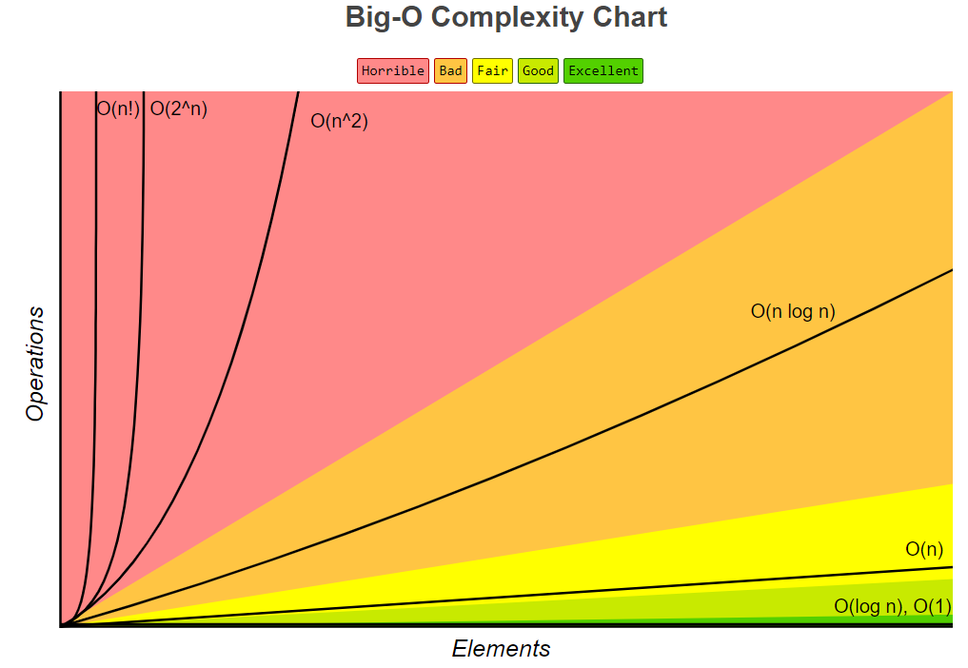
Big-O Complexity

Slide 7
Time Complexity Type
Big O Factor O(1)
Constant Time
public void getComplexity(int n){
result = n * n; // Executed once for every run of algorithm.
return;
}

Slide 8
Time Complexity Type
N | Vs N | N | Vs 2.N | N | Vs 4.N
1 | 1 | 1 | 2 | 1 | 4
2 | 2 | 2 | 4 | 2 | 8
3 | 3 | 3 | 6 | 3 | 12
4 | 4 | 4 | 8 | 4 | 16
5 | 5 | 5 | 10 | 5 | 20
6 | 6 | 6 | 12 | 6 | 24
7 | 7 | 7 | 14 | 7 | 28
8 | 8 | 8 | 16 | 8 | 32
9 | 9 | 9 | 18 | 9 | 36
10 | 10 | 10 | 20 | 10 | 40
11 | 11 | 11 | 22 | 11 | 44
12 | 12 | 12 | 24 | 12 | 48
13 | 13 | 13 | 26 | 13 | 52
14 | 14 | 14 | 28 | 14 | 56
15 | 15 | 15 | 30 | 15 | 60
Linear Time
Big O Factor O(n)
for(int i=0; i<n; i++){
sum += i;
if (arr[i] == 0){ // Worst case, every time condition is false.
mult = i * i;
}
}
for(int i=0; i<n; i++){
sum += i;
}
for(int j=0; j<m; j++){
sum += j;
}
}
Big O Factor O(n + m)
Big O Factor O(n)

Slide 9
Time Complexity Type
Quadratic Time
Big O Factor O(n²)
for(int i=0; i<n; i++){
for(int j = 0; j<m, j++){
sum += i * j;
// A dominant statement executed n * m times
}
}
N | Vs. N^2
1 | 1
2 | 4
3 | 9
4 | 16
5 | 25
6 | 36
7 | 49
8 | 64
9 | 81
10 | 100
for(int i=0; i<n; i++){
for(int j = i; j<m, j++){
sum += i * j;
// A dominant statement.
}
}
Big O Factor O(n²)

Slide 10
Time Complexity Type
N | Log(N)
1 | 0
2 | 1
3 | 1.584963
4 | 2
5 | 2.321928
7 | 2.807355
8 | 3
9 | 3.169925
15 | 3.906891
16 | 4
17 | 4.087463
31 | 4.954196
32 | 5
Logarithmic Time
sum = 0;
while (n > 1) {
n/=2; // Each time, value is half.
sum += n;
}
Big O Factor O(log(n))
For n=8, executed 3 times i.e. 2^3 = 8 i.e 3 = log(8).
For n=16, executed 4 times i.e. 2^4=16 i.e. 4 = log(16)
For n=32, executed 5 times i.e. 2^5=32 i.e. 5 = log(32)

Slide 11
Time Complexity Type
N Logarithmic Time
Big O Factor O(N Log(N))
Low performing algorithms. Suitable for small data size
N | N.Log(N)
1 | 0
2 | 2
3 | 4.754888
4 | 8
5 | 11.60964
7 | 19.65148
8 | 24
9 | 28.52933
15 | 58.60336
16 | 64
17 | 69.48687
31 | 153.5801
32 | 160

Slide 12
Time Complexity Type
N | 2^N
1 | 2
2 | 4
3 | 8
4 | 16
5 | 32
6 | 64
7 | 128
8 | 256
9 | 512
10 | 1024
11 | 2048
12 | 4096
13 | 8192
14 | 16384
15 | 32768
Exponential Time
Low performing algorithms. Suitable for small data size
Big O Factor O(2^{n})
Factorial Time
Low performing algorithms. Suitable for small data size
Big O Factor O(!n)

Slide 13
Time Complexity Type
Factorial Time
Big O Factor O(!n)
Low performing algorithms. Suitable for small data size
N | Fact(N)
1 | 1
2 | 2
3 | 6
4 | 24
5 | 120
6 | 720
7 | 5040
8 | 40320
9 | 362880
10 | 3628800
11 | 39916800
12 | 479001600
13 | 6227020800
14 | 87178291200
15 | 1.30767E+12

Slide 14
Complexity Improvement
N=5, sum = 1 + 2 + 3 + 4 + 5 = 15
N=10, sum = 1 + 2 + .. + 9 + 10 = 55
N=15, sum = 120
Only one loop with O(n)
public int methodMedium(int n) {
int sum = 0;
for (int i=1; i<=n; i++) {
sum += i; // 1 + 2 + 3
}
return sum;
}
Two nested loop with O(n^2)
public int methodWorst(int n) {
int sum = 0;
for (int i=1; i<=n; i++) {
for (int j=1; j<=i; j++) {
sum += 1;
}
}
return sum;
}
N=5, sum = 5 * 6 / 2 = 15
N=10, sum = 10 * 11 / 2 = 55
N=15, sum = 15 * 16 / 2 = 120
Without a loop with O(1)
public int methodBest(int n) {
return n * (n + 1) / 2;
}

Slide 15

Task 1: Jumping of Frog/Deer/Kid/Mr. Beans
X wants to cross river/road from position X to position Y. Each jump covers fixed distance D. Count the minimum number of jumps for Prop to reach to another end.
X=10
Y=85
D=30
X, Y, D are integers in the range 1..1000000000
X<=Y
Starting
Ending
Distance
10
Distance 30
Jump I
40
Distance 30
Jump II
70
85
100
100
Distance 30
Jump III

Slide 16


Task 2: PermMissingElement
Given an array containing N integers from the range of 1..(N+1). It means, one element from given range is missing in the array. Problem is to find missing element.
A
N=4
N is an integer in the range 1.. 100,00
A has N elements of the range 1..(N+1), all are distinct.
Integer Array
Of this size
0
1
2
3
4
Care for empty array.
Whether implementation of Prefix Sum will improve performance?
2
3
1
5

Slide 17
Task 3: TapeEquillibrium
Problem Statement
A non-empty tape is stored with N numbers.
We are using Array of size N to represent Tape.
Split tape at position P into two non-empty parts as Left Split and Right Split.
0 < P < N i.e. P ranges 1..(N-1). If N is 4, P will be 1, 2,3.
Difference: Sum all elements of Right Split – Sum all elements of Left Split.
Difference-P: Its an absolute of above difference.
For multiple such differences, find the minimum and return a value.

Slide 18
Task 3: TapeEquillibrium
0
1
2
3
4
3
1
2
4
3
N is an integer in the range 2.. 100,000
A has N elements of the range -1000…1000.
Consider the case N = 2
Try with Pre-fix Sum also.
P = 1
3
10
|3 - 10| = 7
P = 2
4
9
|4 - 9| = 5
P = 3
6
7
|6 - 7| = 1
P = 4
10
3
|10 - 3| = 7

Slide 19
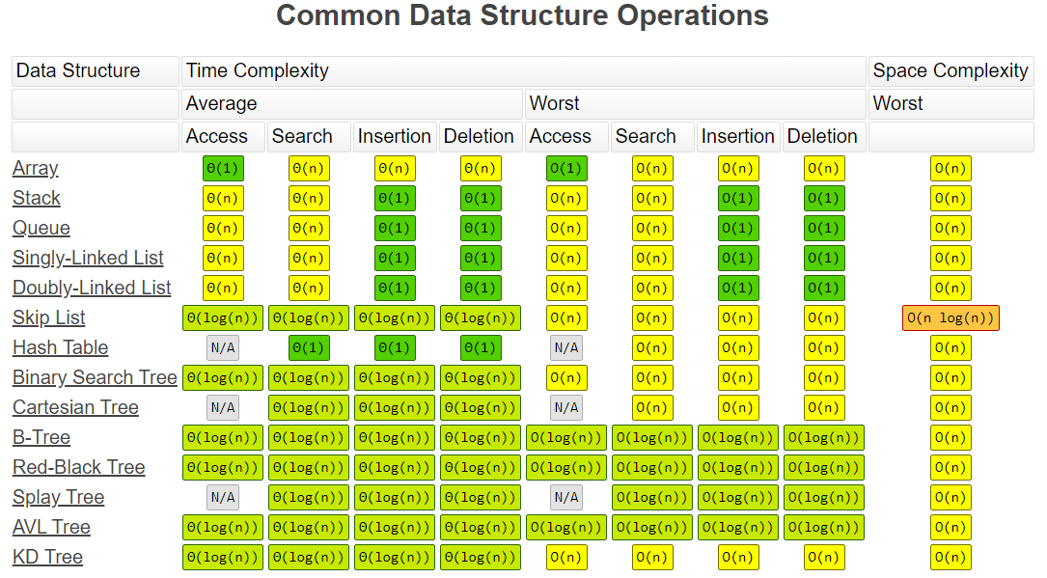
Complexity comparisons for Data Structures

Slide 20
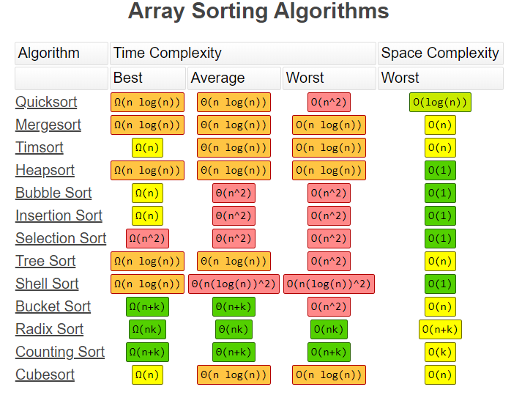
Complexity comparisons for Array Sorting

Slide 21
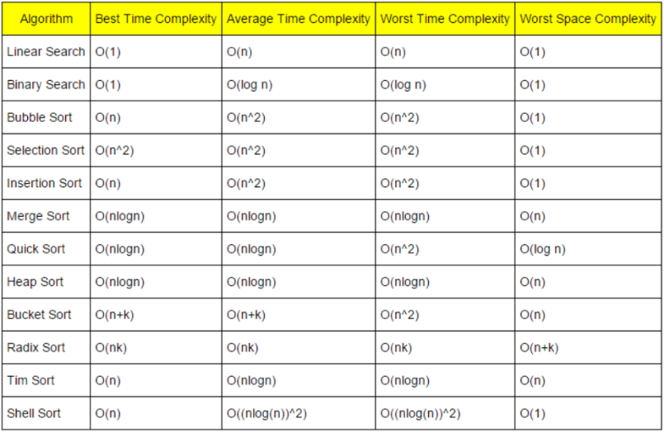
Complexity comparisons for Searching

Slide 22
Q & A
Contact: chandrashekhardeshpande@synergetics-india.com

Slide 23
Thank You

