Slide 1
L1 .Iterations

Slide 2
While Loop:
The simplest of the looping mechanisms.
A while loop will execute as long as the given expression evaluates to true.
For Loop:
An iteration structure that’s useful when the number of iterations is known.
A for loop’s declaration has three components:
initialization of a variable, expression to determine if the loop will end,
and a statement that’s executed at the end of each iteration.
.forEach() Method: A method of the array class that takes a single argument , which is a function, and performs that function with every element within the array.
For…of Loop:
The most recently added of the iteration structures,
this statement requires specifying a temporary variable name that each element in the array will be assigned to as it’s iterated over.

Slide 3
let arr = [];
// while loop let i=0; while(i < arr.length) { // do stuff i++; } | // for loop for(let i=0; i<arr.length; i++) { // do stuff }//
.forEach() method arr.forEach((element) => { // do stuff }); | // for...of loop for(const element of arr) { // do stuff }

Slide 4
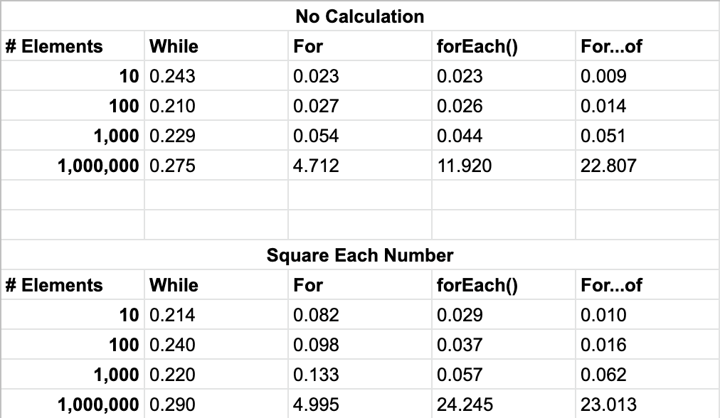

Slide 5
takeaways from this exercise:
while loops scale the best for large arrays.
for...of loops are hands down the fastest when it comes to small data sets,
but they scale poorly for large data sets.
.forEach() and for...of were close enough that neither side
should hang their hat on performance alone over the other.
The execution time of .forEach() is dramatically affected by
what happens inside each iteration.
Standard for loops were mediocre across the board.

Slide 6
While vs For vs Iterator https://docs.oracle.com/javase/8/docs/api/java/util/RandomAccess.html
public interface RandomAccess
Marker interface used by List implementations to indicate that they support fast (generally constant time) random access.
The primary purpose of this interface is to allow generic algorithms to alter their behavior to provide good performance when applied to either random or sequential access lists.
For example, some List implementations provide asymptotically linear access times if they get huge, but constant access times in practice.
Such a List implementation should generally implement this interface.
As a rule of thumb,
a List implementation should implement this interface if, for typical instances of the class, this loop:
for (int i=0, n=list.size(); i < n; i++)
list.get(i);
runs faster than this loop:
for (Iterator i=list.iterator(); i.hasNext(); )
i.next();

Slide 7
DIFFERENCES BETWEEN FOR-EACH LOOP AND REGULAR FOR LOOP IN JAVA
There are a couple of differences between the For-each loop and the one we call standard for-loop in Java. It is important to know the limitations thatFor-each loop has when choosing which of the two to use. All the differences we will see come from the fact that the standard for-loop provides more control of whats happening, while the enhanced for loop provides more convenience and might be easier and faster to create.
An For-each loop is executed consecutively, in other words, there is no counter as there is in the standard for-loop. In the standard for-loop you can change the step to count e.g. i = i + 2, in other words, looping every other element in an array. This is not possible with an enhanced for loop
The For-each loop can only iterate (go through) the array in incremental order. So we can’t configure it to, for example, go backwards through the array. In the standard for-loop we can configure the counter backwards using, i- -, but an for-each loop always goes through the array in the order in which the elements are located
The For-each loop does not have access to the array index, which means that you cannot replace the element with the index. The standard for-loop, on the other hand, has access to the index, which then allows you to replace any element in the array

