Slide 1
DATA ANALYSIS CAPSTONE PROJECT
Bluestock Mutual Fund
Analytics
A complete ETL, performance analytics and risk insights project across
40 mutual fund schemes and 32,778 investor transactions
Sarita Sahoo | June 2026
Notes:
Welcome the audience. Introduce this as an end-to-end capstone project covering the full lifecycle of mutual fund data analytics, from raw data to a working dashboard and risk model.

Slide 2
PROBLEM & OBJECTIVE
Why this project matters
1
2
3
The Problem
The Objective
The Outcome
Mutual fund data is scattered across NAV files, transaction logs and performance reports, making it hard to compare funds or track investor behaviour on a like-for-like basis.
Build a structured pipeline that ingests, cleans and stores this data, then layers performance analytics, risk metrics and an interactive dashboard on top.
A reusable analytics framework: a SQLite database, a Power BI dashboard, a fund scorecard, and a simple risk-based fund recommender.
Notes:
Frame the business problem: fragmented data, no unified way to compare funds. State the objective clearly and preview the outcome - a working pipeline plus dashboard.

Slide 3
DATA SOURCES
Ten datasets, one unified pipeline
Fund Master
40 schemes
Category, expense ratio, risk grade
NAV History
46,000 records
Daily prices, Jan 2022 - May 2026
Investor Transactions
32,778 records
SIP, Lumpsum, Redemption activity
Scheme Performance
40 records
Returns, Sharpe, Alpha, Beta, drawdown
Portfolio Holdings
322 records
Stock and sector-level weights
Benchmark Indices
8,050 records
Nifty 50, Nifty 100 and more
Notes:
Walk through the breadth of data: from static fund attributes to nearly 33,000 individual transactions and over 8,000 benchmark index data points. Mention live NAV data was also pulled from the mfapi.in API.

Slide 4
ARCHITECTURE
From raw CSVs to insights
Raw CSVs
+ Live API
Clean &
Validate
SQLite
Database
Analytics &
Notebooks
Power BI
Dashboard
Star schema: dim_fund linked to fact_nav, fact_transactions, fact_performance and fact_aum via amfi_code
Notes:
Explain the pipeline visually: ingestion, cleaning, the SQLite star-schema database, the analytical notebooks, and finally the Power BI dashboard layer.

Slide 5
EDA HIGHLIGHTS
SIP inflows and folios are both climbing fast
SIP inflows grew 169% from Rs 11,517 Cr (Jan 2022) to an all-time high of Rs 31,002 Cr (Dec 2025), while total folios nearly doubled from 13.26 Cr to 26.12 Cr over the same period.
Notes:
Highlight the strongest growth story in the dataset: SIP discipline and investor base growth, both climbing consistently even through the 2024 correction.

Slide 6
EDA HIGHLIGHTS
Who invests, and from where
Notes:
Cover investor behaviour: Lumpsum dominates by value even though SIP is more frequent by count. Punjab, Tamil Nadu and Madhya Pradesh lead geographically; the 26-35 age group leads demographically.

Slide 7
PERFORMANCE METRICS
Ranking funds beyond raw returns
Composite Fund Scorecard (0-100): 30% 3yr return + 25% Sharpe + 20% Alpha + 15% expense ratio + 10% drawdown
Scheme | Score | 3yr CAGR | Sharpe | Rank
ICICI Pru Midcap Fund - Regular - Growth | 79.75 | 31.78% | 1.18 | 2
HDFC Mid-Cap Opportunities - Regular | 78.25 | 32.44% | 1.09 | 4
ICICI Pru Bluechip Fund - Direct - Growth | 77.81 | 32.49% | 1.03 | 5
Axis Midcap Fund - Regular - Growth | 74.50 | 35.11% | 1.00 | 6
DSP Midcap Fund - Regular - Growth | 64.25 | 26.87% | 1.13 | 11
ICICI Prudential Midcap Fund ranked highest overall, balancing strong 3-year returns with a healthy Sharpe ratio of 1.18 - rewarding consistent, risk-adjusted performance over chasing the single highest return.
Notes:
Explain the scorecard methodology briefly, then point out that the top fund balances return and risk rather than simply having the highest headline return.

Slide 8
PERFORMANCE METRICS
Risk tells the other half of the story
Risk concepts used in this analysis
Value at Risk (95%)
Worst loss expected on a normal bad day, for every one of the 40 schemes
Maximum Drawdown
Largest peak-to-trough decline; deepest for small/mid cap funds during the 2024 correction
Rolling 90-day Sharpe
Tracked for the top 5 funds, showing risk-adjusted performance dip and recovery across the cycle
Sector HHI
Flags equity funds with concentrated sector bets versus broadly diversified portfolios
Notes:
Show that Small Cap funds top the return charts, then pivot to risk: VaR, drawdown, rolling Sharpe and HHI all help explain why high returns came with higher risk for these same funds.

Slide 9
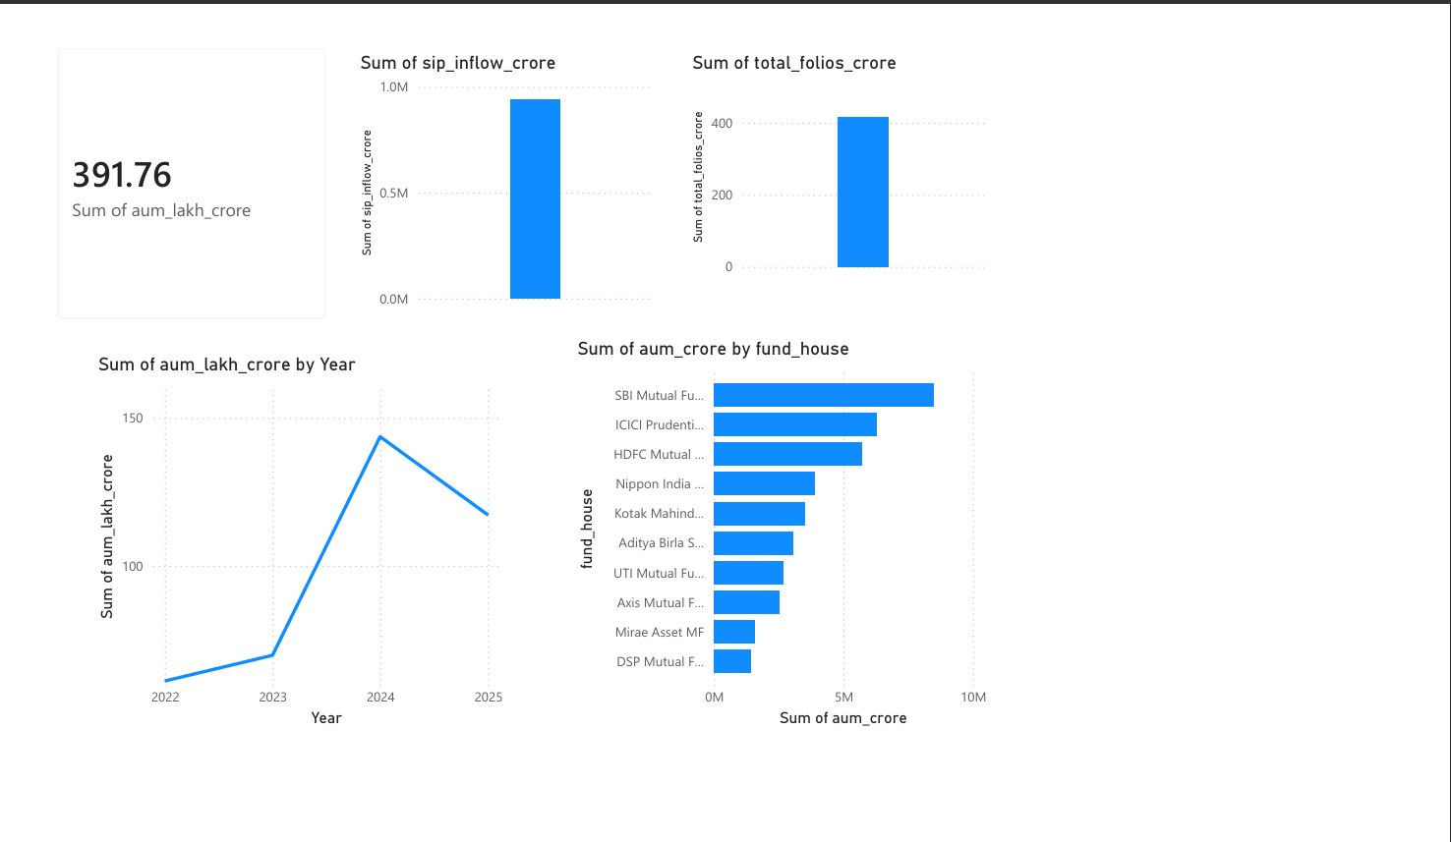
INTERACTIVE DASHBOARD
Page 1: Industry Overview
Notes:
Show the first dashboard page: KPI cards for total AUM, SIP inflows and folios, plus the AUM trend and fund-house ranking bar chart with SBI leading.

Slide 10
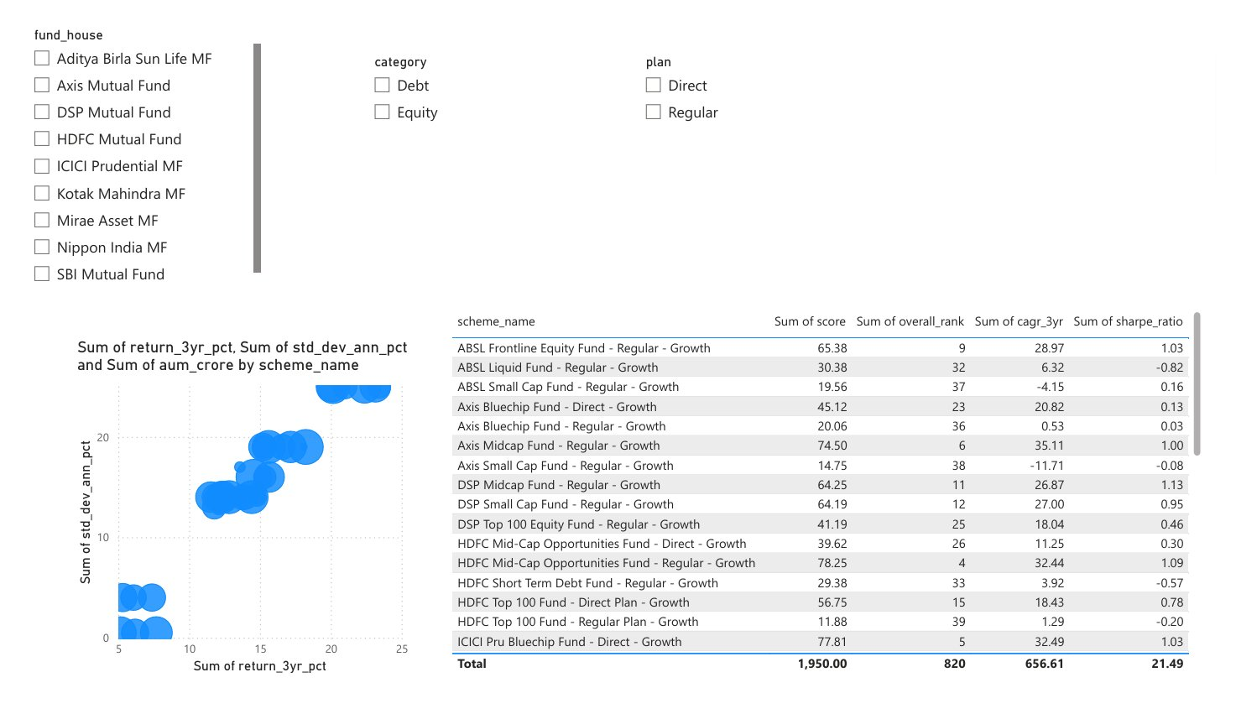
INTERACTIVE DASHBOARD
Page 2: Fund Performance
Notes:
Show the risk-return scatter plot and the full sortable fund scorecard table, filterable by fund house, category and plan.

Slide 11
KEY FINDINGS
What the data tells us
01
SIP inflows grew 169% (2022-2025), reaching an all-time high of Rs 31,002 Cr in Dec 2025
02
Total investor folios nearly doubled, from 13.26 Cr to 26.12 Cr
03
Small Cap equity funds led on 1-year returns, but carried higher VaR and drawdown
04
SBI Mutual Fund holds the largest average AUM among all fund houses studied
05
26-35 age group contributes the highest SIP investment value of any age band
06
Liquid and short-duration debt funds offer the most stable, low-risk return profiles
Notes:
Summarise the six most important takeaways from the entire project in one slide - this is the slide audience members will remember.

Slide 12
Thank You
Questions and discussion welcome
Sarita Sahoo
github.com/saritasahoo08/mutual_fund_project
Notes:
Close with thanks and invite questions. Mention the GitHub repository link for anyone who wants to explore the code, notebooks or dashboard file directly.

