Slide 1

KATHMANDU UNIVERSITY SCHOOL OF ENGINEERING DEPARTMENT OF CIVIL ENGINEERING
Final presentation on
DEMONSTRATIVE MODEL OF ISOLATED AND COMBINED FOOTINGS
Group: 6
Team members
Nilesh Jha (16)
Prabin Kumar Khadka (17)
Suraj Khadka (18)
Sarita Sapkota (44)
Prabin Shah (45)
Saras Mainali (63)
Project Coordinator
Assist. Prof.Vimesh Poudel
Project Supervisor
Er. Sudip Bajgain
Teaching Assistant

Slide 2
OUTLINES OF PRESENTATION
Introduction
Objectives and limitation
Methodology
AutoCAD Drawing of the project
Model Construction
Work Schedule
Budget
Result and Conclusion
References

Slide 3
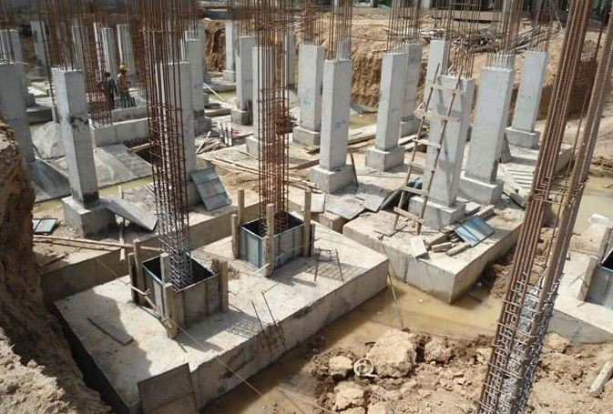
Introduction
Footings
The lowest load bearing structure of the building.
Mainly supports the foundation and the structures, prevents the settling.
Acts as a base to the floor columns and floor walls.
Transfer the vertical loads from columns and floor walls directly to the soil.
Fig: Combined Footing
Source: The Engineering Community;17 July,2021

Slide 4
Contd…
Types of footing depending on the type of building and the soil bearing capacity.
Shallow foundations (Depth is equal to or less than its width)
Isolated footing
Combined footing
Strap footing
Mat raft footing
Deep foundations (Depth is greater than it’s width.)
Deep strap footings
Pile foundations
Pier or drill caisson
Well (cassions) foundation

Slide 5
Objectives and Limitations
Objectives
Primary Objective
To prepare the demonstrative model of isolated and combined footings
Secondary Objective
To understand the application of footings.
To understand the load transfer mechanism in footing.
Limitations
Some of the hooks of stirrups might not be perfectly bent at 135°.
GI wire was used instead of Fe500TMT rods.

Slide 6
Methodology
Preliminary study
Literature Review
Consultation
Calculations
Material Collection
Model Construction
Fig: Methodology

Slide 7
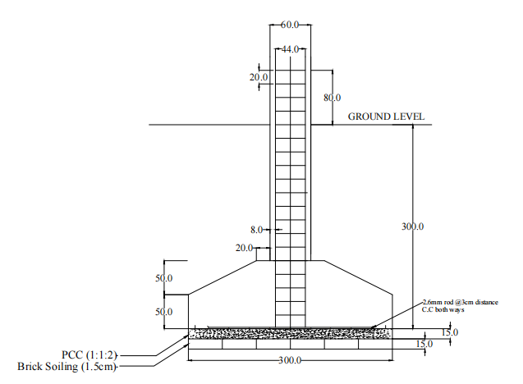
AutoCAD drawing of the project
All dimensions are in mm
Fig: Side view of section of Isolated Footing

Slide 8
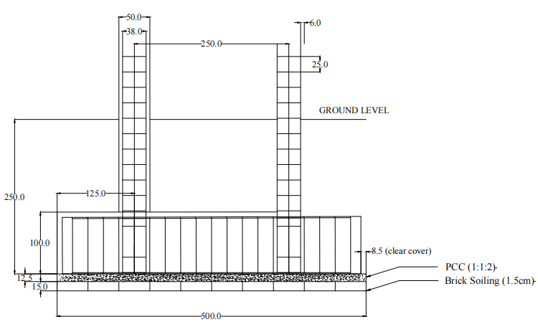
Contd…
All dimensions are in mm
Fig: Side view of section of combined footing

Slide 9
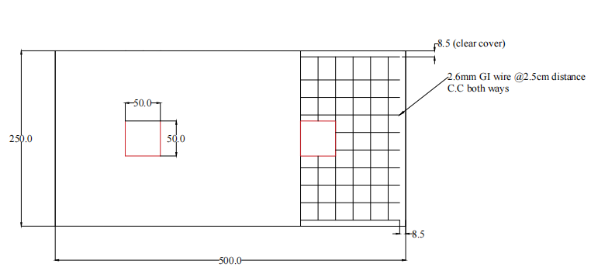
Contd…
All dimensions are in mm
Fig: Top view of section of combined footing

Slide 10
Calculation
For Isolated Footing
Name of the Components | Actual Dimension | Reduced Dimension | R.F.
Footing | (150×150) cm² | 30×30 cm² | 1:5
Footing depth | 150cm | 30 cm | 1:5
Brick soiling | 230×115×57 mm³ | 50×25×15 mm³ | 1:5
PCC | 7.5cm | 1.5 cm | 1:5
Lower portion volume | (150×150×25) cm³ | 30×30×5 cm³ | 1:5
Height of Truncated Pyramid | 25cm | 5 cm | 1:5
Pedestal | (50×50) cm² | 10×10 cm² | 1:5
Column | (30×30) cm² | 6×6 cm² | 1:5

Slide 11
Contd…
For Combined Footing
Name of the Components | Actual Dimension | Reduce Dimension | R.F.
Footing | (300×150) cm² | 50×25 cm³ | 1:6
Footing depth | 150cm | 25cm | 1:6
Brick soiling | 230×115×57 mm³ | 50×25×15 mm³ | 1:5
PCC | 7.5cm | 1.25 cm | 1:6
Lower portion area | (300×150) cm² | 50×25 cm² | 1:6
Height of lower rectangular portion | 150cm | 10 cm | 1:15
Column | (30×30) cm² | 5×5 cm² | 1:6
Distance between the center of columns | 150cm | 25cm | 1:6

Slide 12
Contd…
For Isolated Footing
For Combined Footing
Ingredients | Quantity
Cement | 5.05kg
Fine Aggregate | 5.6kg
Coarse Aggregate | 12.6kg
Water | 2.8L
Ingredients | Quantity
Cement | 7.16kg
Fine Aggregate | 7.96kg
Coarse Aggregate | 17.85kg
Water | 3.93L

Slide 13
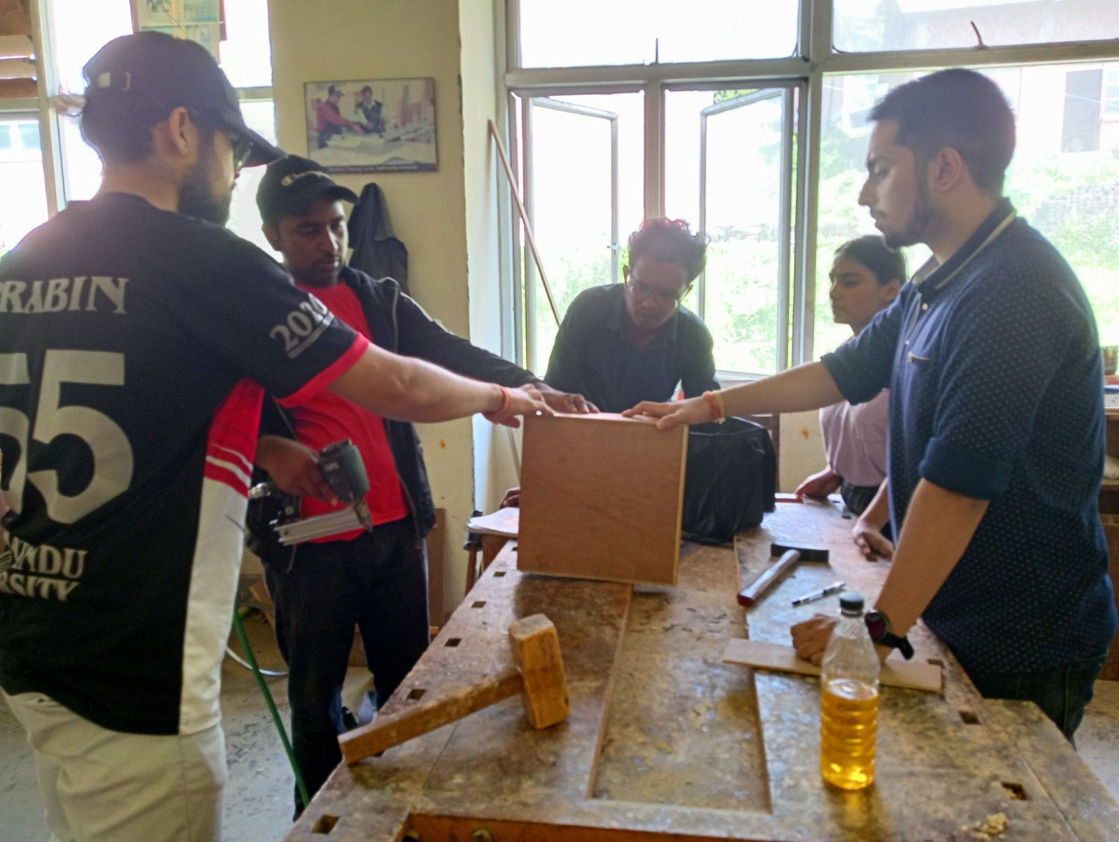
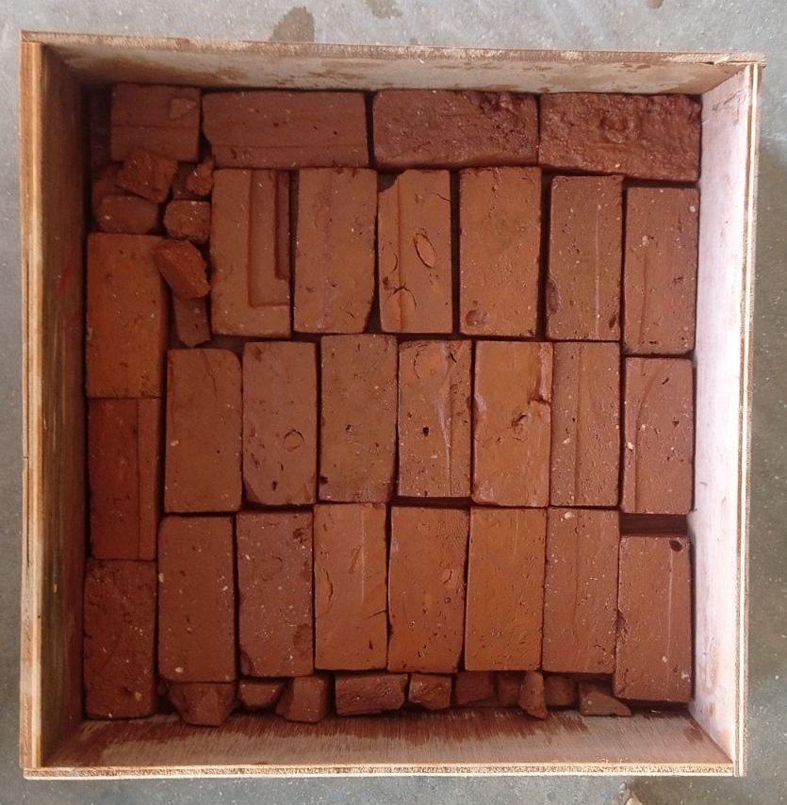
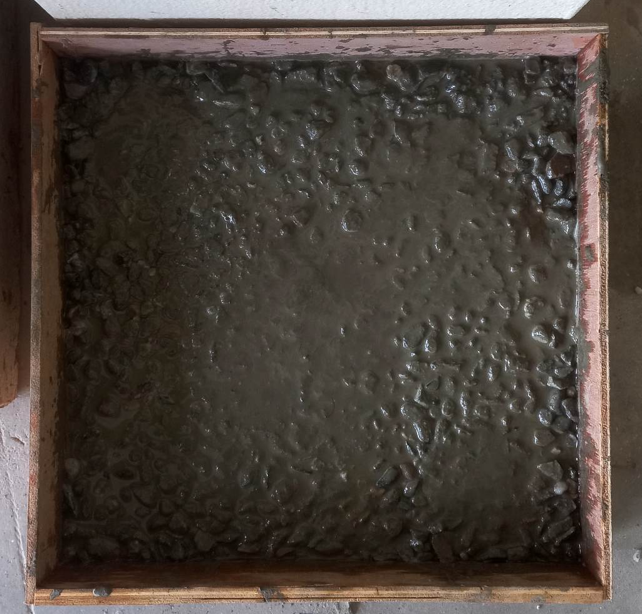
Model Construction
Formwork Preparation, brick laying and PPC for isolated footing

Slide 14
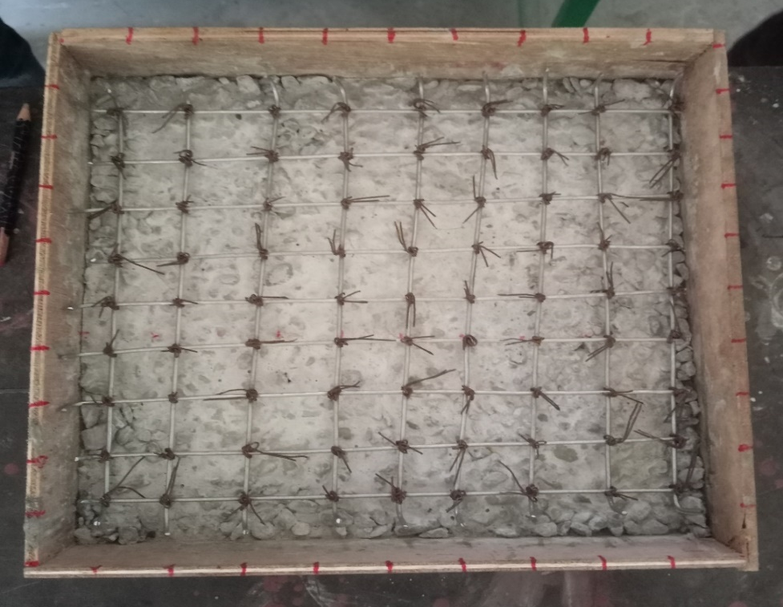
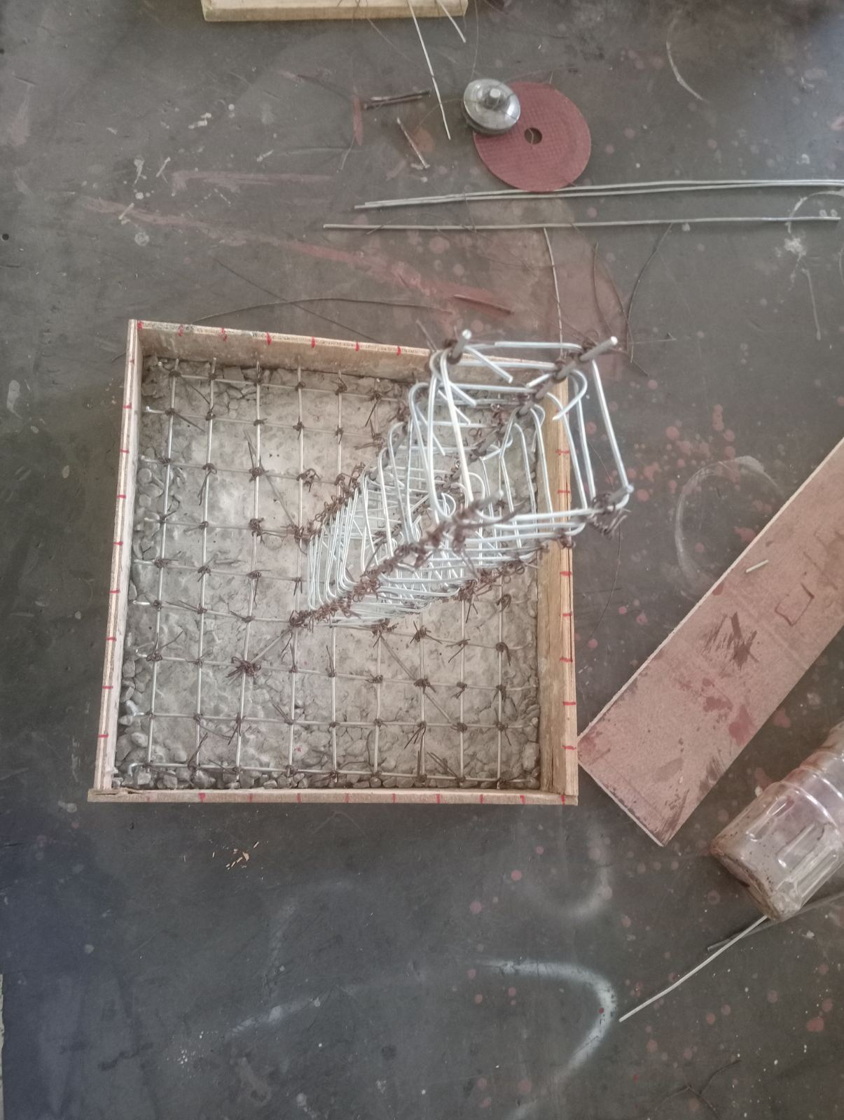
Contd…
Column and base reinforcement of isolated footing

Slide 15
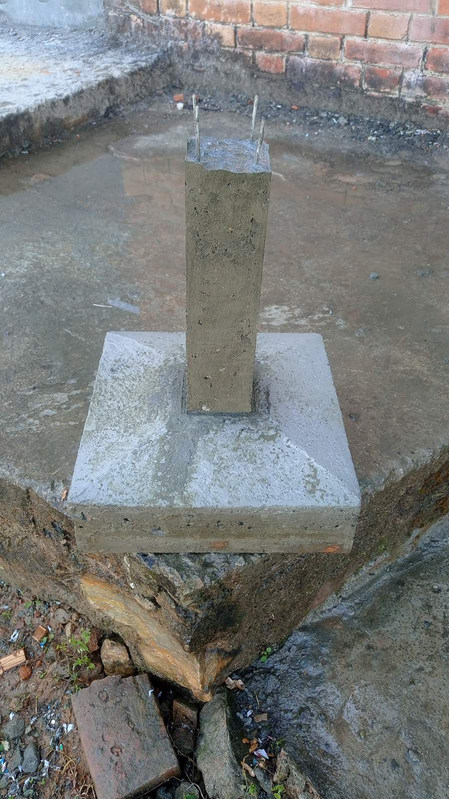
Contd…
Isolated footing

Slide 16
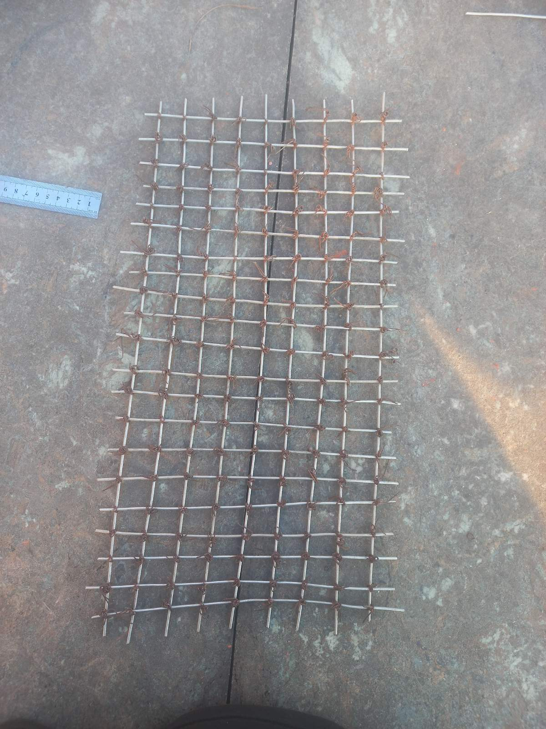
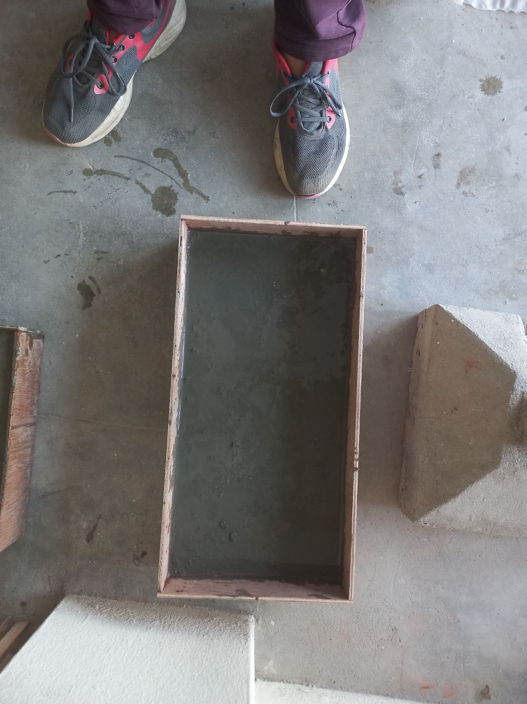
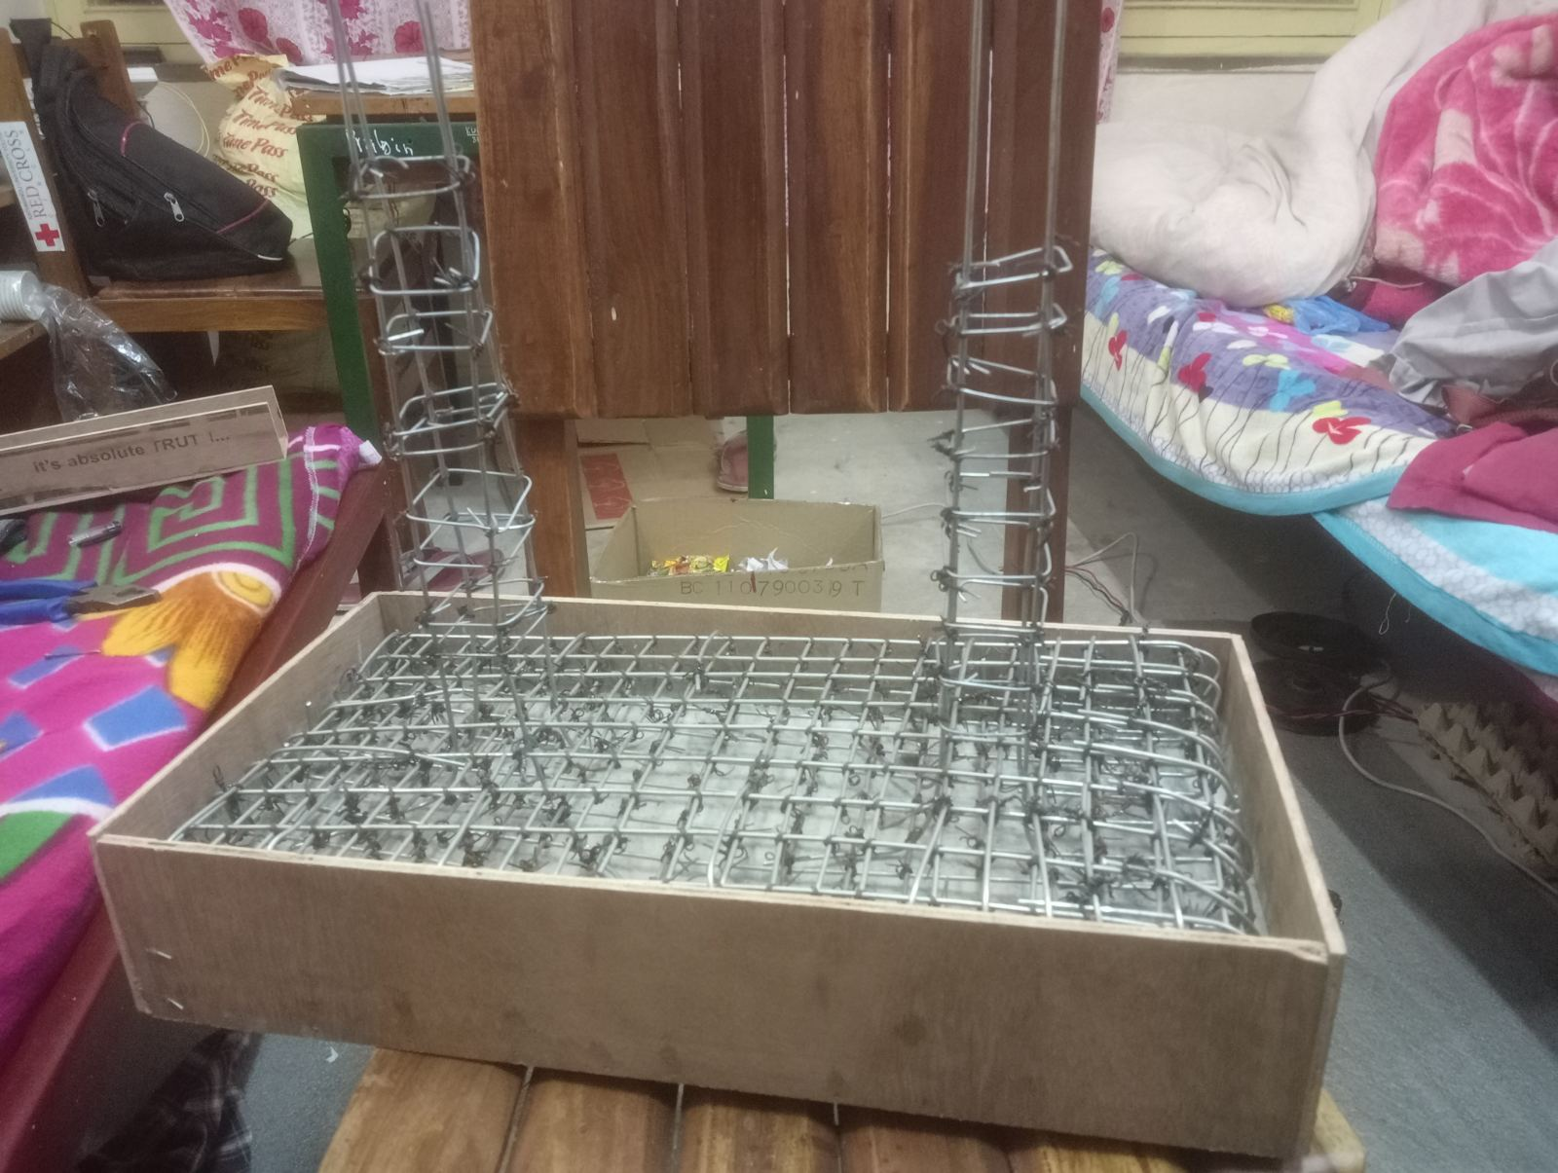
Contd…
PCC and the reinforcement of combined footing

Slide 17
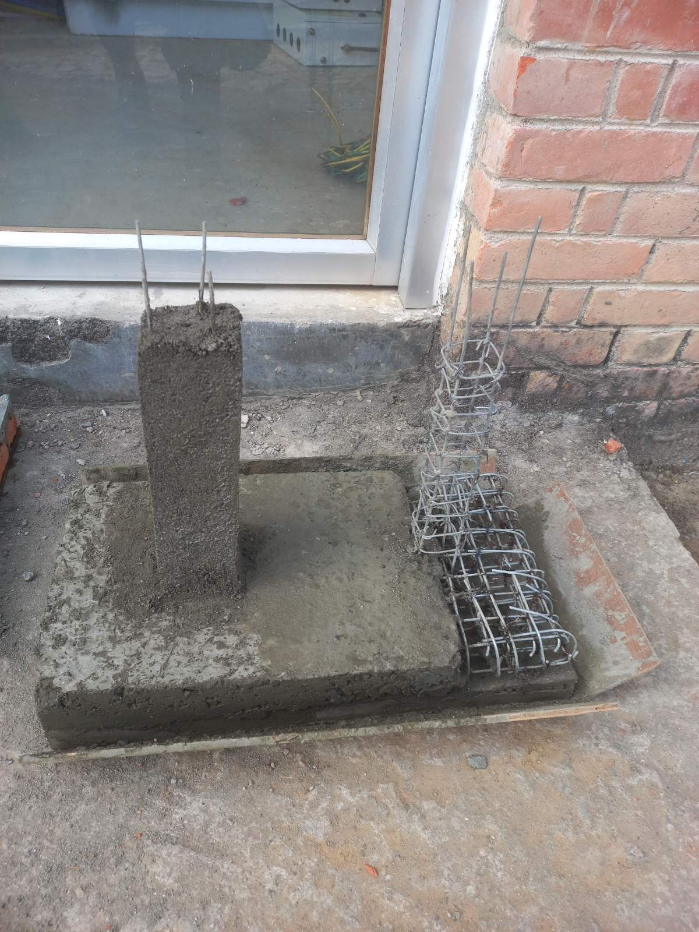
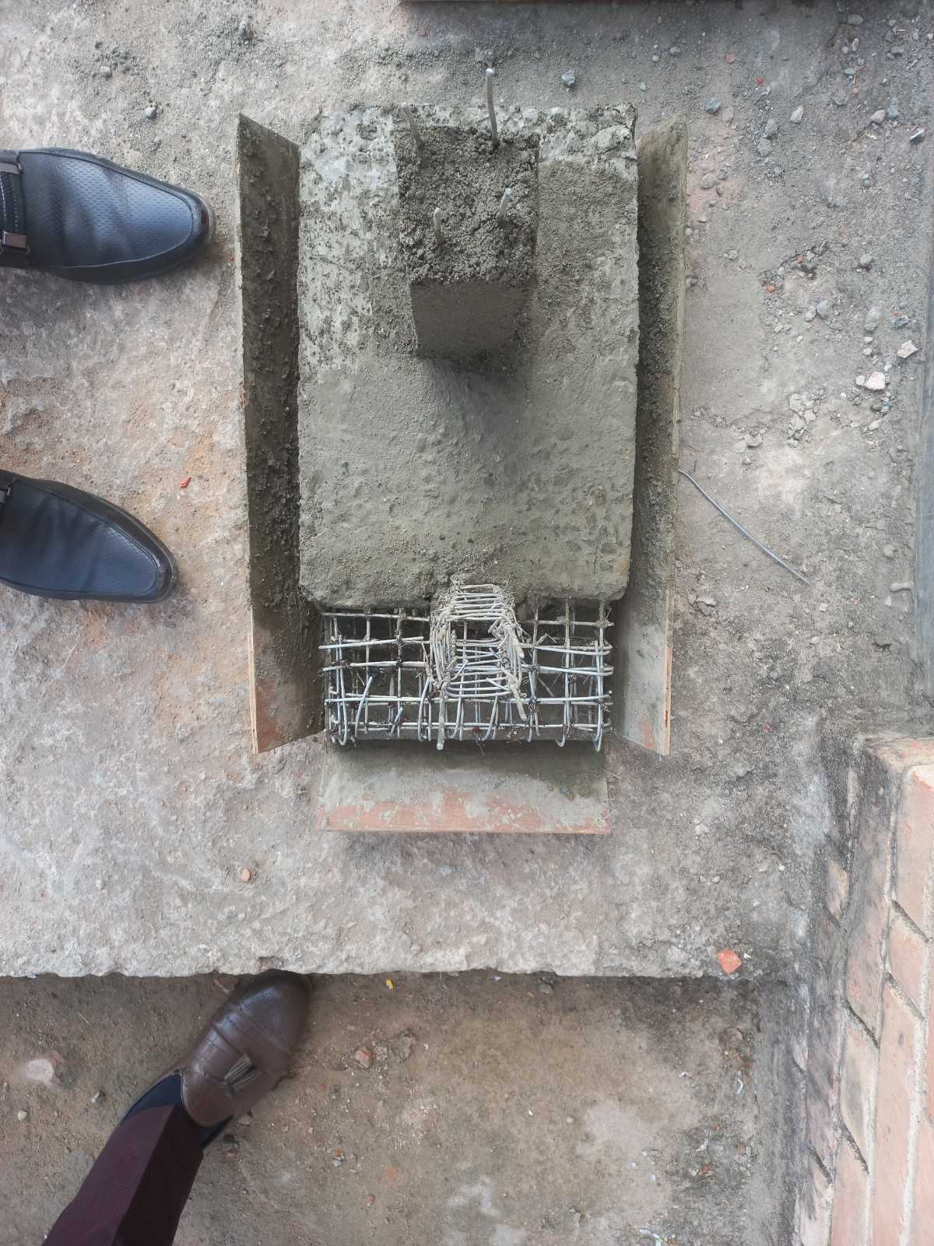
Contd…
Combined footing

Slide 18
Work schedule
Work | Week
 | 1 | 2 | 3 | 4 | 5 | 6 | 7 | 8 | 9 | 10 | 11 | 12 | 13 | 14 | 15 | 16 | 17
Consultation and Literature Review
Calculation
Proposal Defense
Material Collection
Model Construction
Mid-term Presentation
Finishing
Final Report Submission and Presentation
INDEX
Work Completed

Slide 19
Budget
S.N. | Materials | Quantity (kg) | Rate (Nrs) | Total Cost (Nrs) | Remarks
1. | GI-Wire | 3 | 230.00 | 690.00
2. | Binding Wire | 1 | 200.00 | 200.00
3. | Cement | 12.21 | 60.00 | - | Provided by Construction lab
4. | Fine Aggregate | 13.56 | 3710 per m³ | -
5. | Coarse Aggregate | 30.45 | 3750 per m³ | -
Grand Total |  |  |  | 890.00

Slide 20
Result and Conclusions
Demonstrative model of isolated and combined footing is constructed.
Application of footings in a building structure were known.
Load transfer mechanism in footing is known.

Slide 21
References
(n.d.). Retrieved from gharpedia.com: https://gharpedia.com/blog/various-types-of-footings-for-your-house/
civiltoday. (n.d.). Retrieved from Civil Engineering: https://civiltoday.com/geotechnical-engineering/foundation-engineering/161-types-of-foundation
Lamichhane, M. B. (n.d.). National Reconstruction Authority. Retrieved from http://www.nra.gov.np/en/news/details/u3uOGsBqXMUqgPk18I08ST5CKg6sGoXcMasExfjc3ao
IS456.2000.pdf

Slide 22
Thank you !

