Slide 1
U.S. Mental Health Indicators: Anxiety and Depression Trends (2020–2024)
A Tableau-Based Analysis of CDC Household Pulse Survey Data

Slide 2
Why This Topic Matters?
Mental health became a major public health concern during and after COVID-19.
1
Anxiety and depression symptoms increased significantly during the pandemic period.
2
Understanding patterns across states and demographic groups can support better public health planning.
3
The CDC Household Pulse Survey provides timely mental health indicators across the United States.
4

Slide 3
Dataset Overview
Dataset Information
Source: Household Pulse Survey: Conducted by the U.S. Census Bureau.
Timeframe: 2020–2024
Measures:
Anxiety Symptoms
Depression Symptoms
Anxiety or Depression Symptoms
Dimensions:
State
Group/Subgroup
Time Period
Survey Phase

Slide 4
Tableau Design & Methodology
1. Dashboard Features
Interactive parameter selector
KPI cards
Geographic map
Top 10 state comparison chart
National trend line
Confidence interval visualization
Dumbbell chart
Bump chart
Sparkline chart
2. Advanced Tableau Techniques
Calculated fields
Table calculations
Interactive filters
Ranking logic
Parameter actions

Slide 5
Dashboard 1: National Overview
Key Questions Answered
What is the overall symptom level?
Which states report higher symptom rates?
How did national trends change over time?
How reliable are the estimates?

Slide 6
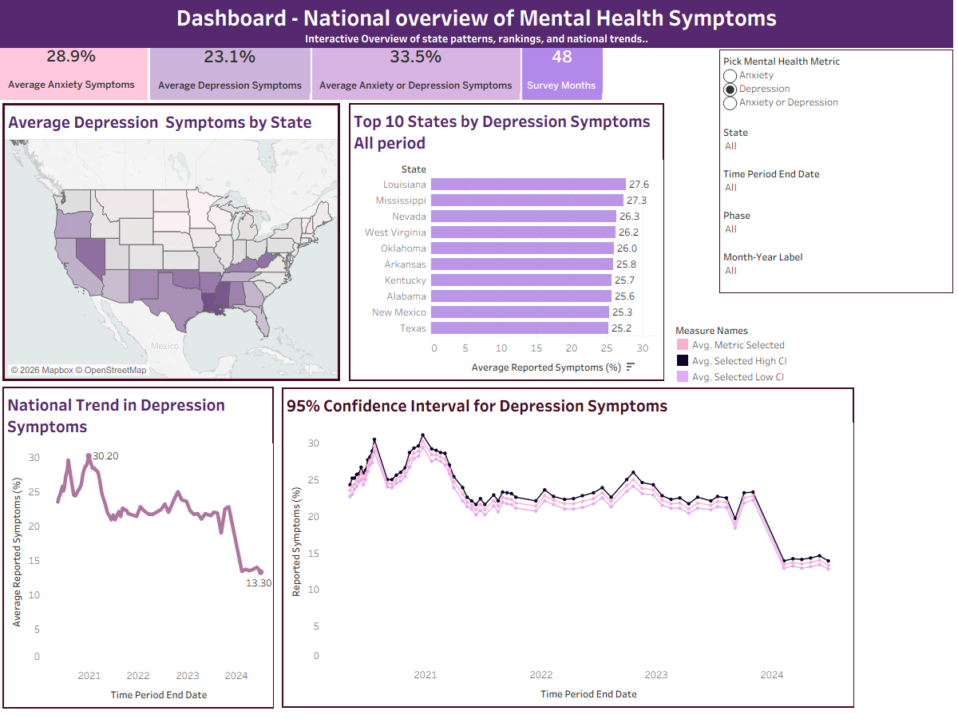

Slide 7
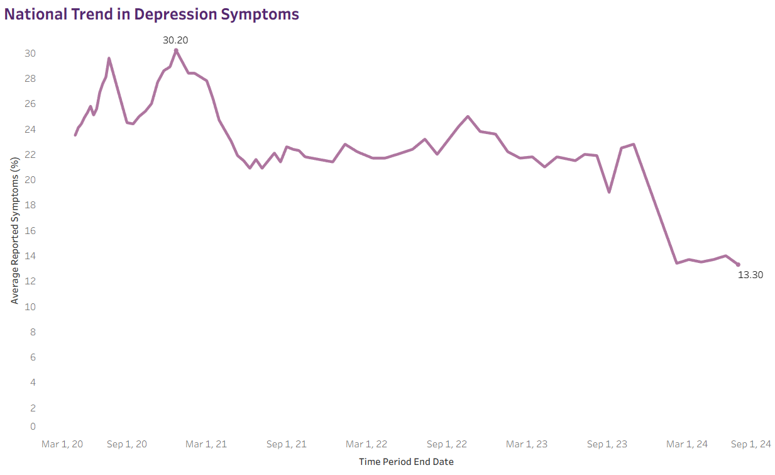
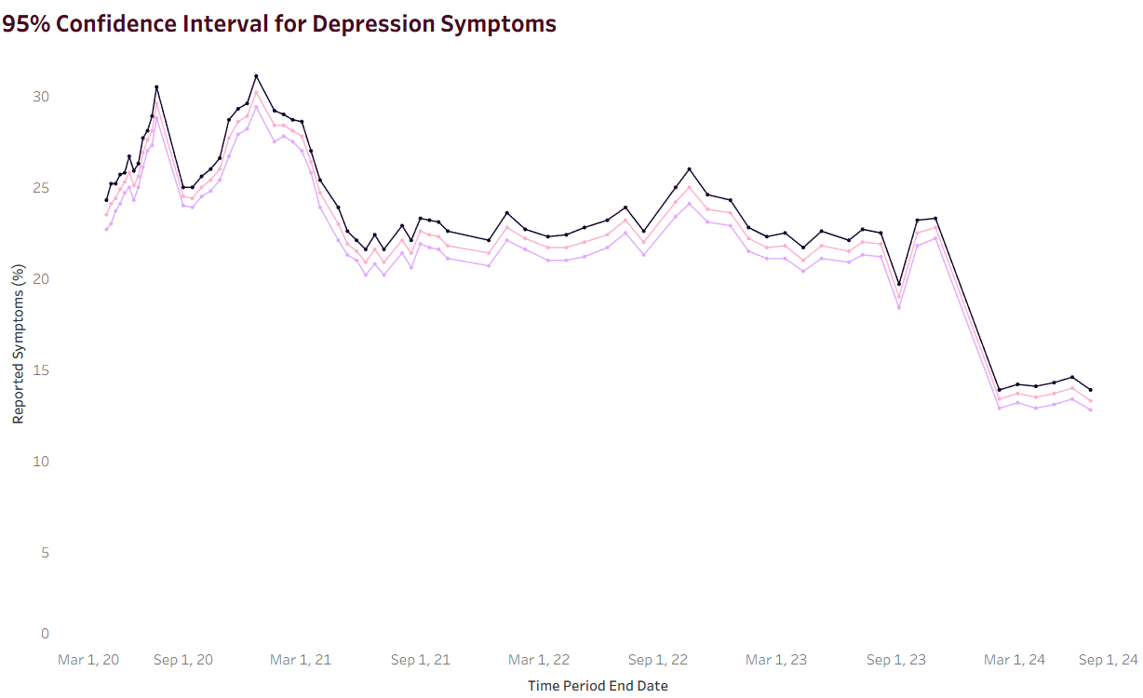
National Trend Analysis
Reported mental health symptoms peaked during late 2020 and early 2021.
Symptom rates gradually declined by 2024.
Interpretation
Early pandemic uncertainty likely contributed to elevated anxiety and depression levels.
The downward trend suggests gradual recovery over time.
Additional Context
Confidence interval charts help evaluate estimate reliability and uncertainty.

Slide 8
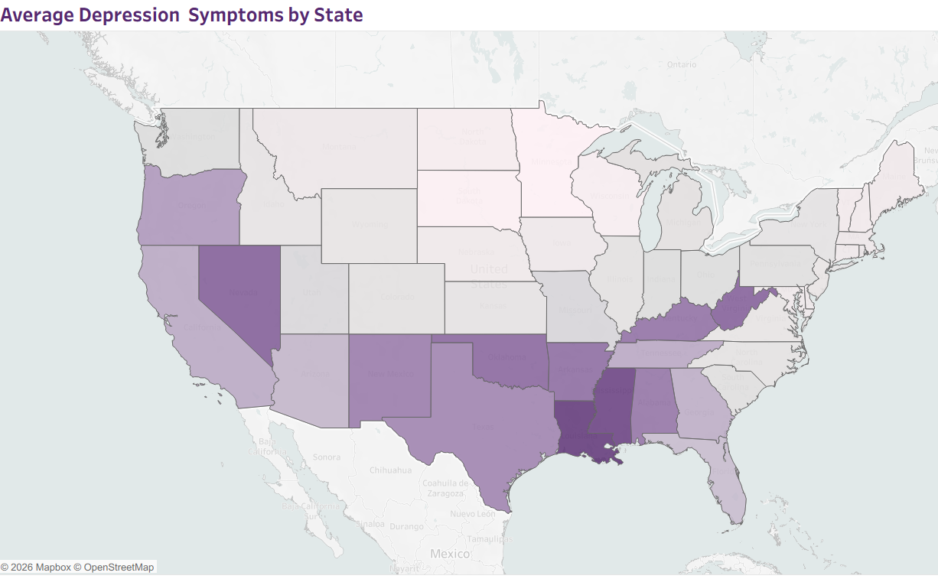
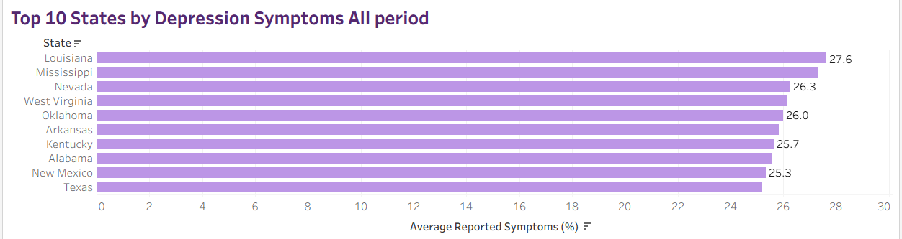
State Level Mental Health Patterns
Mental health symptom rates varied significantly across states.
Some states consistently appeared among the highest reported symptom rates
Geographic disparities indicate unequal mental health burden across the U.S.
State-level analysis helps identify regions requiring additional public health attention.

Slide 9
Dashboard 2: Comparative & Demographic Insights
This dashboard compares anxiety and depression indicators while analyzing state ranking changes and demographic trends.
Key Questions Answered
Is anxiety generally higher than depression?
Which states show larger anxiety–depression gaps?
How did state rankings change over time?
Which demographic groups report higher symptoms?

Slide 10
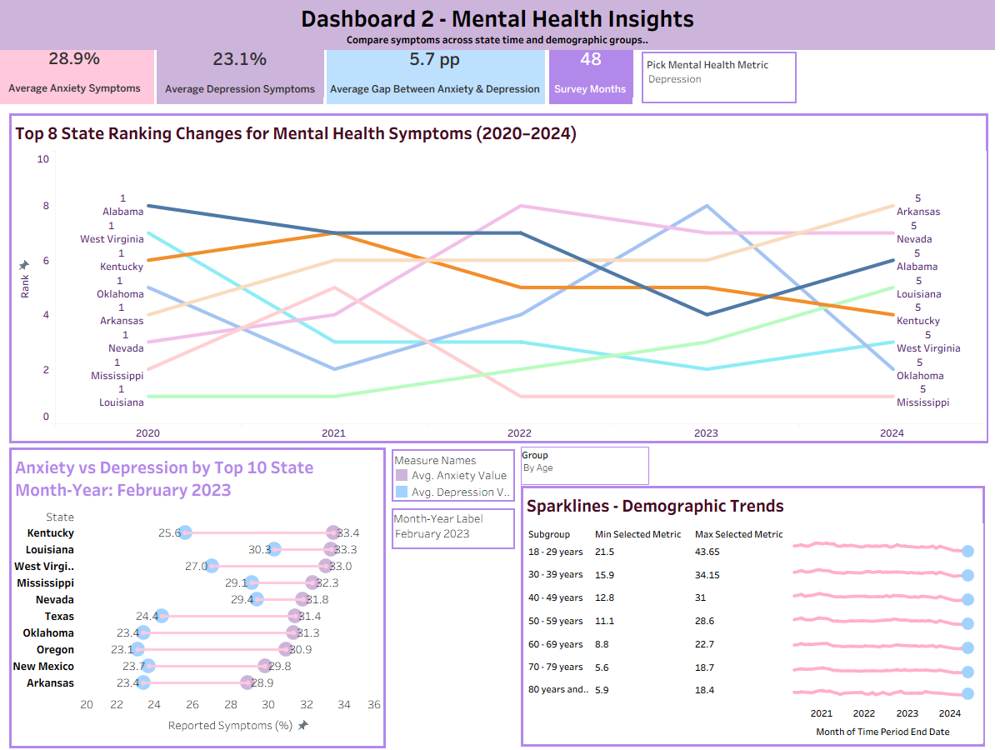

Slide 11
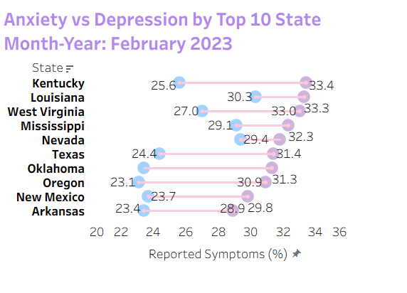
Anxiety vs. Depression Comparison
Anxiety symptom rates are generally higher than depression symptom rates.
Interpretation
The dumbbell chart highlights the gap between anxiety and depression indicators.
Larger gaps may indicate stronger short-term stress responses.
Use percentage points instead of percentages when describing differences.
Example
Anxiety: 28.9%
Depression: 23.1%
Gap: 5.8 percentage points

Slide 12
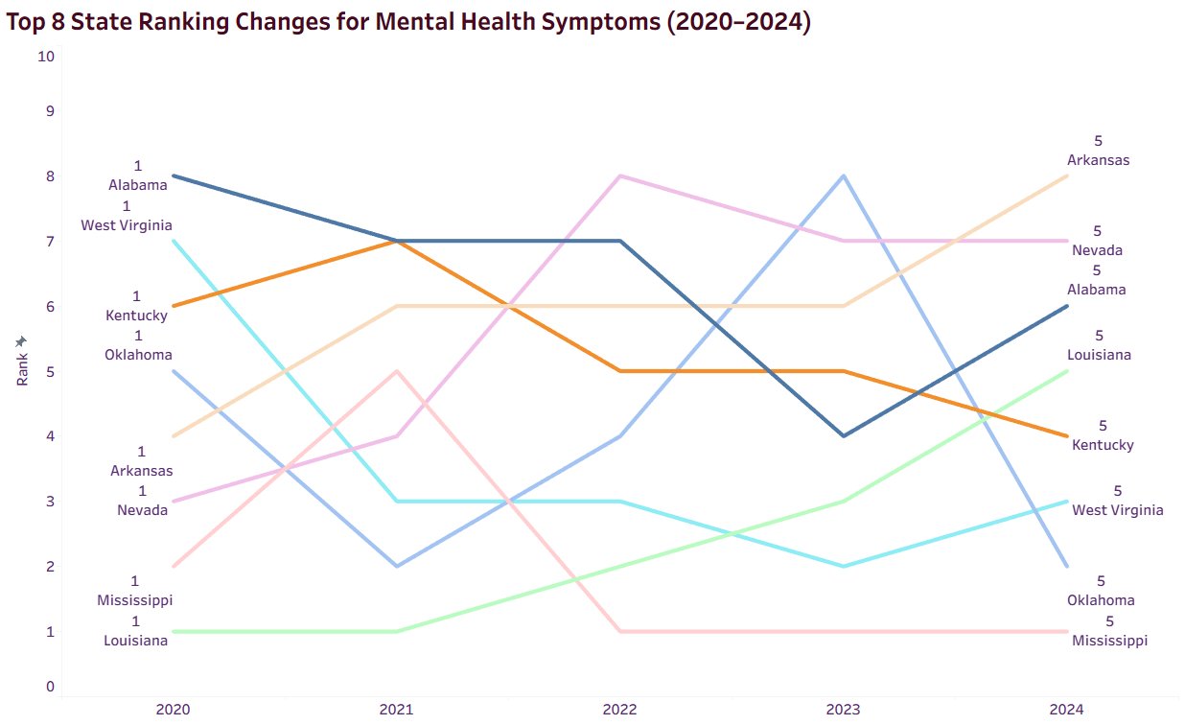
State Ranking Changes Over Time
State rankings shifted across survey periods.
High symptom burden was not permanently concentrated in the same states.
Interpretation
Mental health impacts evolved differently across geographic regions.
Rankings demonstrate changing relative conditions over time.

Slide 13
Key Takeaways
Main Findings
Mental health symptom rates declined nationally by 2024 after peaking during the early pandemic period.
State-level disparities remained visible across survey periods.
Younger adults consistently reported higher anxiety and depression symptom

Slide 14
Recommendations & Stakeholder Applications
Recommendations
Monitor states with consistently higher symptom rates.
Prioritize outreach programs for younger adults.
Use confidence intervals before interpreting small differences.
Continue updating dashboards with future survey data.
Stakeholders Applications
Public health agencies
Policy makers
Healthcare organizations
Community mental health programs

Slide 15
Limitations
Study Limitations
Survey-based self-reported symptoms
Not clinical diagnoses
Survey periods are not daily observations
Some comparisons contain statistical uncertainty
Dashboard findings do not establish causation

Slide 16
Conclusion
The analysis suggests that anxiety and depression symptoms were highest during the early pandemic period and gradually improved by 2024, however:
State disparities remained visible
Younger adults continued reporting higher symptom levels

Slide 17
Citation & Sources
https://www.kaggle.com/datasets/melissamonfared/indicators-of-anxiety-or-depression
YouTube. (n.d.). YouTube. https://www.youtube.com/

