Slide 1
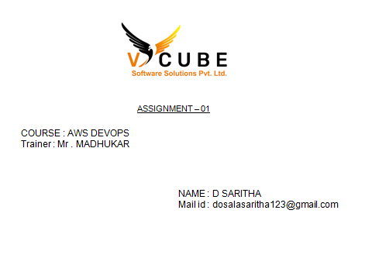

Slide 2
By using terraform create an S3 bucket and upload the file to the S3 bucket

Slide 3
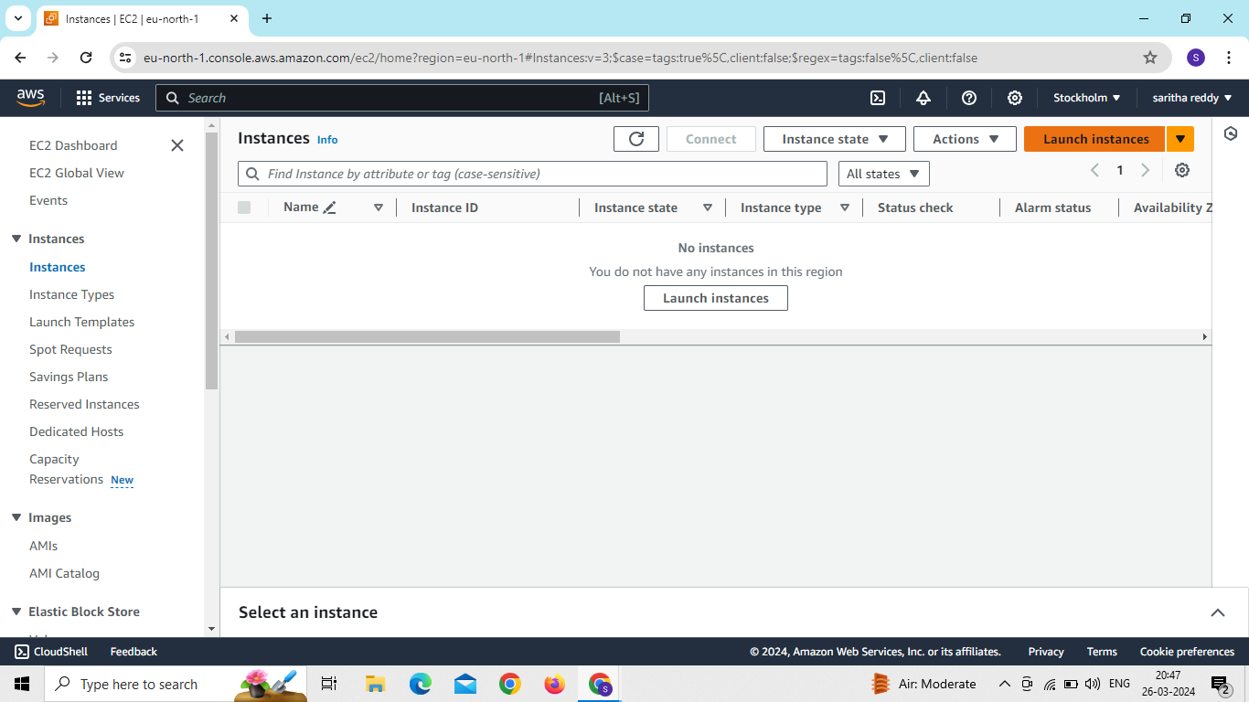
Go to ec2 and click on launch instance
Give instance name
Select ami
Select instance type
Create key pair

Slide 4
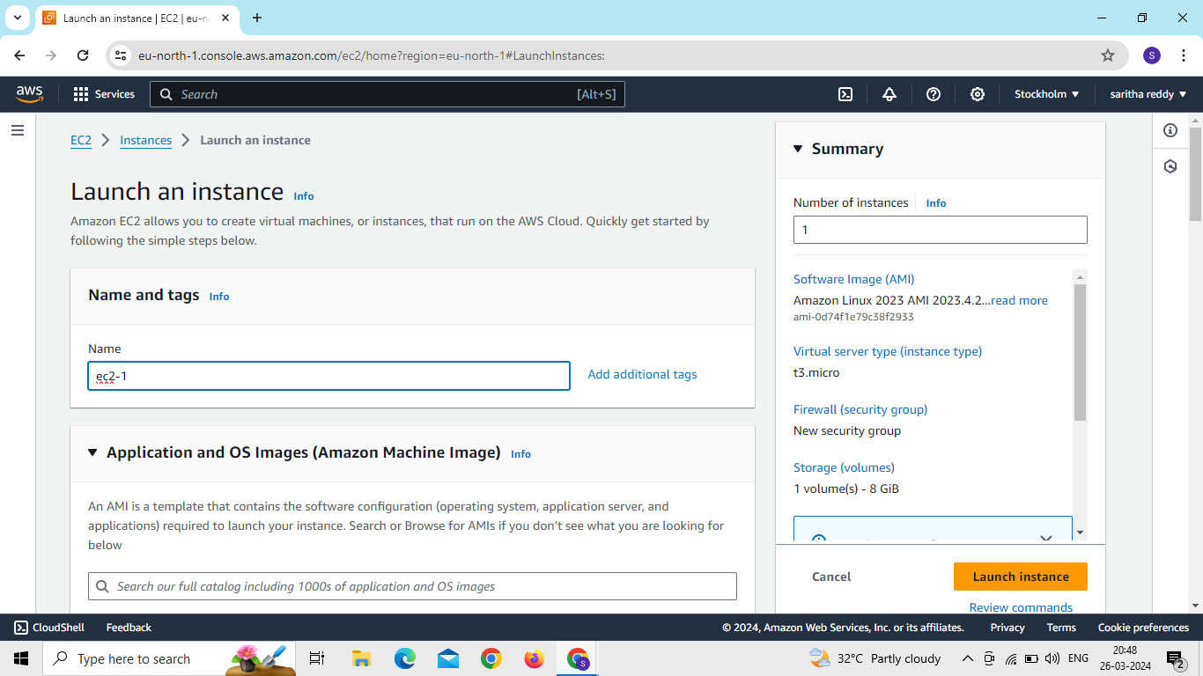

Slide 5
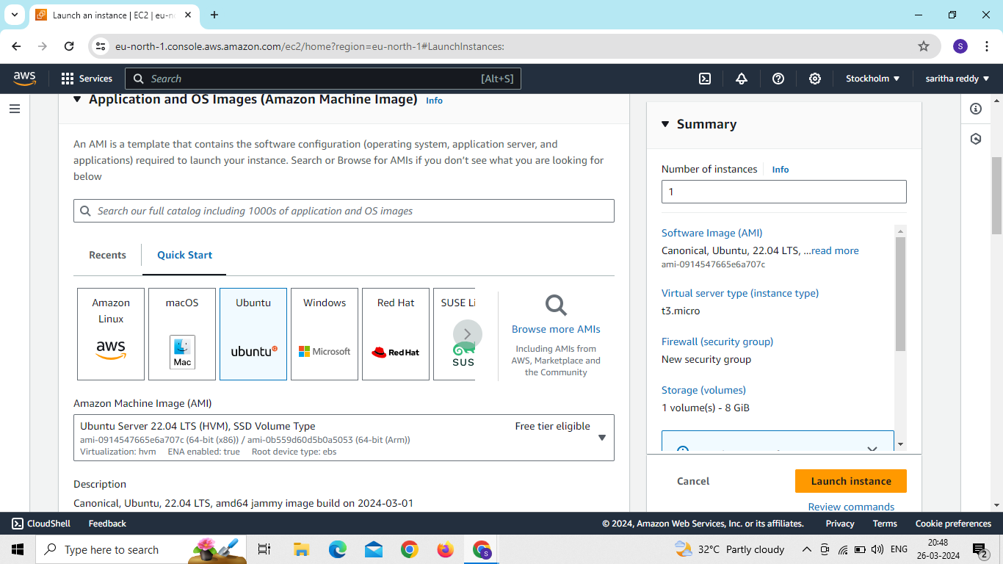

Slide 6
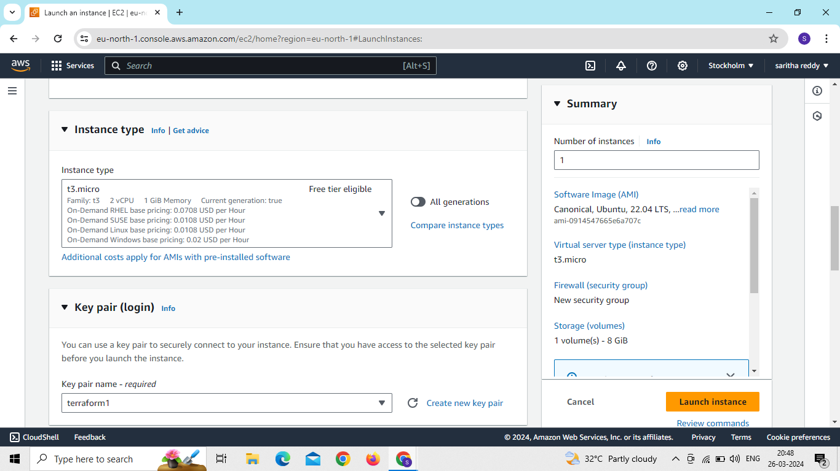

Slide 7
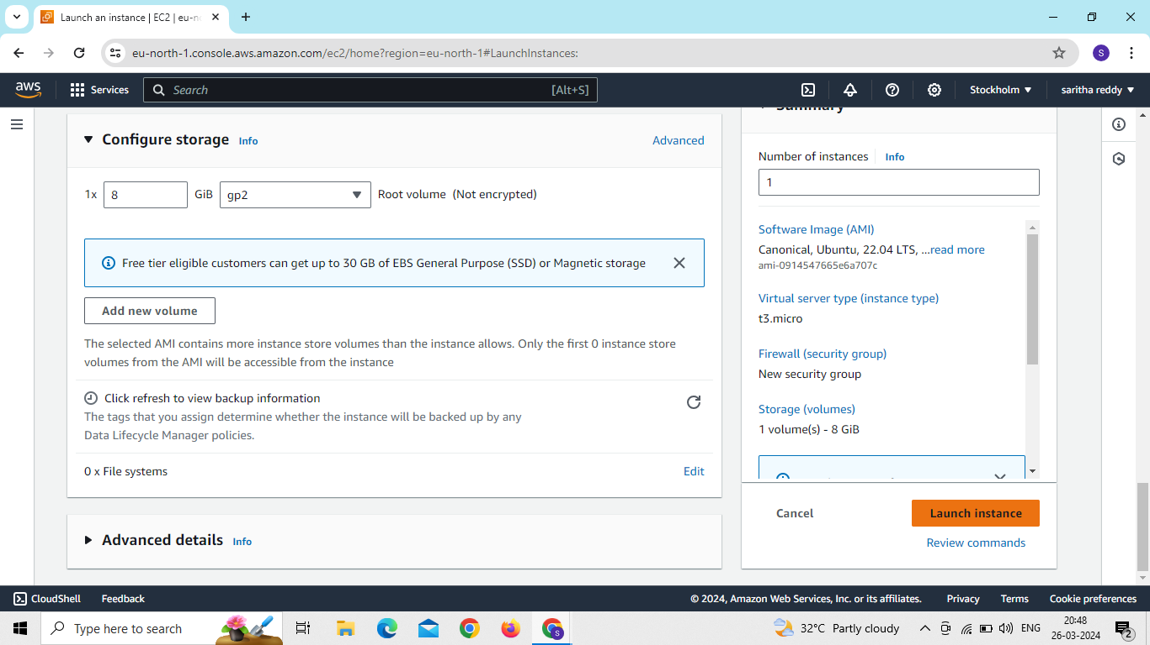
Now click on create instance

Slide 8
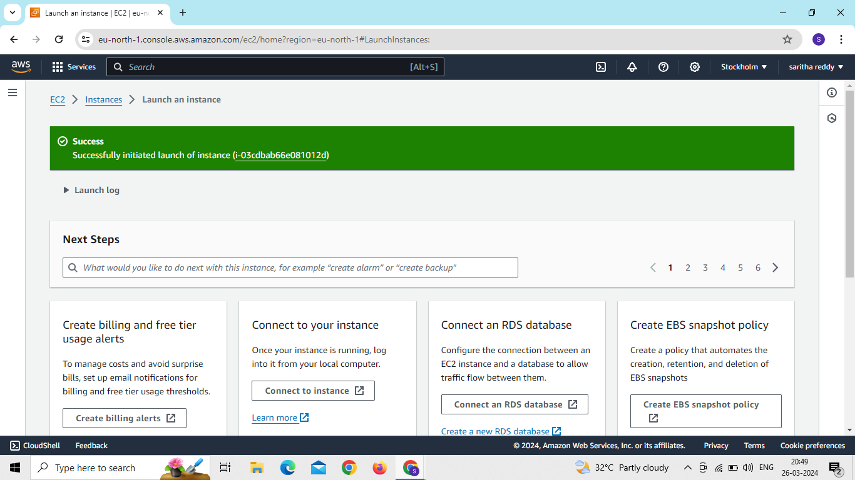

Slide 9
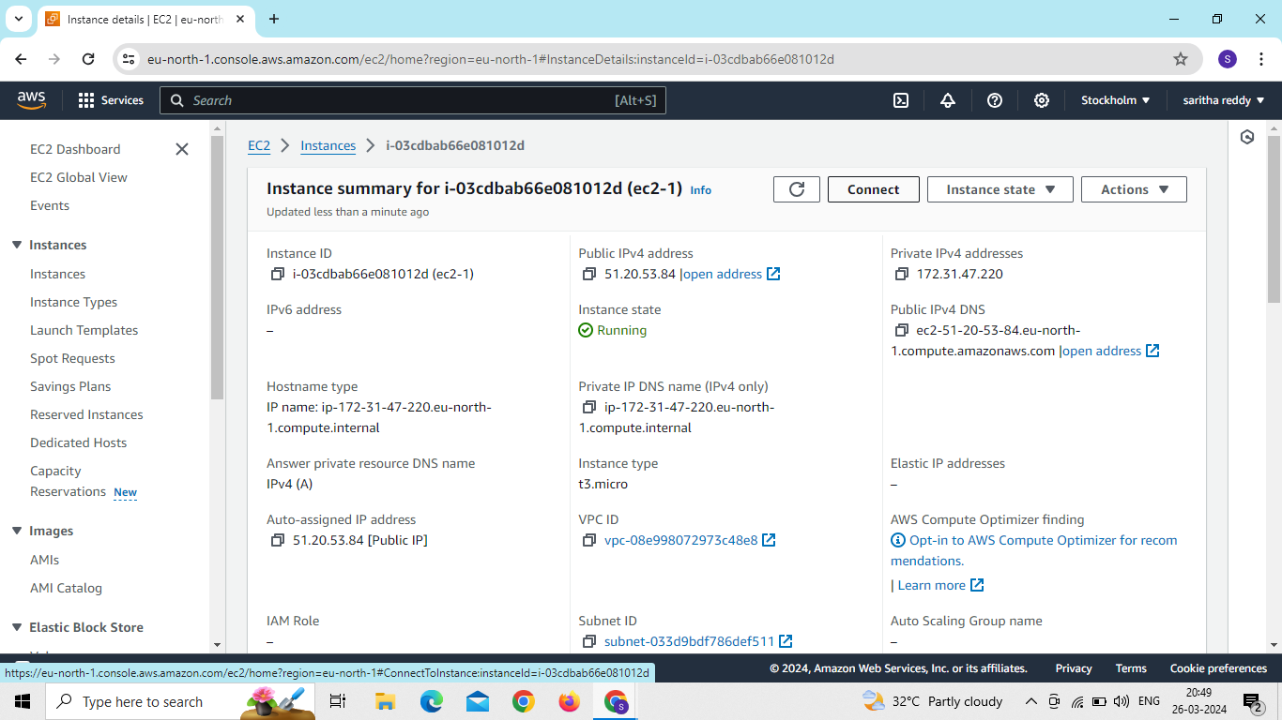
After creating the instance connect to server

Slide 10
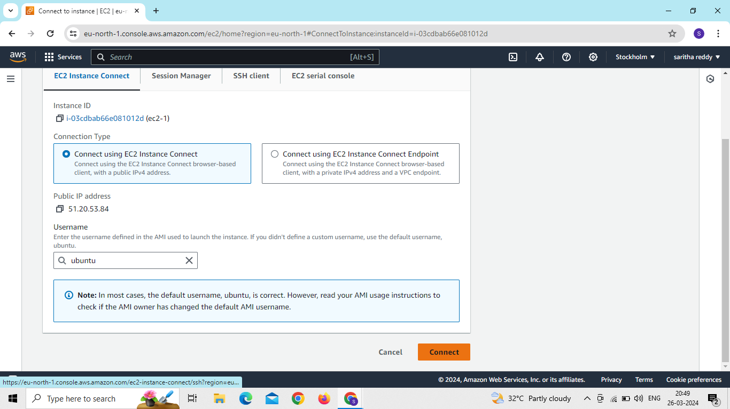

Slide 11
After connecting to the server we use commands are
Sudo –i
Apt aupdate –y
Apt install awscli –y
Aws configure

Slide 12
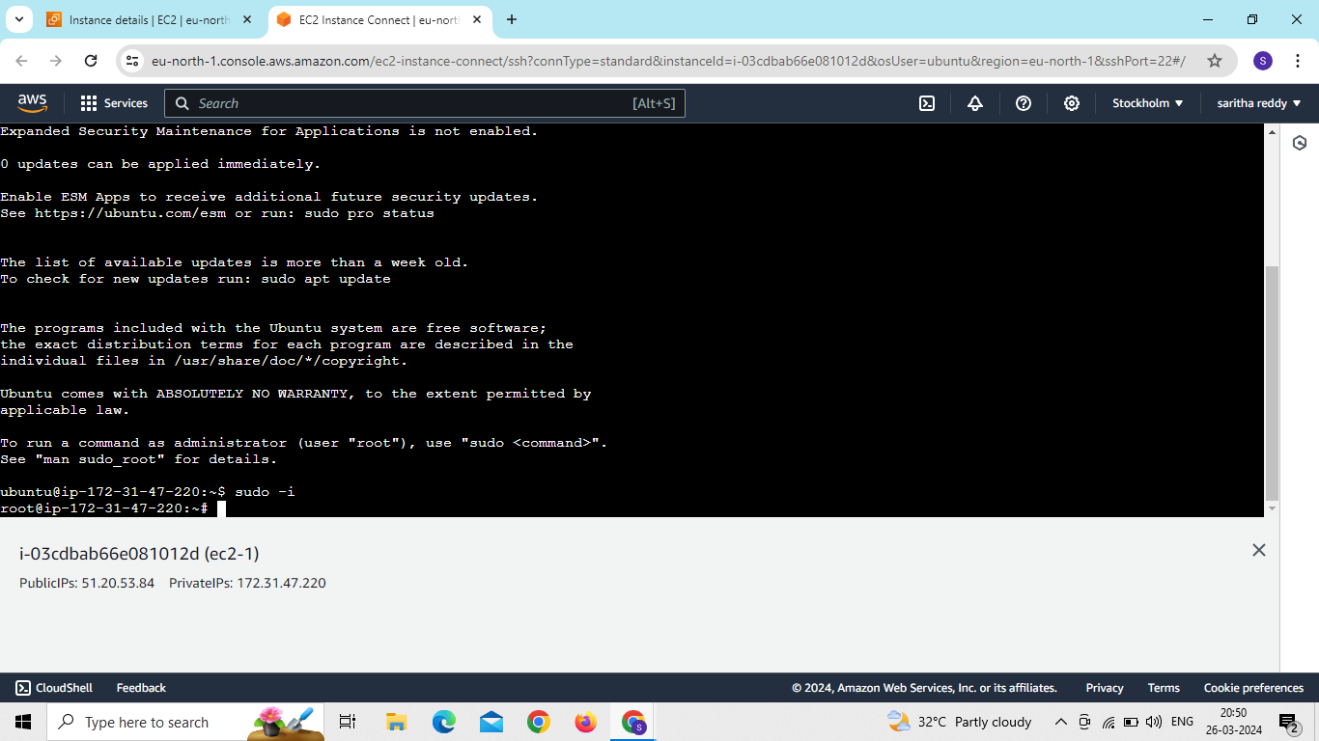

Slide 13
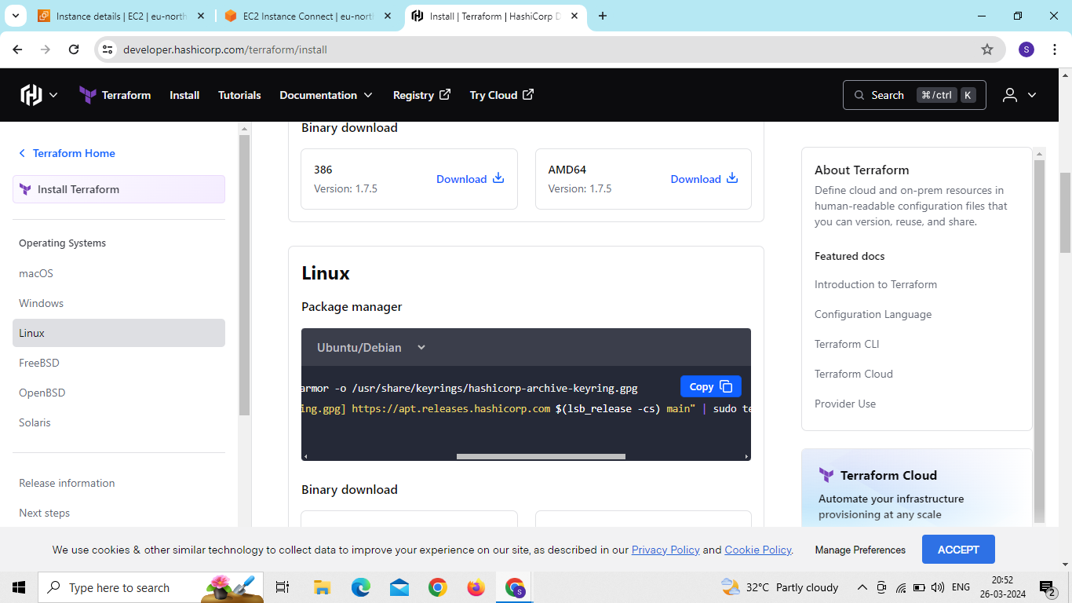
Now we install terraform on the server

Slide 14
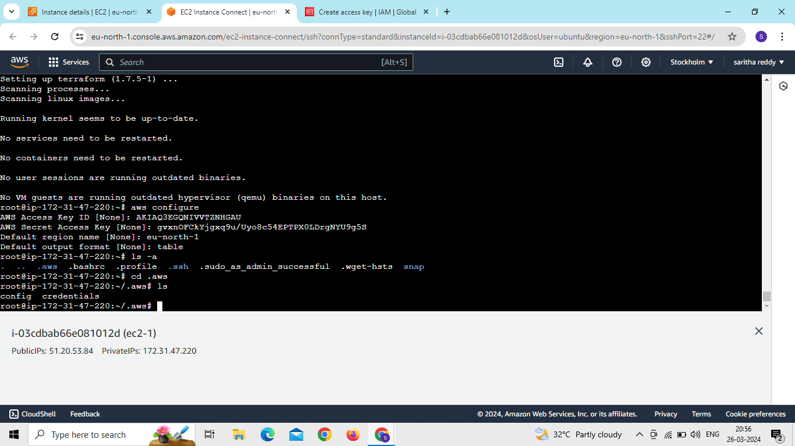

Slide 15
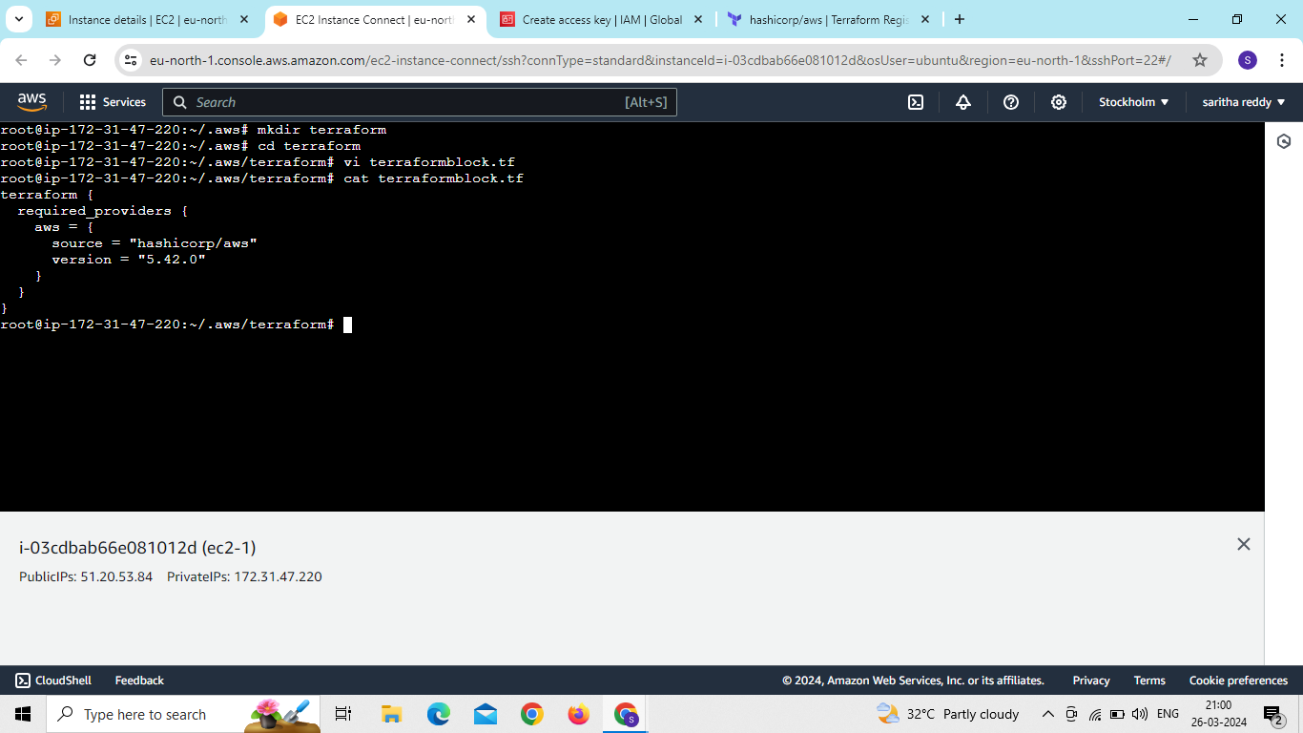

Slide 16
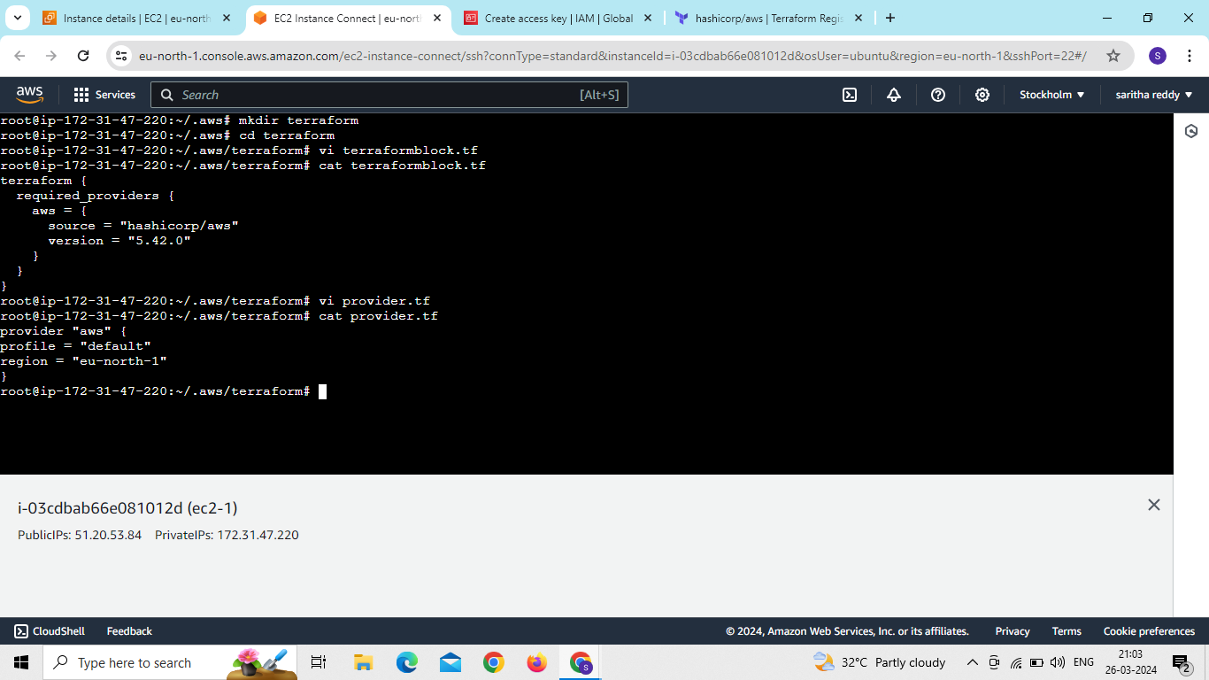

Slide 17
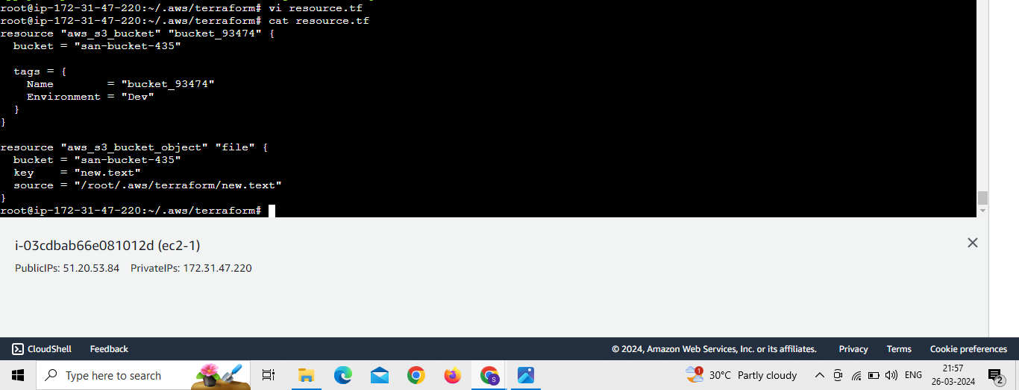

Slide 18
We use commands for terraform
Terraform init
Terraform validate
Terraform plan
Terraform apply

Slide 19
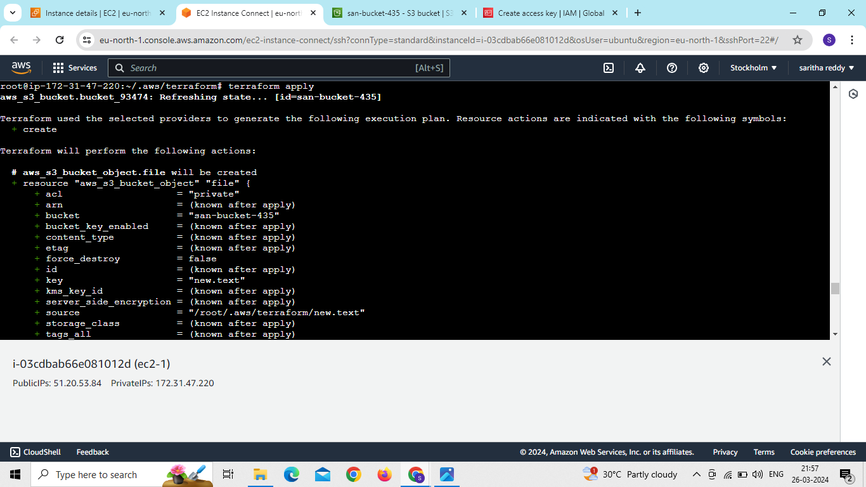

Slide 20
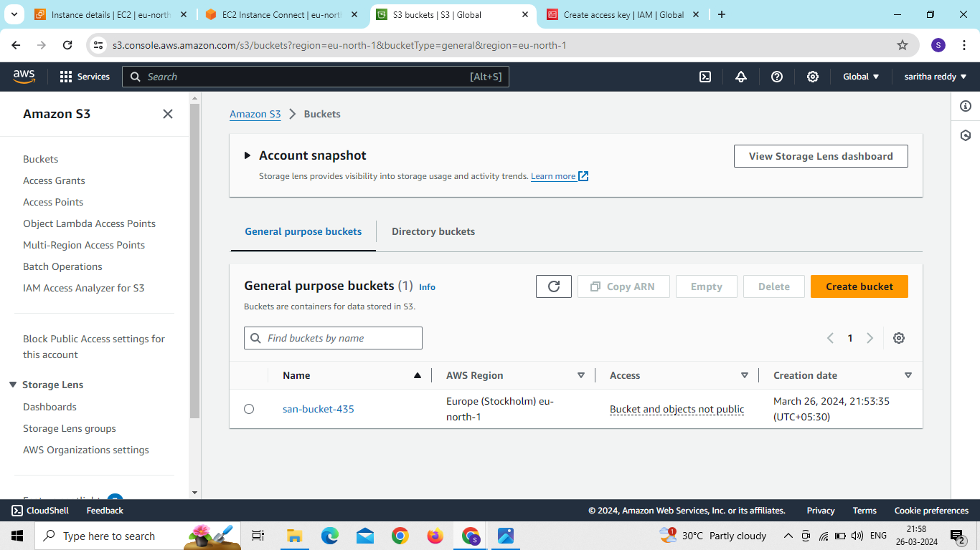
Now go to S3 and see the bucket

Slide 21
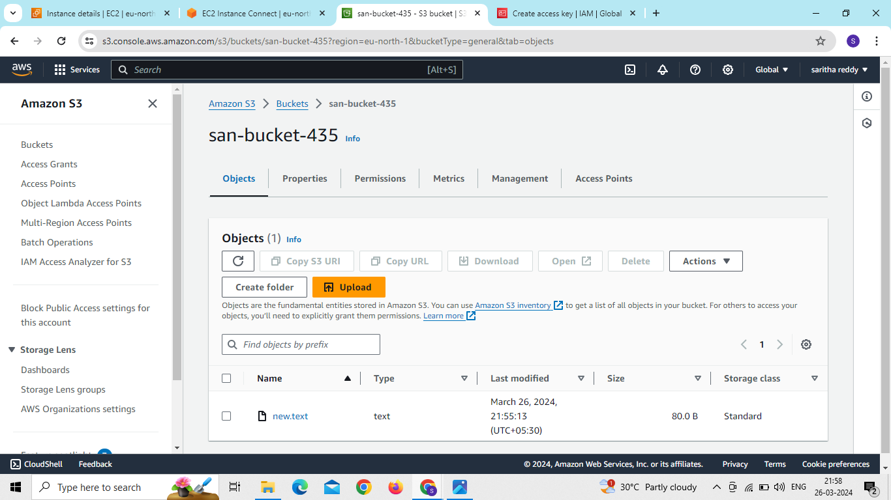
The file also uploaded in the created bucket

