Slide 1
DATA ENGINEERING • HEALTHCARE ANALYTICS
+
Healthcare Patient Analytics Pipeline
+
From raw patient records to trusted risk metrics, dashboards and automated monitoring.
+
Azure Blob
Databricks
Delta Lake
Airflow
+
+
Daily batch • Data Quality • Medallion Architecture • Alerts

Slide 2
01 • PROJECT
Project Overview
02
SOURCE
PROCESSING
CONSUMPTION
Kaggle Heart Disease Dataset / patient health records delivered as CSV files. Raw path pattern: s3://bucket/raw/health_records/YYYY/MM/DD/
Databricks + PySpark process records through Bronze, Silver and Gold Delta layers.
Gold datasets power healthcare analytics, risk metrics, dashboards and monitoring.
The pipeline is designed for reliable daily processing with validation, error handling and orchestration.
01
INGEST
02
CLEAN
03
ANALYZE
04
MONITOR
Capture source records
Standardize & validate
Calculate risk metrics
Alert & troubleshoot
HEALTHCARE PATIENT ANALYTICS • DATA ENGINEERING PROJECT

Slide 3
02 • OBJECTIVES
What the solution achieves
03
01
Reliable ingestion
02
Medallion design
03
Data quality
Bring patient records into cloud storage with controlled ingestion.
Implement Bronze → Silver → Gold for progressively trusted data.
Handle missing values, duplicates, invalid records and schema issues.
04
Risk analytics
05
Monitoring
06
Automation
Create aggregated metrics and patient risk indicators.
Use Slack alerts and logs for failures and anomalies.
Orchestrate and validate the pipeline with Airflow and PyTest.
HEALTHCARE PATIENT ANALYTICS • DATA ENGINEERING PROJECT

Slide 4
03 • SOURCE & QUALITY
Source Dataset & Data Quality
04
QUALITY CHECKS
SOURCE DATASET
• CSV patient health records • Patient vitals and diagnosis-related attributes • Daily cloud landing pattern • Source metadata captured for traceability • Raw data preserved for reprocessing
✓
Missing / NULL values
Detect and handle incomplete records
✓
Duplicates
Remove duplicate patient records
✓
Schema
Validate columns and data types
✓
Formats
Standardize dates and medical codes
✓
Malformed rows
Isolate invalid input records
HEALTHCARE PATIENT ANALYTICS • DATA ENGINEERING PROJECT

Slide 5
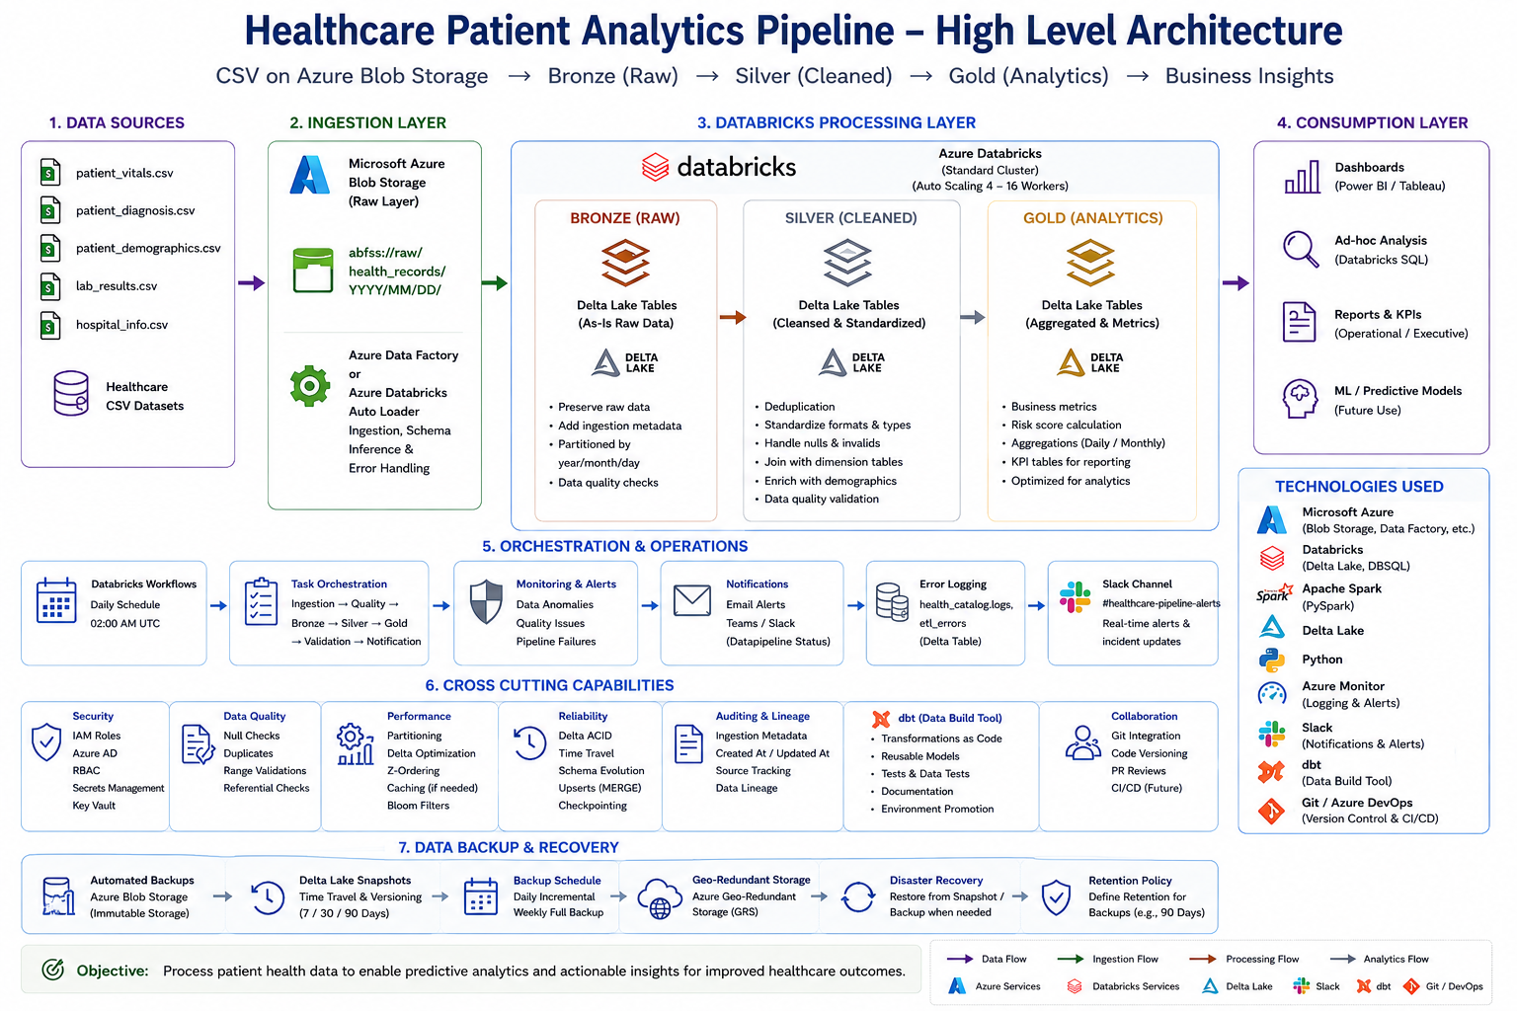
04 • ARCHITECTURE
High-Level End-to-End Design
05
HEALTHCARE PATIENT ANALYTICS • DATA ENGINEERING PROJECT

Slide 6
05 • DATA LAKE
Storage & Target Design
06
RAW
Original CSV
s3://bucket/raw/health_records/YYYY/MM/DD/
PARQUET
Ingested format
Columnar files for scalable processing
BRONZE
health_catalog.raw.patient_records
Raw Delta table
SILVER
health_catalog.processed.patient_cleaned
Cleaned & standardized
GOLD
health_catalog.analytics.health_metrics
Aggregated risk metrics
LOGS
health_catalog.logs.etl_errors
Errors & monitoring details
HEALTHCARE PATIENT ANALYTICS • DATA ENGINEERING PROJECT

Slide 7
06 • MEDALLION
Bronze → Silver → Gold
07
BRONZE
SILVER
GOLD
RAW FOUNDATION
TRUSTED DATA
BUSINESS READY
Preserve source data Traceability & reprocessing Unity Catalog / Delta
Clean & deduplicate Standardize formats Join dimensions
Risk metrics Aggregations Dashboards & analytics
HEALTHCARE PATIENT ANALYTICS • DATA ENGINEERING PROJECT

Slide 8
07 • BRONZE
Bronze Layer — Raw Data Preservation
08
TARGET TABLE
IMPLEMENTATION
KEY PRINCIPLE
health_catalog.raw.patient_records Delta table containing raw patient records after ingestion.
• Unity Catalog governance • External location where applicable • Preserve source structure • Capture ingestion metadata • Support reprocessing
Bronze is the trusted landing foundation — raw enough for traceability, structured enough for downstream processing.
HEALTHCARE PATIENT ANALYTICS • DATA ENGINEERING PROJECT

Slide 9
08 • SILVER
Silver Layer — Cleansing & Transformation
09
1
2
3
4
DEDUPLICATE
VALIDATE
STANDARDIZE
ENRICH
Remove duplicate patient records
Check schema and acceptable values
Dates, medical codes and types
Join hospital & demographic dimensions
OUTPUT
health_catalog.processed.patient_cleaned
HEALTHCARE PATIENT ANALYTICS • DATA ENGINEERING PROJECT

Slide 10
09 • GOLD
Gold Layer — Analytics & Risk Metrics
10
+
+
+
+
RISK
TRENDS
QUALITY
DASHBOARD
Patient risk scores
Population / health trends
Validated analytical outputs
Consumption-ready tables
TARGET
health_catalog.analytics.health_metrics
HEALTHCARE PATIENT ANALYTICS • DATA ENGINEERING PROJECT

Slide 11
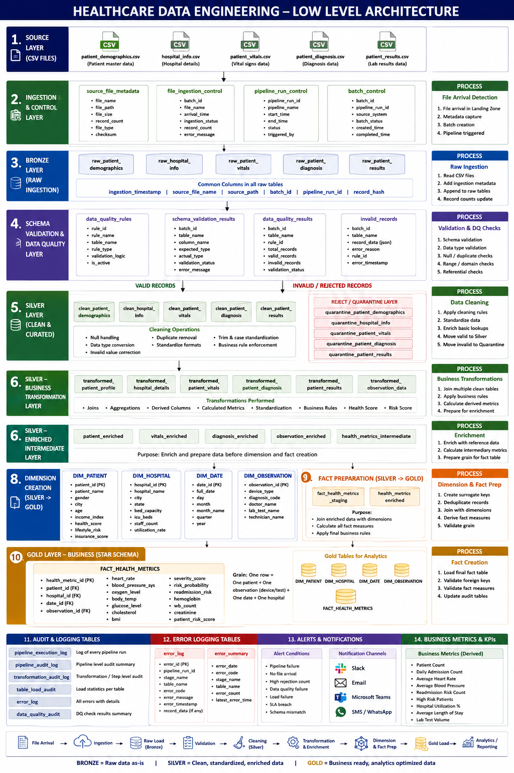
10 • ETL DESIGN
Low-Level Design — Metadata & Rules
11
HEALTHCARE PATIENT ANALYTICS • DATA ENGINEERING PROJECT

Slide 12
11 • CONSUMPTION
Dashboards & Healthcare Analytics
12
PATIENT ANALYTICS DASHBOARD
PATIENTS
HIGH RISK
CLEAN RECORDS
DATA FRESHNESS
12.4K
1.8K
98.6%
2 AM UTC
RISK DISTRIBUTION
KEY INSIGHTS
CONSUMPTION
Patient risk indicators from Gold
Aggregated healthcare metrics
Analytics-ready reporting tables
Gold tables provide consistent, trusted data for dashboards and decision support.
HEALTHCARE PATIENT ANALYTICS • DATA ENGINEERING PROJECT

Slide 13
12 • OPERATIONS
Alerts, Monitoring & Logging
13
!
PIPELINE FAILURE
!
DATA ANOMALY
Notify the team when ETL jobs fail.
Flag quality or unexpected data conditions.
!
SLACK
!
ERROR LOG
Send operational notifications in real time.
Store failures and abnormal records for troubleshooting.
health_catalog.logs.etl_errors
HEALTHCARE PATIENT ANALYTICS • DATA ENGINEERING PROJECT

Slide 14
13 • ORCHESTRATION
Airflow Pipeline Automation
14
START
INGEST
BRONZE
SILVER
GOLD
ALERT
Daily trigger
ADF / storage
Raw Delta
Clean + enrich
Metrics
Slack / logs
ORCHESTRATION RESPONSIBILITIES
Schedule daily execution and manage dependencies.
Trigger Databricks notebooks/jobs for each medallion layer.
Monitor task status and route failures to alerting.
Provide a repeatable, automated production workflow.
HEALTHCARE PATIENT ANALYTICS • DATA ENGINEERING PROJECT

Slide 15
14 • TESTING
PyTest & Data Validation
15
✓
✓
✓
✓
✓
TABLES
COUNTS
SCHEMA
DUPLICATES
VALUES
Required tables created
Outputs are non-empty
Columns & types validated
Duplicate detection
Invalid values filtered
QA GATE
Only validated datasets move forward to analytics consumption.
HEALTHCARE PATIENT ANALYTICS • DATA ENGINEERING PROJECT

Slide 16
15 • TECHNOLOGY STACK
Tools & Technologies
16
•
Azure Blob
•
ADF
•
Databricks
Cloud storage
Data ingestion
Processing
•
PySpark
•
Delta Lake
•
dbt
Transformations
Reliable tables
SQL models
•
Airflow
•
PyTest
•
Slack
Orchestration
Testing
Alerts
HEALTHCARE PATIENT ANALYTICS • DATA ENGINEERING PROJECT

Slide 17
FINAL • BUSINESS VALUE
Business Outcome
A scalable, automated healthcare data platform that turns raw records into reliable insights.
✓
Scalable
Supports daily healthcare data processing.
✓
Reliable
Improves data quality and traceability.
✓
Actionable
Produces patient risk metrics for analytics.
✓
Automated
Reduces manual monitoring and operational effort.
✓
Extensible
Ready for additional datasets and predictive use cases.
RAW → TRUSTED → ANALYTICS → DECISION SUPPORT

