Slide 1
Secure Distributed Data Storage in Cloud

Slide 2
Cryptography as a Primary Technique to Ensure Security
Cloud storage is always a third-party storage where the data is stored in multiple systems, and only service providers have access to all these data locations.
Virtualization allows the sharing of resources by multiple users, thereby increasing the risk of an attack from any of the users leading to data theft.
Storing sensitive data in the cloud requires some security measures to be taken to prevent information theft, unauthorized access, and nonrepudiation.
Cryptography can be used as a direct solution for secure data storage.

Slide 3
Gartner’s Seven Cloud Computing Security Risks
Authentic user access
SLA compliance
Storage location
Shared resources
Data recovery
Troubleshooting
Long-term storage

Slide 4
Need for Data Security
Security of the data is very important for companies, organizations, governments, and individuals.
People are relying on the cloud to store their data due to its ease and economic method of storage
  hospital is storing its patient records, storage of personal identifiers such as biometric images or signatures
Data security and privacy are very crucial to ensure national security as well as to retain business secrets.

Slide 5
Cloud Computing—Attacks
A cloud is a distributed system that connects different machines over the Internet.
It is prone to all attacks that occur in traditional networked architecture
Virtualization of hardware also adds several internal threats.
  Denial of Service (DoS) Attack
  Side Channel Attack
  Man-in-the-Middle Attack
  Authentication Attack
  Inside Job Attack
  Insecure Interfaces and APIs
  Account/Service Hijacking

Slide 6
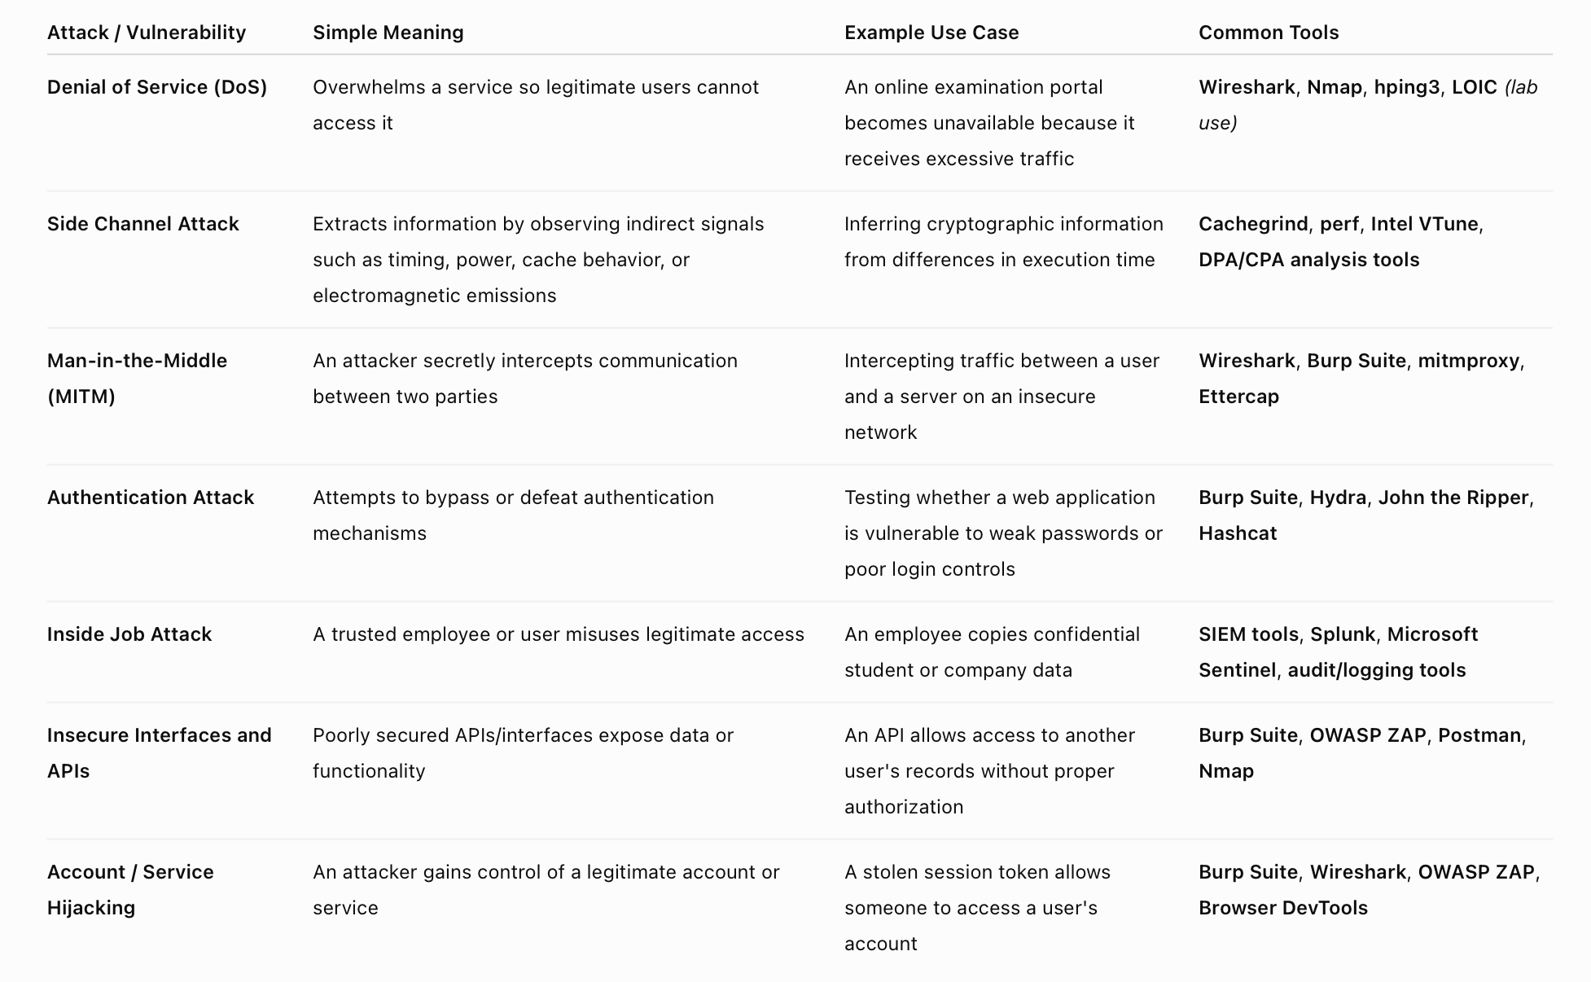

Slide 7
Cloud Data Security Requirements
Authentication
Authorization
Nonrepudiation
Auditability
Integrity
Availability

Slide 8
Cloud Security—Controls
Resources are being shared among multiple users, there is always a chance of security threats from hackers outside and within the cloud computing system.
Cloud security controls are a set of measures taken to prevent, reduce, or counter the damages caused by the attacks.
Deterrent Controls
Preventive Controls
Detective Controls
Corrective Controls

Slide 9
Cloud Security Architecture
Cloud computing is highly prone to security attacks.
The attacks can occur from within the system as well as from outside.
Inside attackers are maybe the authorized users of the cloud who share the resources with the victim user.
Cloud providers, as well as consumers, should jointly enforce security measures to prevent heavy losses due to these attacks.

Slide 10
Cloud Security Provided by Service Providers/Customers at different levels
Service provider is responsible for implementing security at the infrastructure level and platform level.
This will include repeaters, routers, hubs, switches, hypervisors, operating systems, load balancers, firewalls, storage network management consoles, databases, message queues, DNS, directory services, and cloud API.

Slide 11
Baseline to ensure the security standard of any service provider.
  Adherence to security standards such as ISO 27001 or SSAE 1
  Disclosure of the mechanisms and precautions taken against known security threats and vulnerabilities.
  Release of the adopted security architecture, explaining the security implementations at the granular level.
  Automating several tasks such as logging, backing ups, and firewall updates.
  Correctly distinguishing and confirming the security policies to be followed by the users and providers

Slide 12
High-Level Cloud Architecture With Security Services

Slide 13
Steps to improve the security of the cloud architecture.
Architecture security by implementing security schemes for firewalls, routers, storage, DNS, etc.
Identity management and access management by providing cryptographically secure authentication and authorization mechanisms.
Automating firewall updates and intrusion detection rules by developing good learning algorithms.
Encrypting the sensitive data before their storage and transmission.
Accepting data from users who possess a valid authentication certificate.
Logging each event happening within the system.
Enabling continuous monitoring of the cloud resources and architecture.

Slide 14
Cloud Data Security
The data stored in the cloud is vulnerable to several attacks such as data theft, data leakage, and data corruption which will violate the declared security principles.

