Slide 1
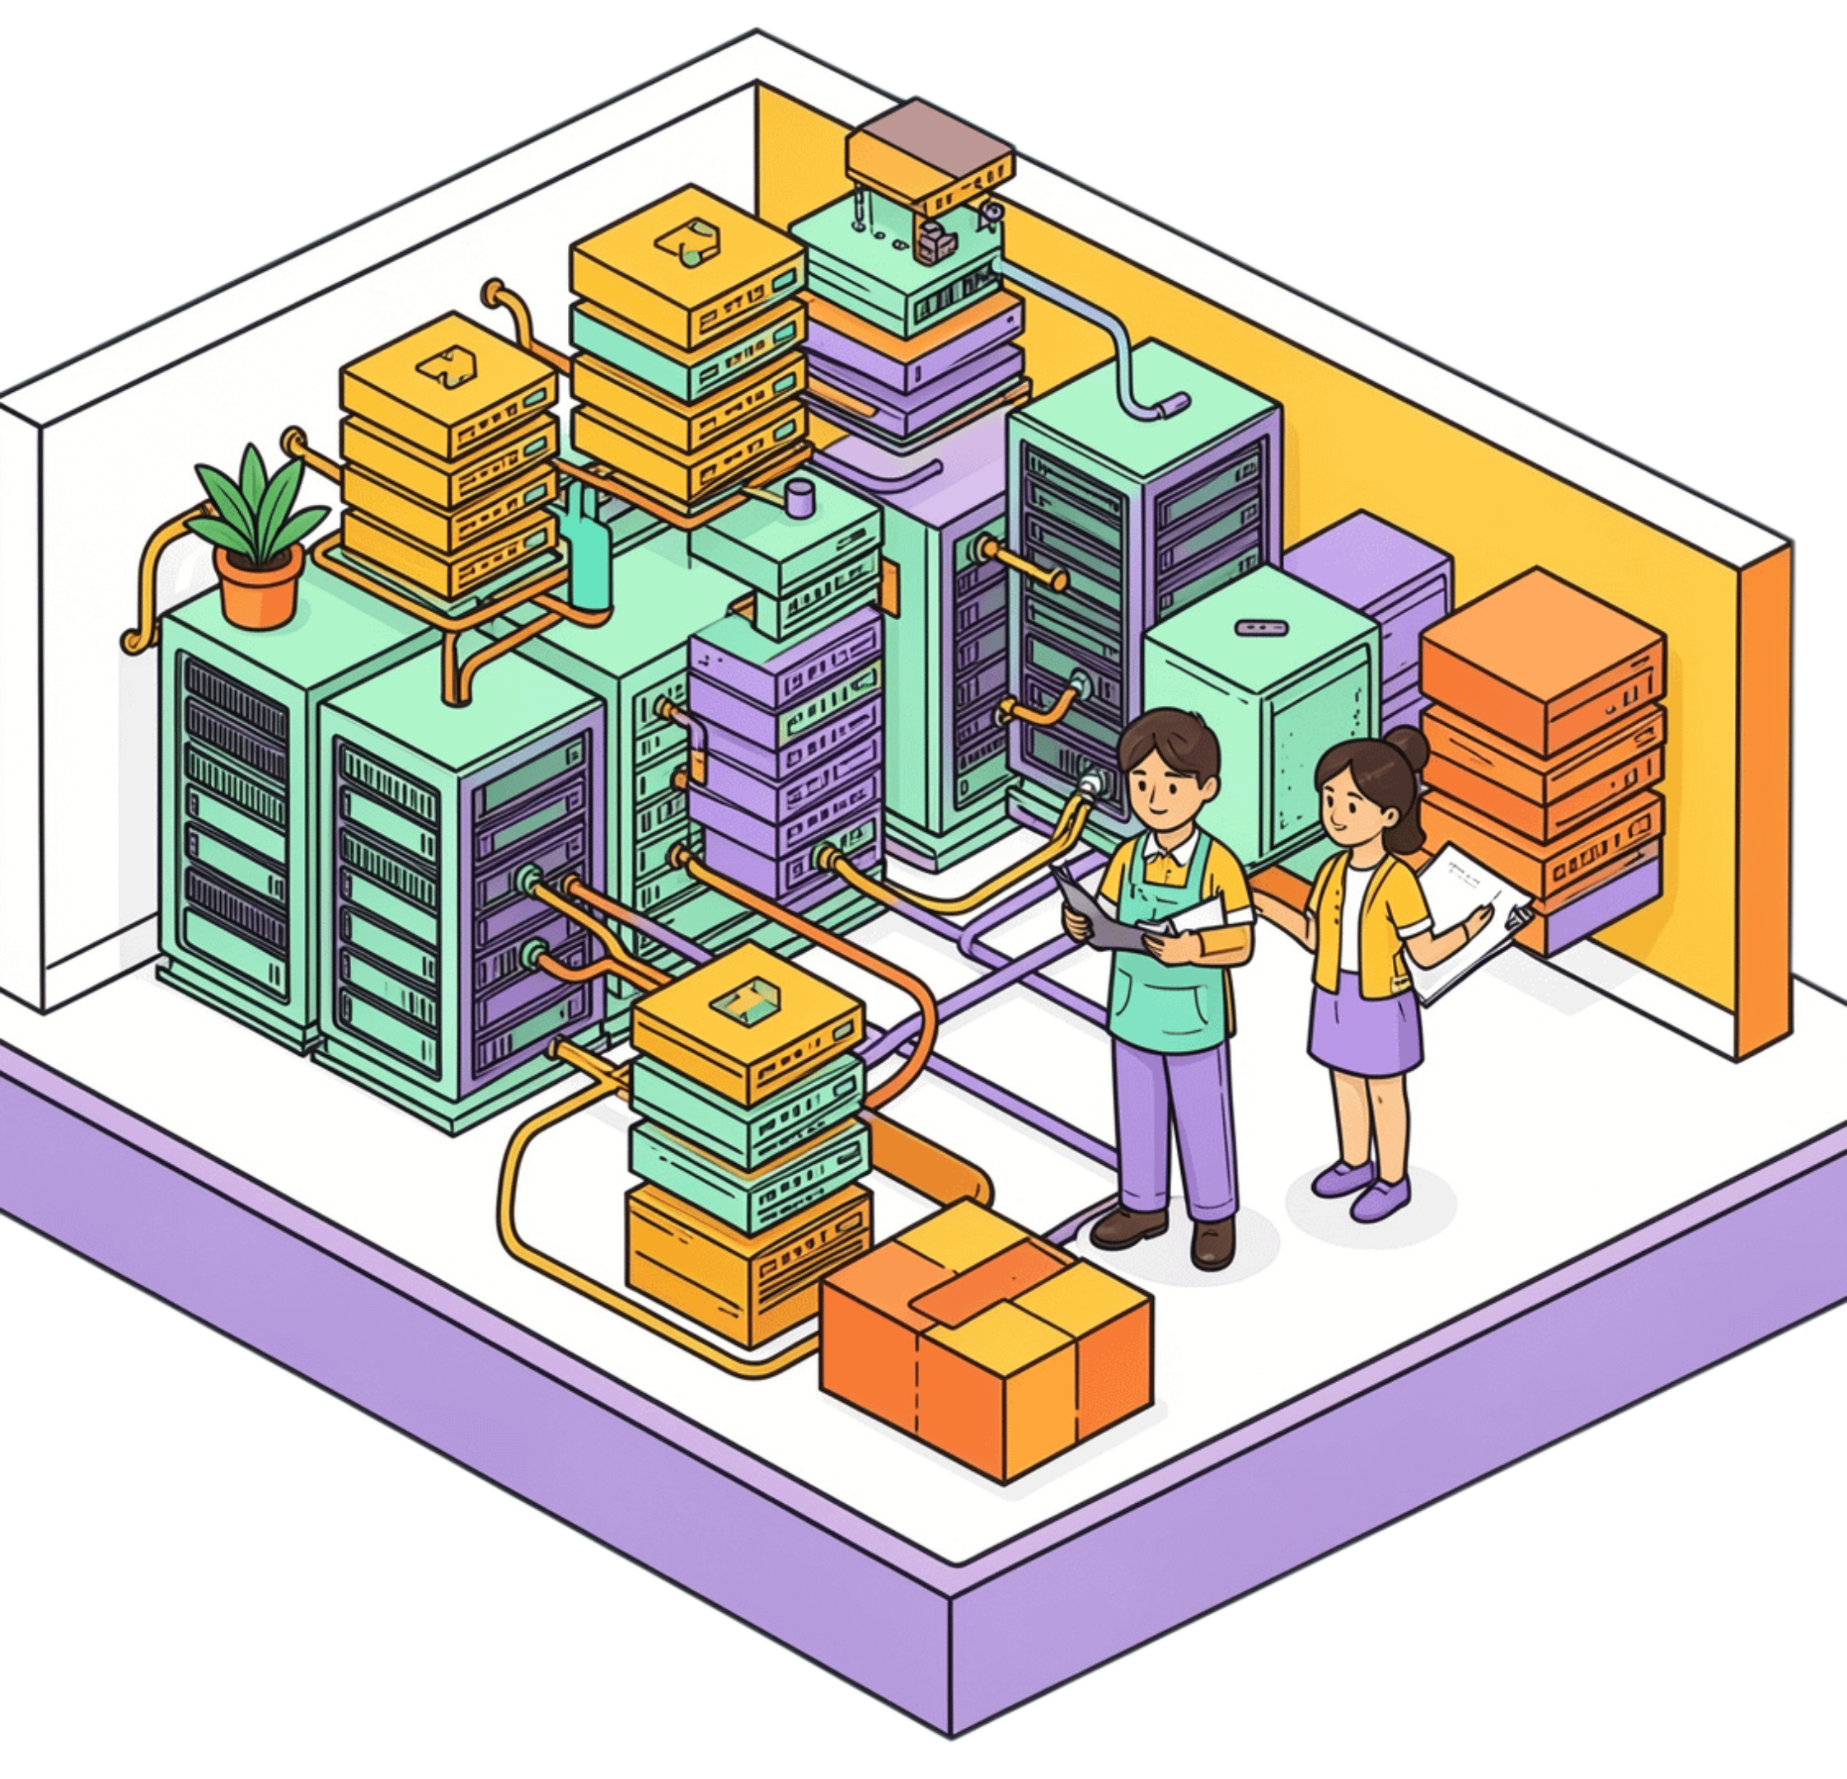
01
CLOUD COMPUTING · PLATFORM LANDSCAPE
Cloud computing platforms & simulation tools
Eucalyptus · OpenNebula · OpenStack · Aneka · CloudSim
Architecture, components, use cases, advantages, limitations, and comparison

Slide 2




02 · THE LANDSCAPE
Where do these technologies fit?
Cloud infrastructure & management
Cloud research & simulation
CloudSim models data centers, hosts, VMs, cloudlets, brokers, and policies without physical infrastructure.
Eucalyptus
OpenNebula
Private or hybrid IaaS; an AWS-compatible model.
Lightweight management of virtualized data centers.
Basic simulation flow
1
2
3
Model
Submit
Evaluate
OpenStack
Aneka
Data center, hosts, VMs
Cloudlets through a broker
Time, cost, utilization, energy
Modular, large-scale platform for private and public clouds.
Middleware to develop and execute distributed applications.
CloudSim is a simulator, not production cloud infrastructure.

Slide 3
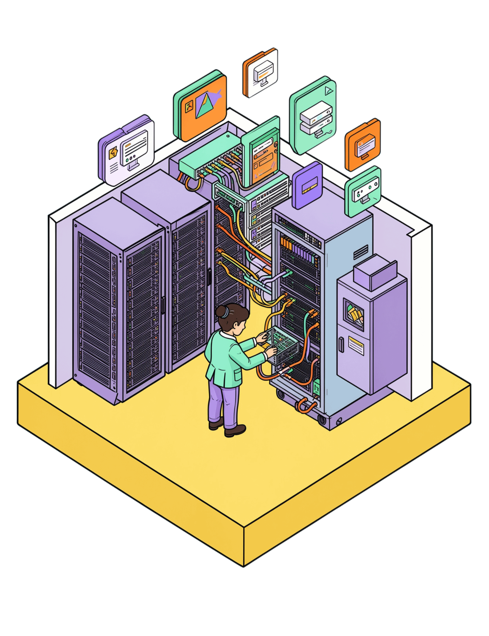
03 · PRIVATE / HYBRID IAAS
Eucalyptus turns existing infrastructure into an on-premises cloud.
Eucalyptus is an open-source IaaS cloud software framework, originally designed for private and hybrid clouds using an AWS-compatible model.
It provides virtual machine-based compute, storage, and networking services, making EC2/S3-style environments useful for migration and experimentation.
"Eucalyptus" derived from "Elastic Utility Computing Architecture for Linking Your Programs To Useful Systems."

Slide 4
04 · EUCALYPTUS ARCHITECTURE
One request moves through layered controllers.
The controller chain separates entry, placement, execution, and storage.
01
02
03
Cloud Controller
Cluster Controller
Node Controller
Central entry point and overall cloud management.
Manages a cluster and coordinates VM placement.
Controls VM instances on physical compute nodes.
USER / API
PLACEMENT
EXECUTION
04
05
Storage Controller (Walrus)
Management Platform (Euca2ool)
Provides block storage services.
Walrus store and organize data - blocks/objects
Manage modules and components
Typical flow: User → Cloud Controller → Cluster Controller → Node Controller

Slide 5
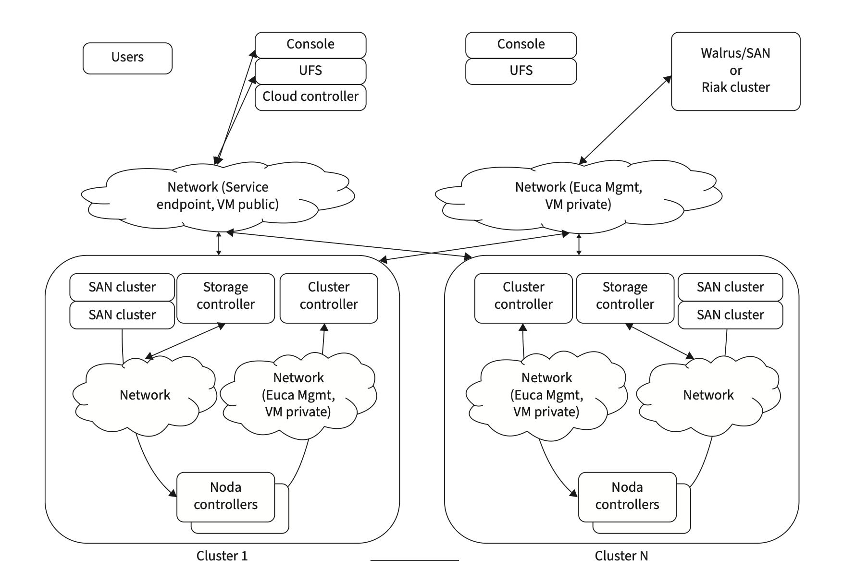
Eucalyptus architecture

Slide 6
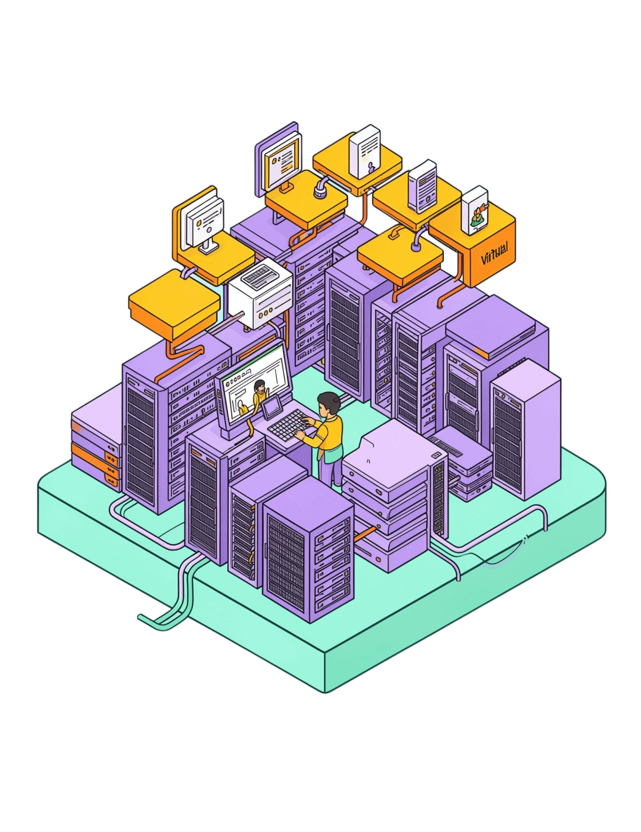
05 · PRIVATE CLOUD MANAGEMENT
OpenNebula keeps virtualized data centers manageable.
OpenNebula is an open-source cloud and virtualization management platform, primarily used to build and manage private clouds.
It centralizes virtual machines, hosts, virtual networks, and datastores while integrating heterogeneous hypervisors, storage systems, and networking.
Its emphasis is simplicity, flexibility, and operational control.

Slide 7

06 · OPENNEBULA ARCHITECTURE
A front-end coordinates the layers beneath it.
Users reach one management plane; execution remains distributed across hosts.
01
02
Virtualization
Storage
Interfaces with hypervisors such as KVM.
Datastores for VM images and persistent data.
Front-end
Central management services plus CLI, GUI, API, and cloud interfaces.
03
04
Networking
Hosts
Virtual networks, VLANs, bridges, and related services.
Physical virtualization servers that execute VM workloads.

Slide 8
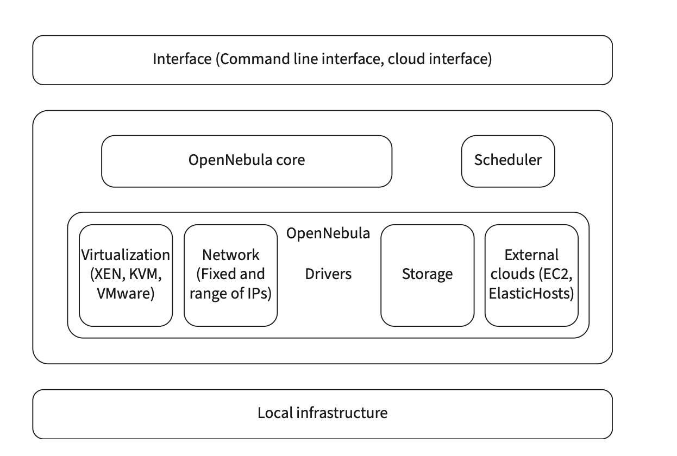
OpenNebula architecture and its components

Slide 9
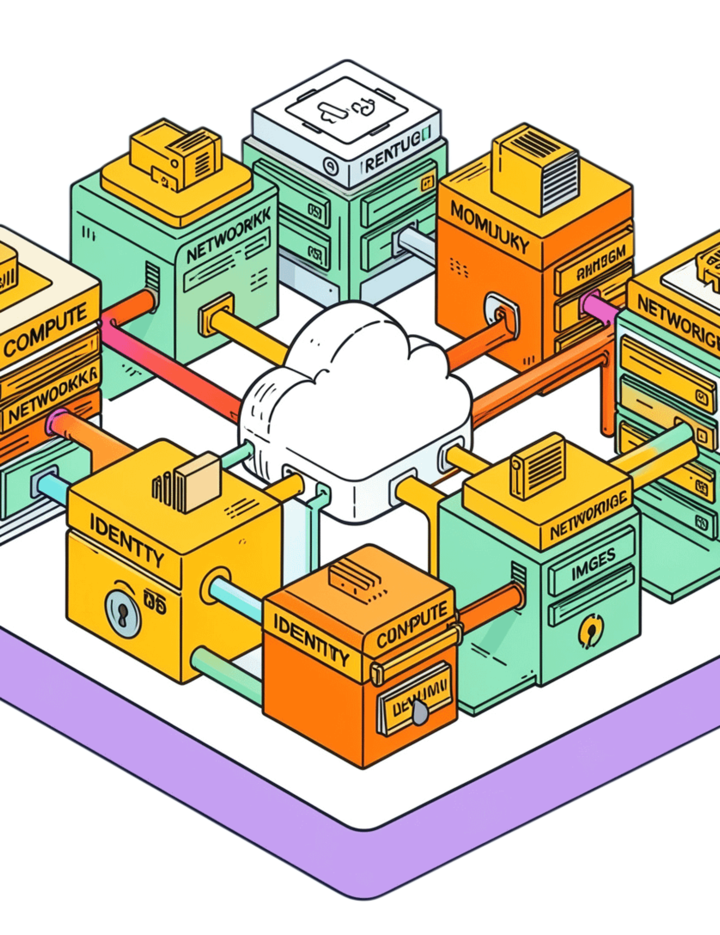
07 · MODULAR CLOUD PLATFORM
OpenStack assembles a cloud from cooperating services.
An open-source platform for private and public IaaS clouds, designed for large-scale, multi-tenant environments.
Its modular architecture lets organizations deploy only the services they need.

Slide 10








08 · OPENSTACK SERVICE MAP
Each service owns one part of the cloud.
Together, the services cover compute, network, identity, images, storage, dashboard, and resource placement.
Nova
Neutron
Keystone
Glance
Compute and VM management.
Networking and virtual network services.
Identity, authentication, and authorization.
VM image management.
Cinder
Swift
Horizon
Placement
Block storage.
Object storage.
Web-based dashboard.
Resource tracking and allocation.

Slide 11
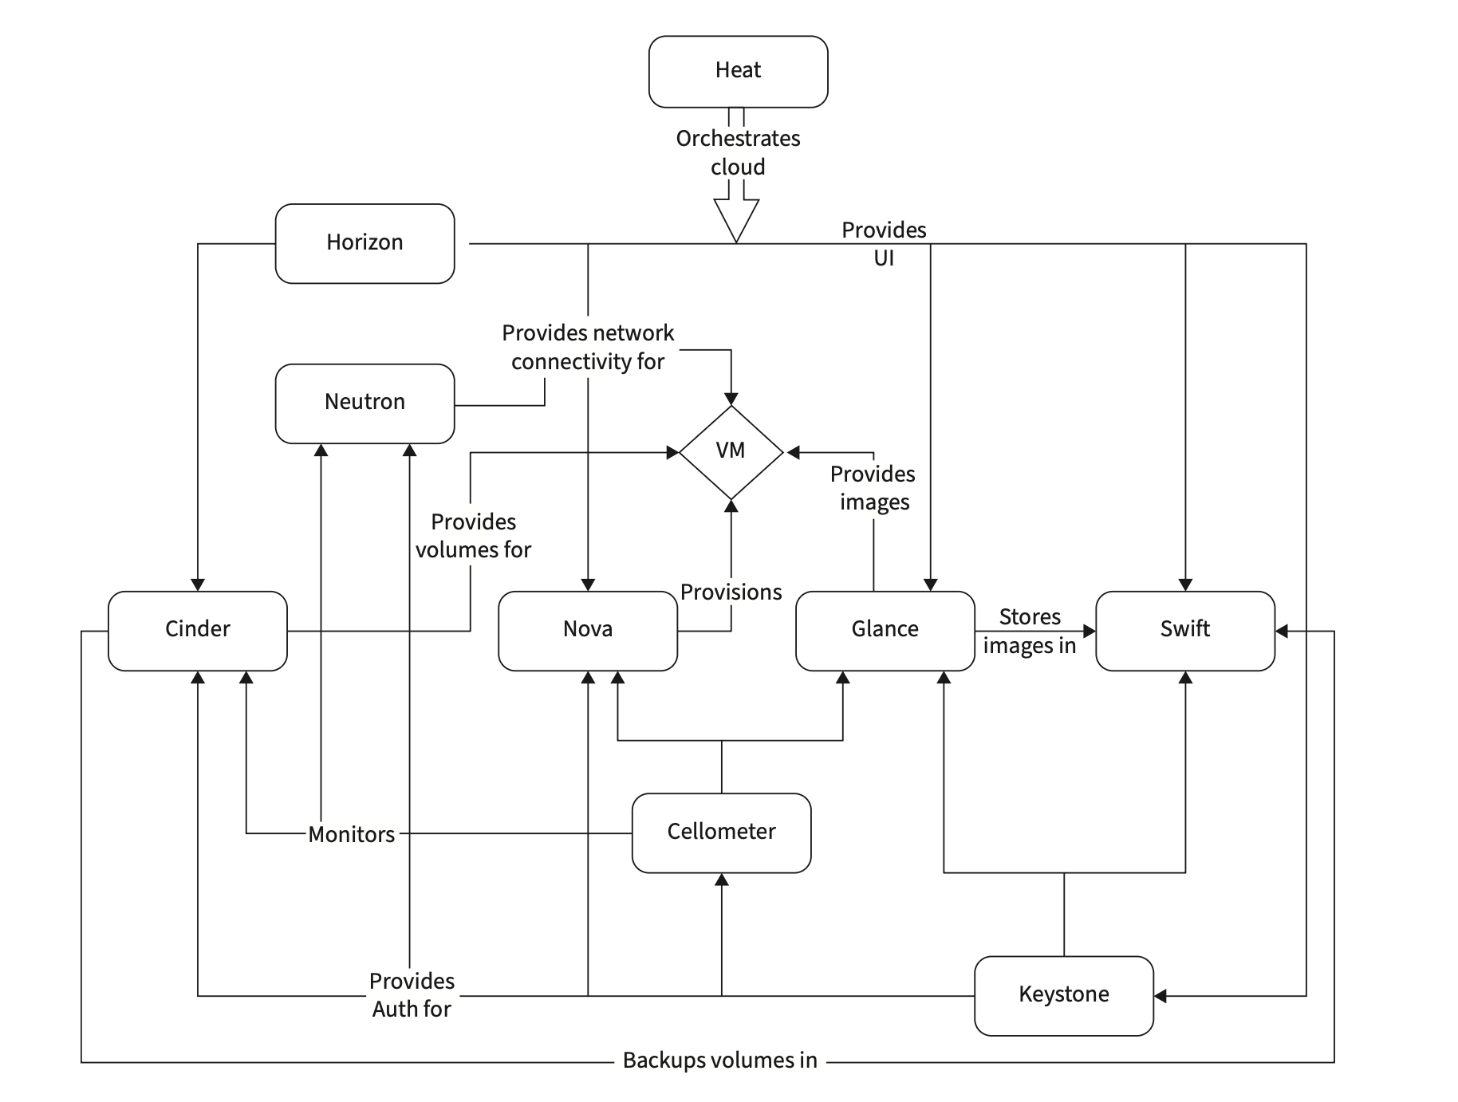
OpenStack Conceptual Architecture

Slide 12
09 · APPLICATION PLATFORM
Aneka puts programming models above infrastructure detail.
A middleware and runtime environment for developing and executing distributed cloud applications.
Three ways to express distributed work
Coordinator
Manages application execution and resource scheduling.
Task
Thread
Independent tasks execute in parallel.
Threads execute across distributed resources.
Execution nodes
Workers run application tasks on physical machines, virtual machines, or cloud resources.
Fabric services provision resources. Foundation services provide membership, storage, security, accounting, and monitoring.
MapReduce
Data-intensive parallel processing.

Slide 13
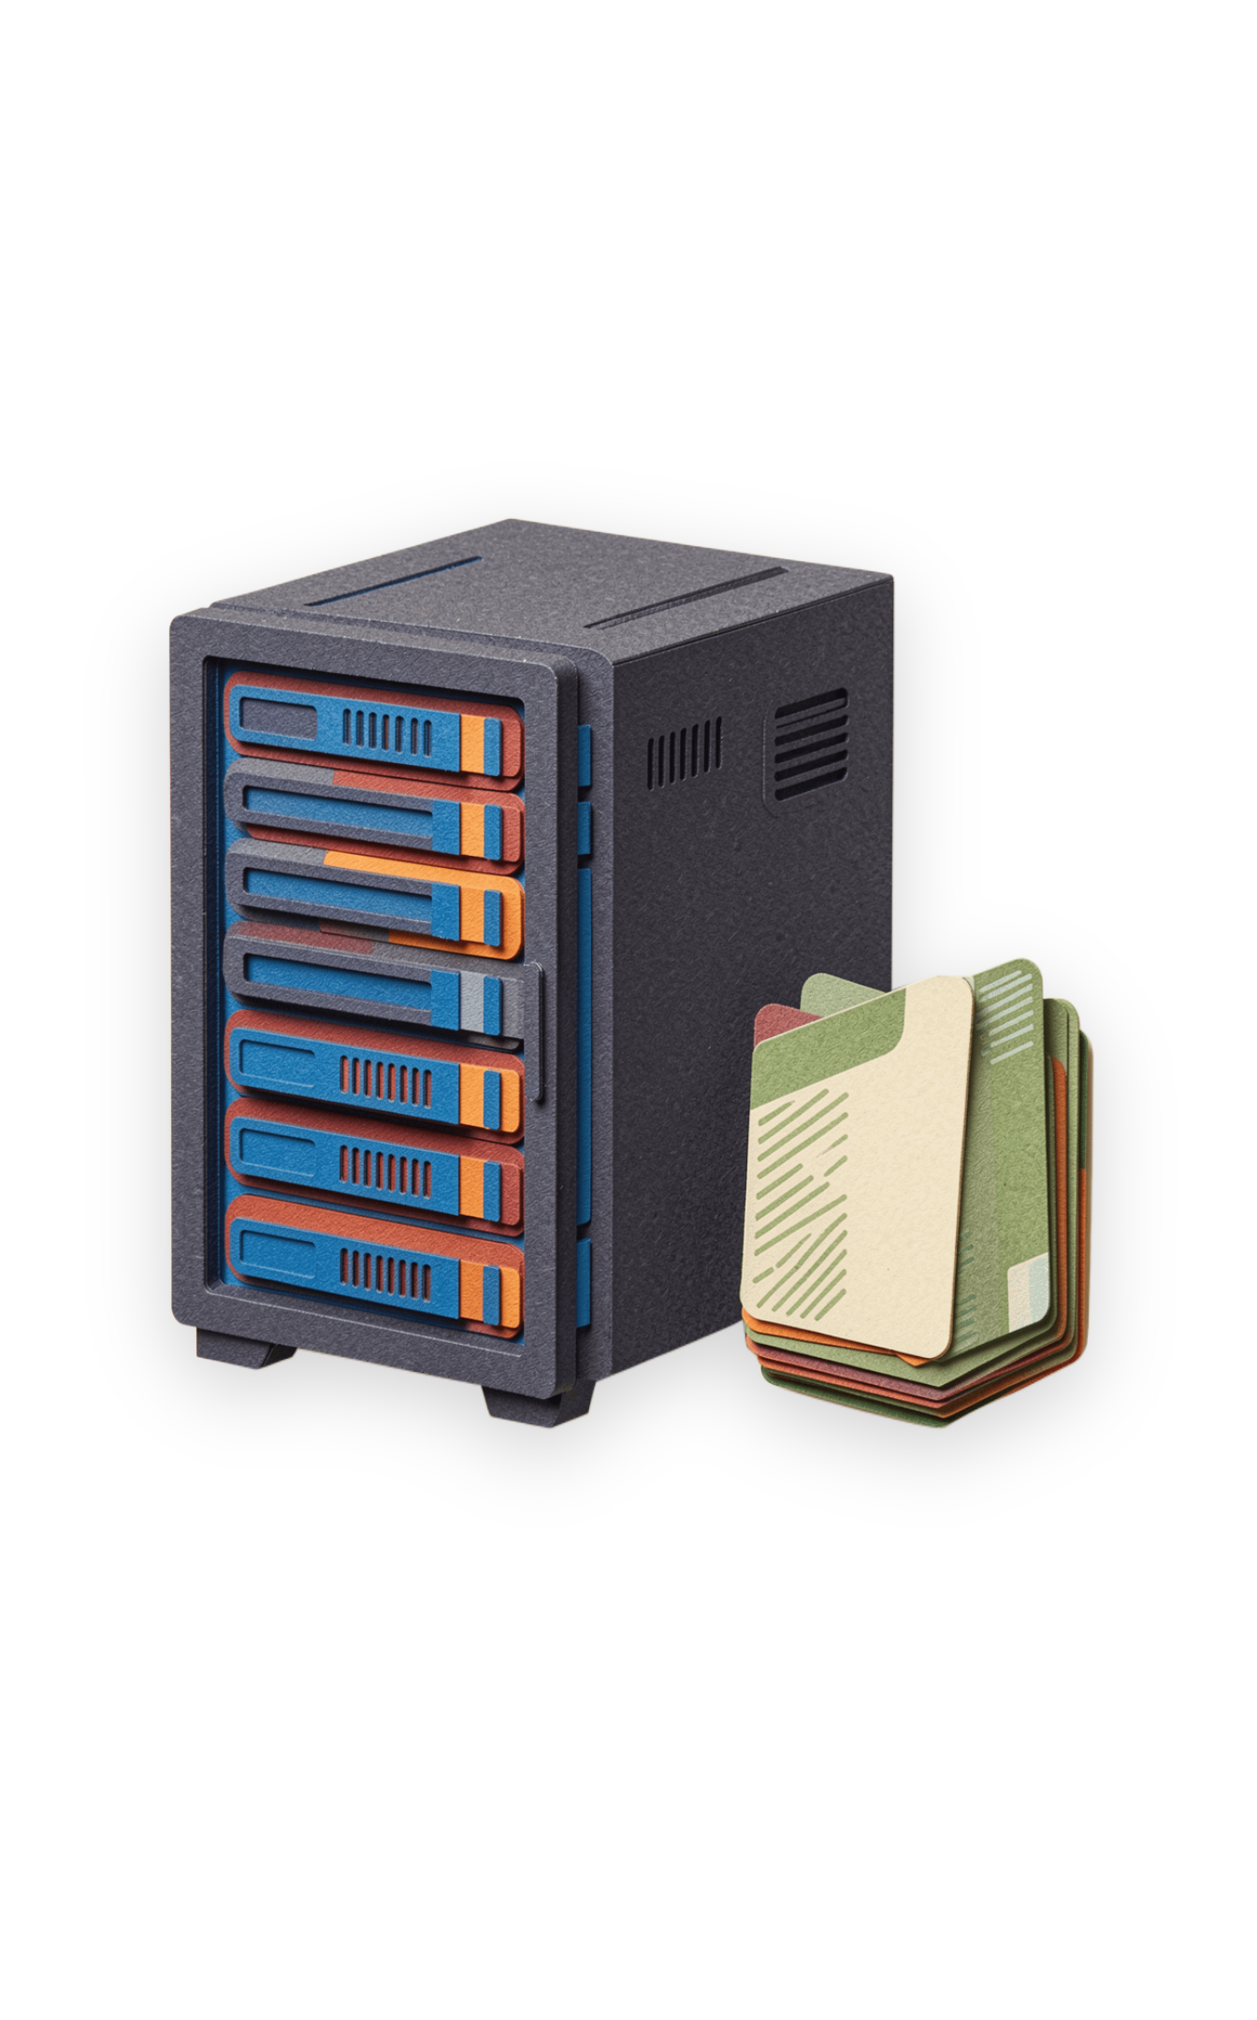
Cloud platform landscape
CloudSim
CloudSim is a simulation toolkit for modeling cloud computing environments.
It allows researchers to test scheduling, provisioning, VM allocation, energy, and resource-management strategies.
Simulation avoids the cost and complexity of building a physical cloud for every experiment.
Typical entities include data centers, hosts, virtual machines, cloudlets, brokers, and policies.
CloudSim is a simulator — it is not itself a production cloud infrastructure.

Slide 14
Simulation method
CloudSim: Basic Simulation Flow
02
Define Hosts and their CPU, RAM, bandwidth, and storage
01
Create a Data Center
04
Create Cloudlets representing application tasks
03
Create Virtual Machines (VMs)
05
Use a Broker to submit VMs and Cloudlets
06
Apply VM allocation / task scheduling policies
07
Run simulation and analyze execution time, cost, utilization, or energy

Slide 15
Comparison at a Glance
Technology | Category | Primary Focus | Typical Use | Key Strength | Main Limitation
Eucalyptus | IaaS framework | Private/hybrid cloud | AWS-like on-prem cloud | AWS compatibility | Smaller ecosystem / legacy adoption
OpenNebula | Cloud manager | Virtualized data centers | Private cloud | Simplicity & flexibility | Smaller ecosystem than OpenStack
OpenStack | Cloud platform | Large-scale IaaS | Private/public cloud | Modular & scalable | Complex deployment/operations
Aneka | Cloud middleware | Application execution | Distributed applications | Multiple programming models | More specialized ecosystem
CloudSim | Simulator | Cloud research | Algorithm/policy evaluation | Low-cost experimentation | Simulation ≠ real deployment

Slide 16



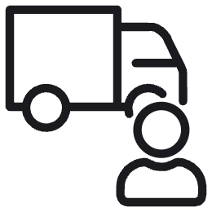

Decision guide
Which One Should you Choose?
Need an AWS-compatible private/hybrid IaaS environment → Eucalyptus
Need a relatively lightweight private-cloud manager → OpenNebula
Need a feature-rich, highly modular cloud platform → OpenStack
Need to develop/test distributed cloud applications using programming models → Aneka
Need to evaluate scheduling, VM allocation, cost, or energy algorithms → CloudSim

Slide 17
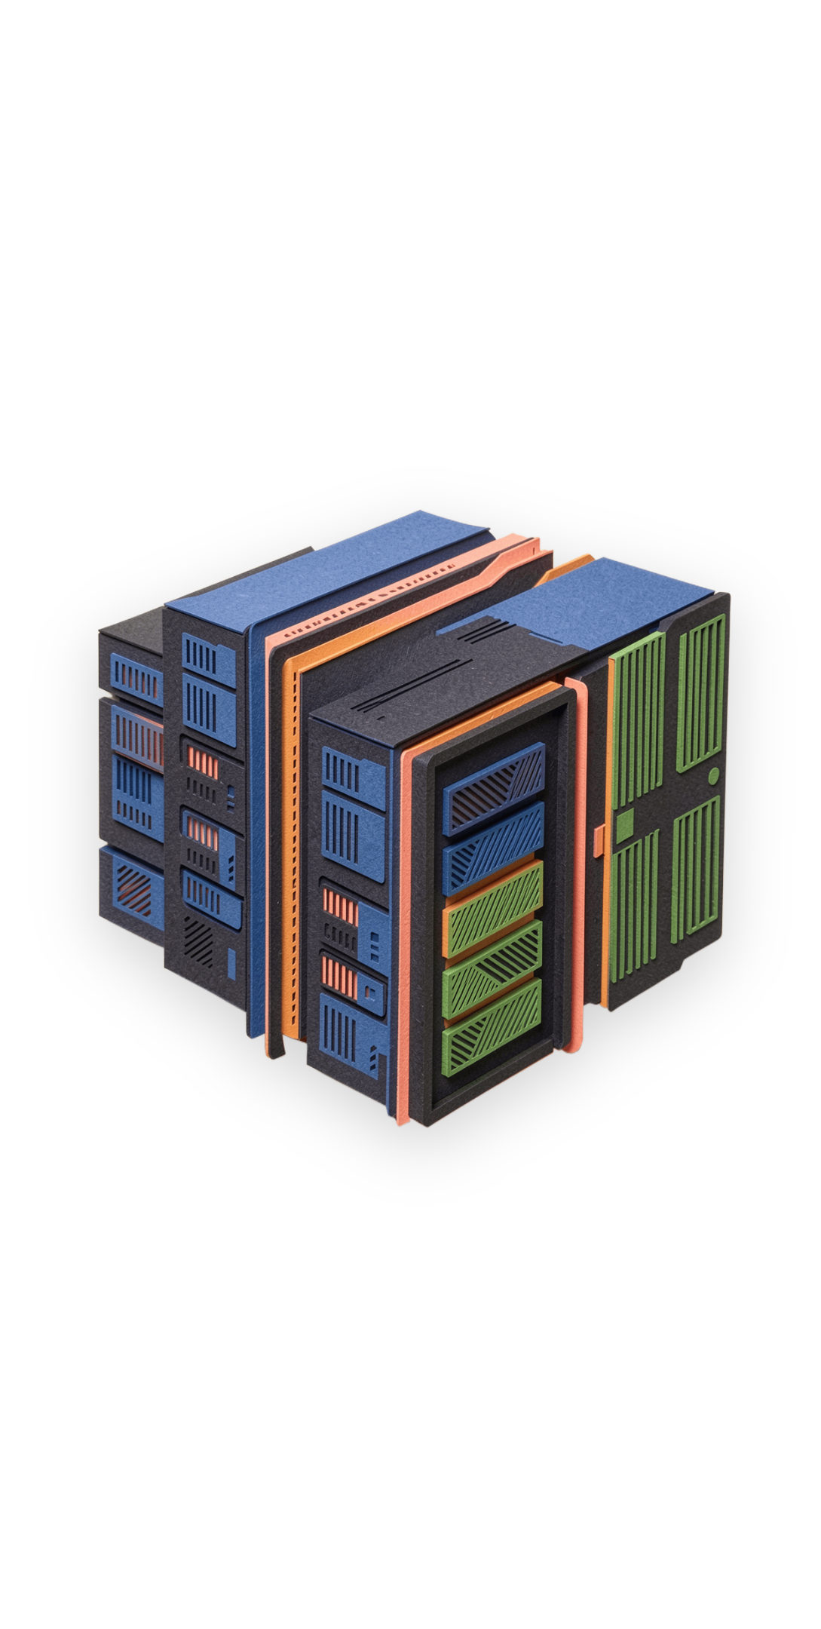
Classroom activity
Classroom Activity / Discussion
Scenario: A college wants to build a private cloud using 10 physical servers.
Q1. Which platform would you consider for production cloud management? Why?
Q2. Which platform would be useful if simplicity is the priority?
Q3. Which tool would you use to test a new VM scheduling algorithm before deployment?
Q4. Which technology focuses more on application programming models than infrastructure management?
Q5. Compare OpenNebula and OpenStack in terms of complexity and scalability.

Slide 18
Final frame
Key Takeaways
Eucalyptus — AWS-compatible approach to private/hybrid IaaS
OpenNebula — streamlined management of virtualized/cloud infrastructure
OpenStack — modular platform for building large-scale clouds
Aneka — middleware for developing and executing distributed cloud applications
CloudSim — simulation environment for cloud research and experimentation
Remember the distinction: cloud platforms manage resources; CloudSim models them for experimentation.

