Slide 1

Cloud Computing
Course Code: PEITT523

Slide 2
Introduction
Cloud computing is a model for enabling ubiquitous, convenient, and on-demand network access to a shared pool of configurable computing resources (e.g., networks, servers, storage, applications, and services) that can be rapidly provisioned and released with minimal management effort or service provider interaction.

Slide 3
Cloud Service Models
Software as a Service
Platform as a Service
Infrastructure as a Service

Slide 4
Cloud Deployment Models
Private Cloud
Public Cloud
Community Cloud
Hybrid Cloud

Slide 5
Characteristics of Cloud Computing
Rapid elasticity
Measured service
On-demand self-service
Ubiquitous network access
Resource pooling

Slide 6
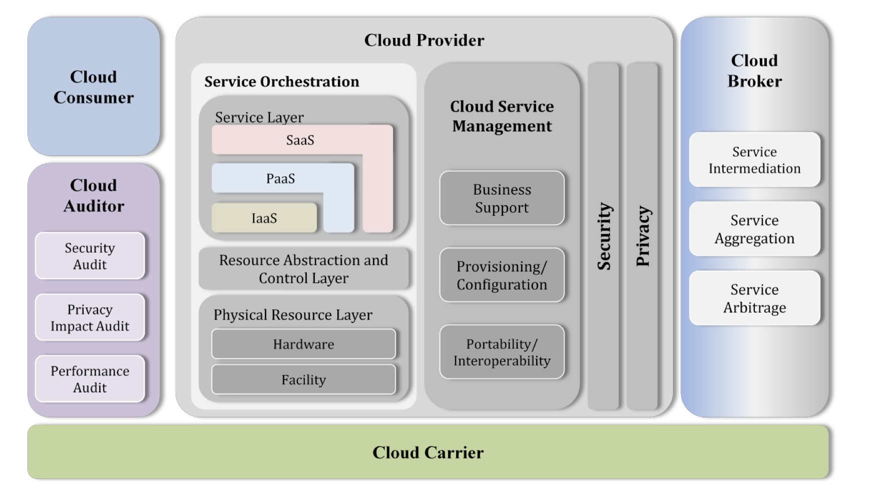
Cloud Computing Reference Architecture

Slide 7
Cloud Computing Reference Architecture
Cloud Consumer
Cloud Provider
Cloud Auditor
Cloud Broker
Cloud Carrier

