Slide 1


Python Beginners
Dr. Sarit Maitra

Slide 2

Why Python
Clear syntax
Python has a clear and clean syntax which is easily readable. It allows even beginners to work with complex software development projects as the team can coordinate easily on the coding front.
The simple coding syntax facilitates test-driven development for all applications of Python.
Scalable
Companies love Python for its scalability. Some of the companies implementing the uses of Python language include Google, Spotify, Netflix, Instagram, and many more that want scalable applications.
It allows handling a massive amount of traffic with ease.
Versatile
Unlike most programming languages, the practical uses for Python are not limited to just web or mobile development.
It is a popular choice for building web apps, gaming applications, enterprise-grade apps, e-commerce applications, ML and AI applications, and much more..

Slide 3
Choosing the version
Why are there different versions?
How are they different?
Which one should we learn?

Slide 4
Learning environment
VS code
Anaconda / Jupyter Notebook
Google Colab

Slide 5
Object-Oriented Programming
Java Script
Java Script
Python
document.addEventListener("DOMContentLoaded", function () {var question = prompt("Ask magic 8 ball a question");var answer = Math.floor(Math.random() * 8) + 1; if (answer == 1) {alert("It is certain");} else if (answer == 2) {alert("Outlook good");} else if (answer == 3) {alert("You may rely on it");} else if (answer == 4) {alert("Ask again later");} else if (answer == 5) {alert("Concentrate and ask again");} else if (answer == 6) {alert ("Reply hazy, try again");} else if (answer == 7) {alert("My reply is no");} else if (answer == 8) {alert("My sources say no")} else {alert ("That's not a question");}alert("The end");})
document.addEventListener("DOMContentLoaded", function () {
var question = prompt("Ask magic 8 ball a question");
var answer = Math.floor(Math.random() * 8) + 1;
if (answer == 1) {
alert("It is certain");
} else if (answer == 2) {
alert("Outlook good");
} else if (answer == 3) {
alert("You may rely on it");
} else if (answer == 4) {
alert("Ask again later");
} else if (answer == 5) {
alert("Concentrate and ask again");
} else if (answer == 6) {
alert("Reply hazy, try again");
} else if (answer == 7) {
alert("My reply is no");
} else if (answer == 8) {
alert("My sources say no")
} else {
alert("That's not a question");}
alert("The end");
})
import random
question = input("Ask magic 8 ball a question")
answer = random.randint(1,8)
if answer == 1:
print("It is certain")
elif answer == 2:
print("Outlook good")
elif answer == 3:
print("You may rely on it")
elif answer == 4:
print("Ask again later")
elif answer == 5:
print("Concentrate and ask again")
elif answer == 6:
print("Reply hazy, try again")
elif answer == 7:
print ("My reply is no")
elif answer == 8:
print ("My sources say no")
else:
print("That's not a question")
print ("The end")

Slide 6
Dynamically typed language
Typing refers to type-checking in programming languages. In a strongly-typed language, such as Python, "1" + 2 will result in a type error since these languages don't allow for "type-coercion" (implicit conversion of data types). On the other hand, a weakly-typed language, such as JavaScript, will simply output "12" as result.
Type-checking can be done at two stages –
Static - Data Types are checked before execution.
Dynamic - Data Types are checked during execution.
Python is an interpreted language, executes each statement line by line and thus type-checking is done on the fly, during execution. Hence, Python is a Dynamically Typed Language.

Slide 7
Computer
A computer is composed of a Central Processing Unit (abbreviated CPU), memory, and Input/Output (abbreviated I/O) devices.
A screen is an output device.
A mouse is an input device.
A hard drive is an I/O device.
The CPU is the brain of the computer. It can store values in memory, retrieve values from memory, add/subtract two numbers, compare two numbers etc.
The CPU can also control which instruction it will execute next. Normally there are a list of instructions, one after another, that the CPU executes. Sometimes the CPU may jump to a different location within that list of instructions depending on the outcome of some comparison.

Slide 8
Interpreted language
Interpreted language executes its statements line by line.
Languages such as Python, JavaScript, R, PHP, and Ruby are prime examples of Interpreted languages.
Programs written in an interpreted language runs directly from the source code, with no intermediary compilation step.

Slide 9
PEP 8 and it’s importance
PEP - Python Enhancement Proposal.
It is an official design document providing information to the Python community or describing a new feature for Python or its processes.
PEP 8 is especially important since it documents the style guidelines for Python Code.
Apparently contributing to the Python open-source community requires you to follow these style guidelines sincerely and strictly.

Slide 10
Memory
The memory of a computer is a place where values can be stored and retrieved.
It is a relatively fast storage device, but it loses its contents as soon as the computer is turned off. It is volatile store.
The hard drive is non-volatile storage or sometimes called persistent storage.
Values can be stored and retrieved from the hard drive, but it is relatively slow compared to the memory and CPU. However, it retains its contents even when the power is off

Slide 11
Byte
In a computer, everything is stored as a sequence of 0’s and 1’s.
One digit in a binary number is called a bit.
Eight bits grouped together are called a byte.
Kilobyte KB - about 1 thousand bytes
Megabyte (MB) - about 1 million bytes (about 1000 KB)
MP3 audio is about 1 megabyte per minute
A high-quality digital picture is about 2-5 megabytes
Gigabyte GB = about a billion bytes (about 1000 MB)
GB is a common unit for modern hardware e.g., 4000 MB = 4 GB
An ordinary computer might have:
4 GB or RAM, 256 GB of persistent storage
A DVD disk has a capacity 4.7GB (single layer)
Figure 2 GB per hour of video (varies greatly)
A flash drive might hold 32 GB
A hard drive might hold 750 GB
One terabyte (TB) is about 1000 gigabytes, or roughly 1 trillion bytes. Hard Drives on computers are usually in the 500 GB to two TB range.

Slide 12
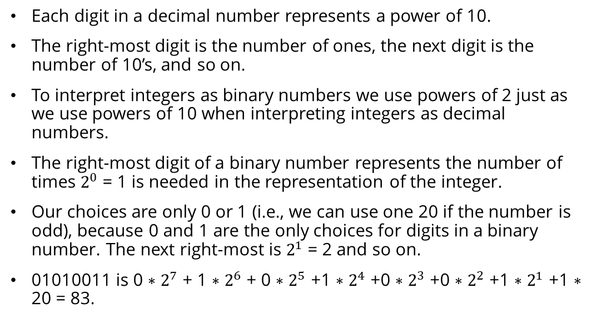
Binary number Representation
Each digit in a decimal number represents a power of 10.
The right-most digit is the number of ones, the next digit is the number of 10’s, and so on.
To interpret integers as binary numbers we use powers of 2 just as we use powers of 10 when interpreting integers as decimal numbers.
The right-most digit of a binary number represents the number of times $2^{0}$ = 1 is needed in the representation of the integer.
Our choices are only 0 or 1 (i.e., we can use one 20 if the number is odd), because 0 and 1 are the only choices for digits in a binary number. The next right-most is $2^{1}$ = 2 and so on.
01010011 is 0 ∗ $2^{7}$ + 1 ∗ $2^{6}$ + 0 ∗ $2^{5}$ +1 ∗ $2^{4}$ +0 ∗ $2^{3}$ +0 ∗ $2^{2}$ +1 ∗ $2^{1}$ +1 ∗ 20 = 83.

Slide 13
Byte Objects vs String
Byte objects are sequence of Bytes, whereas Strings are sequence of characters.
Byte objects are in machine readable form internally, Strings are only in human readable form.
Since Byte objects are machine readable, they can be directly stored on the disk.
Whereas Strings need encoding before which they can be stored on disk.

Slide 14
Encoding
PNG, JPEG, MP3, WAV, ASCII, UTF-8 etc are different forms of encodings.
An encoding is a format to represent audio, images, text, etc in bytes.
Converting Strings to byte objects is termed as encoding.
This is necessary so that the text can be stored on disk using mapping using ASCII or UTF-8 encoding techniques.
This task is achieved using encode().
It take encoding technique as argument. Default technique is “UTF-8” technique

Slide 15
Decoding
Similarly, Decoding is process to convert a Byte object to String.
It is implemented using decode() .
A byte string can be decoded back into a character string, if we know which encoding was used to encode it.
Encoding and Decoding are inverse processes

