Slide 1


Python Beginners
Dr. Sarit Maitra

Slide 2

Why Python
Simple
High level interpreted language with easy syntax and dynamic semantics.
High level – Python derives components from natural language like we do.
Easy to Learn
More emphasis on the solution to the problem rather than the syntax
Interpreted
There are no separate compilation and execution steps like C and C++.
Python code in compiled line by line which makes debugging error easier & efficient.
This also means that management of memory & CPU is much more efficient & easier.
A whole program may take up a lot of memory, but Python would take away the block of code that has already been executed. This frees up memory and makes the code run better.
Because of above, Python is slower than other programming languages (java, C++ etc.)
Easy Syntax
Use indentations to distinguish which block of code comes under which functions. This makes the code distributed and better for anyone to read.
Dynamics Semantics
Do not need to initialise anything before using; Python does all of that dynamically.
Rich Library Support
Study & Practice Materials
Python
Open source
Simple & easy to learn
OOPS
Rich library support
Portability
Interpreted

Slide 3
OOP (Object-Oriented Programming
The main aim of OOP is to bind together the data and the functions that operate on them so that no other part of the code can access this data except that function.
We can model a real-world problem into our code, and we can have security for it such that certain features only access those data elements.
This helps replicating real-world problem.

Slide 4
Choosing the version
Why are there different versions?
How are they different?
Which one should we learn?

Slide 5
Learning environment
VS code
Anaconda / Jupyter Notebook
Google Colaboratory

Slide 6
Object-Oriented Programming
Java Script
Java Script
Python
document.addEventListener("DOMContentLoaded", function () {var question = prompt("Ask magic 8 ball a question");var answer = Math.floor(Math.random() * 8) + 1; if (answer == 1) {alert("It is certain");} else if (answer == 2) {alert("Outlook good");} else if (answer == 3) {alert("You may rely on it");} else if (answer == 4) {alert("Ask again later");} else if (answer == 5) {alert("Concentrate and ask again");} else if (answer == 6) {alert ("Reply hazy, try again");} else if (answer == 7) {alert("My reply is no");} else if (answer == 8) {alert("My sources say no")} else {alert ("That's not a question");}alert("The end");})
document.addEventListener("DOMContentLoaded", function () {
var question = prompt("Ask magic 8 ball a question");
var answer = Math.floor(Math.random() * 8) + 1;
if (answer == 1) {
alert("It is certain");
} else if (answer == 2) {
alert("Outlook good");
} else if (answer == 3) {
alert("You may rely on it");
} else if (answer == 4) {
alert("Ask again later");
} else if (answer == 5) {
alert("Concentrate and ask again");
} else if (answer == 6) {
alert("Reply hazy, try again");
} else if (answer == 7) {
alert("My reply is no");
} else if (answer == 8) {
alert("My sources say no")
} else {
alert("That's not a question");}
alert("The end");
})
import random
question = input("Ask magic 8 ball a question")
answer = random.randint(1,8)
if answer == 1:
print("It is certain")
elif answer == 2:
print("Outlook good")
elif answer == 3:
print("You may rely on it")
elif answer == 4:
print("Ask again later")
elif answer == 5:
print("Concentrate and ask again")
elif answer == 6:
print("Reply hazy, try again")
elif answer == 7:
print ("My reply is no")
elif answer == 8:
print ("My sources say no")
else:
print("That's not a question")
print ("The end")

Slide 7
Python Dynamically typed language
We don't have to declare the type of variable while assigning a value to a variable in Python. Other languages like C, C++, Java, etc.., there is a strict declaration of variables before assigning values to them.
Python don't have any problem even if we don't declare the type of variable. It states the kind of variable in the runtime of the program. So, Python is a dynamically typed language. Let's see one example.
## assigning a value to a variable
x = [1, 2, 3]
## x is a list here
print(type(x))
## reassigning a value to the 'x’
x = True
## x is a bool here
print(type(x))

Slide 8
Python usage
Google: uses Python for better search features.
Dropbox: its server & client applications have been coded using Python.
Netflix: uses ML to understand & cluster certain groups of its users and recommend them TV shows.
NASA: scientists uses Python for scientific calculations
National Security Agency: uses Python for Cybersecurity analysis and for encryption & decryption purposes.
YouTube: uses Python for better searches for its users
BitTorrent: Uses python to share files between the users.

Slide 9
Python data Types
Data types
Numeric
Lists
Sets
Strings
Dictionary
Tuples

Slide 10
Stores numeric values in a variable
Integer (1,7, 39…)
Numeric
Float (2.30, 4.92….)
Not mutable
Complex (10+2a…)
List can have different data inside a list
Lists
A = [2, “Telegu”, 3.79, 43+5j…..]
Lists are set of arrays and changeable
Similar as lists and written with ()
tuple = (‘apple’, ‘banana’, ‘cherry”’
Tuples
Tuples is ordered and unchangeable
Use to hold key value pairs
Dictionary
dict = {‘name’: ‘jane’, ‘gender’ : ’female’, ‘age’: 19}
Changeable / mutable
Unordered collection of unique elements
sets = {1, 2, 3, 4, 5}
Sets
Changeable / mutable
Collection of characters
string = (“Alliance University”)
Strings
Mutable, written in either (‘ ‘) or (“ “)

Slide 11
Computer
A computer is composed of a Central Processing Unit (abbreviated CPU), memory, and Input/Output (abbreviated I/O) devices.
A screen is an output device.
A mouse is an input device.
A hard drive is an I/O device.
The CPU is the brain of the computer. It can store values in memory, retrieve values from memory, add/subtract two numbers, compare two numbers etc.
The CPU can also control which instruction it will execute next. Normally there are a list of instructions, one after another, that the CPU executes. Sometimes the CPU may jump to a different location within that list of instructions depending on the outcome of some comparison.

Slide 12
PEP 8 and it’s importance
PEP - Python Enhancement Proposal.
It is an official design document providing information to the Python community or describing a new feature for Python or its processes.
PEP 8 is especially important since it documents the style guidelines for Python Code.
Contributing to the Python open-source community requires to follow these style guidelines sincerely and strictly.

Slide 13
Memory
The memory of a computer is a place where values can be stored and retrieved.
It is a relatively fast storage device, but it loses its contents as soon as the computer is turned off. It is volatile store.
The hard drive is non-volatile storage or sometimes called persistent storage.
Values can be stored and retrieved from the hard drive, but it is relatively slow compared to the memory and CPU. However, it retains its contents even when the power is off

Slide 14
Byte
In a computer, everything is stored as a sequence of 0’s and 1’s.
One digit in a binary number is called a bit.
Eight bits grouped together are called a byte.
Kilobyte KB - about 1 thousand bytes
Megabyte (MB) - about 1 million bytes (about 1000 KB)
MP3 audio is about 1 megabyte per minute
A high-quality digital picture is about 2-5 megabytes
Gigabyte GB = about a billion bytes (about 1000 MB)
GB is a common unit for modern hardware e.g., 4000 MB = 4 GB
An ordinary computer might have:
4 GB or RAM, 256 GB of persistent storage
A DVD disk has a capacity 4.7GB (single layer)
Figure 2 GB per hour of video (varies greatly)
A flash drive might hold 32 GB
A hard drive might hold 750 GB
One terabyte (TB) is about 1000 gigabytes, or roughly 1 trillion bytes. Hard Drives on computers are usually in the 500 GB to two TB range.

Slide 15
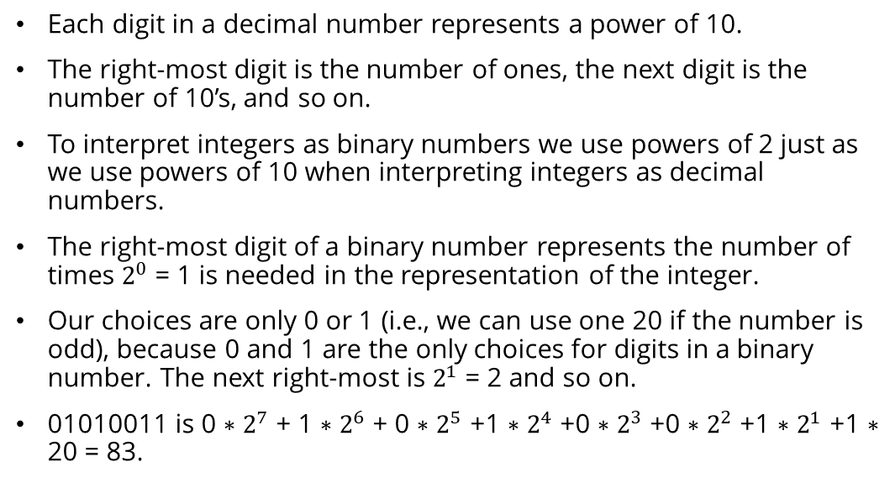
Binary number Representation
Each digit in a decimal number represents a power of 10.
The right-most digit is the number of ones, the next digit is the number of 10’s, and so on.
To interpret integers as binary numbers we use powers of 2 just as we use powers of 10 when interpreting integers as decimal numbers.
The right-most digit of a binary number represents the number of times $2^{0}$ = 1 is needed in the representation of the integer.
Our choices are only 0 or 1 (i.e., we can use one 20 if the number is odd), because 0 and 1 are the only choices for digits in a binary number. The next right-most is $2^{1}$ = 2 and so on.
01010011 is 0 ∗ $2^{7}$ + 1 ∗ $2^{6}$ + 0 ∗ $2^{5}$ +1 ∗ $2^{4}$ +0 ∗ $2^{3}$ +0 ∗ $2^{2}$ +1 ∗ $2^{1}$ +1 ∗ 20 = 83.

Slide 16
Byte Objects vs String
Byte objects are sequence of Bytes, whereas Strings are sequence of characters.
Byte objects are in machine readable form internally, Strings are only in human readable form.
Since Byte objects are machine readable, they can be directly stored on the disk.
Whereas Strings need encoding before which they can be stored on disk.

Slide 17
Encoding
PNG, JPEG, MP3, WAV, ASCII, UTF-8 etc are different forms of encodings.
An encoding is a format to represent audio, images, text, etc in bytes.
Converting Strings to byte objects is termed as encoding.
This is necessary so that the text can be stored on disk using mapping using ASCII or UTF-8 encoding techniques.
This task is achieved using encode().
It take encoding technique as argument. Default technique is “UTF-8” technique

Slide 18
Decoding
Similarly, Decoding is process to convert a Byte object to String.
It is implemented using decode() .
A byte string can be decoded back into a character string, if we know which encoding was used to encode it.
Encoding and Decoding are inverse processes

