Slide 1

Safe Resident
Final Project of Mobile Application Development (CS639)
Developed by : (Team 10) Sarjakkumar Kothiya,
Jalak Gevariya
Guided by: Prof Dr. Christelle Scharff

Slide 2
Overview :
The main goal of the SafeResident app is to help users stay aware of emergencies.
It sends immediate alerts about incidents such as fires, accidents, crimes, and other emergencies happening nearby.
The app aims to keep users informed and prepared so they can respond effectively when needed.

Slide 3
Technologies/Frameworks :
1. App Development :
Programming Language: Kotlin.
IDE : Android Studio
2. Maps and Location Services :
Google Maps Android API: Integrate Google Maps SDK to display maps and visualize incident locations.
3. Firebase RealTime Database :
Implement Firebase RealTime Database for Incidents and users management.
Permissions: Location access, Camera access, Storage access

Slide 4
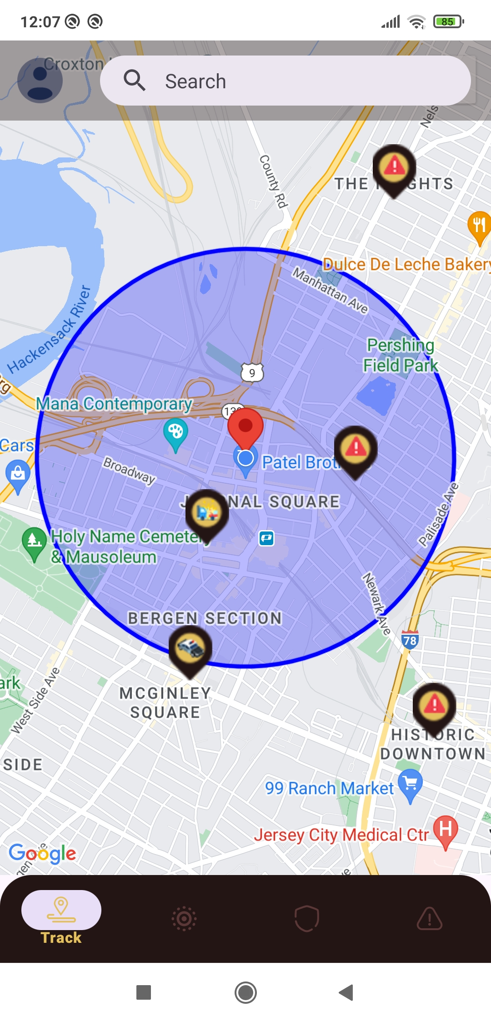
Features :
1. Track Safety Map: Visualize recent incidents and their locations on a map to stay informed about potential risks in specific areas.

Slide 5
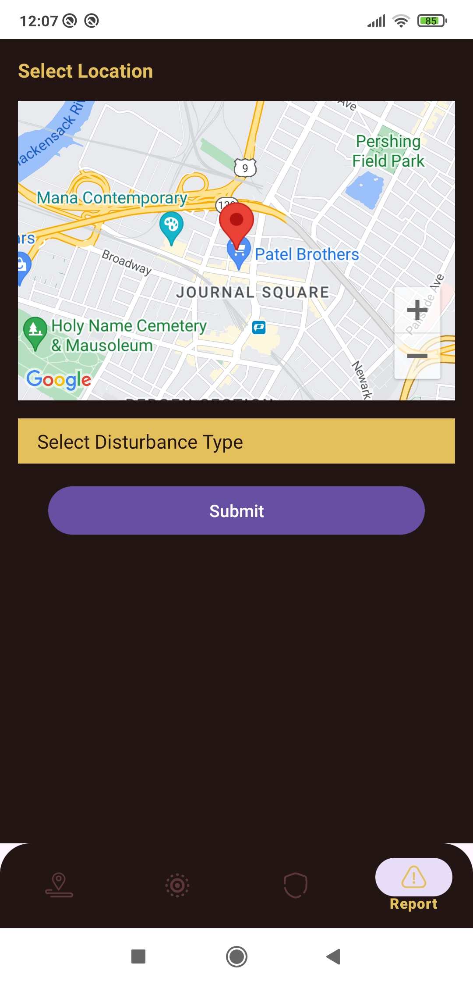
2. Reports: Citizens can report manually about nearby incidents such as fires, accidents, crimes, and emergencies.

Slide 6
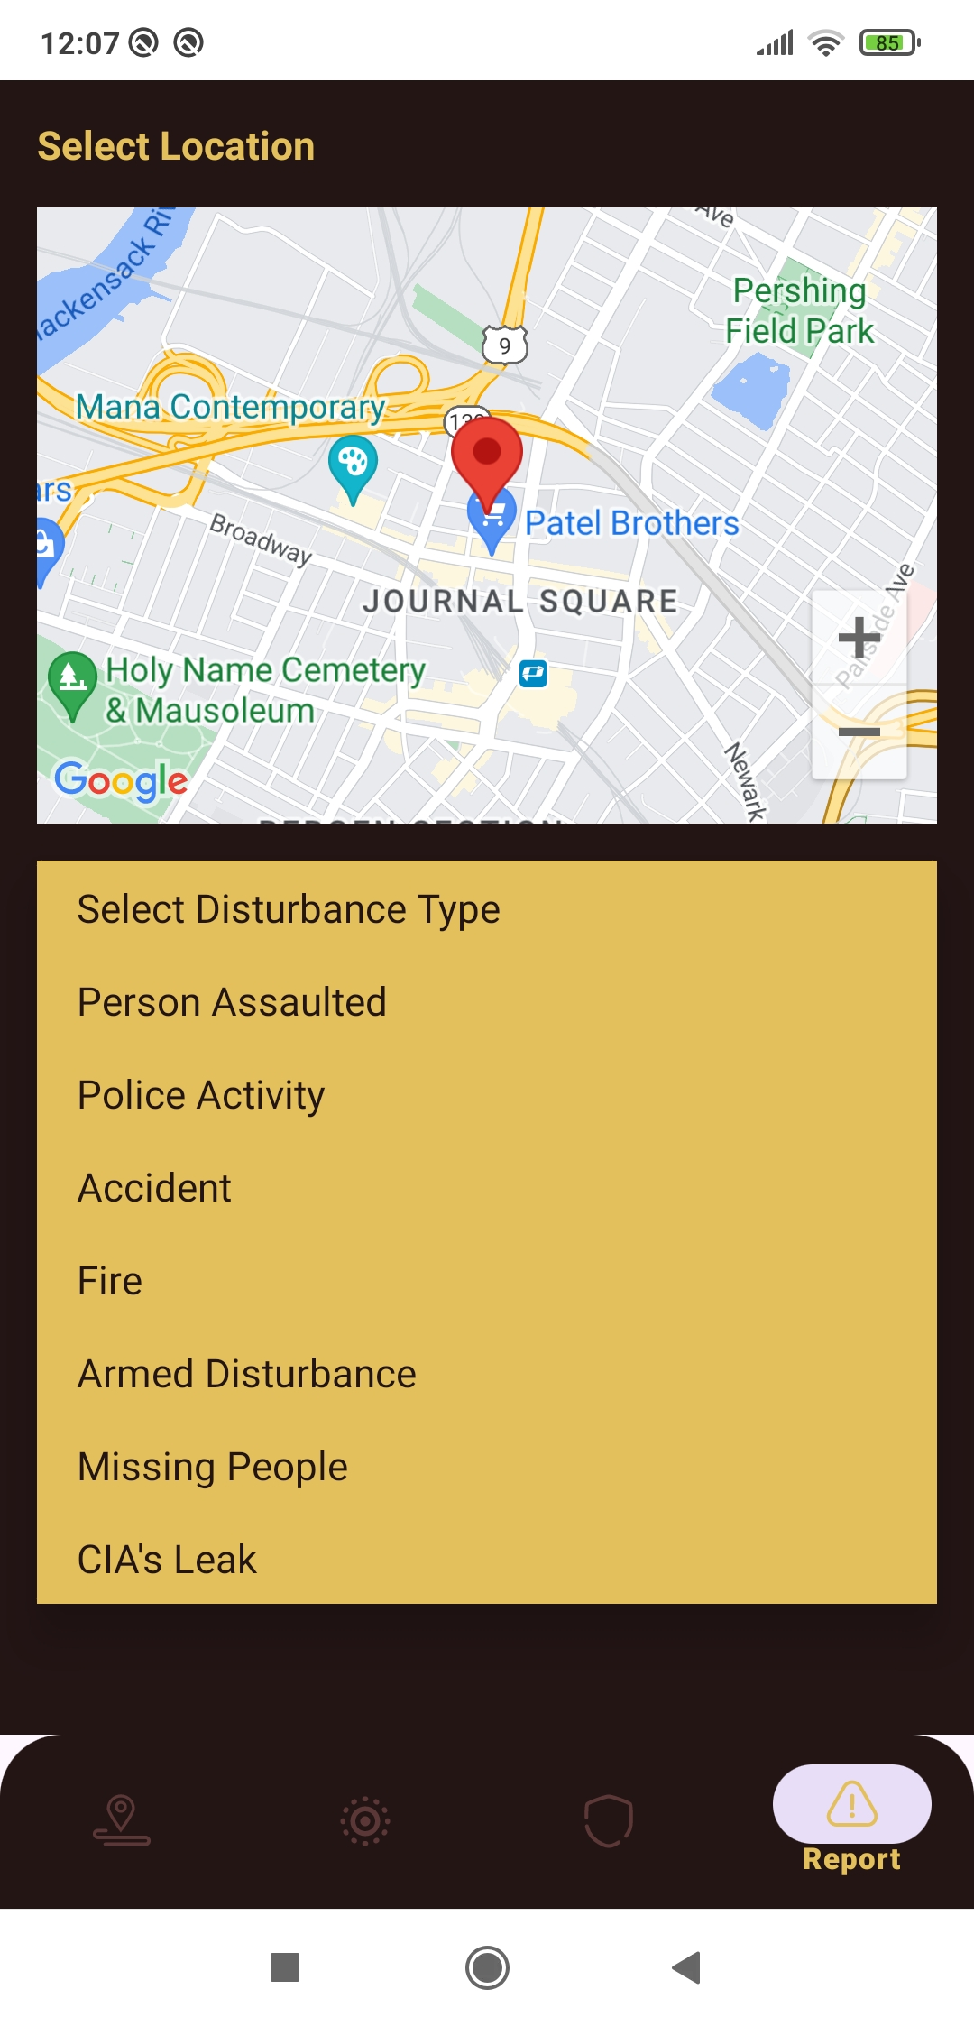






Incidents :
1. Personal Assault :
2. Police Activity :
3. Accident :
4. Fire : 5. Armed Disturbance :
6. Missing People :

Slide 7
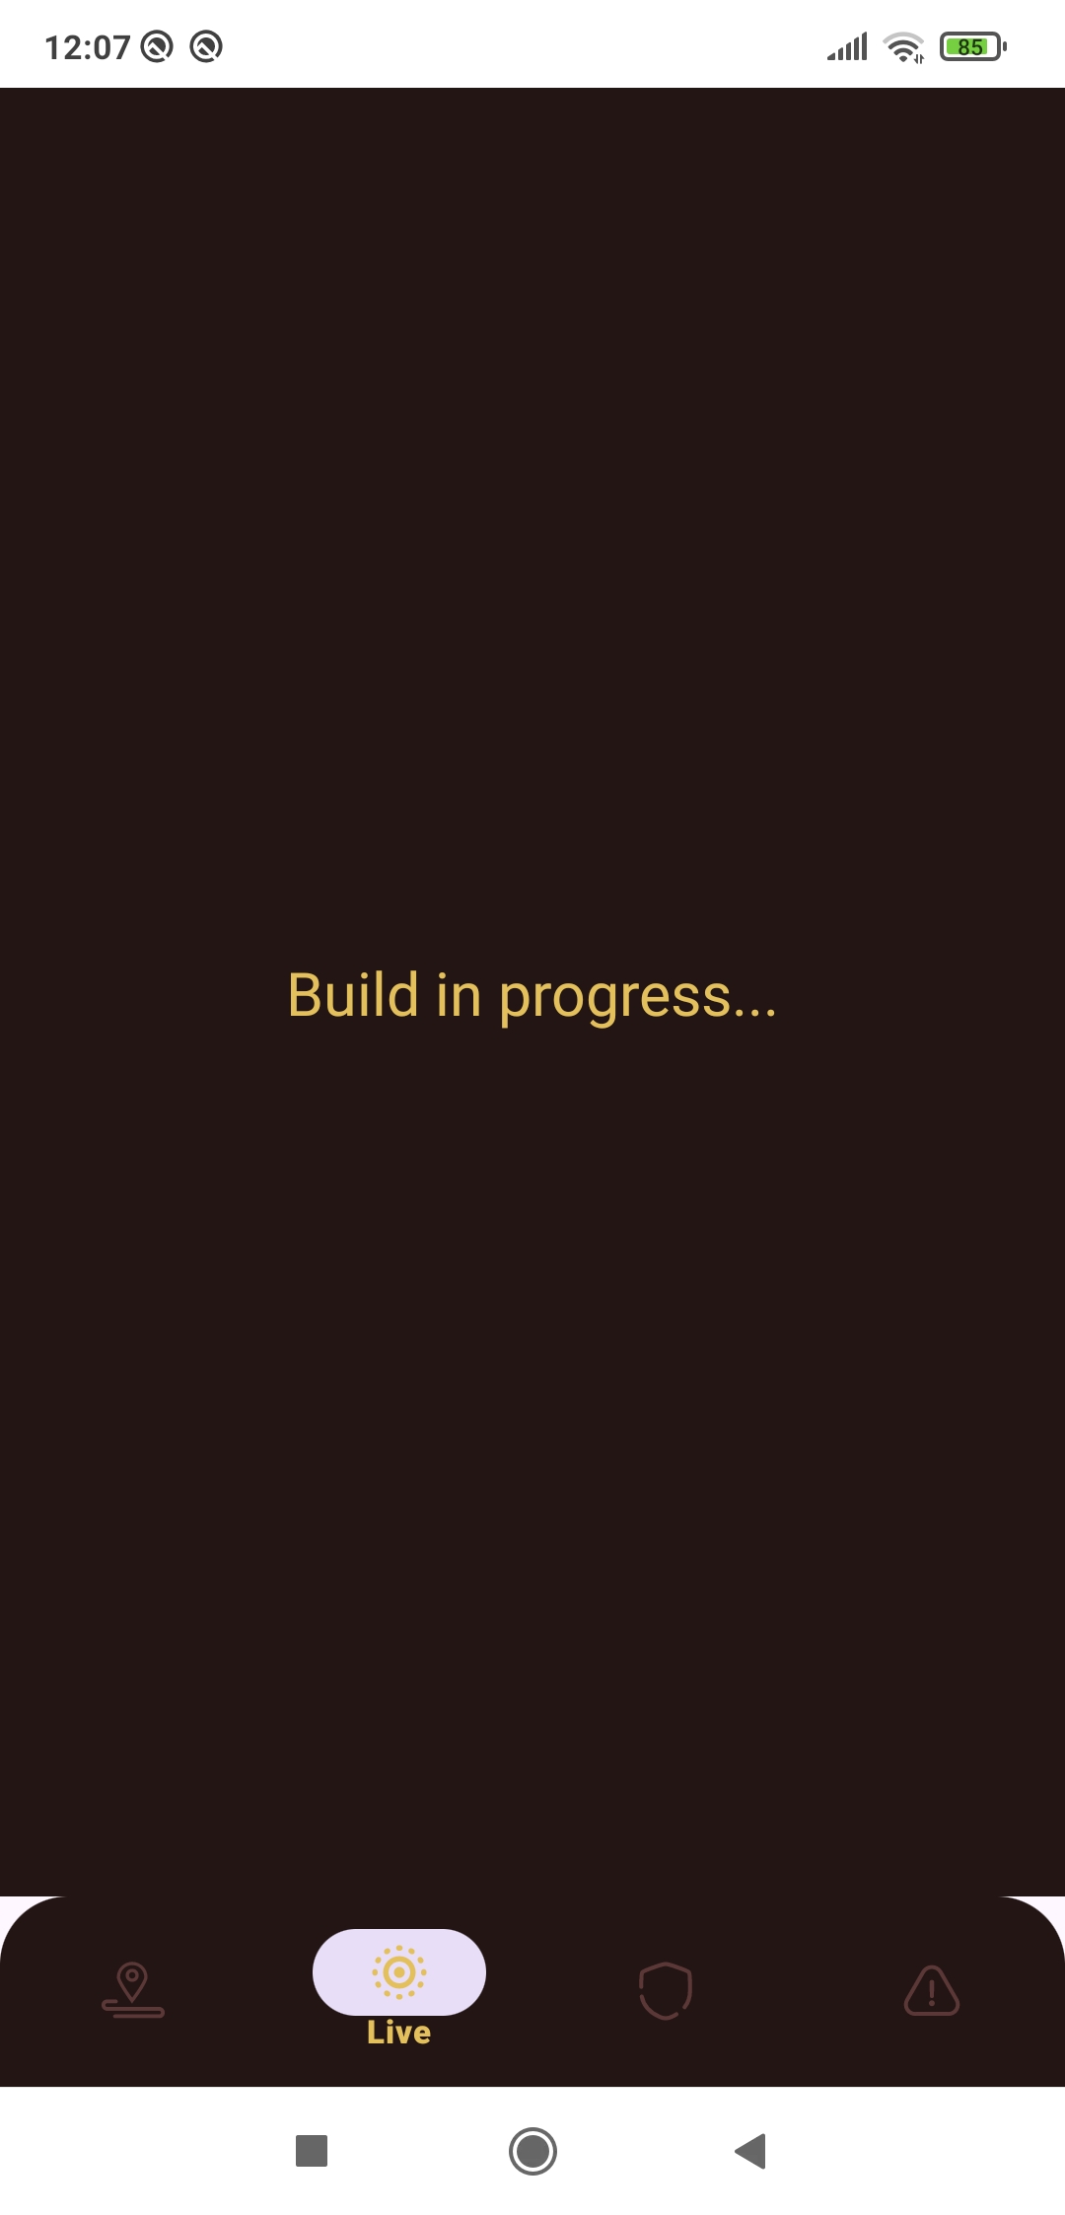
3. Live Video : Access live video feeds from incidents for real-time visual information.

Slide 8
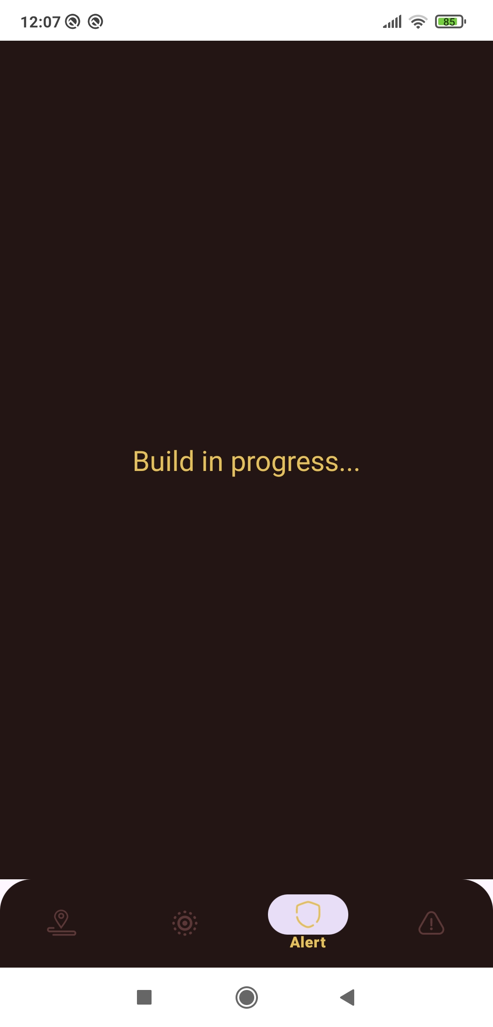
4. Alerts: Receive instant notifications about nearby incidents such as fires, accidents, crimes, and emergencies.

Slide 9
Future Work :
1. Direct Communication with Authorities (911): Improve response times by communicating directly with local law enforcement or emergency services.
2. Localized Safety Recommendations: Receive personalized safety advice based on your location and incident types.
3. Chatbox: people can chat in real time and can provide solutions for the particular event.
4. Education and Training Resources: Access safety education materials and emergency preparedness resources to empower proactive risk management.

Slide 10
Thank You !

